Slide 1
MONEY, MONEY, MONEY...
spending money
shopping
budgeting

Slide 2
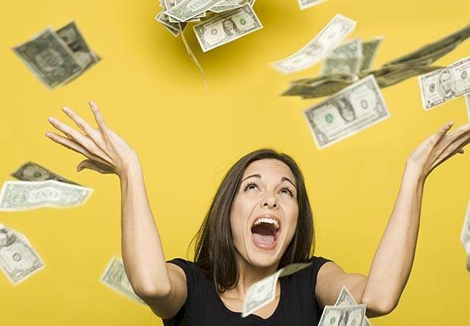
WHAT DO YOU SPEND YOUR MONEY ON?
food
rent
transportation
clothing
books/magazines
movies
music
social life
trips
the gym
other

Slide 3
DESIGN YOUR OWN PIE CHART BASED ON YOUR SPENDING!
(It does not have to be absolutely accurate.)

Slide 4
Compare your pie chart to your partner’s
Are they very similar or very different?
Are your attitudes to spending typical of working people?
Is there anything you’d like to spend less money on?
Is there anything you’d like to spend more money on?
Is it easy to sustain this lifestyle?

Slide 5
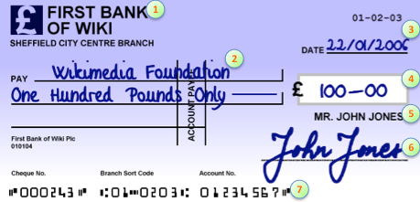
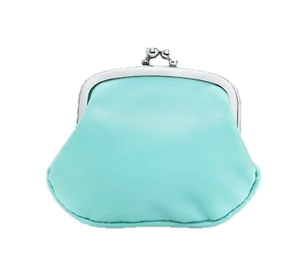
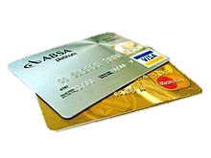
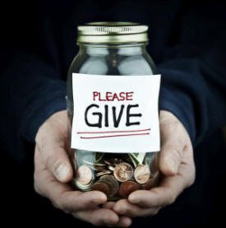
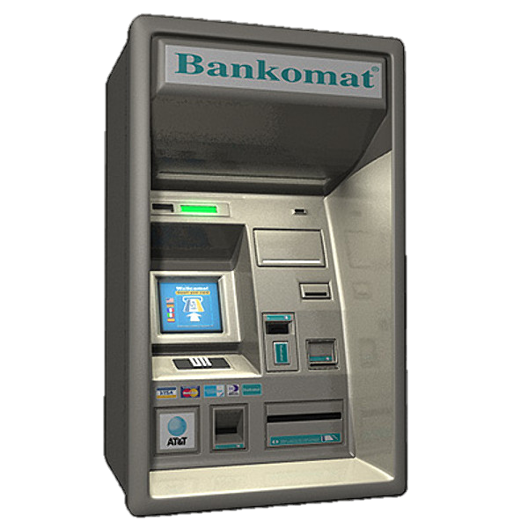
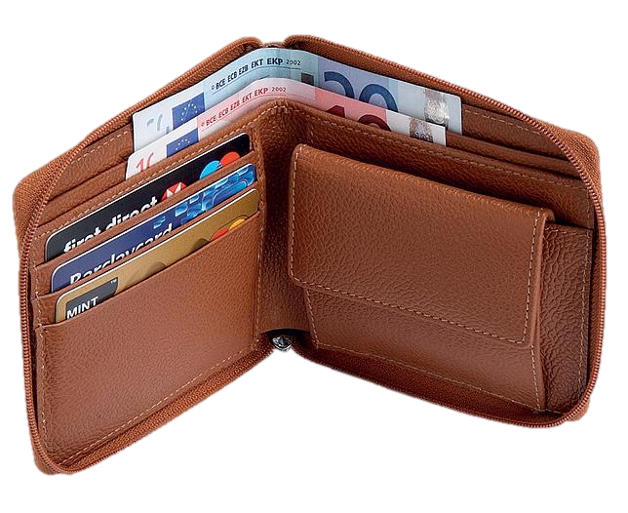
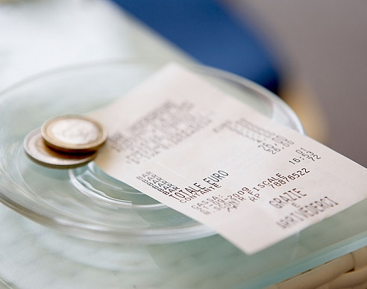
2
bill
cash machine
charity
cheque/check
credit card
purse
wallet
1
3
5
7
6
4

Slide 6
MATCH THESE FINANCIAL EXPRESSIONS TO THEIR DEFINITIONS!
a bargain
a fortune
financially independent
financially secure
stable job
to get by / to make ends meet
to be well off
to splurge
to have expensive taste
to take out a loan
to be in debt
to enjoy luxurious things
to be able to pay your own bills
to have just enough money to pay the bills, not more
a lot of money
to spend lots of money on one thing you really want
to owe money
something you buy for a really good price
a job with regular hours and steady pay
to be wealthy
to borrow money from a bank
to be able to cover your expenses comfortably

Slide 7
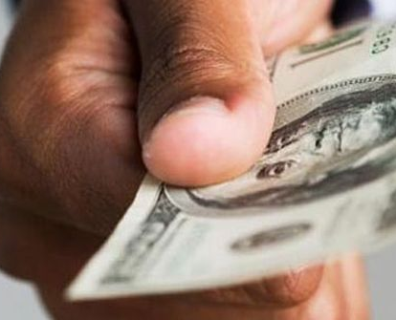
ROLE PLAY Using the terms you just learned…
A college student is having trouble paying his bills and has to ask his parents to lend him some money.
Student A plays the child, Student B plays his mother.
Child (Student A):
“Mom, you know I’ve been having trouble making ends meet lately...”
Parent (Student B):
“You know, you should try to become financially independent.”
Use at least five ‘money terms’ that you just learned!

Slide 8
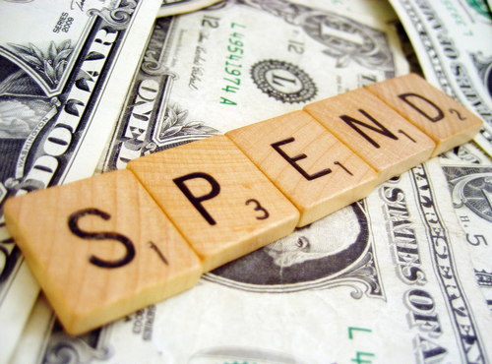
MATCH THESE SAYINGS ABOUT MONEY TO THEIR MEANINGS. DO YOU HAVE ANY SIMILAR SAYINGS IN YOUR LANGUAGE?
Money doesn’t grow on trees.
We all need to save for a rainy day.
Money is no object.
Don’t throw good money after bad.
Put your money where your mouth is.
Stop spending money on something that doesn’t work.
Money is not easy to get.
It doesn’t matter how much something costs.
Don’t spend all your money – you may need it in case of problems.
If you believe in something, you should be willing to spend money on it.

Slide 9
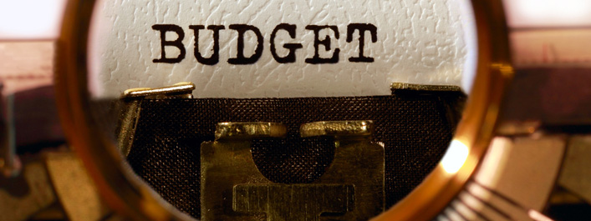
Discuss these aspects of spending money
If you need to save money, which category do you cut back on?
Are you able to stick to a budget and save money?
What is your top priority in terms of money right now? (save up for a holiday, earn more, pay off loans and debts…)

Slide 10
SITUATION: YOU’D LIKE TO VISIT THE UK IN THE SUMMER BUT YOU’RE ON A REALLY TIGHT BUDGET. WHAT ADVICE DOES YOUR PARTNER GIVE YOU?
I’d really like to visit London during the holiday but I don’t have much money.
MAKING SUGGESTIONS
Why don’t you…
How about –ing…
Have you thought about –ing…
Have you considered –ing…
What if you…
Maybe you should…
You could…
How about working overtime to save up?

Slide 11
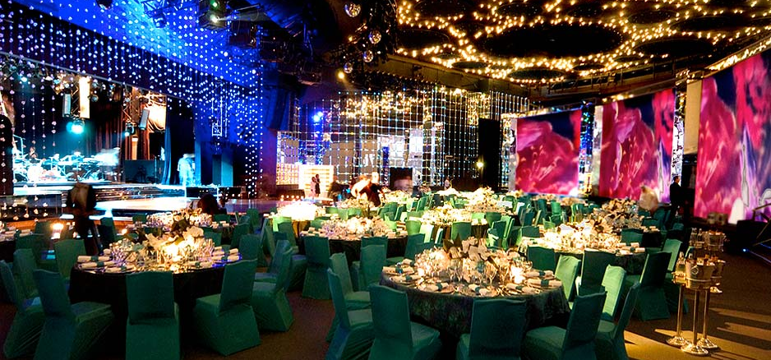
A THREE-MINUTE TALK
What is the most extravagant restaurant, party, or social event that you’ve ever been to? What was it like?

Slide 12
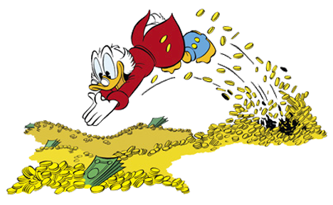
A THREE-MINUTE TALK
Imagine that you could change lives for a day with a person of great wealth. Who would you change places with? Why?

Slide 13
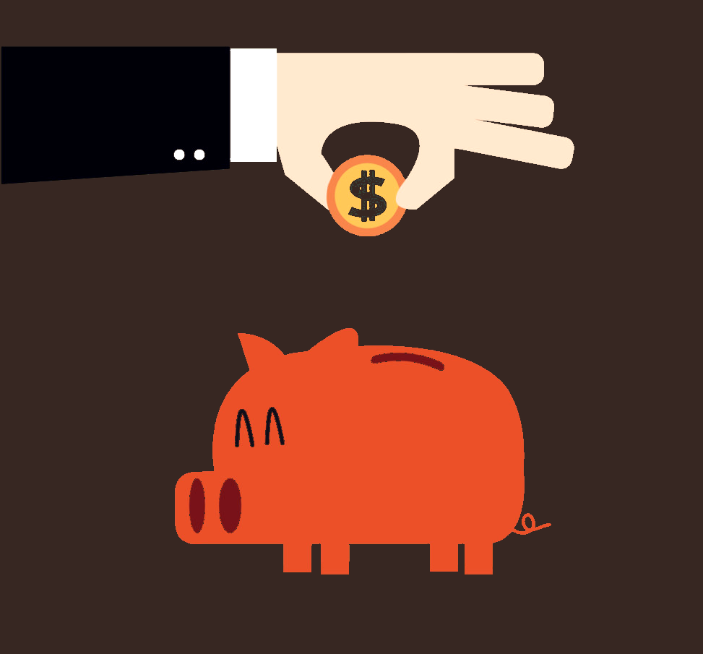
A THREE-MINUTE TALK
What is something you’re saving up for?
Why do you want it/need it?

Slide 14
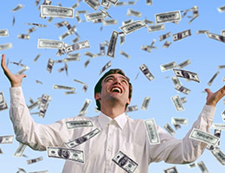
A THREE-MINUTE TALK
If you inherited a large sum of money, what is the first thing you would spend it on? Why?

Slide 15
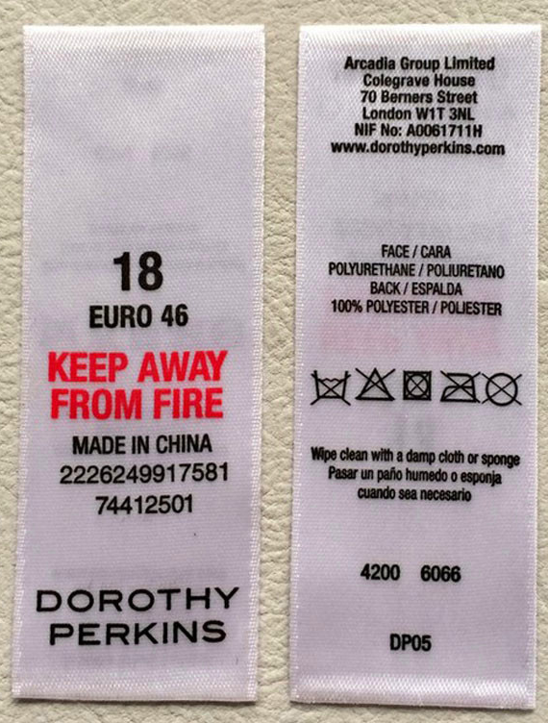
What do you consider when you go shopping?
PRICE?
QUALITY?
BRAND?
WHERE THE ITEM WAS PRODUCED?

Slide 16
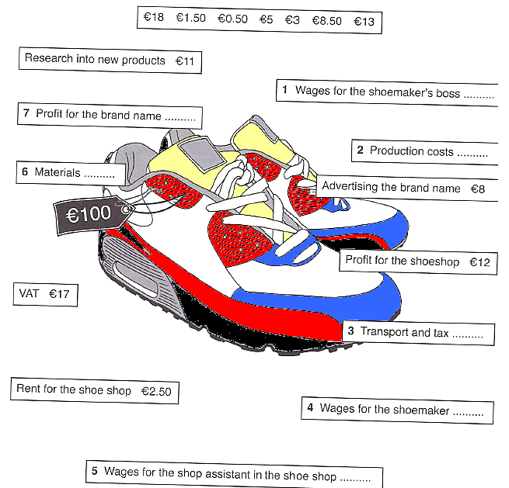
THE REAL COST

Slide 17
Have you heard of the phenomenon called Fair Trade?
What is it?
What is its goal?

Slide 18
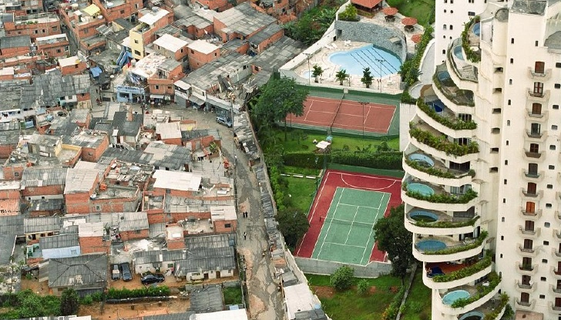
RICH & POOR
In pairs/groups, brainstorm some differences between rich countries and poor countries.
Try to come up with 7 – 10 points.
Choose three of the differences you came up with and agree on the best way of making things more equal.

Slide 19
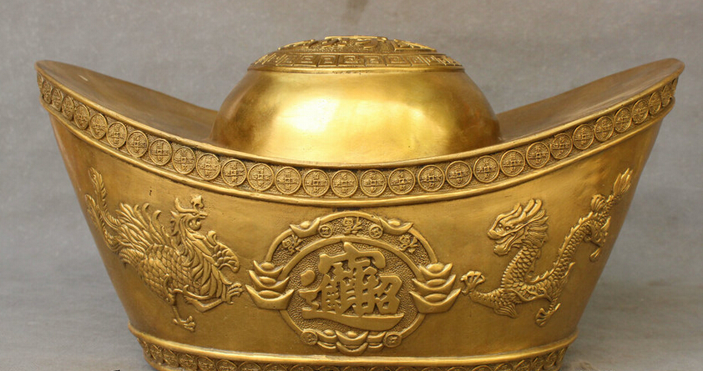
Is money the most important thing?
Why do so many people list money as the most important thing in their lives?
What may be the social or historical reasons?
What is your opinion? Do you feel the same? Why (not)?

