Slide 1
ESSAY WRITING
PLANNING TECHNIQUES
WITH EXAMPLES

Slide 2
WRITING A PLAN
Writing a plan will help you to:
1) Write more logically
2) Write to a particular direction so what you write will have a clear point.
3) Write more coherently, with your ideas linking together.
4) Write faster, so you will get your writing work done in less time.
As you get used in your practice time, you will speed up considerably, to the point where you will be able to knock up a quick essay plan in 3-4 minutes.

Slide 3
THE LIST PLAN
List on a piece of paper all the ideas that you think you would like to write about in your essay.
Here’s a list plan exploring economic development in the USSR under Stalin:
Trotsky ousted
Few safety standards in factories
Stalin outmanoeuvres other committee members
5-years plan for economic development
Large increase in coal, oil, and iron production
By 1921 Russian economy collapsed
Many factory workers illiterate
Famine in 1932-1934
Introduction of collectivism
Purges, people sent to slave labour camps (gulags)
1941 USSR second strongest industrial power in the world

Slide 4
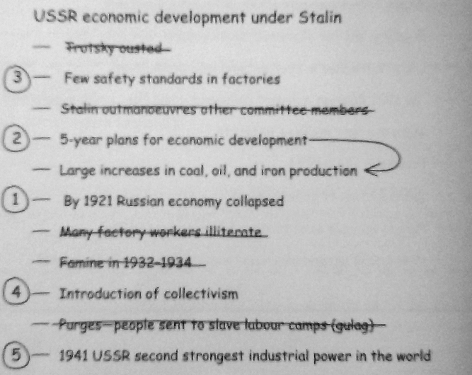
REFINE YOUR LIST
If your essay is five paragraphs long, then your list should have numbers 1, 2, 3, 4, 5 next to relevant ideas on the list.

Slide 5
THE BOXES
Draw the number of boxes equal to the number of paragraphs that you have to write. If your essay is 800 words long, draw 8 boxes.
The first box is the introduction.
The final box is the conclusion.
In the top of the remaining boxes you write the main idea that you would like to write about in that paragraph.
Underneath that big idea, write down 2-3 facts or information about the idea which will help you write the paragraph.
Paragraph 1
Main Idea:
-------------------------
Fact 1:
-------------------------
Fact 2:
-------------------------
Fact 3:
-------------------------

Slide 6
TOOLS TO HELP YOU PLAN
This is an idea sheet.
AUTHOR: (the name)
TITLE: (of the book/film)
BRIEF SUMMARY: (brief outline of what the book or play or film is about: This film describes…., This source states….)
SETTING: (were the book/film/play takes place)
PLOT: (what happens in the story)
CHARACTERS: (list the main characters)
KEY THEMES: (the key themes for the work: revenge, social injustice, war)
QUOTES: (one per theme)

