Slide 1
asking critical questions
Unit 3

Slide 2
What will we learn today?
to infer causes
to forecast consequences
to discuss implications
to put forward alternatives and supporting facts

Slide 3
what does it mean?

Slide 4
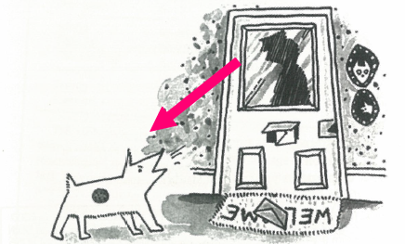
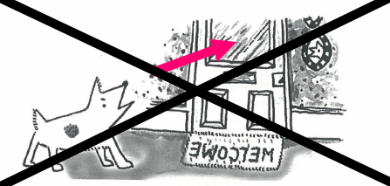
Causal relationship have direction

Slide 5
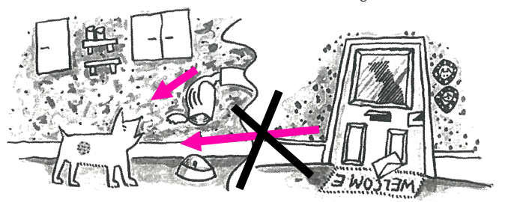
not all relationships have causal links

Slide 6
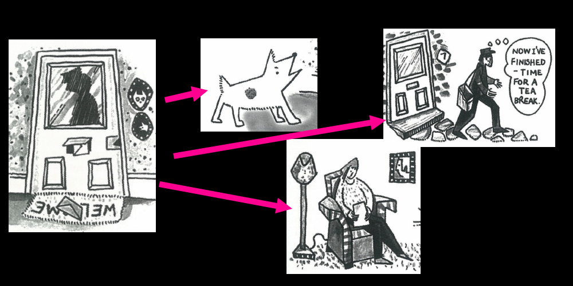
a cause may have more than one effect

Slide 7
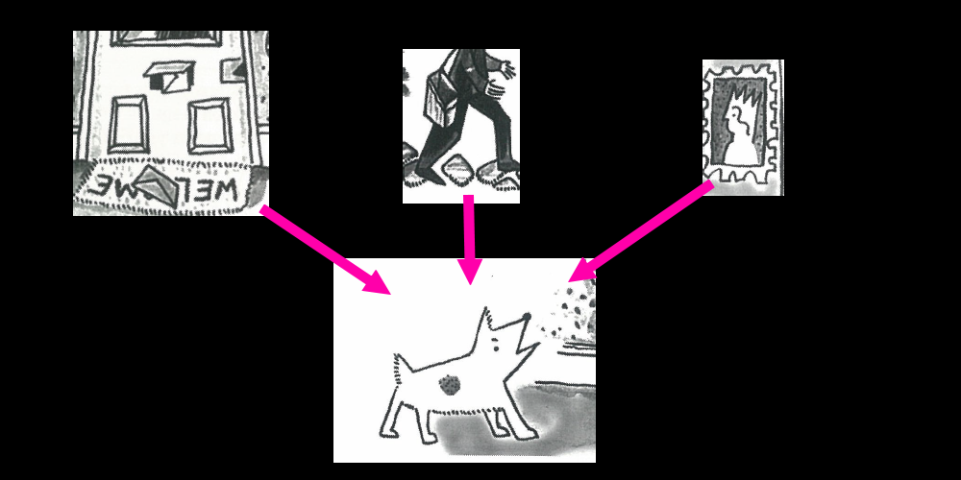
events happen in a wider context

Slide 8
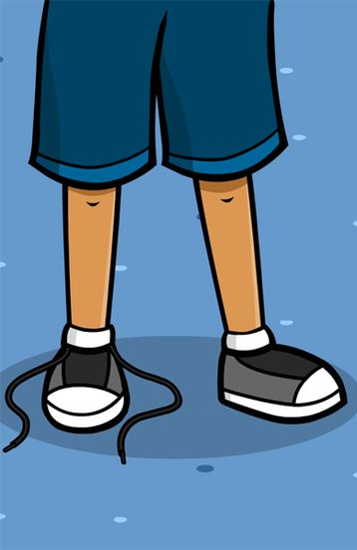
look at this cause. what is the effect?

Slide 9
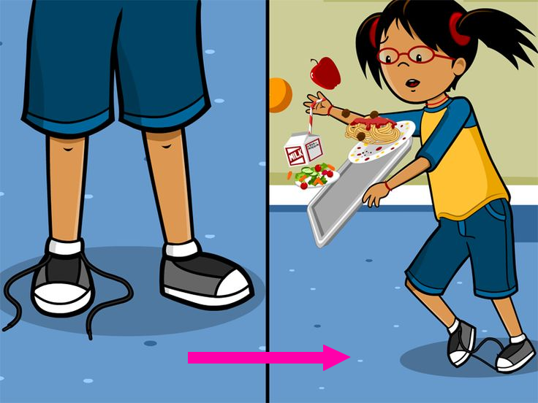

Slide 10
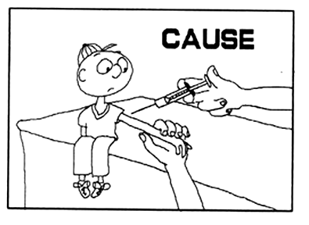
look at this cause. what is the effect?

Slide 11
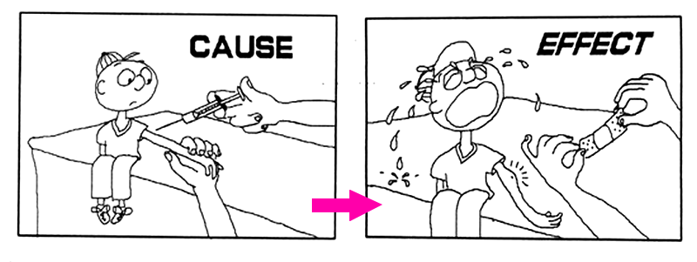

Slide 12
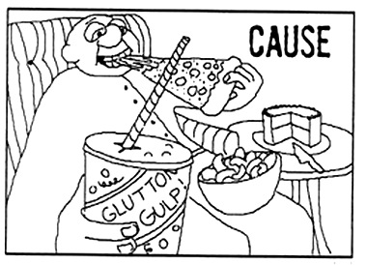
look at this cause. what is the effect?

Slide 13
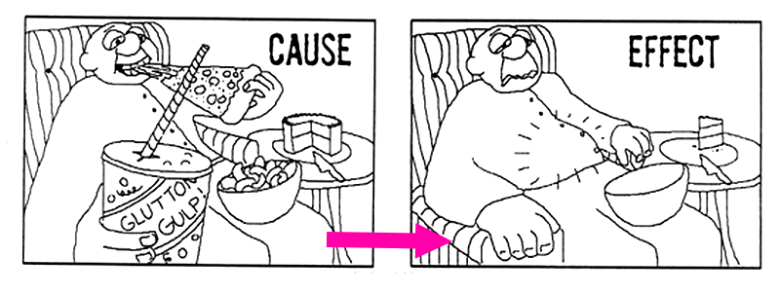

Slide 14
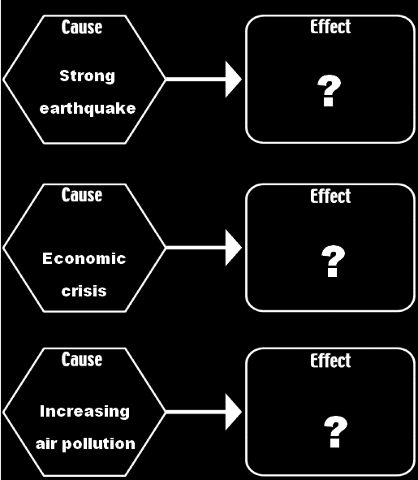
look at these causes. what are the effects?

Slide 15
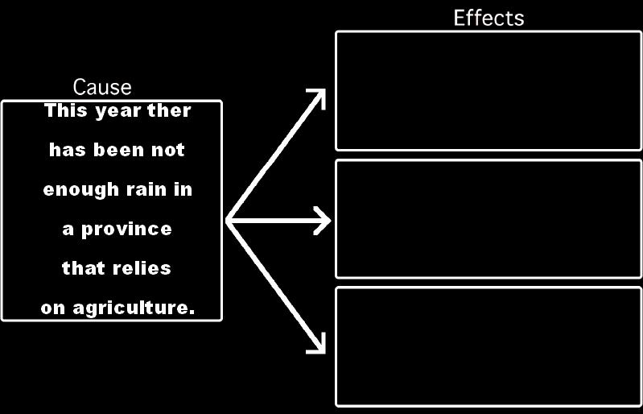
sometimes causes can have more than one effect.

Slide 16
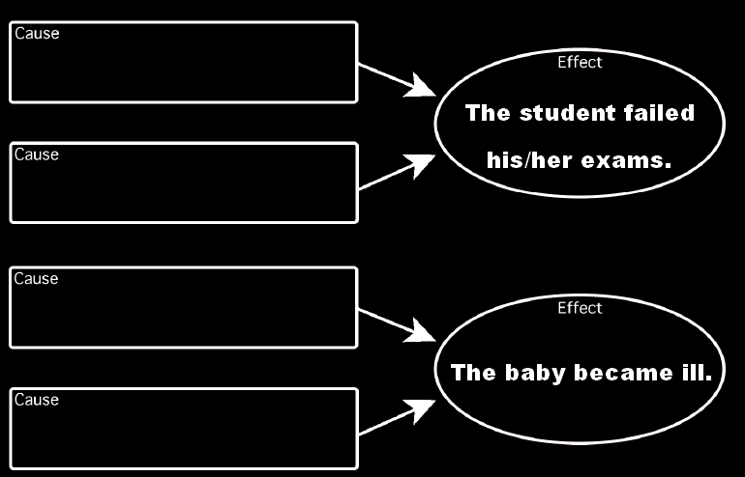
sometimes an effect can have more than one cause.

Slide 17
what will happen?
sometimes people focus too much on a problem at hand that they fail to see long-term consequences

Slide 18
what is happening, and why? What may be the long-term consequences?

Slide 19
what is happening, and why? What may be the long-term consequences?

Slide 20
what is happening, and why? What may be the long-term consequences?

Slide 21
flowchart
Smoking is banned in restaurants
Smokers will go to restaurants less often
Restaurants will lose money
Some restaurants will be forced to close down

Slide 22
Choose a recent controversial event
Create a flowchart describing possible consequences
Post in the homework submission area online OR write it into your notebook
Smoking is banned in restaurants
Smokers will go to restaurants less often
Restaurants will lose money
Some restaurants will be forced to close down

Slide 23
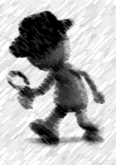
what happens if…?
As a student, you may be given a problem to investigate.
If this happens, you may need to:
look at a variety of solutions
evaluate the consequences of each
determine which is the ‘best’ solution

Slide 24
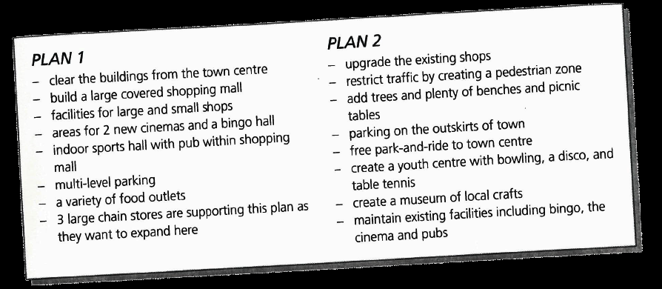
a small town decided to modify its town centre and asked two development companies to submit plans. which plan should the town support, and why? what may be the consequences of your decision?

