Slide 1
APA format

Slide 2
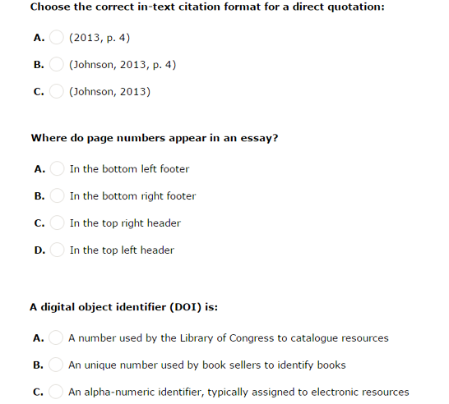

Slide 3
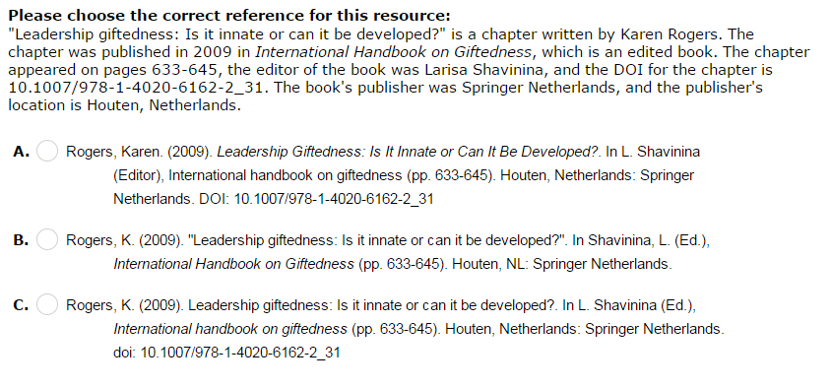

Slide 4
What is the APA reference for Study tasks in English?

Slide 5
