Slide 1
Legal institutions and the administration of justice and law
Rubén Darío Favela Ramírez
Andrea Salazar Aguilar

Slide 2
Content
Legal Institutions in Context
Legal Institutions in the Context of the Chinese Nomenklatura System
Legal Institutions under the Chinese Constitution
Legal Institutions and the Integration of Party and State- The Politico-Legal Committees.
Comparing People’s Courts and People’s Procuratorates
Conclusions

Slide 3
Legal Institutions in Context of the Chinese Nomenklatura System
Nomenklatura. The system in which Party and State are integrated into one strict hierarchical structure under Party control.
Two levels of Party control over institutions and leadership:
1) Three-Decisions Plan: Internal Structure of Party-State organizations and institutions. Compiled by the CPC’s Office of Institutional Establishment and implemented by State Council.
Nature of each institutions
Functions for the institutions
Internal structure and official positions
2) Selection and appointment of leadership positions of Party organizations, legislative, judicial, administrative institutions administered by the Central Organization Department of the CPC.

Slide 4
The Nomenklatura System used to be secretive until the new Working Regulations on the Selection and Appointment of Party and State Leading Cadres.
Principles, procedures, and criteria for the appointment of leading personnel.
The Regulations apply to:
-The selection and appointment of leading members of functional departments and internal structures of the Central Committee of the CPC.
-By reference, to the selection and appointment of personnel who are governed by the Law on Public Servants.
-Non-leading positions which are defined as being positions at county level and above in the Nomenklatura system.
-Leadership positions at township level to be governed by implementing measures to be issued in accordance with the Working Regulations.
-Leadership positions within the army and the armed police forces are to be governed by rules to be issued by the Party Central Military Commission in accordance with these Working Regulations
-State Owned Enterprises don’t figure in the Working Regulations but these are regulated by the Nomenklatura system.

Slide 5
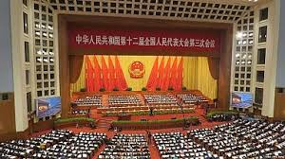
Why is Nomenklatura a complicated system?
Size of China,
Integration of the Party power structure,
Unwritten ‘conventions’.

Slide 6
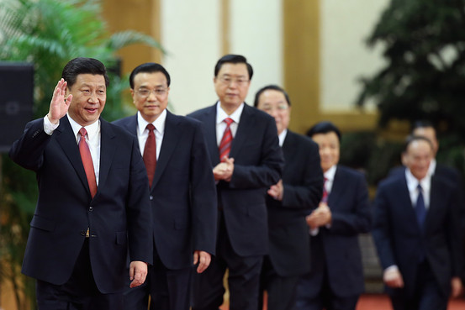
It can be simplified….
-Members of Standing Committee of the Politburo of the CPC are referred as state leaders and core power in China.
-Party Secretary and Head of Party are nominally in the same level, but for administrative and government, the Secretary is ranked as No. 1.
-The half-level rank is different in some positions. Among all vice-presidents of the Supreme People’s court, only the first vice president has ministerial rank, the rest quasi ministerial.
-Difference in terms of power and resources among same ranked official and organizations.

Slide 7
Judicial/Legal Institutions under Chinese Constitution
National People's Congress
State Level (State Council)
Provincial Level (Government)
Provincial Level (High Court)
State Level (Supreme People's Procuratorate)
Provincial Level (High Procuratorate)
Prefectural Level (Government)
County Level (Government)
Prefectural Level (Intermediate Court)
County Level (Basic Court)
Prefectural Level (Intermediate Procuratorate)
County Level (Basic Procuratorate)
State Level (Supreme People's Court)

Slide 8
Legal/Judicial institutions: courts, procurators and public security force (police).
-State Council has 4 ministries involved in administration of law:
Ministry of Justice, Ministry of Supervision, Ministry of State Security, and Ministry of Public Security (Police).
*Notaries and Arbitration Institutions are self-regulated organizations, legal institutions, not judicial institutions.
National People’s Congress (NPC) SUPREME POWER OF THE STATE.
Creates legal institutions.
All NPC levels, both low and high are part of the Nomenklatura of the CPC, unlike Western Parliaments.
Party and hierarchical and bureaucratic structures in within legal institutions are the same with the relation of Party and administrative authorities.
The Communist Party and the executive have powers over judicial institutions in financial allocation and appointment of personnel.

Slide 9
Legal Institutions and the Integration of Party and State/The Politico-legal Committees.
Politico-Legal Committees:
Mechanism created by the Party.
1ST Politico-Legal Committee was more moderate than the current one.
Integrates Party and State.
Financial control by the Government.
Personnel control that integrates the Party with the State.
Places legal and law branches of government under one leadership.

Slide 10
1958. Central Politico-Legal Leading Group of the Party, by the Politburo of the Party.
Led to establish leading groups in party committees at level county and above.
Created the practice of examination and approval of major cases by Party committees.
1960. Combined offices of the court, procurators and police under leadership of the police.
Unification or integration of powers, and Party and Government.
Ceased to exist in 1972 due Cultural Revolution.
1978. Reestablishment of the Central Politico-Legal Leading Group.
Assist the Supreme People’s Court, Supreme People’s Procuratore, Ministry of Public Security and Ministry of Civil Affairs.
Instructions on Resolutely Guaranteeing the Implementation of Criminal and Criminal Procedure Law upon the adoption of the 1979 Criminal Law and Criminal Procedure Law. These abolished the examination and approval by Party Committees.
1980. Efforts to separate Party and legal institutions.
1988. Replacement of Central Politico-legal Committee by Central Politico-legal Leading Group, with less power with the policy of separate Party from Government.
1989. Tiananmen!!!, stopped the political reform and reintroduction of the Politico-Legal Committee, the CPC
‘’sword of the Party and tool for people’s dictatorship’’.
1991. Central Committee of the CPC established the Central Committee on Comprehensive Control of Security and Social Order
Share the office with Central Politico-legal committee
Assist Central Committee of the CPC
Central Politico-legal committee became one office with two names.

Slide 11
Expansion of powers of Politico-legal committees
To legal Institutions To Party Committees at different levels:
Provide ideological and political leadership;
Policy guidance;
Leadership and
Management of different levels.
Decision making on personnel appointment in legal institutions (courts and procurators).
Functional departments of the Party Committees.
Involved in handling major and difficult cases.

Slide 12
Contradictions?
2013. Meng Jianzhu (head of Central Politico-legal Committee) in a meeting of national politico-legal committees.
‘’Need to clarify their functions; Exploration of new methods for leadership; New capacity for the coordination of politico-legal work, Necessity for leadership by the Party over Politico-legal institutions’’.
More power to the party and its integration to government and legal-judicial institutions.
Relaxation in daily case handling! Refrain from cases conducted by judiciary and let them handle independently the cases. More transparent.

Slide 13
THE PEOPLE’S COURTS
Hierarchy
Supreme People’s Courts
High People’s Courts
Provincial Level
Intermediate People’s Courts
Cities & Prefectures within Provinces
Basic People’s Courts
County Level

Slide 14
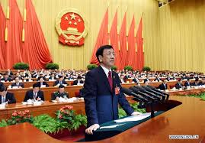
The people’s procuratorates
Procuratore System:
Initiating public prosecution on behalf of the state.
Exercise functions and powers of supervising the implementation of law.
Undertake direct investigation of crimes (graft, infringement of citizens’ democratic rights, dereliction of duty, etc.).

Slide 15
Hierarchy
Supreme People’s Procuratorate
High People’s Procuratorates
Provincial Level
Intermediate People’s Procuratorates
Cities & Prefectures within Provinces
Basic People’s Procuratorates
County Level

Slide 16
Comparing Procuratorates System and Court System
Organizational structures.
Rules on appointment and removal of personnel.
Improvements on Educational qualifications of personnel.
Leadership by superior procuratorates is weak. No leadership between higher and lower Courts.
Governments at corresponding level are responsable for funding.
Specialized procuratorates and Specialized courts established at the intermediate level.
PEOPLE’S COURTS
Certain Independence on adjudication.
Freedom from interference in administration bodies, social organizations and individuals.
PEOPLE’S PROCURATORATES
All procuratoratos are under dual leadership: Superior Procuratorate and State Authorities (local People’s Congresse’s and Government).

Slide 17
Conclusions
-Evolution of Legal Institutions
-Continuous Changes through the time
-Hierarchy system of the Legal Institutions
-Involvment of the Party in the Legal Institutions

