Slide 1
finding information
unit 4

Slide 2
study is not just about going to school
at university, you will have to find much of the information you need by yourself
you will need to use study resources like books and libraries independently

Slide 3
finding your way around the library
first of all, you have to find out what your university library contains (it is never only textbooks)
libraries are a vital parts of study
libraries vary in the number of books and the variety of services they offer

Slide 4
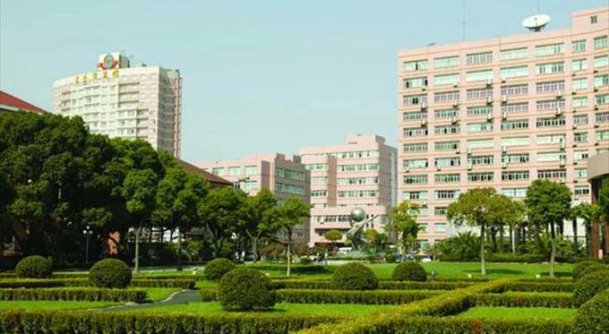
Have you visited the sisu library?
How is it organised?
Are there any leaflets or booklets to help you know what information is available and how to find it?
What kinds of books are there?

Slide 5
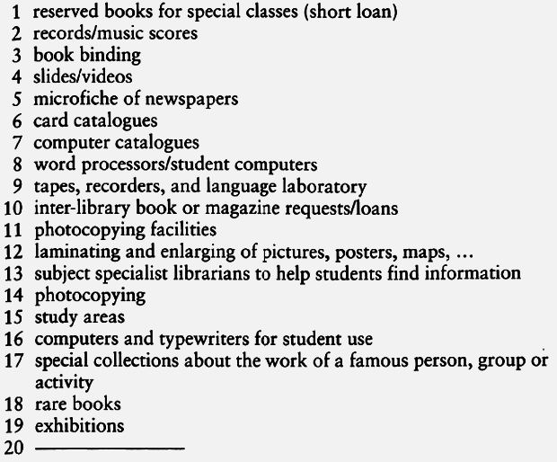
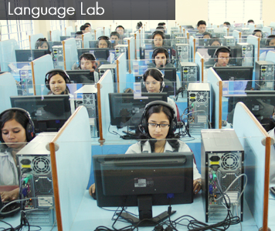
are these services available in your library? visit your library to find out! write a report.

Slide 6
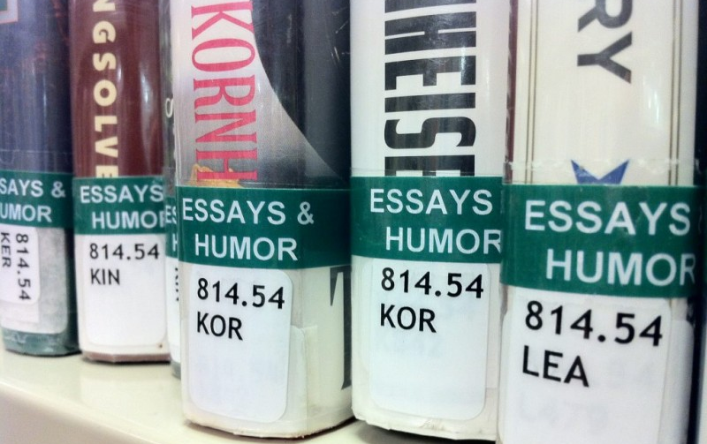
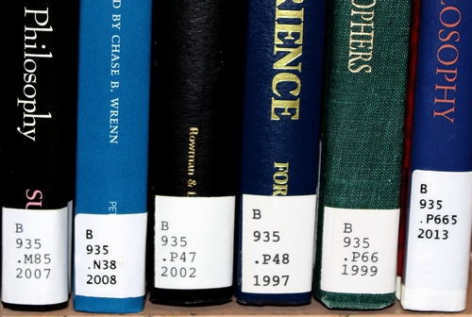
systems for arranging items in the library (used in the english-speaking world and beyond)
DECIMAL
items on a specific topic have the same number
e.g. all the books about Shakespeare would be located together
ALPHABETICAL (or mixed letter and number system)
items are arranged alphabetically
items on related subject are together
e.g. Shakespeare’s plays would be located in a different place from essays about Shakespeare

Slide 7
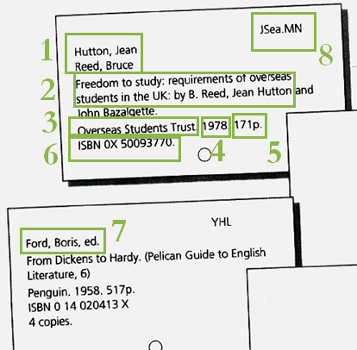
card catalogues
alphabetised by
title card
author card
subject card
What details can you find on the cards?

Slide 8
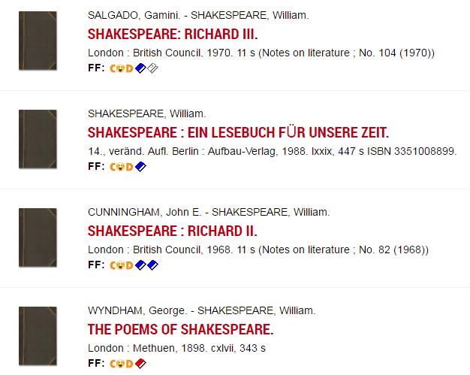
… but these days you probably won’t need to use card catalogues. computers have taken over!
computer systems can tell you all these details as well as
if a book is on loan
which books can be checked out
if it is possible to request a specific book

Slide 9
what subjects could you try if you needed to find information about the following topics?
the use of television advertising to raise money for charities
the causes of death of world leaders in the twentieth century
the use of art treasures as an economic investment
the influence of soap operas on children

Slide 10
finding your way around a textbook
academic books have many features in common
if you know what they are and learn to use them, it’ll save you a lot of time and worry

Slide 11
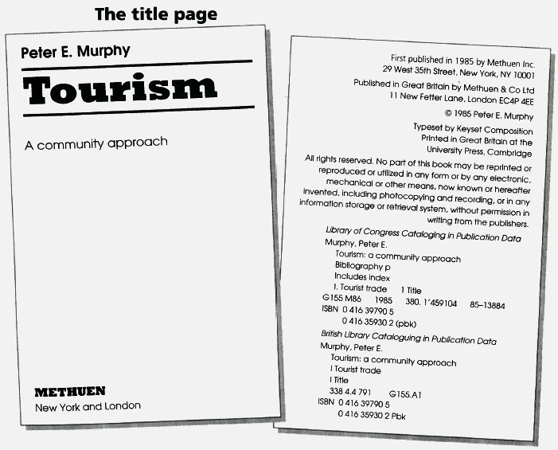
the title page
Look at the title page and locate these parts of the book:
title of book
subtitle of book
author
publisher
place of publication
ISBN

Slide 12
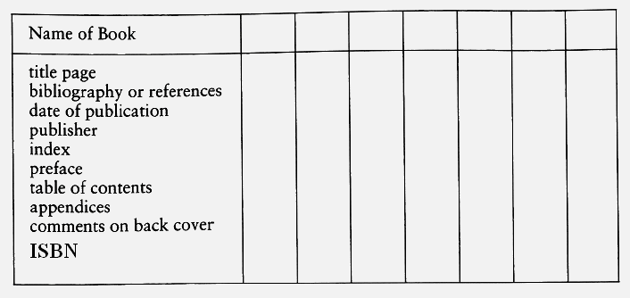
look at one or two textbooks and fill in the table below (p. 42). write where each part is found (page number). If it is not in the book, leave the space blank.

Slide 13
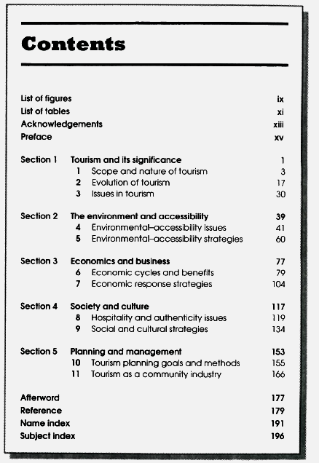
what is the difference?
the table of contents
appendix/appendices
index

Slide 14
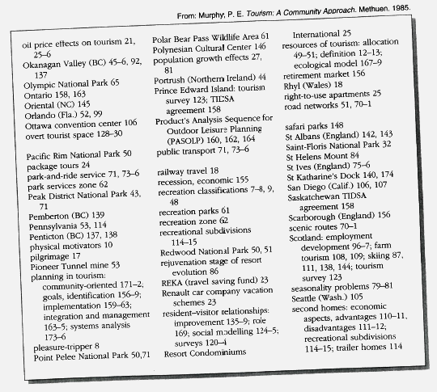
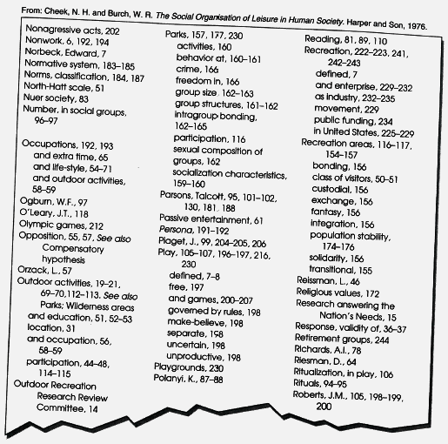
the index useful for looking up specific details or information
Where would you find this information, looking at the two indexes on pp. 44 - 45? (Which key words/subjects do we need? Which page(s)?)
What are the effects of population growth on tourism?
Are safari parks an effective use of land resources?
What is REKA?
What examples are there of parks improving the tourist industry?
How does train travel affect tourism?
What is the difference between recreation and play?

Slide 15
getting the most out of a book
at university you will have to cope with vast amounts of reading material
you will need to learn to determine quickly whether a book has the information you need and where it is located
otherwise you will end up reading a whole book, whereas you may have needed only a few pages

Slide 16
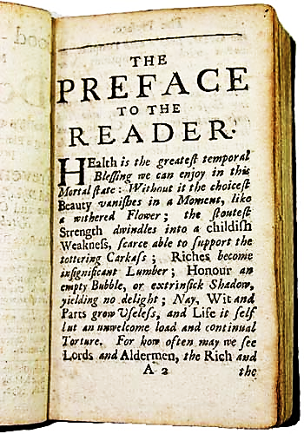
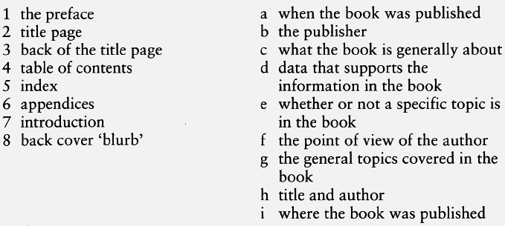
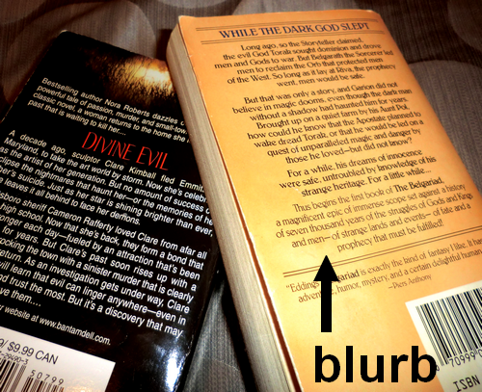
match the part of the book with the information it contains. some may have more than one aswer. you can refer to your textbooks for help.

Slide 17
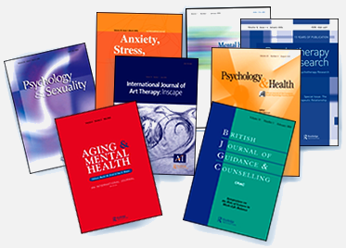
journals and other printed sources of information
JOURNALS
academic and professional magazines on specific subjects
also referred to as ‘serials’ or ‘periodicals’

Slide 18
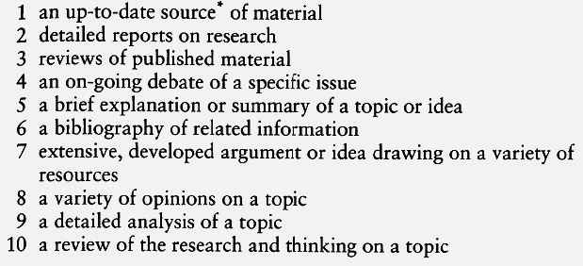
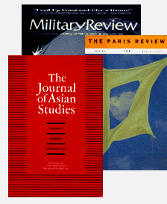
think about what you know or have just learnt about journals, and look at the statements below. which statements apply primarily to textbooks; to journals; to both?

Slide 19
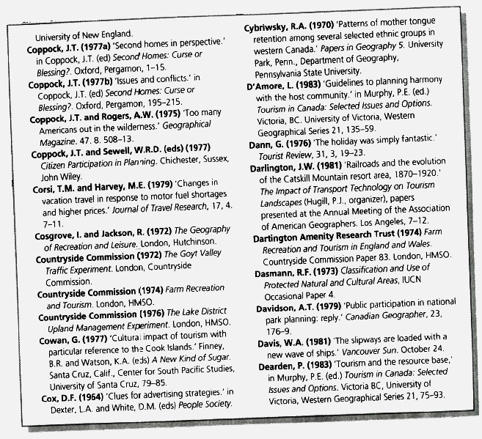
bibliographic references and notes
bibliography is a list of all the references the author used in writing the book/article
the section can be called ‘bibliography’, ‘notes’ or ‘references’
useful for looking up additional sources of information

Slide 20
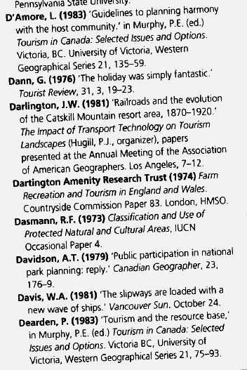
how is the information in a bibliography indicated? e.g. location, variety of type, punctuation. (in your books on p. 50)
the name of the author(s)
publisher
date of publication
place of publication
two authors
if the book is an edited collection of articles

Slide 21
you have to know the right format when…
writing essays and theses
citing/quoting
writing a bibliography at the end of an essay/thesis

