Slide 1
ESSAY WRITING
BASICS

Slide 2
WHAT IS AN ESSAY?
An essay is an argument.
The purpose of the essay is to take a position on a question and then argue your viewpoint based on evidence.
You need to decide what is your point of view.
Then, you do some gathering of information and examples.
You start argue your essay.
Consider your ideas carefully, as you start writing them.
Add some interesting words and sentences.
Work done.

Slide 3
WHAT ARE THE ‘LEVELS’ OF WRITING?
YOUR PIECE OF WRITING AS A WHOLE
the order of the main parts (sections, paragraphs…)
how the parts are linked together
ORGANISATION WITHIN THE SECTIONS/PARAGRAPHS
how well sentences are connected together
‘BASIC BUILDING BLOCKS OF WRITING’
vocabulary
grammar
spelling
punctuation …
SPECIAL CONVENTIONS OF ACADEMIC WRITING
footnotes
references
bibliographies …

Slide 4
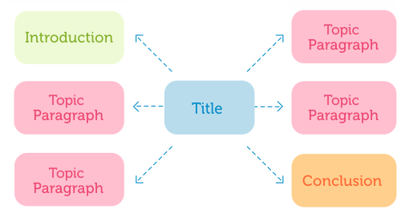

Slide 5
THE STRUCTURE
Essay writing has a form and structure.
Your essay will have an introduction, a body, and a conclusion.
There are expected lengths for each of these sections.
You don’t need to spend long on the introduction because your real marks will be gained in the body of the essay.
In the body of the essay you use analysis.
All types of essay are handled in the same way, as you scrutinise and discuss the points you are making in arguing your idea.

Slide 6
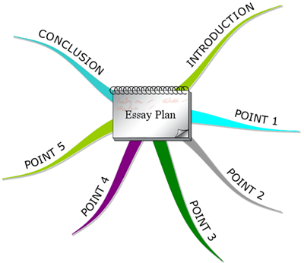

Slide 7
MULTIPLE ANSWERS
An essay question can have a few different possible answers.
Teachers or examiners are looking for how well you put together your case, how convincing your argument is and the quality of evidence that you submit.

Slide 9
RESEARCH OR STUDY FOR ESSAYS
In doing research of study for your essay, you are preparing better for the argument and the quality of your answer.
Some of the suggestions for your research: ask your teacher, individual study, go to the local library and ask for assistance, read a lot about the subject, research on the Internet, read biographies, look at the end of the chapters and see suggested references or studies, look for professional publications or websites, read newspapers, use TV, documentaries, YouTube and Google.
Take notes while you do your research. Start a fresh page of notes for each new book, source or article you are documenting. When you finish you can collate your thoughts.
In the research process you will discover new ways of thinking.

Slide 10
MAKE A VALID CASE
You are expected to provide some solid evidence to back up your case.
You don’t sit there and be neutral, but you will adopt a position on your question.
You may argue one side or the other, but you will take a stand and make a case.
Provide robust evidence to back up your case, not just first thing that pops into your head, in the heat of the moment.

Slide 11
ANSWER IN THE INTRODUCTION
The convention in essay writing is that you state your answer in your introduction.
Make the point clear and firm!
This is one of the most important rules of essay composition.
State your case firmly, clearly, and boldly in the opening paragraph of your essay.
In the body of your essay demonstrate why this point of view is so important.

Slide 12
SECTIONS OF AN ESSAY
An essay has three sections: the introduction, the body, and the conclusion.
You need to know how much you need to write for different lengths of the essay.
Most of the students write about 300 words per A4 side (10 words per line).

Slide 14
ESSAY LENGTH
400 word essay - 1.5 pages
600 word essay - 2 pages
800 word essay - 2.5 pages
1000 word essay - 3 pages

Slide 15
PARAGRAPHS
One of the keys to good essay writing is to think in paragraphs.
A paragraph is a collection of sentences exploring a single idea.
Paragraphs are the building of blocks of essay construction.
The paragraphs you write should be around 80-100 words long. That is 4 or 5 good-sized sentences per paragraph.
Always think in terms of how many paragraphs you have to write.
Next slide is an example.

Slide 16
EXAMPLE: 200 WORDS ESSAY
Introduction - allow 30 words (2 sentences of 15 words per sentence), a short paragraph.
Conclusion - allow 40 words (3 good-sized sentences), a large paragraph.
Body - allow 130 words (3 short paragraphs of 40 – 45 words each, 2 – 3 sentences per paragraph).

Slide 17
Spacing

Slide 18
Quoting

