Slide 1
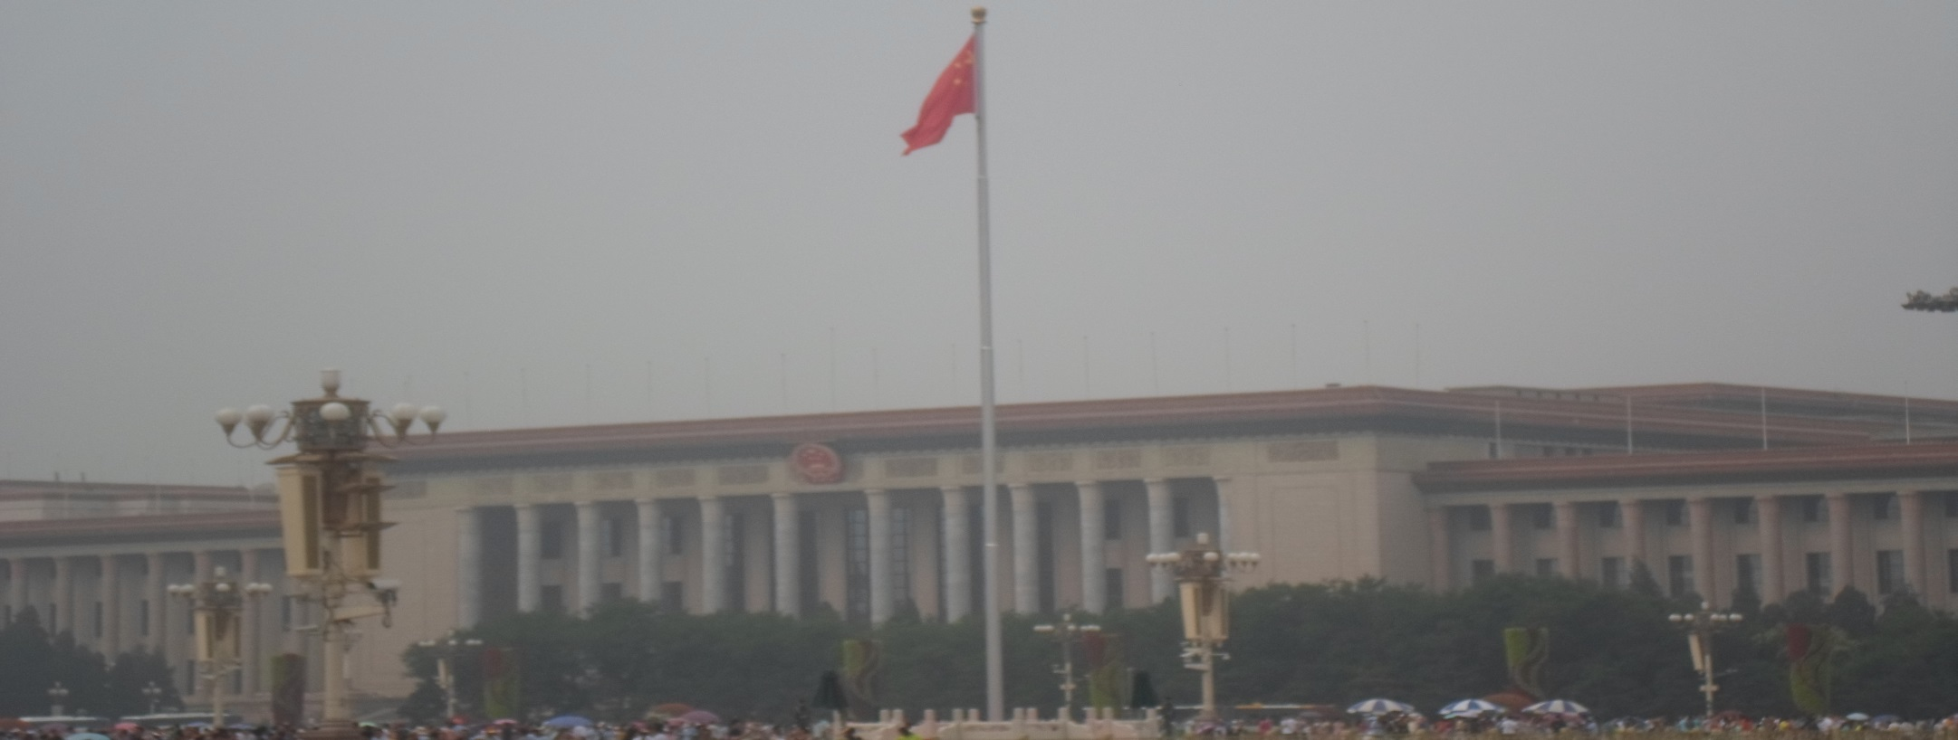
Legislature of the People’s Republic
An Overview by
Christopher Hornung
SISU China Studies
School of International Relations

Slide 2
National People’s Congress (NPC)
Around 3,000 delegates
Unicameral Legislature, One Party System
Elections Commence Every 5 years to U.S 6.
Democratic Centralism: (
Top Postions of the NPC include Chairman, Vice-Chairman, and Secretary General.
Guidelines include the Constitution, Legislati

Slide 3
Top Duties
Elections of President and Premier
-Qualifications are Party Loyalty, 45 years of age, elected directly from the NPC.
Appointments of Premiers, Vice Premiers, State-Councillors, Auditor Generals, and Secretary Generals of the State Council.
Approving Reports of high party members, statues,
Officiates State of the Country and ratifies and Amends National Law.

Slide 4
Elections
Party Approval is necessary for election, as the CPC has complete control over the Standing Committee
The 1/3rd of non-Party entities are distributed across congress for their expertise, not in a role crucial to opposition.
Secret Ballot Voting system. Voters are encouraged to “recall” elections.
Autonomous areas such as Hong Kong have their own electoral process, although this is changing for more seats in congress.

Slide 5
Relationship with State Council
Headed by the Premier with 35 members, acting as central authority from Poliburo down.
Initially, the first stage of law making is generated here, and then decided amongst larger powers as the law gains ground.
Has the power to amend or interpret laws, unlike most other countries.
Special exceptions are made for REGULATION, particularly of local laws and autonomous regions, which are placed differently from Administrative laws of much of the mainland.

Slide 6
Special Committees within
Ethnic Affairs Committee
Law Committee
Internal and Judicial Affairs Committee
Education, Science, and Culture Committee
Foreign Affairs Committee
Enviornmental Protection Committee
Agricultural and Rural Affairs Comitteee

Slide 7
Questions…

