Slide 1
The Story of My Life
Storytelling
World Pass U1

Slide 2
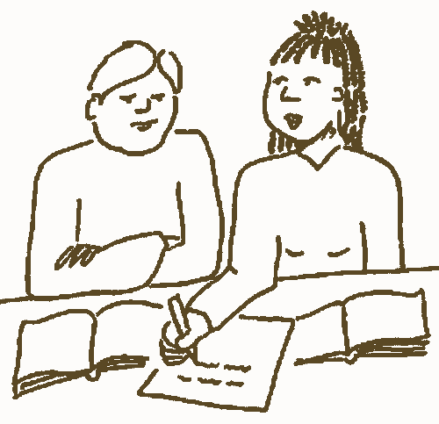
We both…
work in pairs
5 minutes
find as many things you have in common as possible
write a list
tell the class

Slide 3
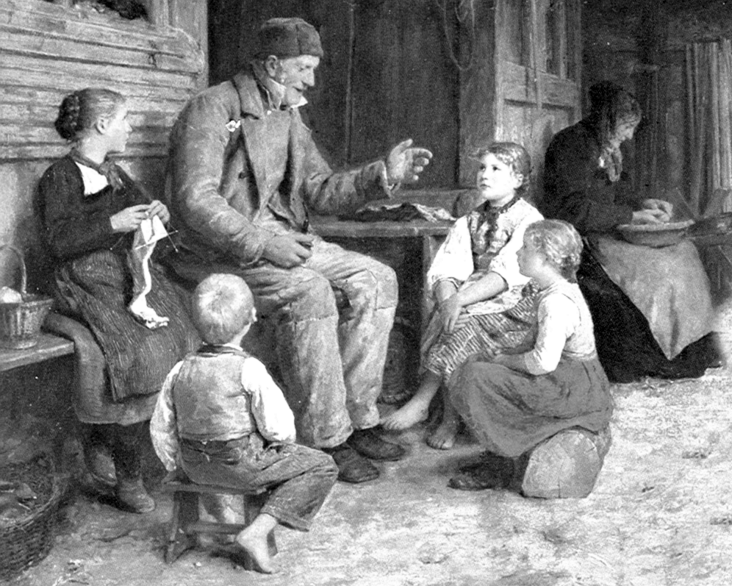
Storytelling
Do you know someone who’s a good storyteller?
Who is it?
What do they like to talk about?
Are you a good storyteller?

Slide 4
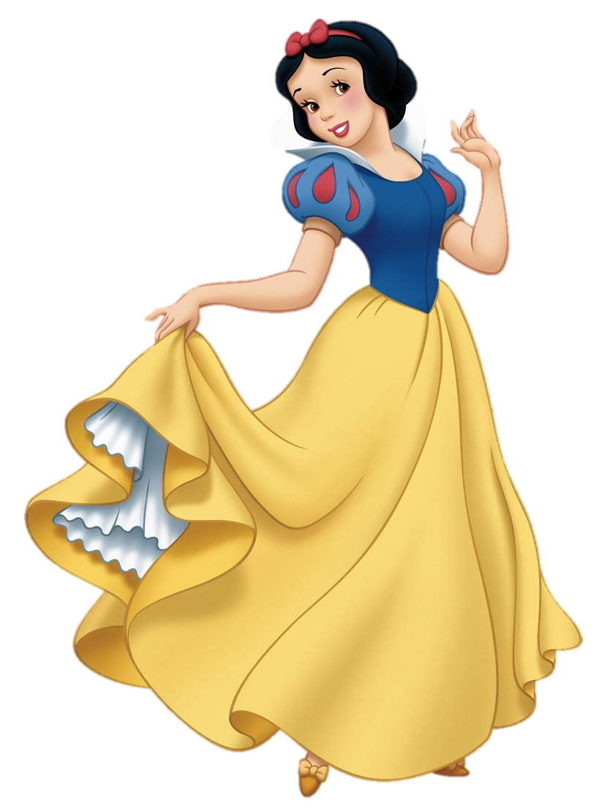
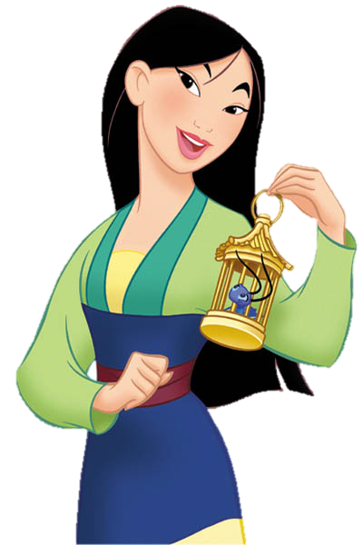
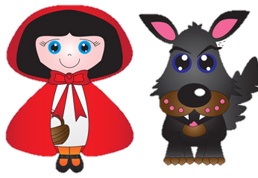
Old stories
What are some very old stories that are still popular?
Which ones have been made into movies?

Slide 5
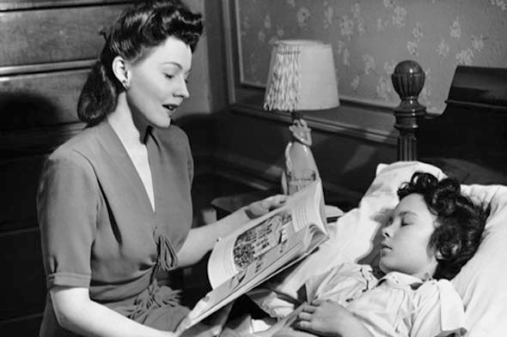
What’s the story?
People use the word story in many different ways.
e.g. ‘a news story’ or ‘a bedtime story’
Can you think of other ways?
In pairs/groups, make a list and tell the class.

Slide 6
Read these four short conversations. Who do you think might have these conversations? Where might the people be?
Conversation 1
What’s his story?
He says he was at home watching TV when the robbery occurred.
Conversation 2
I don’t want to hear any more stories out of you, young man!
But it’s true! I didn’t eat all the cookies. I swear!
Conversation 3
What’s the magazine’s cover story this week?
The Olympics. The Games are big news right now.
Conversation 4
How was the movie?
The special effects were excellent, but the story was too predictable.

Slide 7
Match the story-related verbs (on the left) to their definitions (right).
verify
alter
make up
go after
cover
go over
interpret
piece together
invent something (to fool someone)
review
figure out what happened
analyse (to get the meaning)
change
report a new story
pursue an idea
check to see if something is true

Slide 8
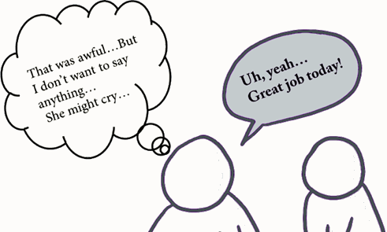
White lies (untrue stories told to avoid hurting someone’s feelings)
A proverb in English says ‘Honesty is the best policy.’ Do you think that’s always true? Why or why not?
Have you ever made up a story?
Have you ever told a white lie?

Slide 9
Scary stories
Do you find them fun and interesting?
Why or why not?
Do you know any scary or horror stories?

Slide 10
Once upon a time… Put the events of the story in order. Notice the underlined expressions that are used when telling a story.
It happened when we were living in an old house on Beach Street. Everyone in the neighbourhood said it was haunted, but we just laughed and ignored them.
I was shocked at what I saw! The living room furniture was in different positions! My wife immediately said ‘A ghost moved our furniture!’ Then we heard a noise from the closet.
Did I ever tell you about the time there was a ghost in our house?
It seems funny now, but at the time we were really scared!
One night, however, we were asleep in our bedrooms upstairs. Suddenly, we heard some loud thumping noises downstairs. At first, I was too sleepy to do anything about it. But finally, I went downstairs to investigate.
In the end, it wasn’t a ghost after all. We opened the door and saw my cousin hiding there. He was playing a joke on us.

Slide 11
Think of a time when one of these things happened. Tell your partner a story about it. Use the expressions in the boxes.
You saw something scary.
You lost something important.
You did something very embarrassing/funny/risky.
… or any other interesting story that happened to you!
Telling a story
Did I ever tell you…
I’ll never forget the time…
A couple of years ago/last week/…
It happened when…
One night/day…
All of a sudden/suddenly…
In the end…
Listening to a story
Wow!/Really!/Unbelievable!/Are you joking?/…
And then what happened?
What did you do next?
What do you mean?
What did you say?

Slide 12
Story chain
Personality adjective
Profession
Verb in past tense (+ object)
Location
Reason

