Slide 1
END-OF-TERM REVISION
WEEKS 7 - 14

Slide 2
topics covered
Storytelling
Technology
Personality
Sports
Family
Changing the World
Mysterious disappearances
Jobs
Crime and punishment
Money
Travelling
Men and women
Emergency

Slide 3
topics for revision this week
Mystery
Jobs
Crime and punishment
Money
Travelling
Men and women
Emergency

Slide 4
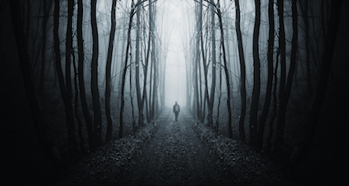
Mystery (World Pass unit 5)
Have you ever read a story about someone who has mysteriously disappeared or died? What happened?
Do you believe in aliens? Why do some people think they exist?
Why are stories about Sherlock Holmes so popular?

Slide 5
- Telepathy - Reincarnation - Déjà vu - Miracle - Horoscope - Prediction - Séance - Psychic - Superstition - Coincidence
a meeting with a ghost
belief in something that is not proven but is said to bring luck or misfortune (broken mirrors, black cats...)
rebirth (in a different body)
a person who can talk to ghosts
communication using only thoughts
a strange feeling that you have been in this situation before
an unplanned, unexpected lucky accident
something amazing that cannot be explained by science
guessing the future
reading of your future based on your day of birth

Slide 6
DREAMS
Are dreams predictions?
Why do we dream?
Do you usually remember your dreams?
Do you think that animals dream? Why or why not?
Have you ever had the same dream more than once?
Are your dreams usually nightmares or sweet dreams?
Have you ever had a dream that later came true? Why might this happen?

Slide 7
Jobs and work (World Pass unit 6)
Why do so many people do jobs that are not enjoyable but pay well?
Why don‘t some parents let children decide what they want to do in life themselves ?
What are the most wanted jobs in China? Why?

Slide 8
How bad? WHY? Rank from worst to least bad
A woman at a job interview who doesn't say that she is two months pregnant.
Phoning up to say you're ill, when you're not, to get a day (or days) off.
Making personal photocopies on the company's photocopier.
Lying about your qualifications at a job interview.
Drinking a lot of alcohol during the work break.
Stealing office supplies (e.g. pens and paper).
Failing to report a small mistake you made.
Taking longer breaks than permitted.
Cheating on the expense account.
Selling company secrets.

Slide 9
Dirty jobs?
A pharmaceutical company which tests its beauty products on animals.
A multinational which trades with the governments of politically oppressed people.
A weapons producer.
A fast food chain that opens 'restaurants' in beautiful places.
A nuclear power station.
A tobacco company.

Slide 10
Crime (World Pass unit 7)
What is the most commonly committed crime in China? Why is it so common?
Do you know anyone who has committed a crime? What and why?
How can the government prevent people from committing crimes?

Slide 11
Circle the correct form of the verb.

Slide 12
Do you agree or disagree? Why?

Slide 13
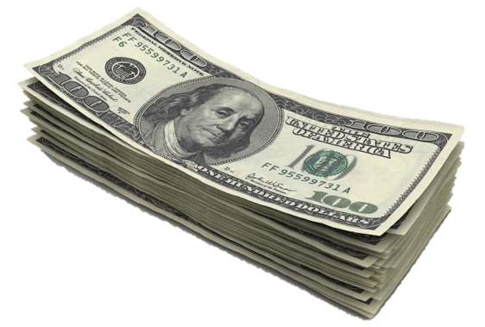
Money (World Pass unit 8)
What would you do if you had a million dollars?
Have you ever donated any money to charity?
Have you ever lost your card or money? Did you find it in the end?

Slide 14
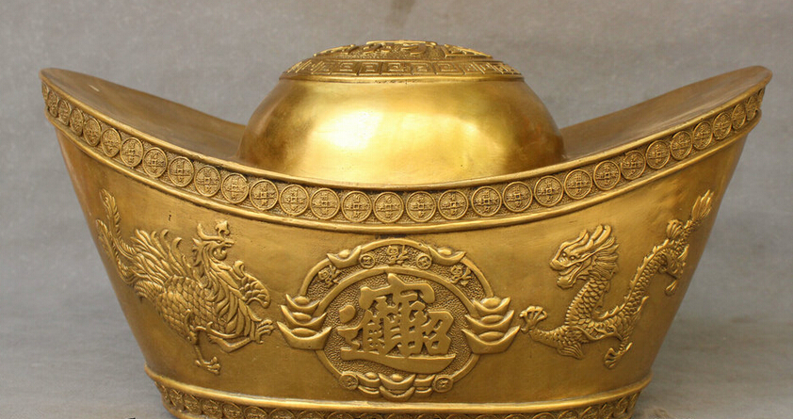
Is money the most important thing?
Why do so many people list money as the most important thing in their lives?
What may be the social or historical reasons?
What is your opinion? Do you feel the same? Why (not)?

Slide 15
What is the most extravagant restaurant, party, or social event that you’ve ever been to? What was it like?
Imagine that you could change lives for a day with a person of great wealth. Who would you change places with? Why?
What is something you’re saving up for? Why do you want it/need it?
If you inherited a large sum of money, what is the first thing you would spend it on? Why?
What is something you’d never do for money? Why not?

Slide 16
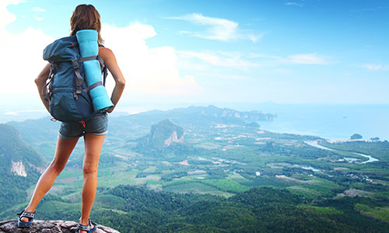
Travelling (World Pass unit 10)
What country do you want to visit the most? Why?
Do you like travelling with your family? Why (not)?
Do you think all students should travel abroad? Why (not)?

Slide 17
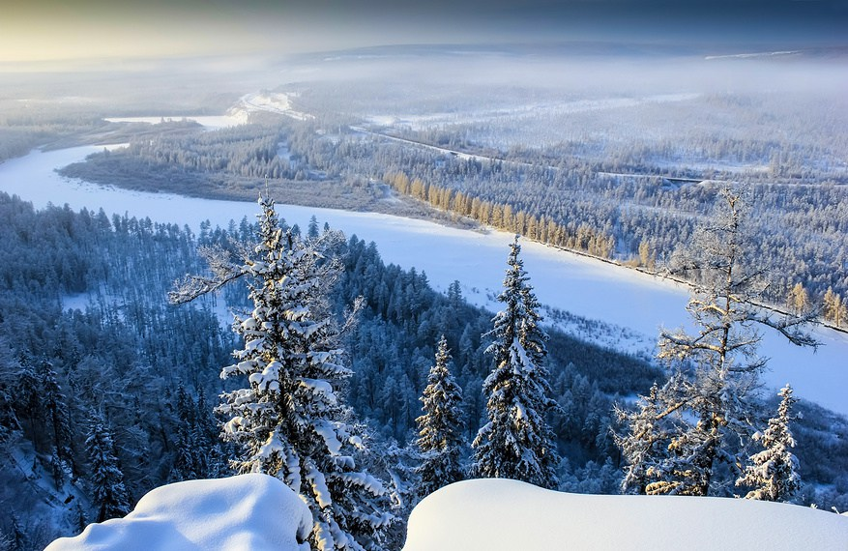
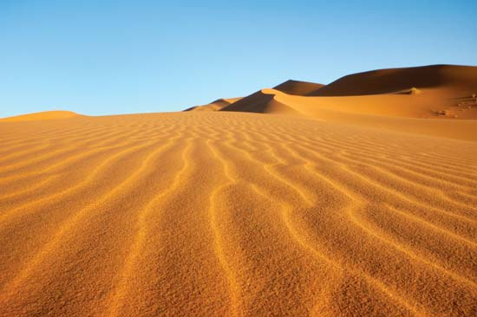
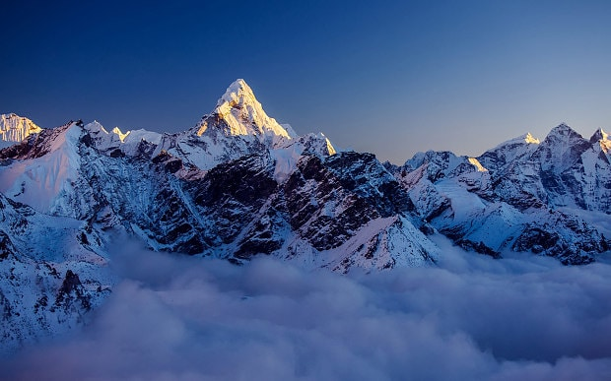
Adventure holidays
What are these places like?
Weather / main features / animals
What could you do there?

Slide 18
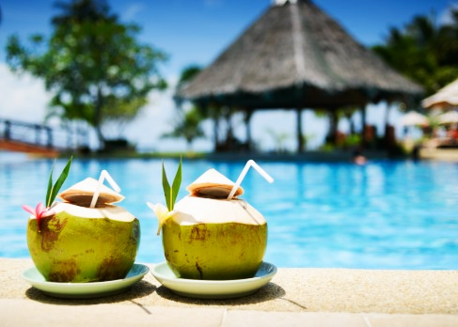
YOUR IDEAL HOLIDAY
Summer or winter holiday?
Where would you go? Why?
Who would you take with you?
What would you do there?
What would you pack in your suitcase?

Slide 19
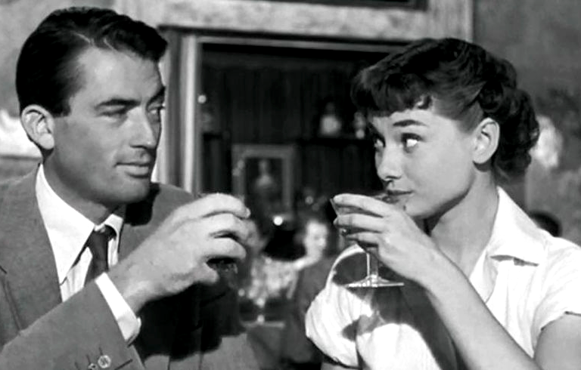
Men and women (World Pass unit 11)
What in your opinion are the main differences in male and female thinking?
Without being sexist, do you think there are areas women are better at than men? And men than women?
In recent years, we have witnessed the rise in equality between the two sexes. Can you think of any examples?

Slide 20
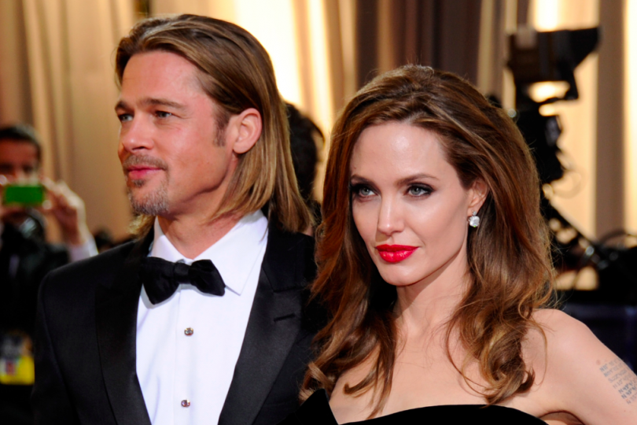
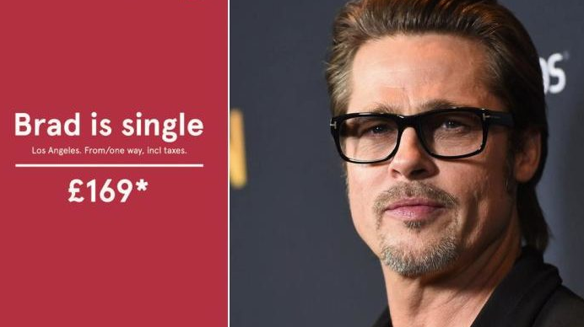
Commitment issues
You often hear people say ‘celebrity marriages never last.’
Why do you think celebrities are always breaking up?
Why do you think so many celebrities have unhappy love lives?
Do you know any celebrities in long, happy relationships?

Slide 21
Breaking up
What are different ways of breaking up with someone?
Which are the most common? Which are the least common?
Make a list with a partner and then share your ideas with the class.
What is the kindest way to break up with someone? Why?

Slide 22
Emergency! (World Pass unit 12)
How well can you keep calm? Do you tend to panic in emergency situations?
Do you think you would be able to help people who have been struck by an earthquake or another disaster?
Have you ever been in an emergency situation? If yes, how did you deal with it? If not, do you think you would handle it well?

Slide 23
What would you do in this situation?
You are on your way home from work, walking along the road and you are nearing the intersection when there is a screech of metal ripping and bending. Screams fill the air, car horns wail and your eyes focus on several cars in the street, unmoving. Smoke is billowing and bodies are thrown all over the street, a school bus has turned over. You’d better get some help.

Slide 24
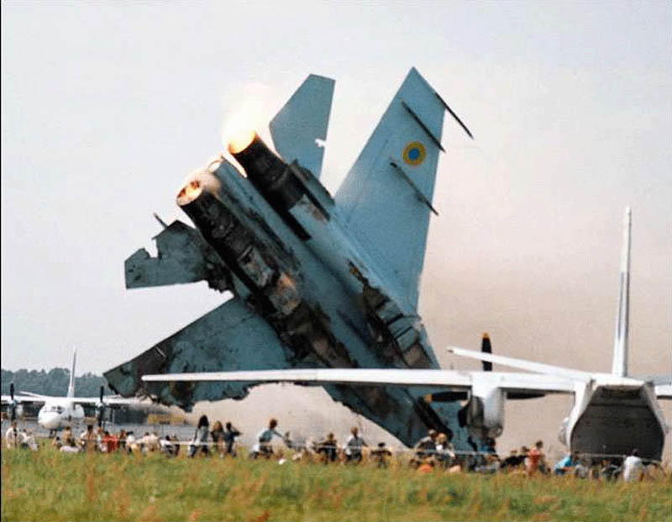
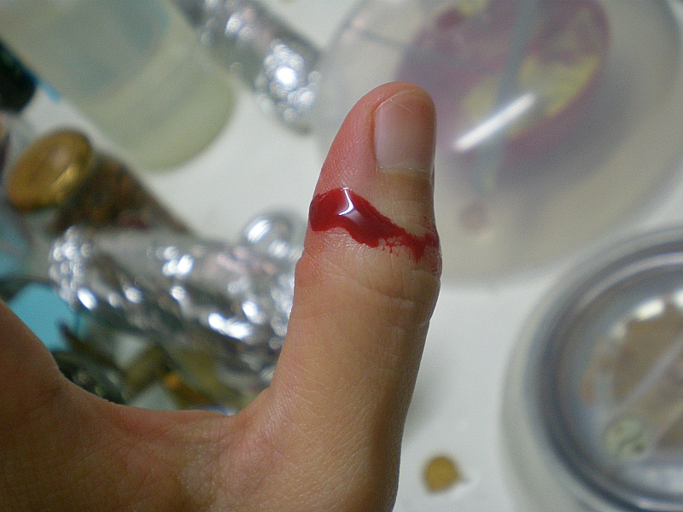
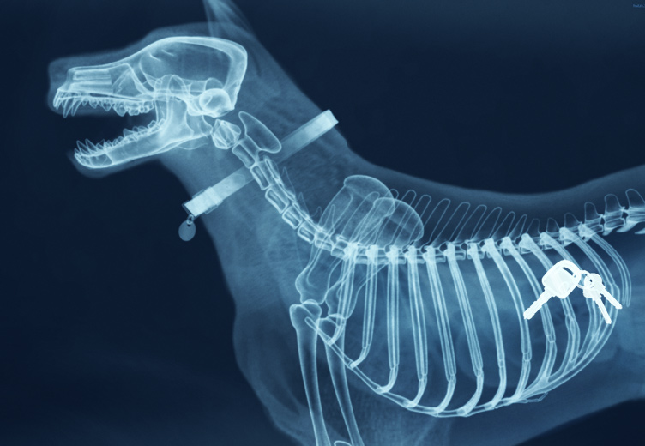
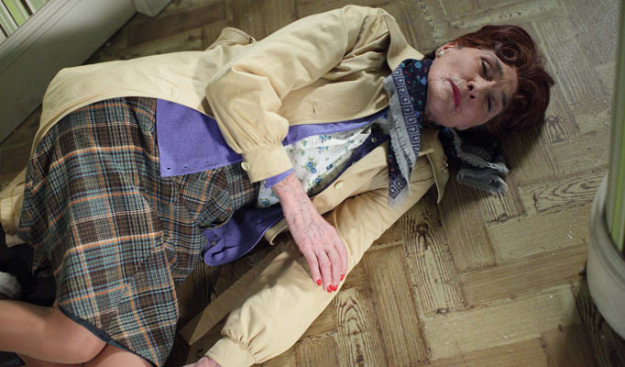
Who do you call? What do you do? Discuss.

