Slide 1
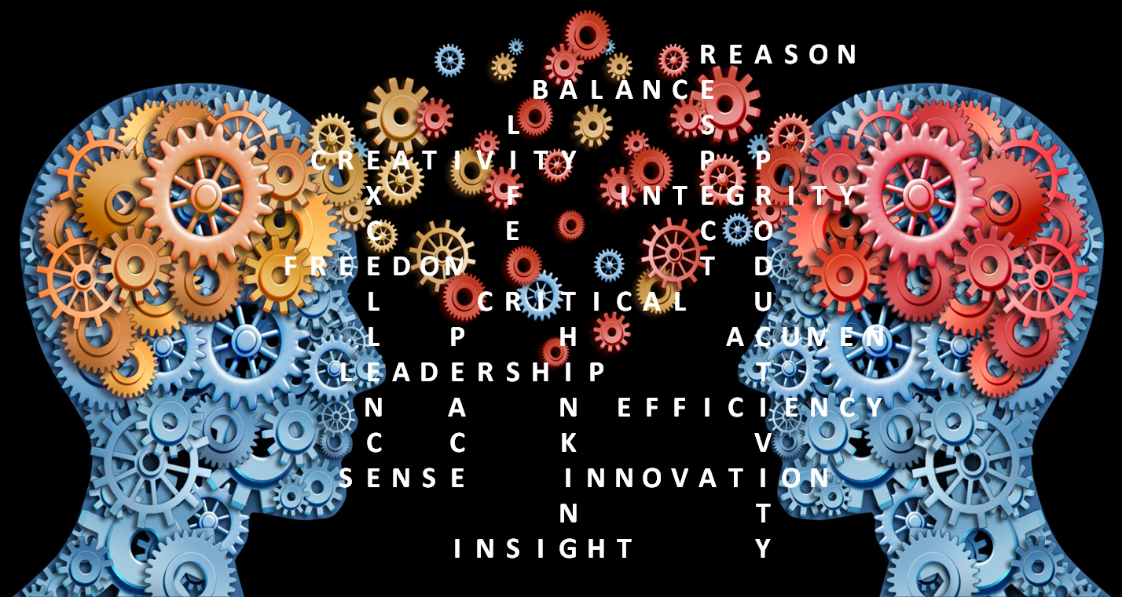
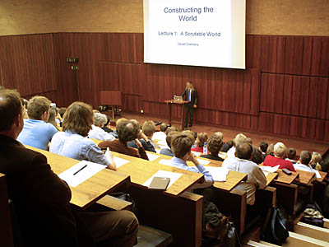
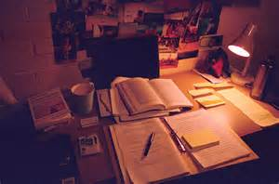
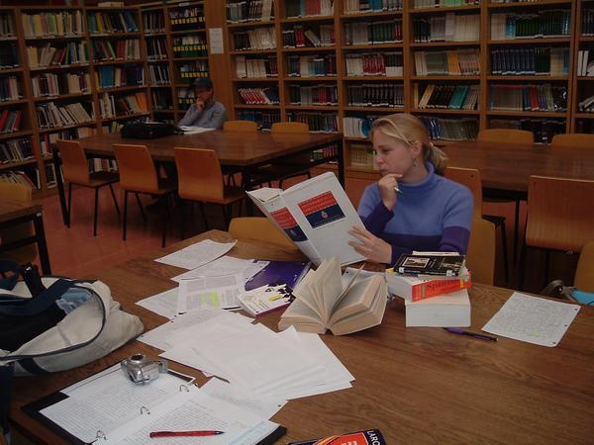
Critical Thinking

Slide 2
Warm-up Discussion

Slide 3
You have already learned how to
format an Academic work in English.
(those of you who failed the midterm will have to review)
So, the most important thing you will
have to do in your essay is:
Show me that you are a critical thinker.

Slide 4
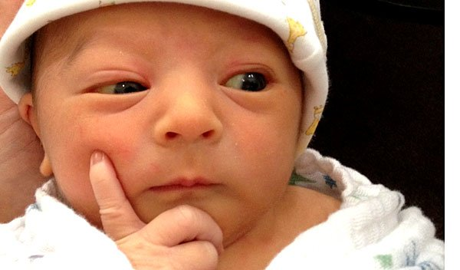
Wait! You mean… LEARNING is about more than just
memorizing and copying things?
Yes, Baby.

Slide 5
Now let’s have a look at some new vocabulary:
(a) critic – (to) criticize – (to be) critical – criticism – (to) critique – (a) critique
(a) judge - (to) judge – (one’s) judgment – (a) judgment
(to be) gullible – gullibility
(to be) skeptical – skepticism – (a) skeptic
(to be) subjective – subjectivity
(to be) objective – objectivity
(an) opinion
(a) fact – (to be) factual
(a) bias – (to be) biased – confirmation bias
(a) prejudice – (to be) prejudiced

Slide 6
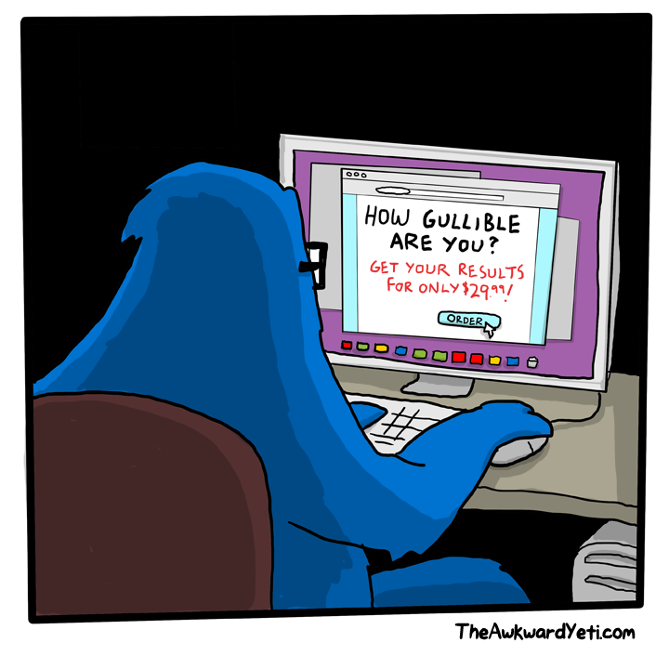
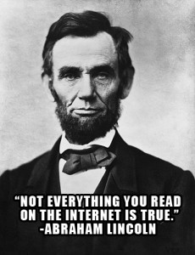
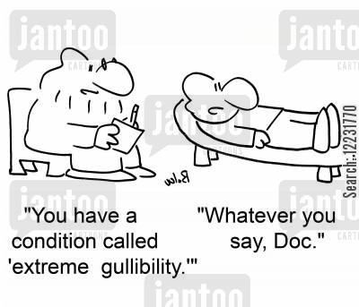
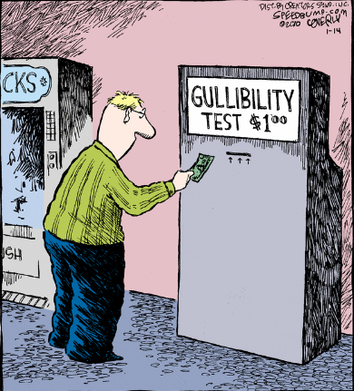
Gullible – Gullibility

Slide 7
“Je pense donc je suis!”

Slide 8
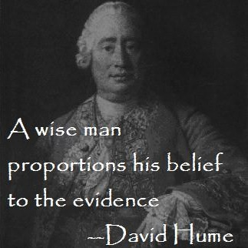
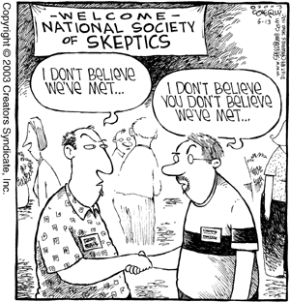
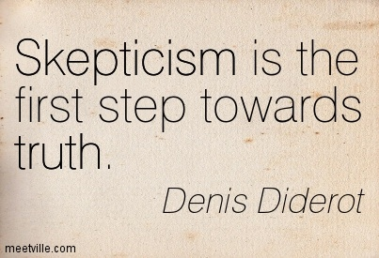
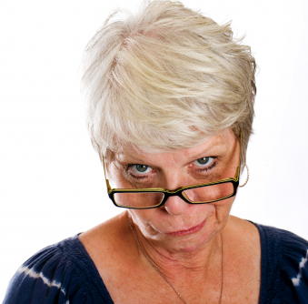
Skeptical – Skepticism - Skeptic
Oh, really?

Slide 9
Subjective – Subjectivity

Slide 10
Subjective Judgment
Which one is better? Why?

Slide 11
Objective – Objectivity

Slide 12
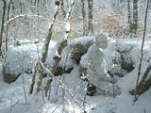
Objective Judgments
Which one is better? WHY???

Slide 13
Judgment
An opinion that you form about something
(hopefully after thinking about it)
(carefully…)

Slide 14
Opinions & Facts
subjective
objective
Facts do not depend on your subjective feelings & opinions.
But your opinions (about objective realities) should depend very heavily on facts.

Slide 15
Bias & Prejudice
America is the greatest country in the history of the world.
China is the greatest country in the history of the world.
Why are Chinese people such bad drivers?
Why are American people so arrogant?

Slide 16
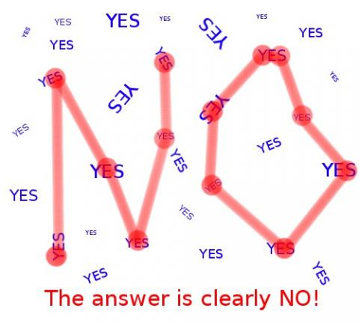
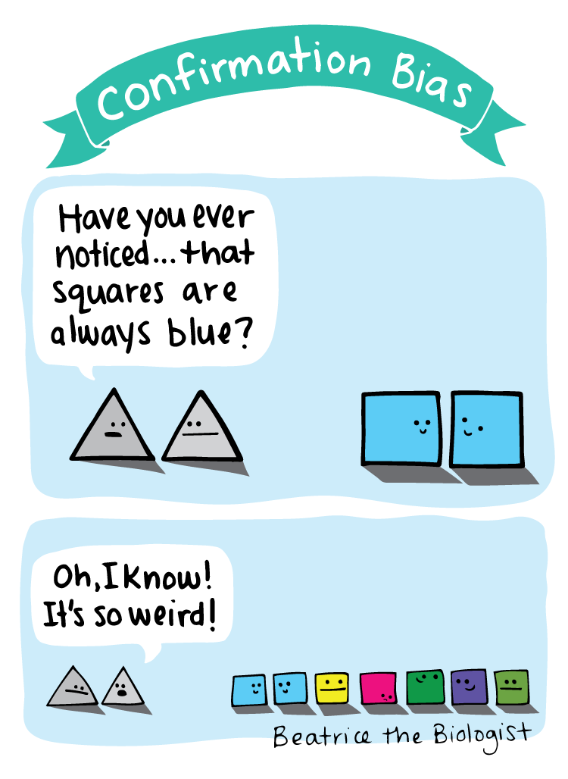

Slide 17
κριτικός
Kritikos
Critic (critical)
About making judgements

Slide 18
Critical thinking…
… is well thought out.
… does not allow for beliefs with out evidence.
… analyzes/evaluates factual evidence.
… is logically reasoned (rational).
… is skeptical.
… is unbiased.
… is objective.
… liberates the mind to think independently.
… enables you to identify faulty arguments.
… enables you to construct good arguments.
… enables you to identify the relevance and importance of ideas (old and new).

Slide 19
Critical thinking…
…. is not natural.
… is something we must LEARN how to do.

Slide 20
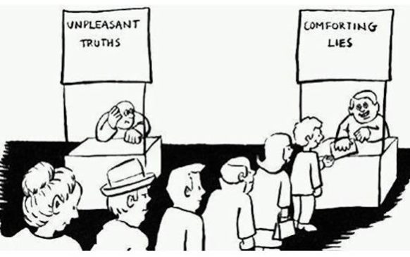

Slide 21
What is natural?
Prejudice is natural.
Bias is natural.
Believing what someone tells you is natural. (gullibility)
Believing something you read is natural. (gullibility)
Believing what you see on TV or hear on the radio is natural. (gullibility)
These things will always be natural to you.
What sets people with critical thinking skills apart is that they can (often) recognize these things in themselves and then make efforts to correct them when necessary.

Slide 22
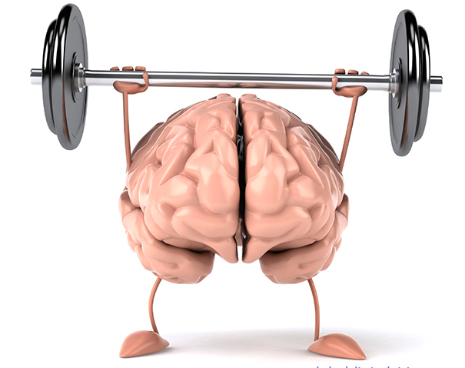
“The unexamined life is not worth living.”
-Socrates
“It is the mark of an educated mind to be able to entertain a thought without accepting it.”
-Aristotle
“Education is not the learning of facts, but training the mind to think.”
-Albert Einstein

Slide 23
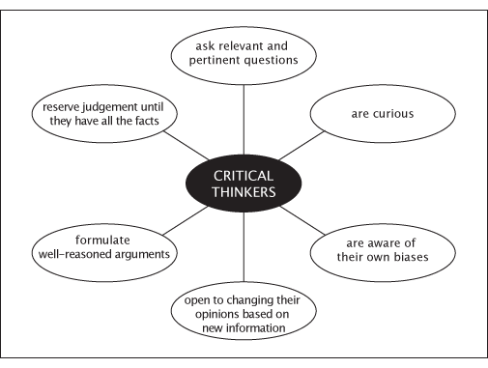

Slide 24
Time to exercise your logic.
But first,
a few more
vocabulary words:

Slide 25
Logic vocabulary:
Conclusion:
This is your final judgment… your belief.
This is what you would argue other to believe as well.
Premise(s):
These are the claims, arguments, facts, reasons and evidence you have used to build you conclusion.
Logical:
1 + 1 = 2
Illogical:
1 + 1 = 3

Slide 26
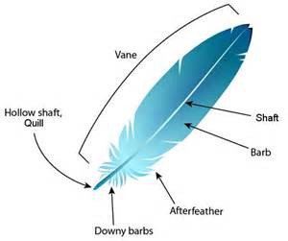
Analyzing an Argument
There is a mysterious animal named “X”. No one has ever seen animal X but we have evidence of it. We have found feathers which belong to animal X. In nature, only birds have feathers. Therefore we know that animal X is a bird.
What is the writer’s conclusion? (2 minutes)
Conclusion:
Animal X is a bird.
What are the premises which the writer uses to justify his conclusion? (3 minutes – find 2)
Premise A:
Only Birds have feathers.
Premise B:
Animal X has feathers.
Does the writer have a logical argument? (1 minute)
YES!

Slide 27
Examining Conclusions:
Step 1:
Identify the premises the person used to draw his/her conclusion.
Step 2:
Determine whether or not the conclusion is logical if the premises are presumed to be true.
Step 3:
If the conclusion is logical. We may now examine the premises to see if they are legitimate. If we find problems with the premise, then there must also be a problem with the conclusion.

Slide 28
Analyzing an Argument
Since we know that animal X is a bird, we can also know that animal X is able to fly because all birds can fly.
What is the writer’s conclusion? (1 minute)
Conclusion:
Animal X can fly.
What are the premises for this conclusion? (2 minutes - find 2)
Premise A:
all birds can fly.
Premise B:
animal X is a bird.
Does the writer have a logical argument?
YES!

Slide 29
Logical Arguments
I do not know who Donald Trump is. I didn’t even know if Donald Trump was a man or a woman. Then I heard Donald Trump’s voice on the radio. It was deeper than my mother’s voice. Since most men have deeper voices than most women, I can now know that Donald Trump is a man.
What is the speaker’s conclusion?
Conclusion:
Donald Trump is a man.
What are the premises for this conclusion?
Premise A:
My mother is a woman.
Premise B:
Most men have deeper voices than most woman.
Premise C:
Donald Trump has a deeper voice than my mother (who is a woman).
Does the speaker have a logical argument?
NO!

Slide 30
Point:
Beliefs can be logical and untrue.
Beliefs can be illogical and true.
Ideally, you should like YOUR beliefs to be logical AND true.
You might say: Well as long as my beliefs are true, why does it matter if they are logical or not?
I would then say to you: How on earth do you plan to demonstrate to others that your beliefs are true if they are not based in logical reasoning???
To show that your belief is logical, make sure that your belief logically follows the support of clear premises.
To show that your belief is true, make sure that your premises are logical AND true.

Slide 31
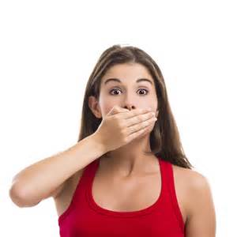
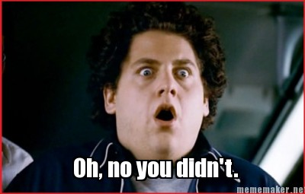
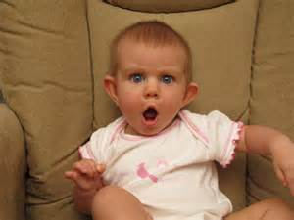
Taboo!

