Slide 1
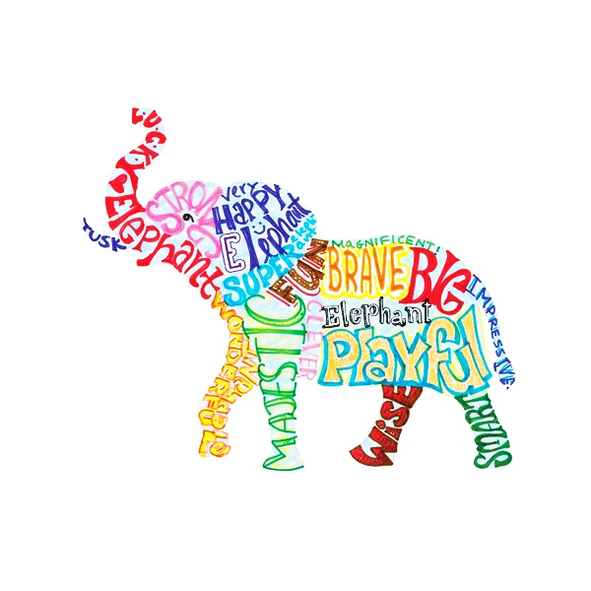
ACADEMIC ENGLISH GRAMMAR FOCUS : USING ADVACED WORD FORMATIONS IN DIALOGUE

Slide 2
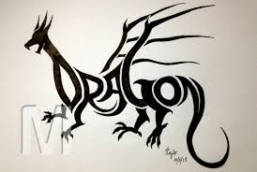
CLASS INTENTIONS
To be able to recognize common word suffixes derived from roots such as ‘able’, ‘accord’ and ‘abstain’ to form correct spoken structures in dialogue.
To improve proofreading and error correction skills in various grammatical formations.
To improve confidence in speaking.

Slide 3
Suffix recognition in word formation
Example ONE:
Root – ABLE having skill, power, means to complete a task.
(1) Ability (noun) -ity suffix forms NOUNS
(2) Enable en + verb prefix forms VERBS to CAUSE X thing
similar formations: enrich, enlighten, enmesh, enlarge,
enact, encapsulate, encase, encircle, encourage.
en + rich = to cause richness. a. Attending your courses on time enrich your mind.
en + light = to bring or cause the light of intelligence or wisdom to emerge. b. Talking to a priest will enlighten you.
(3) Disable dis + verb prefix means forms VERBS to PREVENT or REMOVE something.
disabled
disability

Slide 4
Encase, encircle, encapsulate
En + case = to cause something to be surrounded by a cover.
En + circle = to be covered in a circle by something
En + capsulate = to physically put something in a capsule ; to verbally express the difference between something.
Examples
The fine jewel is encased in gold.
The soldiers encircled the enemy prior to attack.
The professor encapsulated the complex idea accurately

Slide 5
Written practice
Please WRITE the following sentences in your notebook or practice sheet with your own ideas.
I should carefully encase the ___ to avoid damage.
If you encircle the ___ it won’t be able to escape!
Conceptual materials such as ___ must be verbally encapsulated.

Slide 6
PRACTICE: Choose the correct formations disable / enable
Terrible accidents and injuries may totally ____ you.
Studious practice will surely ____ you to achieve high levels of success.
When you write your essay, don‘t forget to ________ the spellchecker!
This toilet is accessible for _________ people.

Slide 7
Prefix / Suffix recognition in word formation
Additional suffix recognition:
Root: ACTIVE – energetic, operative, lively
Inactive (in + adj forms negative form)
Actively (adv.)
Activate (verb +ate forms VERBs to bring about or cause ; other examples other examples: prognosticate, formulate, integrate, predominate, circulate)
Activity: (-ity forms NOUNS for a thing)
Activist ( -ist forms NOUNS for a PERSON)
Activism ( -ism froms NOUNS for an IDEOLOGY)
Activator ( person NOUN) )
Activation (the state or condition NOUN)
Notes:
NOUN FORMATIONS ACTIVITY / ACTIVIST / ACTIVISM / ACTIVATOR / ACTIVATION

Slide 8
NOUN FORMATIONS ACTIVITY / ACTIVIST / ACTIVISM / ACTIVATOR / ACTIVATION
EXAMPLE SENTENCES
1. The rather complex activity requires careful rehearsal and practice.
2. Environmental activism is characterized by deliberate protest and public speeches.
3. It is terribly unjust and awful that the activist was thrown in jail for organizing demonstration.
4. The fire was most certainly the activator of the alarm system.
5. It is only via the activation of specialized neural circuits that you shall be able to remember all the details of this class!

Slide 9
NOUN FORMATIONS ACTIVITY / ACTIVIST / ACTIVISM / ACTIVATOR / ACTIVATION
EXAMPLE SENTENCES
1. The rather complex ______ requires careful rehearsal and practice.
2. Environmental ________ is characterized by deliberate protest and public speeches.
3. It is terribly unjust and awful that the ______ was thrown in jail for organizing a demonstration.
4. The fire was most certainly the ________ of the alarm system.
5. It is only via the ________ of specialized neural circuits that you shall be able to remember all the details of this class!

Slide 10
Please WRITE the following sentences in your notebook or practice sheet with your own ideas.
It is quite clear to me that the best activity I could possibly imagine during my free time is ____.
I think that any activist that wishes to stage a protest against the cruelty committed on animals should be allowed to do so because ___.
Environmental activism is clearly needed in the human society because ______.
The activator of the chemical reaction was __________ ! It was tremendously dangerous!
I need to promote the activation of ____ in order to complete this task!

Slide 11
formulate, integrate, predominate, circulate
Definitions and examples:
Formulate: formulate + ate --- to develop an idea
Integrate: to pull together
Predominate: to be the strongest in the market
Circulate: circle + ate --- to circle around
Examples
1. The professor of physics will formulate how best to solve the problem.
2. A variety of style of art are effectively integrated in the work of contemporary artists.
3. It is clear to me that in Shanghai iPhones predominate in style and status as compared to Huawei.
4. If you circulate around the complex you will eventually find the entry.

Slide 12
Formulate, circulate, predominate, integrate
COMPLETION
CHOOSE THE CORRECT WORDS ABOVE TO COMPLETE THE FOLLOWING EXAMPLES:
In the laboratory I shall carefully _____ the exact reaction that occurred when I combined dangerous acidic chemicals.
The most impressive of artists are able to ___ styles that are distinct and seemingly incompatible.
In Korea, sadly the ____ view is that facial perfection and plastic surgery are mandatory.
The pattern of movement that will allow success requires that you ___ around your enemies on the battlefield!!!

Slide 13
Oral Practice Open Ended Questions
Talk with your partner using the following dialogue questions:
Against what sort of conditions and laws might you be a environmental activist?
The activation of your interest in the classroom is promoted by what type of discussion and activities?

Slide 14
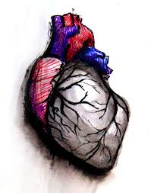
Suffix recognition in word formation
By adding prefixes and suffixes, come up with as many words created from the root HEART as you can!
HEART
dishearten (remove + heart
disheartened
heartening
heartbeat
heartbreak
heartburn
heartland
heartless (heart + without / lacking)
heartsick
heartwarming
heartache ( heart + pain ----- -ache (pain) ; backache, stomachache, etc.)
hearten (to add positive emotion, cheer or confidence to something)

Slide 15
Practice which heart word to add
Charity and giving something back to the community is a naturally ___ activity that will make you smile.
Your cruel and unusually mean actions really ____ me in this special time of joy and celebration!
My lively mood and joyful behavior should surely ___ this environment.

Slide 16
Oral Practice Open Ended Questions
Talk with your partner using the following dialogue questions:
What do you think of as the most heartwarming activity?
Do you know anyone who is mean and heartless?

Slide 17
Suffix recognition in word formation
Example:
MOBILE
Mobilize: ---- -ize verb forms means to cause change or bring something into being. Other examples ---- proselytize, apologize, crystalize, theorize, hospitalize, etc.)
Mobility: NOUN concerns with HOW mobile
Immobile: im- (not ) mobile
Immobilize: (not) + mobile + to cause or enact

Slide 18
Root + ize/ise = to make or cause | Meaning
Proselytize | To make, cause or attempt to convert someone from one belief (usually religious) to another
Apologize | To make amends, justice for error
Crystalize | To make or cause solidity
Theorize | To engage in speculation or thought
Hospitalize | To put someone in hospital
Dramatize | To engage in emotional re-enactment
Terrorize | To cause fear or dismay
Oxidize | To chemically combine with O²
Tyrannize | To treat someone cruelly or with malice

Slide 19
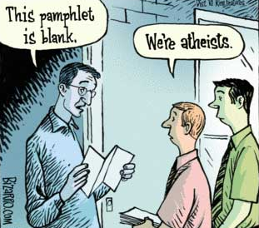
Practice
Speak and fill in –ize/ise
formations from previous slide
into the following:
When coal is burned with sulfur it is ____ to sulfur di-oxide.
The players on the Shakespearean stage effectively ____ the conflict between Romeo and Juliet.
The pastor in the church will always try to ____ you if you if he disagrees with your belief system.

Slide 20
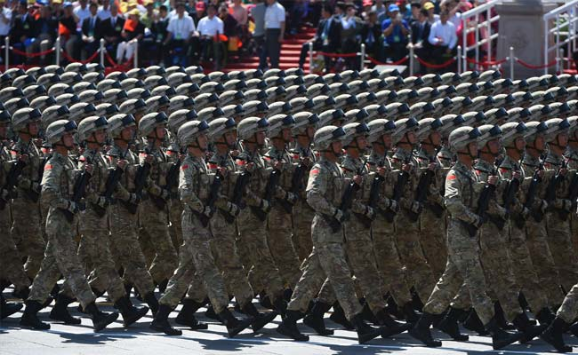
Oral Practice Open Ended Question
Talk with your partner using the following dialogue question:
What do you think might cause the Chinese military to mobilize?

Slide 21
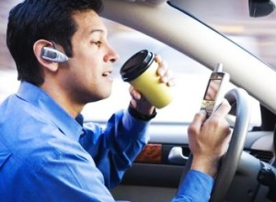
Suffix recognition in word formation
Example
NEGLECT: to fail to pay attention to
Negligence: NOUN for the state or action of not being attentive.
Negligent: ADJ describing a PERSON who behaves in this way.
Negligently: ADV
Negligible: ADJ describing a THING that is indeed not worth paying attention to

Slide 22
Examples
Root – NEGLIGENT
The degree of negligence you demonstrated surely will result in imprisonment!
Your negligent behavior will without any doubt result in severe punishment!
If a police officer is to notice you negligently behave, surely there will be severe consequences!
The financial loss is quite small and therefore is negligible.

Slide 23
Please WRITE the following sentence in your notebook or practice sheet with your own ideas.
An example of negligence I have noticed in my peers is ____.

