Slide 1
Literary and cultural theory Intensive introduction (for Spring 2018) 2 credits
Prof. Michael Steppat

Slide 2
Literary and cultural theory
Spring 2018
大家好
祝你成功 !

Slide 3
Literary and cultural theory
Spring 2018
And: A sincere word of praise for the
Chinese government

Slide 4
Literary and cultural theory
Spring 2018
If you are not yet sure whether you will join this course:
Please make sure to prepare the “Structuralism“ chapter in Peter Barry, Beginning Theory
…and to draft 1-2 questions of your own on the chapter
You will be welcome to join us, whether
for credit or just sitting in!

Slide 5
Literary and cultural theory
Spring 2018
For 2 credits: ESSAY → due by end of August
Minimum 1400 words
How do Poststructuralism and Deconstruction relate to at least one other theory that you know? Please outline any similarities or differences. (PLUS a question about the helpfulness of theory for investigating literature: to be specified, see e-learning platform!)

Slide 6
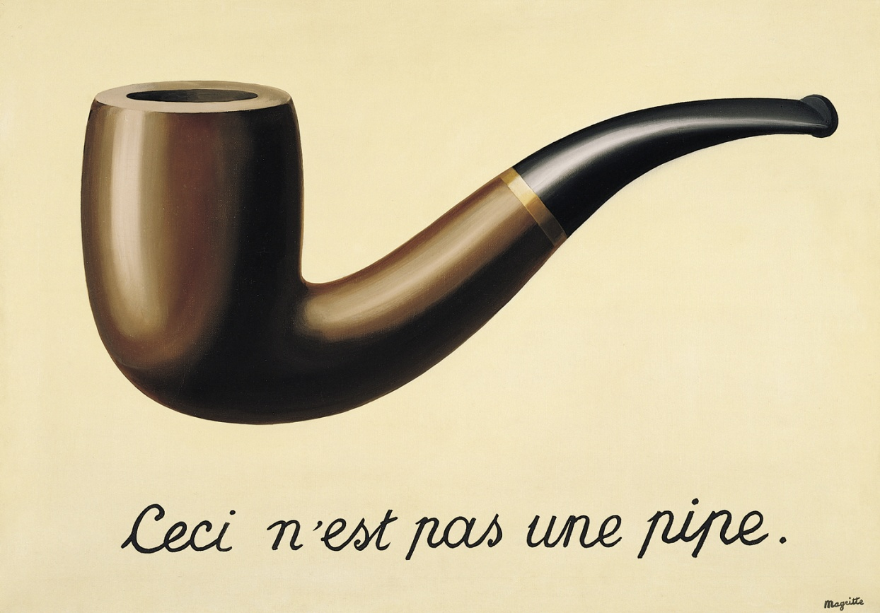
Literary and cultural theory
A voyage of exploration
Our starting point:

Slide 7
Literary and cultural theory
• This is YOUR course …
* I will ask you along the way: Is there anything you would like me to change? Do differently? (You could just let me know)

Slide 8
Literary and cultural theory
• Again: This is YOUR course …
* Are there any statements or topics you would have highlighted in the textbook, and which I did not highlight? Please consider this… for each of the sections… and just let us know (e.g., e-learning forum)

Slide 9
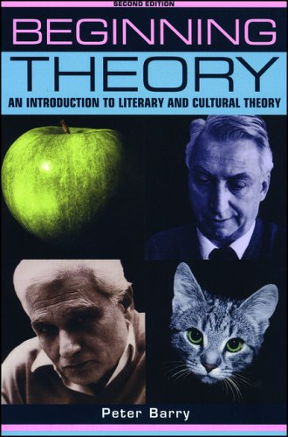
Literary and cultural theory
First major stop:
Peter Barry, Beginning Theory
Structuralism
“Structuralism is an intellectual movement which began in France in the 1950s ....“
For discussion and analysis: YOUR questions (to upload for circulation)

Slide 10
Literary and cultural theory
First major stop:
As for structuralist binaries:
“There may be said to be two classes
of people in the world; those who
constantly divide the people of the world
into two classes, and those who do not.”
(Robert Benchley, Vanity Fair 1920)

Slide 11
Literary and cultural theory
Next:
Peter Barry, Beginning Theory
Post-structuralism and deconstruction
“Is post-structuralism a continuation and
development of structuralism ....?“
For discussion and analysis: YOUR questions
Remember: The pipe that is not a pipe

Slide 12
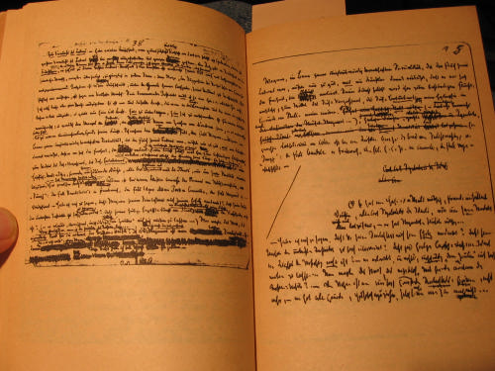
Literary and cultural theory
(Supplement) Anticipation of Post-structuralism
Against positivism, which halts at phenomena--"There are only facts"--I would say: No, facts is precisely what there is not, only interpretations.
What about these conventions of language? Are they really the products of knowledge, of the sense of truth? Do the designations and the things coincide? Is language the adequate expression of all realities? ... What is a word? The image of a nerve stimulus in sounds. But to infer from the nerve stimulus, a cause outside us, that is already the result of a false and unjustified application of the principle of reason. ... The different languages, set side by side, show that what matters with words
is never the truth, never an adequate expression. ...
What, then, is truth? A mobile army of metaphors,
metonymies, and anthropomorphisms.
Friedrich Nietzsche (1873 / 1880s)

Slide 13
Literary and cultural theory
Post-structuralism and deconstruction
“Is post-structuralism a continuation and
development of structuralism ....?“
For discussion and analysis: YOUR questions
Remember: The pipe that is not a pipe

Slide 14
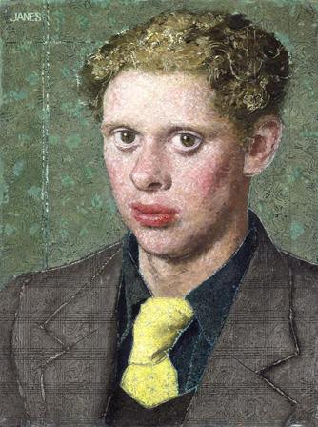
Literary and cultural theory
To illustrate the analysis:
Dylan Thomas, “A Refusal to Mourn
the Death, By Fire, of a Child
in London”
Never until the mankind making Bird beast and flower Fathering and all humbling darkness Tells with silence the last light breaking And the still hour Is come of the sea tumbling in harness ….

Slide 15
Literary and cultural theory
Next:
Peter Barry, Beginning Theory
Psychoanalytic criticism
“Psychoanalytic criticism is a form of literary
criticism which uses some of the
techniques of psychoanalysis ....“
For discussion and analysis: YOUR questions

Slide 16
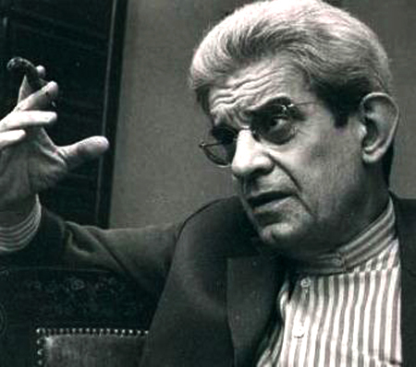
Literary and cultural theory
Lacanian stages (psychic development):
supplement
Before consciousness: The “Real” (pure need, no sense of separation, an ‘impossible’ stage not accessible to linguistic articulation), omitted by Peter Barry
Then the “Imaginary order” (body is separate from mother/other, sense of lack), reinforced by “Mirror stage” (reflection suggests a complete and unified being, not the same as the perceiving self)
Finally the “Symbolic order” (entrance into language and patriarchal rules, Oedipus complex)

Slide 17
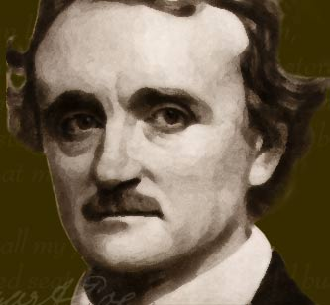
Literary and cultural theory
To illustrate the analysis:
Edgar Allan Poe, “The Purloined
Letter” (1844)
At Paris, just after dark one gusty evening in the autumn of 18--, I was enjoying the twofold luxury ….
Query: Is Shakespeare‘s Hamlet a better illustration?

Slide 18
Literary and cultural theory
Next:
Peter Barry, Beginning Theory
Feminist criticism
“The 'women's movement' of the 1960s
was not, of course, the start of feminism ....“
For discussion and analysis: YOUR questions

Slide 19
Literary and cultural theory
• Our voyage of mutual discovery will now take us to …
but first: A PIT STOP
* Any questions about what we did last
* Is there anything you would like me to change?

Slide 20
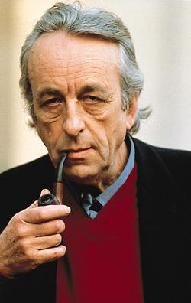
Literary and cultural theory
Next:
Peter Barry, Beginning Theory
Marxist criticism
“Karl Marx (1818-1883), a German philosopher, and
Friedrich Engels (1820-1895), a German sociologist
……”
For discussion and analysis: YOUR questions
Louis Althusser

Slide 21
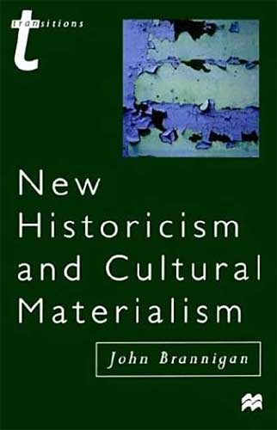
Literary and cultural theory
Next:
Peter Barry, Beginning Theory
New historicism and cultural materialism
“The term 'new historicism' was coined by the American critic Stephen Greenblatt …..”
For discussion and analysis: YOUR questions

Slide 22
Literary and cultural theory
Next:
Peter Barry, Beginning Theory
Narratology (mainly structuralist)
“This chapter is about narratology, which is the
study of narrative structures ....“
And once again, for discussion and analysis: YOUR questions

Slide 23
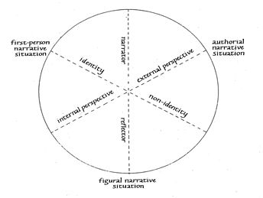
Literary and cultural theory
Narrative theory (Franz Stanzel): a classic alternative
Typological circle (simplified)

Slide 24
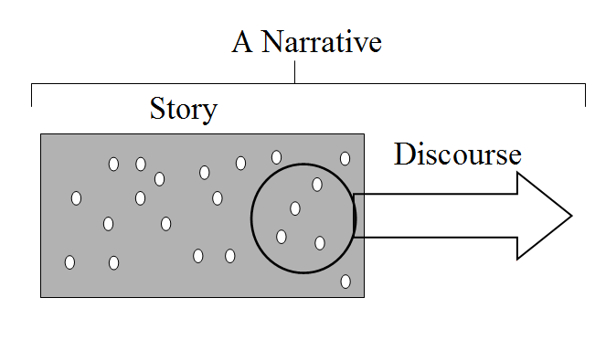
Literary and cultural theory
Narrative theory (Gerard Genette): structuralism

Slide 25
Literary and cultural theory
To illustrate the analysis:
Edgar Allan Poe, “The Oval Portrait”
(1850)
THE CHATEAU into which my valet had ventured to make forcible entrance, rather than permit me, in my desperately wounded condition, to pass a night in the open air ….

Slide 26
Literary and cultural theory
Postclassical/Critical
Narratology (optional):
Routledge Encyclopedia of Narrative Theory, ed. David Herman et al., section “Postclassical Narratology” (Googlebooks)
Interview with David Herman: http://cf.hum.uva.nl/narratology/a11_an_interview_with_david_herman.htm

Slide 27
Literary and cultural theory
Next and last in this course segment:
Peter Barry, Beginning Theory
Ecocriticism
“Simply defined, ecocriticism is the study of the relationship between literature and the physical environment' (Cheryll Glot-felty) ….“
For discussion and analysis:
YOUR questions

Slide 28
Literary and cultural theory
Extension of cultural theory:
Posthumanism (brief introduction)
(Building on Nietzsche, “On Truth and Lies in an Extra-Moral Sense”
Against anthropocentric concepts
Handout: see e-learning platform
For discussion and analysis:
YOUR questions

Slide 29
Literary and cultural theory
Thank you for assisting in these discussions! Our voyage of mutual discovery will now take us …
to Essay preparation:
Poststructuralism/deconstruction: relation to other theories that we are discussing; (and then) helpfulness of any of the theories for understanding literature (see e-learning platform for the precise task)
NB. Please read the literary works in good time!

Slide 30
Literary and cultural theory
Next on our menu:
A further little literary analysis, to exemplify

Slide 31
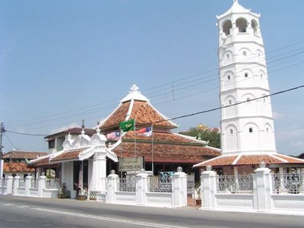
Literary and cultural theory
Literary analysis, to exemplify
Ee Tiang Hong, “Tranquerah Road”
(Tranquerah/Tengkera, Malacca/Melaka)
Poor relative, yet well-connected,
same line, same age as Heeren Street
(more or less, who knows?),
the long road comes and goes ….

Slide 32
Literary and cultural theory
As the literary samples show, two questions will help to enable the application of any theory:
(1) Why is this part of the text formulated/phrased in just this way? What alternatives would there be?
(2) What is unspoken/invisible/concealed on the text surface?
Remember: The pipe that
is not a pipe

Slide 33
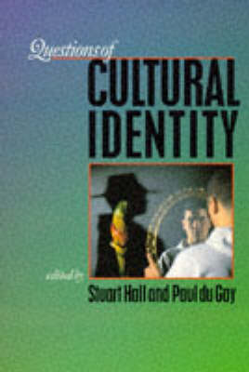
Literary and cultural theory
Next on our menu:
Questions of Cultural Identity
(Stuart Hall and colleagues)

Slide 34
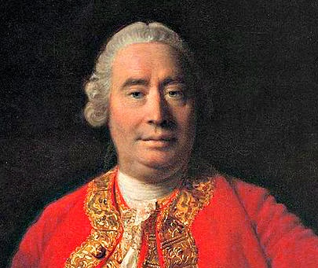
Literary and cultural theory
Questions of cultural identity
We have a distinct idea of an object, that remains invariable and uninterrupted through a supposed variation of time; and this idea we call identity. … Identity is nothing really belonging to these different perceptions, and uniting them together; but is merely a quality, which we attribute to them. Self or person is not any one impression, but that to which our several impressions are supposed to have a reference. But there is no impression constant and invariable. They are nothing but a bundle or collection of different perceptions, which succeed each other with an inconceivable rapidity, and are in a perpetual flux and movement. (David Hume, 1739)

Slide 35
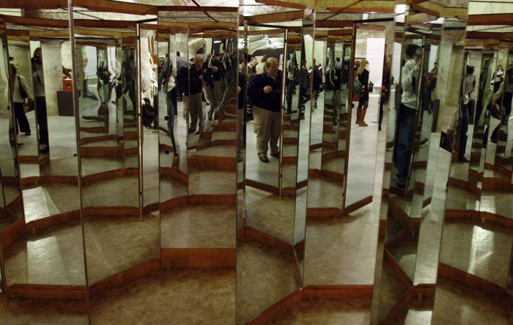
Literary and cultural theory
Questions of cultural identity
(Stuart Hall) Identities are about how we are represented, they are constituted within representation
From the Lacanian
‘Mirror Stage’ to ……………

Slide 36
Literary and cultural theory
Is there a ‘decentering’ of our knowledge?
Reminder: From astronomy to subnuclear theoretical physics, research hypotheses produce ‘signifiers‘. These are not identical with ‘signifieds‘, which are difficult to deduce. (As for observed objects: their shape is dependent on the kind of observation.)
…… And in culture?
Reminder: Magritte‘s ‘pipe‘ which is
not a pipe

Slide 37
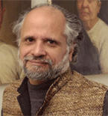
Literary and cultural theory
Stuart Hall & Paul du Gay, ed. Questions of Cultural Identity
Homi K. Bhabha “Culture‘s In-Between“ Optional extension

Slide 38
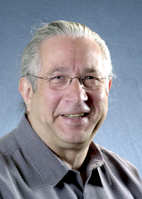
Literary and cultural theory
Stuart Hall & Paul du Gay, ed. Questions of Cultural Identity
Lawrence Grossberg “Identity and Cultural Studies…“ Optional extension

Slide 39
Literary and cultural theory
Next on our menu:
Again, a sampling of selected literary works

Slide 40
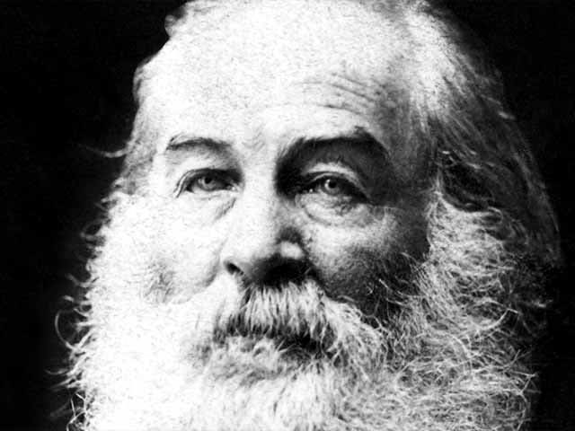
Literary and cultural theory
Sampling of selected literary works
Walt Whitman, “Years of the
Modern” (1859)
Years of the modern! years of the unperform'd! Your horizon rises, I see it parting away for more august dramas, I see not America only, not only Liberty's nation but other nations preparing, I see tremendous entrances and exits, new combinations, the solidarity of races ….

Slide 41
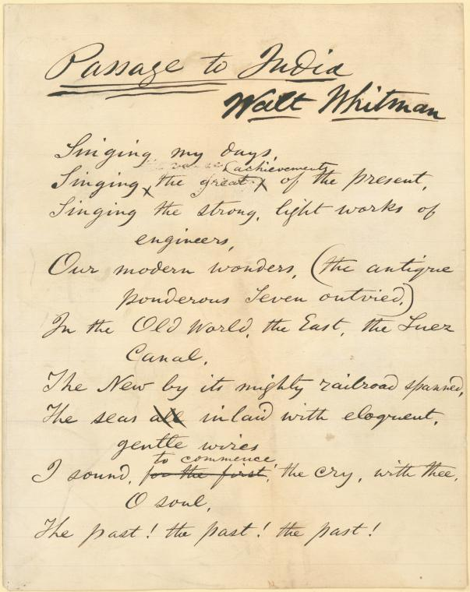
Literary and cultural theory
Sampling of selected literary works
Walt Whitman, “Passage to India”
(1871)

Slide 42
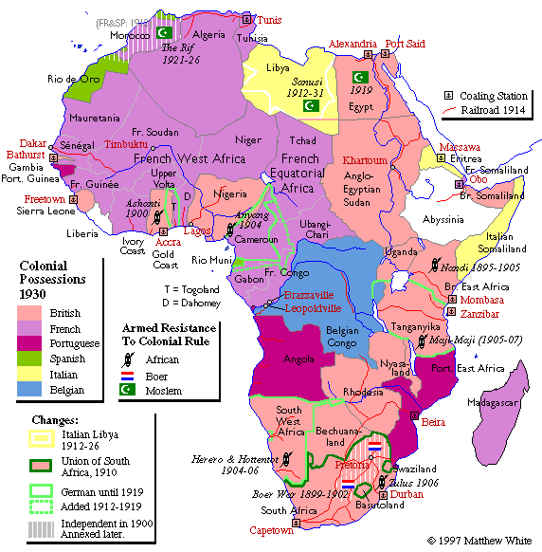
Literary and cultural theory
Joseph
Conrad,
Heart of
Darkness

Slide 43
Literary and cultural theory
Do you see any relevance of
… poststructuralism/deconstruction
… psychoanalytic theory
… feminist theory
… other theories
for analyzing this work?

Slide 44
Literary and cultural theory
(Heart of Darkness)
The old river in its broad reach rested unruffled at the decline of day, after ages of good service done to the race that peopled its banks, spread out in the tranquil dignity of a waterway leading to the uttermost ends of the earth. …
"And this also," said Marlow suddenly, "has been one of the dark places of the earth.“ He was the only man of us who still "followed the sea." The worst that could be said of him was that he did not represent his class. He was a seaman, but he was a wanderer, too …

Slide 45
Literary and cultural theory
(Heart of Darkness)
My purpose was to stroll into the shade for a moment; but no sooner within than it seemed to me I had stepped into a gloomy circle of some Inferno. Black shapes crouched, lay, sat between the trees …
(Pt. 2) The savage who was fireman: He was an improved specimen; he could fire up a vertical boiler. He was there below me, and, upon my word, to look at him was as edifying as seeing a dog in a parody of breeches and a feather hat, walking on his hind-legs.

Slide 46
Literary and cultural theory
(Heart of Darkness)
The men were—No, they were not inhuman. Well, you know, that was the worst of it—this suspicion of their not being inhuman. What thrilled you was just the thought of their humanity—like yours—the thought of your remote kinship with this wild and passionate uproar.
I missed my late helmsman awfully,—I missed him even while his body was still lying in the pilot-house. And the intimate profundity of that look he gave me … a claim of distant kinship affirmed in a supreme moment. He had no restraint, no restraint—just like Kurtz.

Slide 47
Literary and cultural theory
(Heart of Darkness)
I let the young fool believe anything he liked to imagine as to my influence in Europe. I became in an instant as much of a pretense as the rest of the bewitched pilgrims. This simply because I had a notion it somehow would be of help to that Kurtz whom at the time I did not see—you under-stand. He was just a word for me. … It seems to me I am trying to tell you a dream … (It had become so pitch dark that we listeners could hardly see one another. For a long time already he, sitting apart, had been no more to us than a voice.)
(Marlow on Kurtz): The man presented himself as a voice.

Slide 48
Literary and cultural theory
Identities are constructed through
difference—through the relation to
the Other and to their ‘constitutive
outside’ (Stuart Hall) …..
As in this work?

Slide 49
Literary and cultural theory
Conrad’s HEART OF DARKNESS
Kurtz is “hollow at the core”
… “It is his extremity that
I seem to have lived through”
Charlie Marlow as Buddha
but with “sunken cheeks”?

Slide 50
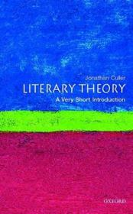
Literary and cultural theory
To back up the overview (option)
Jonathan Culler, Literary Theory
Are there any approaches or theoretical propositions that go beyond what we have covered so far—or that raise new questions?

Slide 51
Literary and cultural theory
EXCURSUS (only if time allows)
A question for us to consider:
Is the study of culture different from the study of society? If so, how is it different?

Slide 52
Literary and cultural theory
EXCURSUS Two propositions
A: Culture is “a social construction produced through communication practices within cultural discourse. Cultural discourse is the historically transmitted expressive system of communication practices, of acts, events, and styles, which are composed of specific symbols, symbolic forms, norms, and their meanings.” (Donal Carbaugh, 2007 & 2013)
OR
B: Edward Sapir (a linguist): “There are as many cultures as there are individuals in the population” (ed. E.F.K. Koerner, 1984)

Slide 53
Literary and cultural theory
Do you see any relevance of
… poststructuralism/
deconstruction
… psychoanalytic theory
… feminist theory
… other theories
for analyzing Shakespeare’s great tragedy OTHELLO?

Slide 54
Literary and cultural theory
Bringing together some theoretical paradigms:
Aristotelian ‘hamartia’ (see Narratology) ….
How are cultural identities constructed through difference—through the relation to the Other and to their ‘constitutive outside’ (Stuart Hall) ….
As in OTHELLO?

Slide 55
Literary and cultural theory
Shakespeare’s
OTHELLO
Performative dimension of drama: Does the distinction between actor and role (including female role) leave room for a ‘center’? Is there a theory that might explain this?

Slide 56
Many thanks for your sustained attention!

