Slide 1
Taking notes when listening
mind maps
Cornell notes

Slide 2
What are we going to do today?
revise what mind maps and Cornell notes are
practise listening to and watching lectures
create mind maps based on the listening
write Cornell notes (exam practice)

Slide 3
What makes good notes?
NO - writing down everything you read/hear
YES - actively deciding
what to note
how it should be noted
how the notes are to be used

Slide 4
Good notes should be well organised
CORNELL NOTES
linear (topic is outlined one point after another)
indentation
spacing
numbering/lettering
MIND MAPS
pattern (the shape of the notes shows how the main ideas are related)
e.g. mind maps

Slide 5
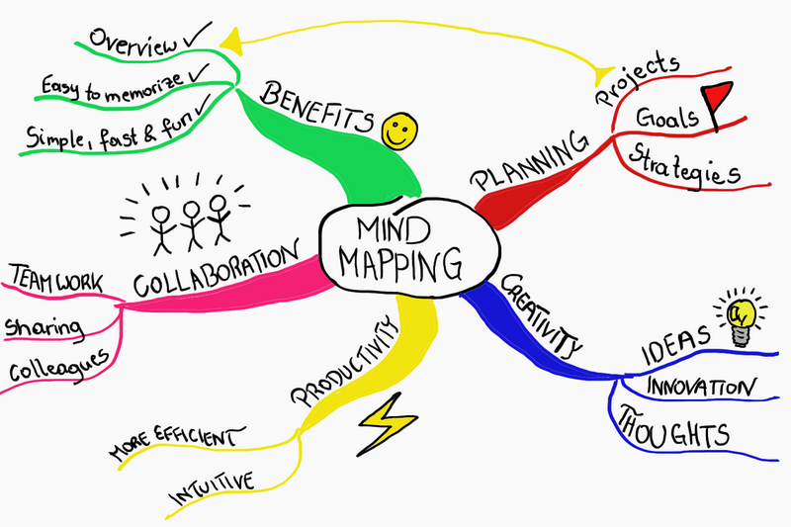
Mind maps (spider diagrams)
for visual learning
used for showing how ideas relate
particularly useful when brainstorming ideas
they can help you recall information you already know

Slide 7
Taking notes when listening
spoken communication differs from writing
consider
way of speaking (emphasis, repeating, etc.)
use of aids (blackboard, projector etc.)
use of set expressions (‘okay’, ‘right’ etc.)

Slide 8
Let’s watch a TED talk about making new words in English!

Slide 9
Match these words with their meaning!
squish
linguist
compound
blend
shift
part of speech
mix or combine together
consist of two or more parts
person who researches languages
crush something
one of the grammatical groups, e.g. noun or verb
change in position, direction or function

Slide 10
Let’s draw a mind map! … based on a short lecture
You’re going to listen to a lecture called Go ahead, make up new words!
The speaker is describing six ways in which you can come up with new words in English.
First, just listen. You can take short notes.
Second, in your teams, draw a mind map of the six ideas put forward in the lecture, giving as much detail as possible
Use colours, big letters, and pictures

Slide 11
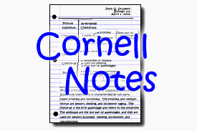
Cornell Notes
A systematic format for condensing and organising notes.
These notes can be taken from any source of information, such as fiction and nonfiction books, DVDs, lectures, text books, etc.
Long sentences are avoided; symbols or abbreviations are used instead.
To assist with future reviews, students write relevant questions or key words in the left column.
Record as soon as possible so that the lecture and questions will be fresh in the student's mind, usually within 24 hours.

Slide 12
Cornell Notes
Students then write a brief summary in the bottom five to seven lines of the page.
This helps to increase understanding of the topic.
When studying for either a test or quiz, the student has a concise but detailed and relevant record of previous classes.
When reviewing the material, the student can cover the note-taking (right) column while attempting to answer the questions/keywords in the key word or cue (left) column.

Slide 13
Layout

Slide 14
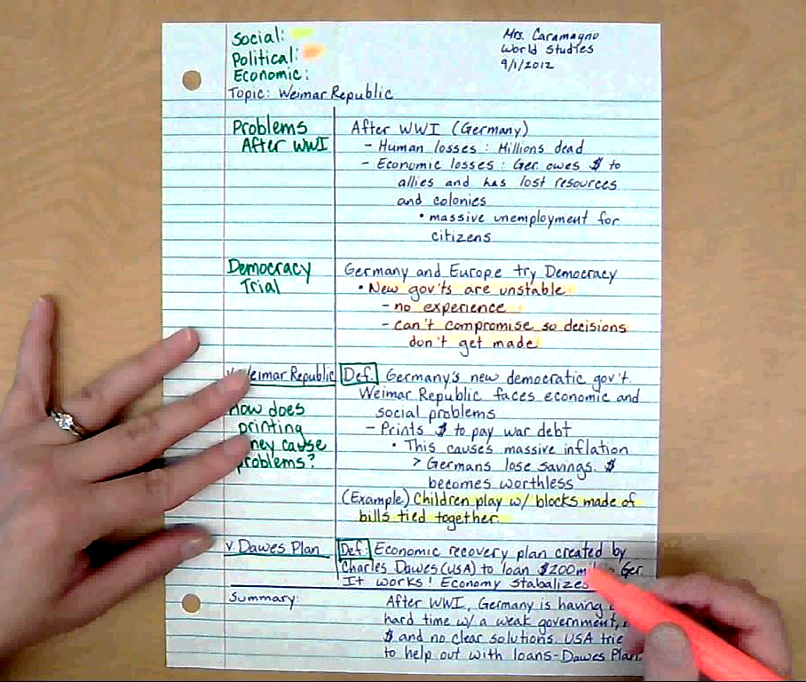
Cornell notes taken in a history class

Slide 15
Let’s practice taking Cornell notes!
we’re going to watch a few more TED talks
take Cornell notes, and don’t forget to include
the heading (your name, class, date, the name of the talk and speaker)
the points covered in the talks and any details
the questions, main ideas and/or keywords
a summary written in your own words
(you will be given some time to fill in the keywords and summary at the end)

Slide 17
Choosing the right career
Let’s take a look at the topic of…

Slide 18
Pre-listening questions discuss in your groups
How do you choose what career path is suitable for you?
What is a skill set and why is it important in choosing a career?
What career path are you pondering for yourself and why have you chosen this path?

Slide 19
Compare the career paths in the table
Career | Talent, skill, ability
EDUCATION
BUSINESS
FINANCE
HEALTH CARE
MILITARY
For each path write below what SKILL or APTITUDE you think is required to be successful.

Slide 20
Pre-listening vocabulary
In English, DEFINE EACH OF THE BELOW key words and phrases
Aptitude
Occupation
Fulfilling career
Altruism

Slide 22
Post-listening discussion
Why is being extroverted a good match for a job as a salesperson?
What is the difference between having an ABILITY to perform well at a job and having a PASSION for a job?
Which should you focus on more closely when choosing a career?

Slide 23
And if you know what your dream job is…
What should you do to get it?
What shouldn’t you do?

Slide 25
Think about various ways your career might make a difference. Review the table below about various career paths. Add at least one point to each career.
NURSING | Help heal people, make a difference in other’s lives
JOURNALISM | Inform the public about current events
ARTIST | Inspire people
POLITICIAN | Change laws
TEACHER | Educate young minds
COMPUTER SCIENTIST | Develop software that will change the world
PILOT | See the world
CARPENTER | Build people’s houses

