Slide 1
李白诗歌里的大唐盛世
The flourishing age of the Tang dynasty in Li Bai’s poetry

Slide 2
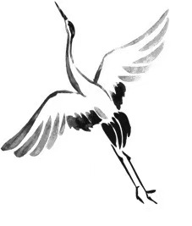
The Roc
—To Li Yong
上李邕
大鹏一日同风起，
扶摇直上九万里。
假令风歇时下来，
犹能簸却沧溟水。
时人见我恒殊调，
闻余大言皆冷笑。
宣父犹能畏后生，
丈夫未可轻年少。
If once together with the wind the roc could rise,
He would fly ninety thousand li up to the skies.
E ' en if he must descend when the wind has abated,
Still billows will be raised and the sea agitated.
Seeing me, those in power think I’m rather queer;
Hearing me freely talk, they can’t refrain from sneer.
Confucius was in dread of talents that would be,
A sage shall not look down upon a youth like me.

Slide 3
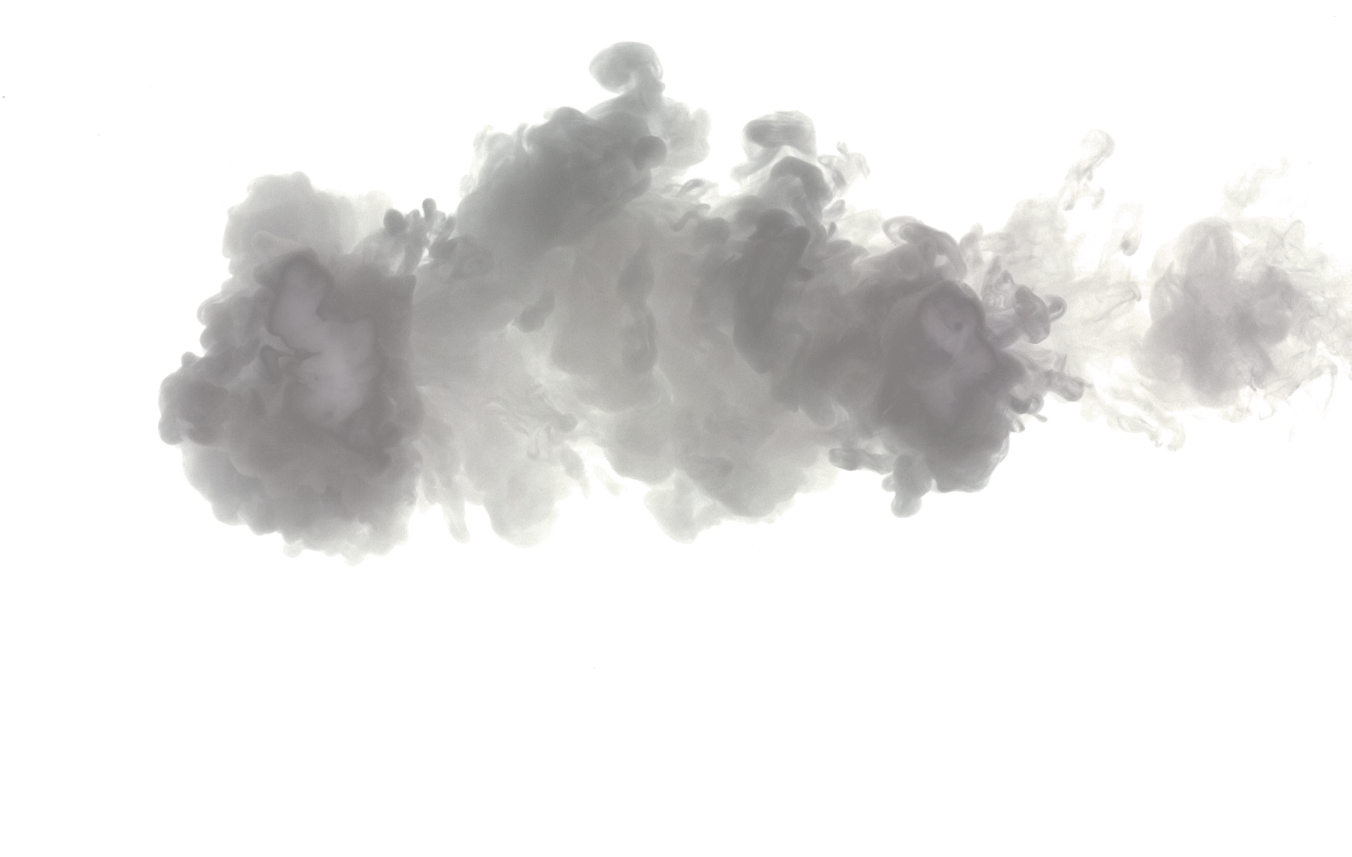
当时的李白
当时的大唐
开元盛世（712年－ 741年）
李邕是在开元年至九年前后，
曾任渝州（今重庆市）刺史。
即（719年－721年）
李白（701年－762年）
开元盛世前期，唐玄宗励精图治，发掘人才，稳定政局的同时大力发展经济。

Slide 4
英雄主义表现
前半借庄子《逍遥游》中神鸟大鹏以自比 → 远大志向
后半借孔子“后生可畏”直言年少不可轻 → 充满自信

Slide 5
塞下曲（其一）
五月天山雪，无花只有寒。
笛中闻折柳，春色未曾看。
晓战随金鼓，宵眠抱玉鞍。
愿将腰下剑，直为斩楼兰。
Frontier Song(One of Six Poems)
In summer sky-high mountains white with snow,
In bitter cold no fragrant flowers blow.
Songs on the flute are heard of Willows Green,
But nowhere is the vernal colours seen.
From dawn till dusk to beats of drum they fight;
With saddle in their arms they rest at night.
From scabbard at my waist I’d draw my sword
To kill the chieftain of the Turki horde.

Slide 6
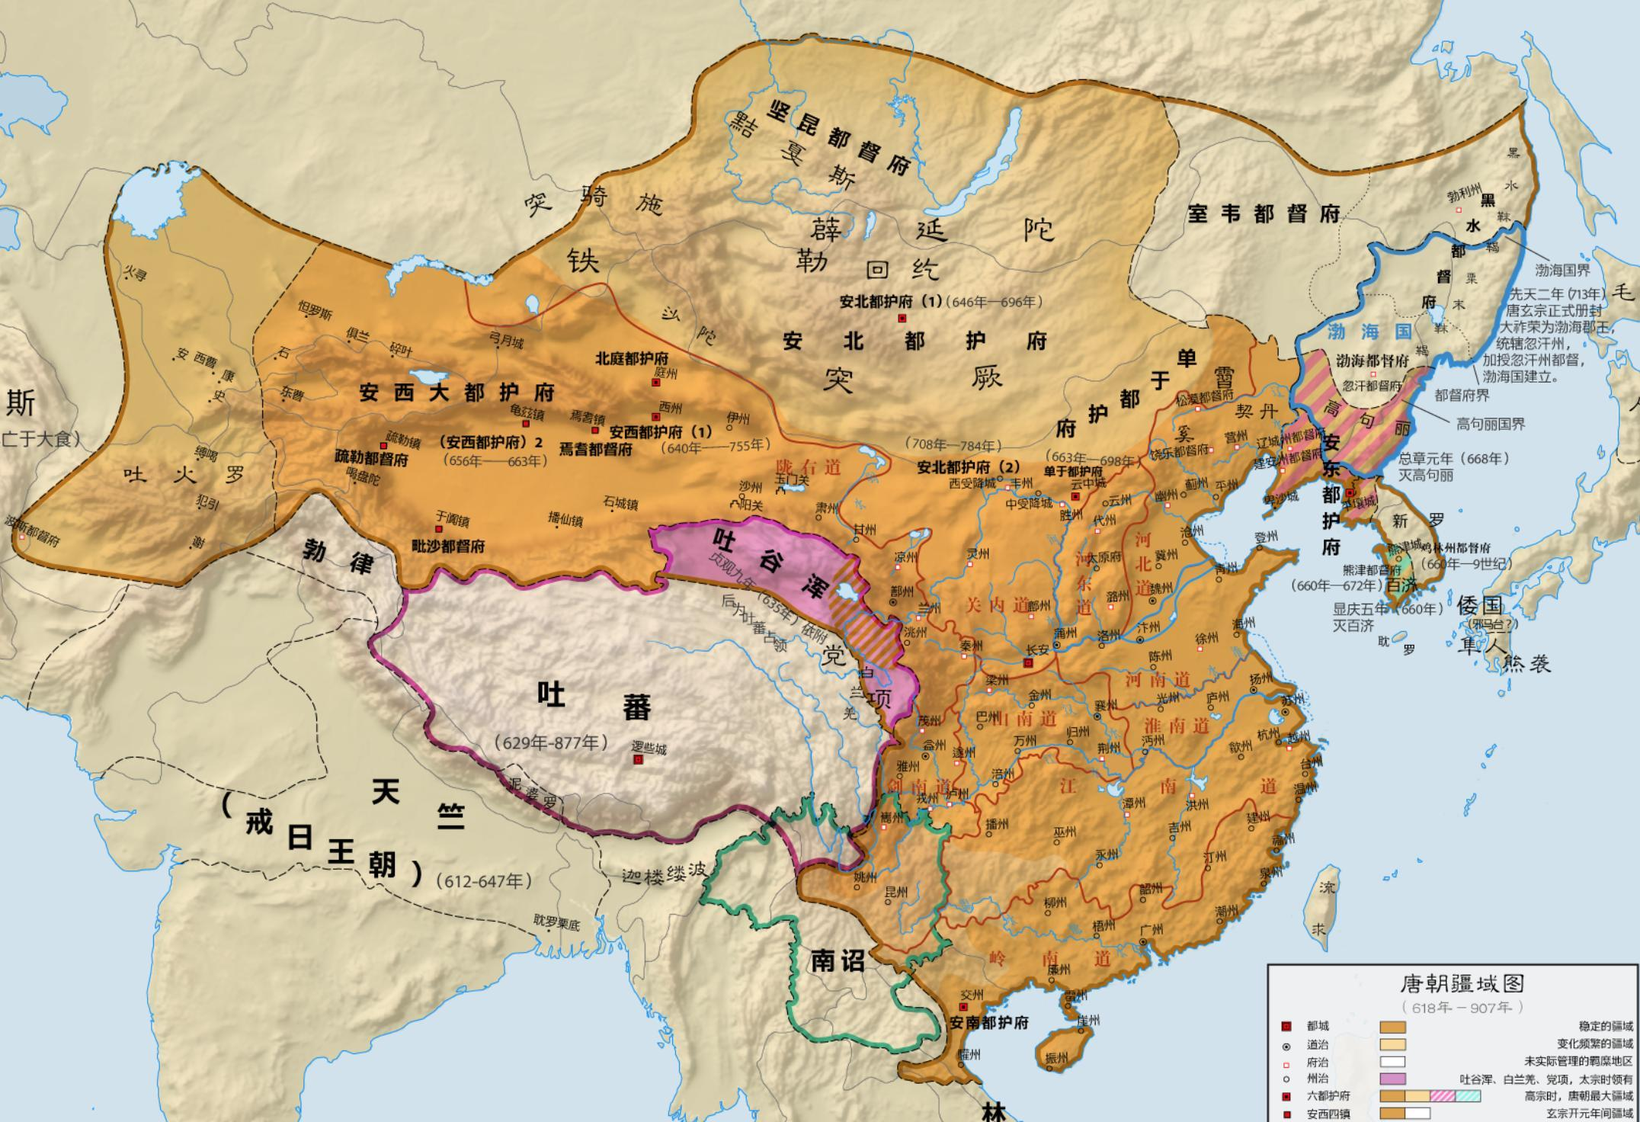

Slide 7
哭晁卿衡
Elegy on Abe Nakamaro
My Japanese friend Abe left the imperial shore,
His single sail turned round for the three Fairy Isles.
The moon has sunk in the sea to return no more,
The land’s over spread with gloomy clouds for miles and miles.
日本晁卿辞帝都，
征帆一片绕澎湖。
明月不归沉碧海，
白云愁色满苍梧。

Slide 8
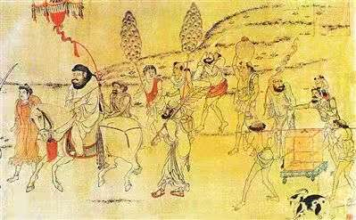
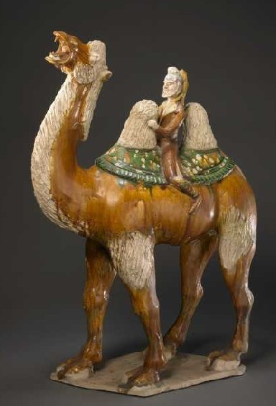
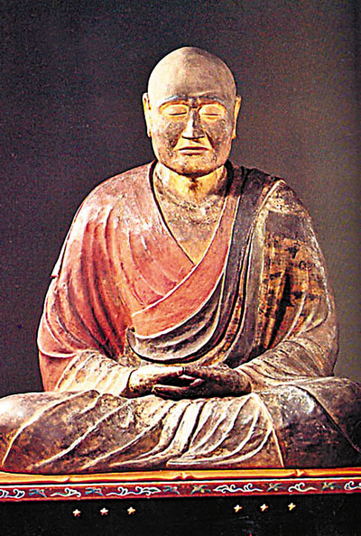
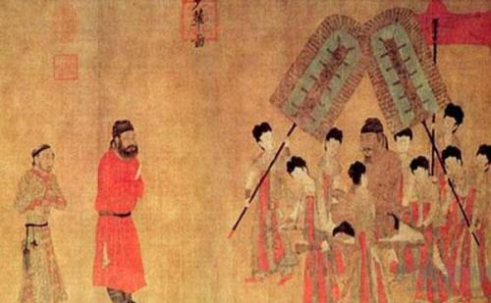
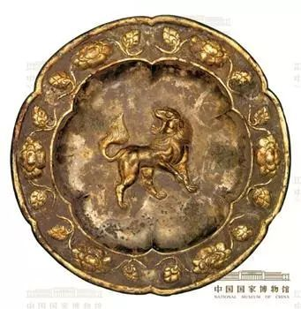
鉴真像
朝贡
Tribute
唐三彩胡人俑
Tri-coloured glazed pottery
和亲
peace-making marriage
唐狮纹金花银盘

Slide 9
Crows Going Back to Their Nest
---Satire on the King of Wu
O’er Royal Terrace when crows flew back to their nest,
The king in Royal Palace feast’d his mistress drunk.
The Southern maidens sang and danced without rest.
Till beak-like mountain-peaks would peck the sun half-sunk.
The golden clepsydra could not stop water’s flow,
O’er river waves the autumn moon was hanging low.
But wouldn’t the king enjoy his fill in Eastern glow?
乌栖曲
姑苏台上乌栖时，
吴王宫里醉西施。
吴歌楚舞欢未毕，
青山欲衔半边日。
银箭金壶漏水多，
起看秋月坠江波。
东方渐高奈乐何！

Slide 10
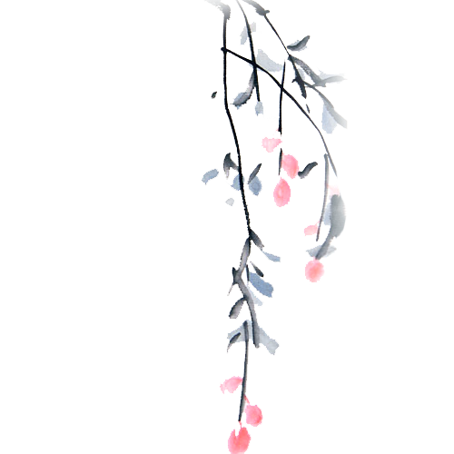
李白这首诗讽刺了宫廷生活，形式上也做出了创新。
传说吴王夫差花费大量人力物力和三年时间建设了姑苏台。
前两句诗没有着重写宫廷生活的奢靡，而是勾勒出了吴宫和宫女的美。
时间过得很快，但沉迷享乐的人们常常认识不到这一点。不知不觉中，黄昏就要到来了。
银箭金壶预示着时间的流逝。秋夜即将结束，欢乐的夜晚渐渐隐于幕。
东方已经发白，天就要亮了，寻欢作乐不能再继续下去了。这一句，既像是恨长夜之短的吴王所发出的欢乐难继、好梦不长的叹喟，又像是诗人对沉溺不醒的吴王敲响的警钟。
诗人并没有详细叙述一些细节，但通过时间的流逝和场景的变换体现出了奢靡的宫廷生活，揭示了夫差的醉生梦死。
全篇客观叙述，但是却深刻揭露出了主题，充满讽刺，引人深思。
解说

Slide 11
Passing One Night in an Old Woman’s Hut at the Foot of Mount Five Pines
宿五松山下荀媪家
I lodge under the five pine trees,
Lonely, I feel not quiet at ease.
Peasants work hard in autumn old;
Husking rice at night, the maid’s cold.
Wild rice is offered on her knees;
The plate in moonlight seems in freeze.
I’m overwhelmed with gratitude.
Do I deserve the hard-earned food?
我宿五松下，寂寥无所欢。
田家秋作苦，邻女夜舂寒。
跪进雕胡饭，月光明素盘。
令人惭漂母，三谢不能食。

Slide 12
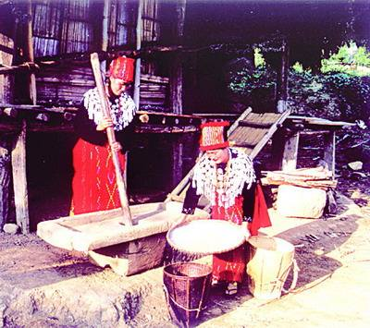
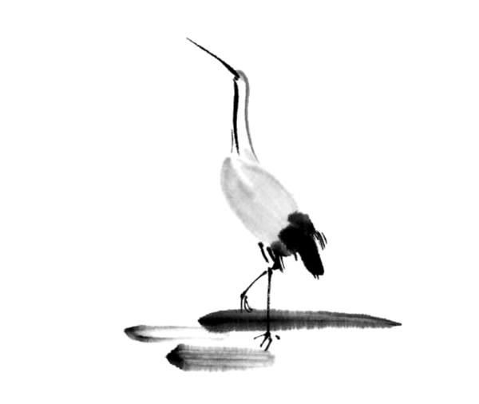
舂米就是把打下的谷子去壳的过程，舂出来的壳就是米糠（ rice hulls /husks），剩下的米粒就是我们吃的白米，舂米的工具有点像捣药罐，有一个棒槌、一个盛器。用棒槌砸谷子，把米糠砸掉。
舂米（Pounding Rice）

Slide 13
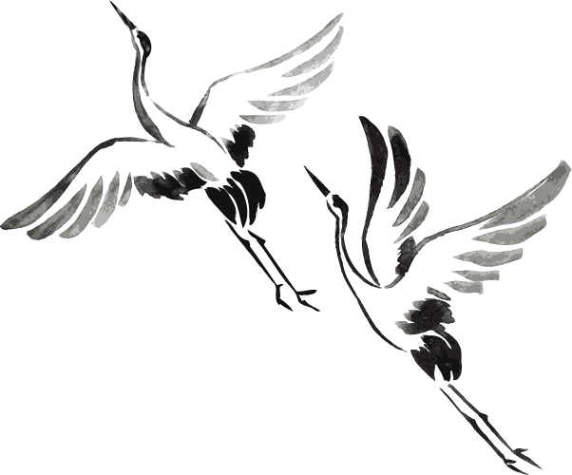
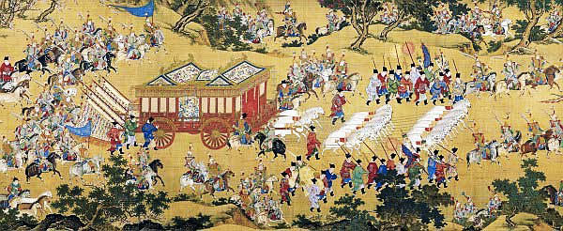
安史之乱（ An Lushan Rebellion）
Date：16 December 755 – 17 February 763 (7 years, 2 months and 1 day)
Location：Northern China

Slide 14
To sum up…
lofty aspirations of young talents
battlefield
poor peasant life
criticism of political corruption

Slide 15
aid all mankind and to stabilize the state
convey his indignation and distress
amiable and humble
a soaring roc (a legendary bird of great size)
swordsman’s spirit

Slide 16
谢谢
多语种口译1班
王益琛 0203701106
蒋心竹 0203701103
张琰 0203701107
徐天汉 0203701108
金依蕊 0203701104
夏正岩（组长） 0203701105

