Slide 1
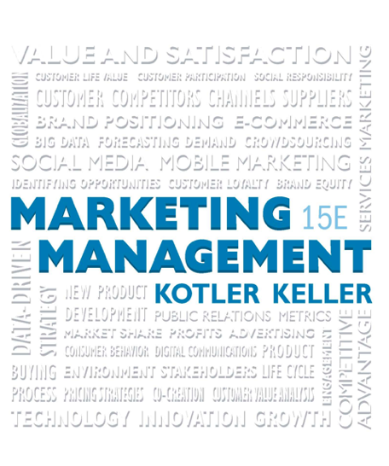
Marketing Management
Fifteenth Edition
Chapter 2
Developing Marketing Strategies and Plans
Notes:
If this PowerPoint presentation contains mathematical equations, you may need to check that your computer has the following installed:
1) MathType Plugin
2) Math Player (free versions available)
3) NVDA Reader (free versions available)

Slide 2
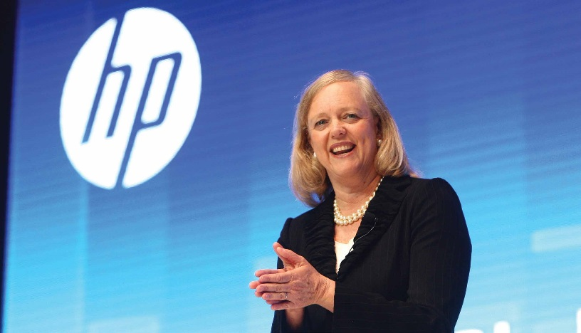
Learning Objectives
2.1 How does marketing affect customer value?
2.2 How is strategic planning carried out at the corporate and divisional levels?
2.3 How is strategic planning carried out at the business unit level?
2.4 What does a marketing plan include?

Slide 3
Marketing and Customer Value
The value delivery process
The value chain
Core competencies
The central role of strategic planning

Slide 4
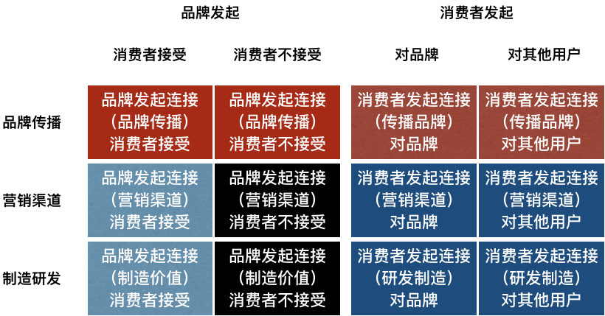
The Value Delivery Process
Choosing the value
Providing the value
Communicating the value
Notes:
We can divide the value creation and delivery sequence into three phases. First, choosing the value is the
“homework” marketers must do before any product exists. They must segment the market, select the appropriate target, and develop the offering’s value positioning. The formula “segmentation, targeting, positioning (STP)” is the essence of strategic marketing. The second phase is providing the value. Marketing must identify specific product features, prices, and distribution. The task in the third phase is communicating the value by utilizing the Internet, advertising, sales force, and any other communication tools to announce and promote the product. The value delivery process begins before there is a product and continues through development and after launch.

Slide 5
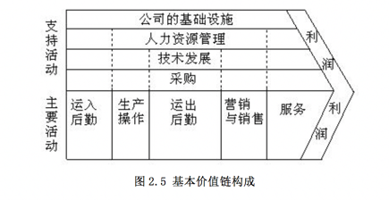
The Value Chain
A tool for identifying ways to create more customer value
Every firm is a synthesis of activities performed to design, produce, market, deliver, and support its product
Notes:
Nine strategically relevant activities—five primary and four support activities—
create value and cost in a specific business.
The primary activities are (1) inbound logistics, or bringing materials into the business; (2) operations,
or converting materials into final products; (3) outbound logistics, or shipping out final products; (4) marketing,
which includes sales; and (5) service. Specialized departments handle the support activities—(1)
procurement, (2) technology development, (3) human resource management, and (4) firm infrastructure.
(Infrastructure covers the costs of general management, planning, finance, accounting, legal, and government
affairs.)

Slide 6
Core Business Processes
Market-sensing process
New-offering realization process
Customer acquisition process
Customer relationship management process
Fulfillment management process
Notes:
The firm’s success depends not only on how well each department performs its work, but also on how well the
company coordinates departmental activities to conduct core business processes. These processes include:
• The market-sensing process—gathering and acting upon information about the market
• The new-offering realization process—researching, developing, and launching new high-quality offerings
quickly and within budget
• The customer acquisition process—defining target markets and prospecting for new customers
• The customer relationship management process—building deeper understanding, relationships, and offerings
to individual customers
• The fulfillment management process—receiving and approving orders, shipping goods on time, and collecting
payment

Slide 7
Core Competencies
A source of competitive advantage and makes a significant contribution to perceived customer benefits
Applications in a wide variety of markets
Difficult for competitors to imitate
Notes:
Competitive advantage also accompanies distinctive capabilities or excellence in broader business processes.
Wharton’s George Day sees market-driven organizations as excelling in three distinctive capabilities: market
sensing, customer linking, and channel bonding.

Slide 8
Maximizing Core Competencies
(Re)define the business concept
(Re)shaping the business scope
(Re)positioning the company’s brand identity
Notes:
Peabody Energy implemented a new global organizational structure—creating geographic business units in the Americas, Australia, and Asia—to reflect its growing global footprint. Changes in business fortunes often necessitate realignment and restructuring, as Panasonic and other Japanese technology and electronic companies found.

Slide 9
Central Role of Strategic Planning
Managing the businesses as an investment portfolio
Assessing the market’s growth rate and the company’s position in that market
Establishing a strategy
Notes:
Most large companies consist of four organizational levels: (1) corporate, (2) division, (3) business unit, and (4)
product. Corporate headquarters is responsible for designing a corporate strategic plan to guide the whole enterprise; it makes decisions on the amount of resources to allocate to each division as well as on which businesses to start or eliminate. Each division establishes a plan covering the allocation of funds to each business unit within the division. Each business unit develops a strategic plan to carry that business unit into a profitable future. Finally, each product level (product line, brand) develops a marketing plan for achieving its objectives.

Slide 10
Marketing Plan
The central instrument for directing and coordinating the marketing effort
Strategic
Tactical
Notes:
The marketing plan operates at two levels: strategic and tactical. The strategic marketing plan lays out the target markets and the firm’s value proposition, based on an analysis of the best market opportunities. The tactical marketing plan specifies the marketing tactics, including product features, promotion, merchandising, pricing, sales channels, and service.

Slide 11
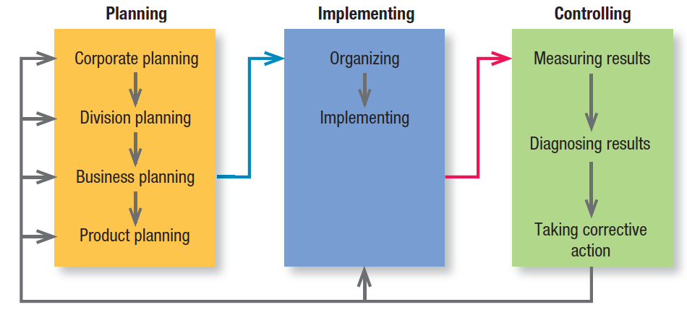
Figure 2.1 Strategic Planning, Implementation, and Control Processes
Notes:
Only a select group of companies have historically stood out as master marketers (see Table 2.1 on slide 12). These companies focus on the customer and are organized to respond effectively to changing needs. They all have well-staffed marketing departments, and their other departments accept that the customer is king. They also often have strong marketing leadership in the form of a successful CMO.

Slide 12
Some Examples of Master Marketers
Table 2.1 Some Examples of Master Marketers
Amazon.com | Enterprise Rent-A-Car | Red Bull
Apple | Google | Ritz-Carlton
Bang & Olufsen | Harley-Davidson | Samsung
Best Buy | Honda | Southwest Airlines
BMW | IKEA | Starbucks
Caterpillar | LEGO | Target
Club Med | McDonald’s | Tesco
Costco | Nike | Toyota
Disney | Nordstrom | Virgin
eBay | Procter & Gamble | Walmart
Electrolux | Progressive Insurance | Whole Foods

Slide 13
Corporate and Division Strategic Planning
Defining the corporate mission
Establishing strategic business units
Assigning resources to each strategic business unit
Assessing growth opportunities
Notes:
Whether they let their business units set their own goals and strategies or collaborate in doing so, all corporate
headquarters undertake these four planning activities.

Slide 14
Defining the Corporate Mission
What is our business?
Who is the customer?
What is of value to the customer?
What will our business be?
What should our business be?
Notes:
These simple-sounding questions are among the most difficult a company will ever face. Successful companies continuously ask and answer them.

Slide 15
Product Orientation vs. Market Orientation
Company | Product | Market
Missouri-Pacific Railroad | We run a railroad | We are a people-and-goods mover
Xerox | We make copying equipment | We improve office productivity
Standard Oil | We sell gasoline | We supply energy
Columbia Pictures | We make movies | We market entertainment
Notes:
Companies often define themselves in terms of products: They are in the “auto business” or the “clothing business.” Market definitions of a business, however, describe the business as a customer satisfying process. Products are transient; basic needs and customer groups endure forever. Transportation is a need: the horse and carriage, automobile, railroad, airline, ship, and truck are products that meet that need.
A target market definition tends to focus on selling a product or service to a current market. A strategic market definition, however, also focuses on the potential market.

Slide 16
Good Mission Statements
Focus on a limited number of goals
Stress the company’s major policies and values
Define the major competitive spheres within which the company will operate
Take a long-term view
Are as short, memorable, and meaningful as possible
Notes:
A clear, thoughtful mission statement, developed collaboratively with and shared with managers, employees, and often customers, provides a shared sense of purpose, direction, and opportunity. At its best it reflects a vision, an almost “impossible dream,” that provides direction for the next 10 to 20 years.

Slide 17
Establishing Strategic Business Units
A single business or collection of related businesses
Has its own set of competitors
Has a leader responsible for strategic planning and profitability
Notes:
Large companies normally manage quite different businesses, each requiring its own strategy. The purpose of identifying the company’s strategic business units is to develop separate strategies and assign appropriate funding. Senior management knows its portfolio of businesses usually includes a number of “yesterday’s has-beens” as well as “tomorrow’s winners.”

Slide 18
Assigning Resources to Each SBU
Management must decide how to allocate corporate resources to each SBU
Portfolio-planning models
Shareholder/market value analysis
Notes:
Portfolio-planning models like these have largely fallen out of favor as oversimplified and subjective.
Newer methods rely on shareholder value analysis and on whether the market value of a company is greater with an SBU or without it. These value calculations assess the potential of a business based on growth opportunities from global expansion, repositioning or retargeting, and strategic outsourcing.

Slide 19
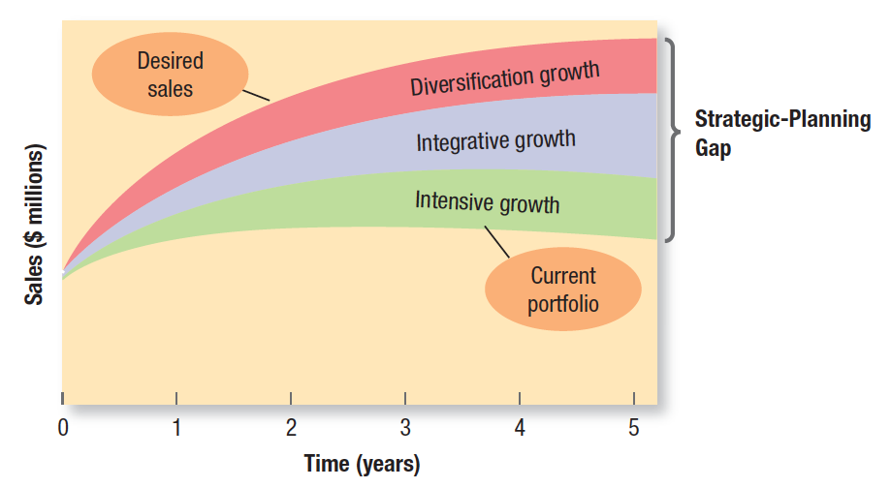
Assessing Growth Opportunities (1 of 2)
Figure 2.2 The Strategic- Planning Gap
Notes:
Assessing growth opportunities includes planning new businesses, downsizing, and terminating older businesses. If there is a gap between future desired sales and projected sales, corporate management
will need to develop or acquire new businesses to fill it.
Figure 2.2 illustrates this strategic-planning gap for a hypothetical manufacturer of blank DVD discs called Cineview. The lowest curve projects expected sales from the current business portfolio over the next five years. The highest describes desired sales over the same period.

Slide 20
Assessing Growth Opportunities (2 of 2)
Intensive Growth
Integrative Growth
Diversification Growth
Downsizing and Divesting Older Businesses
Notes:
Evidently, the company wants to grow much faster than its current businesses will permit. How can it fill the strategic planning gap? The first option is to identify opportunities for growth within current businesses (intensive opportunities). The second is to identify opportunities to build or acquire businesses related to current
businesses (integrative opportunities). The third is to identify opportunities to add attractive unrelated businesses (diversification opportunities).

Slide 21
Intensive Growth
Corporate management should first review opportunities for improving existing businesses
Notes:
One useful framework is a “product-market expansion grid,” which considers the strategic growth opportunities for a firm in terms of current and new products and markets. The company first considers whether it could gain more market share with its current products in their current markets, using a market-penetration strategy. Next it considers whether it can find or develop new markets for its current products, in a market-development strategy. Then it considers whether it can develop new products for its current markets with a product-development strategy. Later the firm will also review opportunities to develop new products for new markets in a diversification strategy.

Slide 22
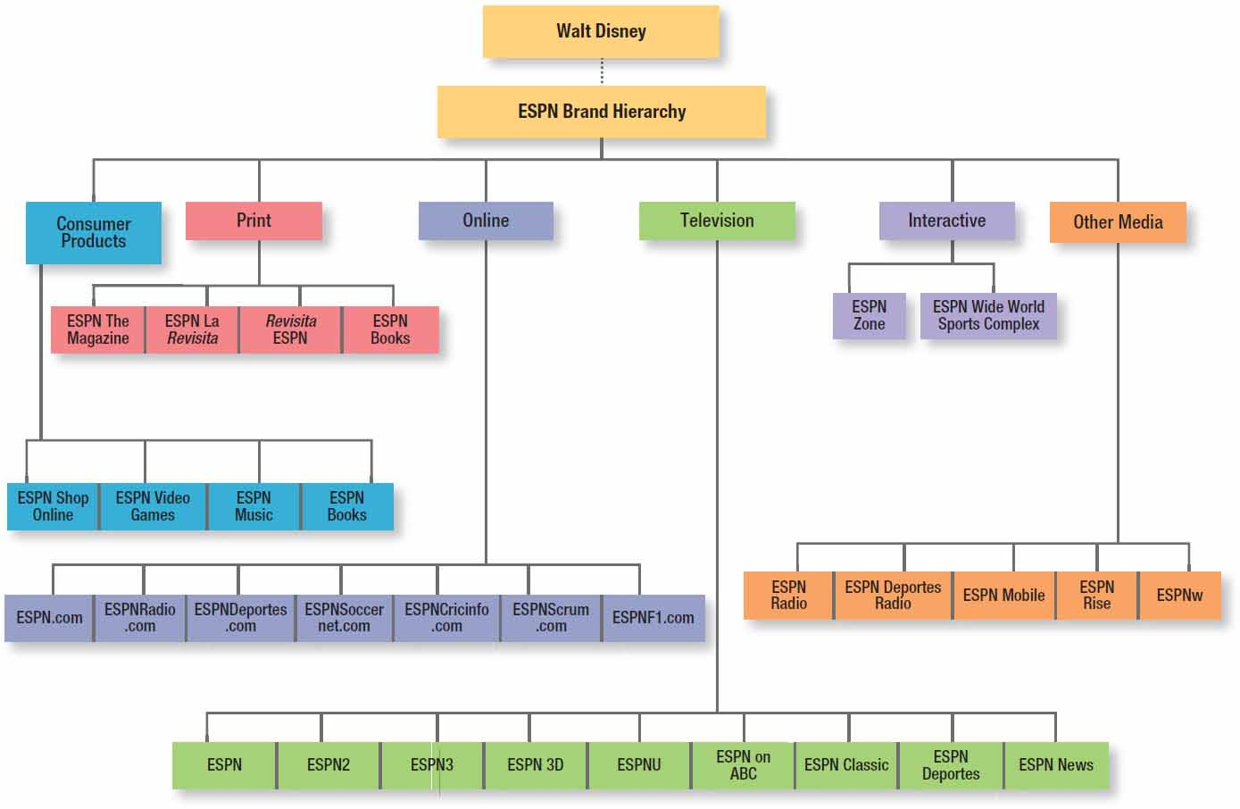
Figure 2.3 ESPN Growth Opportunities
Notes:
ESPN has pursued a variety of growth opportunities. Through its singular focus on sports programming and news, ESPN grew from a small regional broadcaster into the biggest name in sports. In the early 1990s, the company crafted a well-thought-out plan: Wherever sports fans watched, read, and discussed sports, ESPN would be there. It pursued this strategy by expanding its brand and now encompasses 10 cable channels, a Web site, a magazine, a few restaurants (ESPN Zone), more than 600 local radio affiliates, original movies and television series, book publishing, a sports merchandise catalog and online store, music and video games, and a mobile service.

Slide 23
Integrative Growth
A business can increase sales and profits through backward, forward, or horizontal integration within its industry
Notes:
Merck formed joint ventures as far back as 1989 with Johnson & Johnson to sell over-the-counter pharmaceuticals and 1991 with DuPont to expand basic research. In 1997, Merck and Rhône-Poulenc S.A. (now Sanofi-Aventis S.A.) combined their animal health and poultry genetics businesses to form Merial Limited, a fully integrated animal health company. Finally, Merck acquired Schering-Plough in 2009.

Slide 24
Diversification Growth
Diversification growth makes sense when good opportunities exist outside the present businesses
The industry is highly attractive and the company has the right mix of business strengths to succeed
Notes:
From its origins as an animated film producer, The Walt Disney Company has moved into licensing characters for merchandised goods, publishing general interest fiction books under the Hyperion imprint, entering the broadcast industry with its own Disney Channel as well as ABC and ESPN, developing theme parks and vacation and resort properties, and offering cruise and commercial theatre experiences.

Slide 25
Downsizing and Divesting Older Businesses
Companies must carefully prune, harvest, or divest tired old businesses to release needed resources for other uses and reduce costs
Notes:
To focus on its travel and credit card operations, American Express spun off American Express Financial Advisors, which provided insurance, mutual funds, investment advice, and brokerage and asset management services (it was renamed
Ameriprise Financial). American International Group (AIG) agreed to sell two of its subunits—American General Indemnity Co. and American General Property Insurance Co.—to White Mountains Insurance Group as part of a long-term growth strategy to discard redundant assets and focus on its core operations.

Slide 26
Organization and Organizational Culture (1 of 2)
A company’s organization consists of its structures, policies, and corporate culture, all of which can become dysfunctional in a rapidly changing business environment
Notes:
Whereas managers can change structures and policies (though with difficulty), the company’s culture is very hard to change. Yet adapting the culture is often the key to successfully implementing a new strategy.

Slide 27
Organization and Organizational Culture (2 of 2)
Corporate culture: “The shared experiences, stories, beliefs, and norms that characterize an organization”
Notes:
Walk into any company and the first thing that strikes you is the corporate culture—the way people dress, talk to one another, and greet customers.

Slide 28
Marketing Innovation
Innovation in marketing is critical
Employees can challenge company orthodoxy and stimulate new ideas
Firms develop strategy by choosing their view of the future
Scenario analysis
Notes:
Imaginative ideas on strategy exist in many places within a company. Senior management should identify and encourage fresh ideas from three generally underrepresented groups: employees with youthful or diverse perspectives, employees far removed from company headquarters, and employees new to the industry.
Scenario analysis, which develops plausible representations of a firm’s possible future using assumptions about
forces driving the market and different uncertainties. Managers think through each scenario with the question, “What will we do if it happens?,” adopt one scenario as the most probable, and watch for signposts that might confirm
or disconfirm it.

Slide 29
Figure 2.4 The Business Unit Strategic-Planning Process
Notes:
The business unit strategic-planning process consists of the steps shown in Figure 2.4

Slide 30
SWOT Analysis
Strengths
Weaknesses
Opportunities
Threats
Notes:
Imaginative ideas on strategy exist in many places within a company. Senior management should identify and encourage fresh ideas from three generally underrepresented groups: employees with youthful or diverse perspectives, employees far removed from company headquarters, and employees new to the industry.
Scenario analysis, which develops plausible representations of a firm’s possible future using assumptions about
forces driving the market and different uncertainties. Managers think through each scenario with the question, “What will we do if it happens?,” adopt one scenario as the most probable, and watch for signposts that might confirm
or disconfirm it.

Slide 31
Market Opportunity Analysis (MOA) (1 of 2)
Can we articulate the benefits convincingly to a defined target market(s)?
Can we locate the target market(s) and reach them with cost-effective media and trade channels?
Does our company possess or have access to the critical capabilities and resources we need to deliver the customer benefits?
Notes:
To evaluate opportunities, companies can use market opportunity analysis (MOA) to ask questions like those posed on this slide and the next one.

Slide 32
Market Opportunity Analysis (MOA) (2 of 2)
Can we deliver the benefits better than any actual or potential competitors?
Will the financial rate of return meet or exceed our required threshold for investment?
Notes:
To evaluate opportunities, companies can use market opportunity analysis (MOA) to ask questions like those posed on this slide and the previous one.

Slide 33
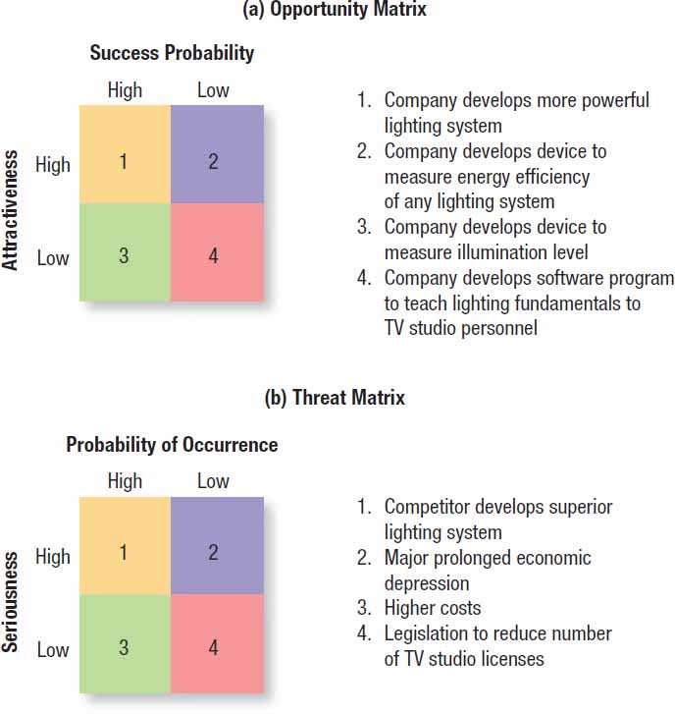
Figure 2.5 Opportunity And Threat Matrices
Notes:
By using the SWOT analysis and market opportunity analysis, we can create opportunity and threat matrices.
In the opportunity matrix in Figure 2.5 (a), the best marketing opportunities facing the TV-lighting-equipment company appear in the upper-left cell (#1). The opportunities in the lower-right cell (#4) are too minor to consider. The opportunities in the upper-right cell (#2) and the lower-left cell (#3) are worth monitoring in the event that any improve in attractiveness and potential.

Slide 34
Internal Environment
Strengths
Weaknesses
Notes:
It’s one thing to find attractive opportunities and another to be able to take advantage of them. Each business needs to evaluate its internal strengths and weaknesses.

Slide 35
Goal Formulation (MBO)
Unit’s objectives must be arranged hierarchically
Objectives should be quantitative
Goals should be realistic
Objectives must be consistent
Notes:
Once the company has performed a SWOT analysis, it can proceed to goal formulation, developing specific goals for the planning period. Goals are objectives that are specific with respect to magnitude and time.

Slide 36
Strategic Formulation: Porter’s Generic Strategies
Overall cost leadership
Differentiation
Focus
Notes:
Michael Porter has proposed three generic strategies that provide a good starting point for strategic thinking: overall cost leadership, differentiation, and focus.
With overall cost leadership, firms work to achieve the lowest production and distribution costs so they can underprice competitors and win market share.
With differentiation, the business concentrates on achieving superior performance in an important customer benefit area valued by a large part of the market.
With focus, the business focuses on one or more narrow market segments, gets to know them intimately, and pursues either cost leadership or differentiation within the target segment.
According to Porter, competing firms directing the same strategy to the same target market constitute a strategic group. The firm that carries out the strategy best will make the most profits.

Slide 37
Program Formulation and Implementation
McKinsey’s Elements of Success
Skills
Staff
Style
Strategy
Structure
Systems
Shared values
Notes:
According to McKinsey & Company, strategy is only one of seven elements—all of which start with the letter s—in successful business practice. The first three—strategy, structure, and systems—are considered the “hardware” of success. The next four—style, skills, staff, and shared values—are the “software.” The first “soft” element, style, means company employees share a common way of thinking and behaving. The second, skills, means employees have the skills needed to carry out the company’s strategy. Staffing means the company has hired able people, trained them well, and assigned them to the right jobs. The fourth element, shared values, means employees share the same guiding values. When these elements are present, companies are usually more successful at strategy implementation.

Slide 38
Marketing Plan Contents
Executive summary
Table of contents
Situation analysis
Marketing strategy
Marketing tactics
Financial projections
Implementation controls
Notes:
Although the exact length and layout varies from company to company, most marketing plans cover one year in anywhere from 5 to 50 pages. Smaller businesses may create shorter or less formal marketing plans, whereas corporations generally require highly structured documents. A marketing plan usually contains the sections listed in the slide.

