Slide 1
coping with research
unit 10

Slide 2
topic outline
types and methods of research
primary, secondary, tertiary sources
parts of a research document
reliability and validity

Slide 3
meanings of ‘research’
library research
looking at books and articles
use the results to form one’s own conclusions
e.g. literary studies
empirical research
collecting information ‘in the field’
may involve experiments, surveys, interviews…
e.g. science, social sciences

Slide 4
empirical research
= a way of solving some problem or uncovering information by means of observation and experimentation, as well as reading

Slide 5
research methods
OBSERVATION (CASE STUDY)
a survey in which factors are observed and recorded without the involvement of the observer
the purpose is to find out how things are done
e.g. watching a child work out sums; watching a bee send messages

Slide 6
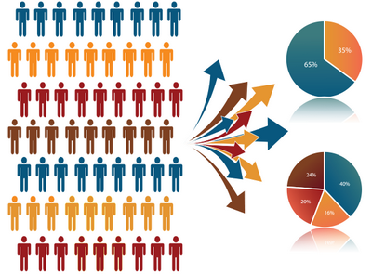
research methods
SAMPLING
representative samples are collected for description and analysis
e.g. collecting rock samples from a beach; asking people what kind of tea they drink

Slide 7
research methods
EXAMINING RECORDS
looking at previously collected information in order to uncover new relationships or descriptions
used for e.g. historical descriptions, developmental patterns, forecasting trends
it may use e.g. police records, past weather records

Slide 8
research methods
EXPERIMENTS
manipulating different factors (=variables) to see what happens
usually at least two representative samples
first group = ‘experimental’ group
second group = ‘control’ group
the two groups are then compared
any changes attributed to the experiment

Slide 9
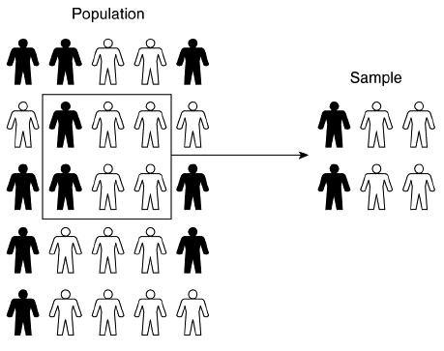
are the samples representative?
the population = the group being studied in a piece of research
the sample = the part of population actually investigated

Slide 10
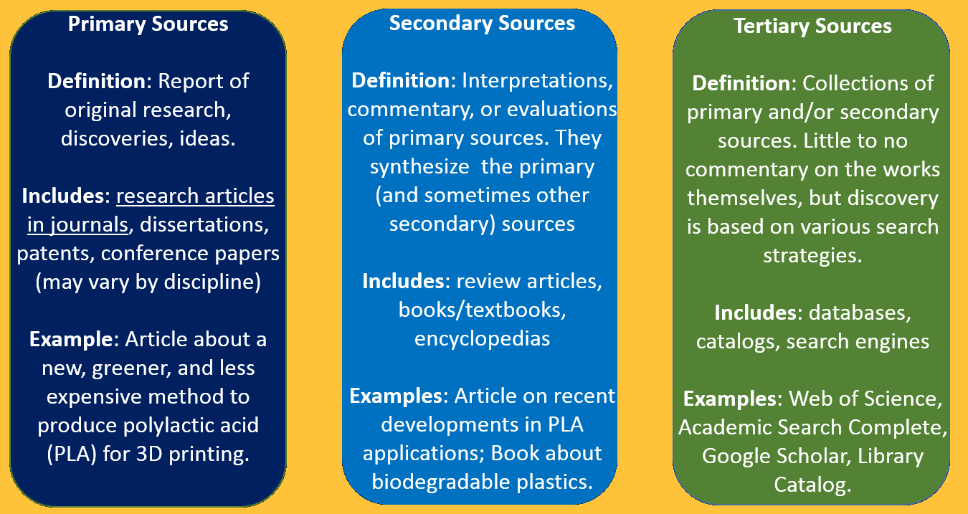
PRIMARY, SECONDARY OR TERTIARY?

Slide 11
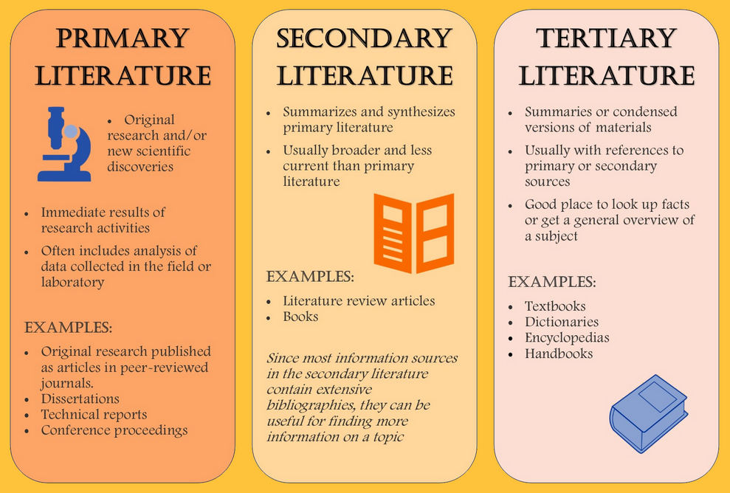
PRIMARY, SECONDARY OR TERTIARY?

Slide 12
writing up a research
convey the information accurately and concisely
describe how the information was obtained
describe the information itself

Slide 13
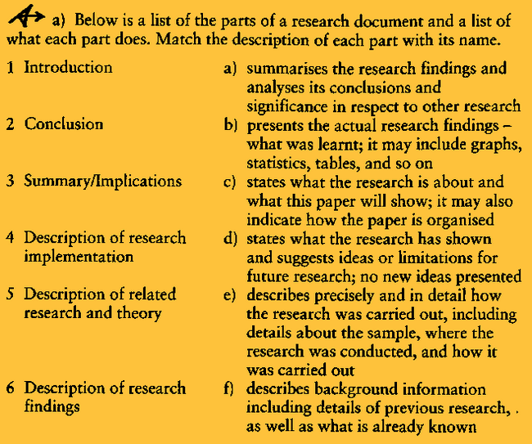

Slide 14
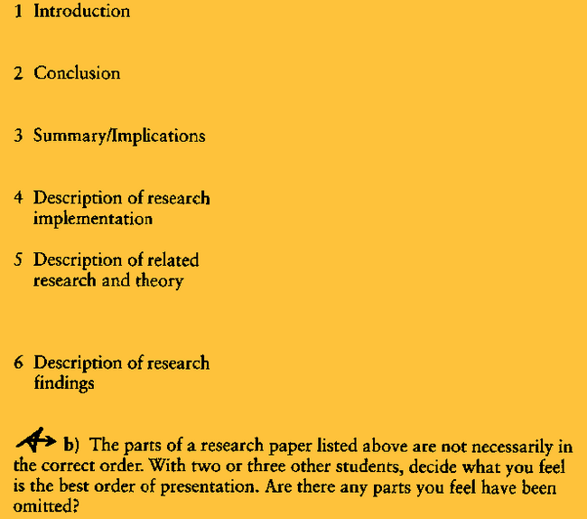

Slide 15
reliability and validity
RELIABILITY
whether or not the findings are constant and unchanging, and do not depend on what sample is chosen, who the researcher was, or how the questions are interpreted
= you can rely on the results to describe the population accurately
VALIDITY
whether or not the results describe what they say they describe
Do the methods used affect the results, and what populations can the results be attributed to?

Slide 16
how to ensure reliability and validity?
check the language you’re using in your research
make sure the language is reliable (not ambiguous)
check the background knowledge
make sure the results are logical and clearly thought out
record your results carefully

