Slide 1
GETTING STARTED ON WRITING
unit 8

Slide 2
What are we going to talk about today?
writing as a process
the stages of this process
writing basics
getting started on writing
essay planning
tips

Slide 3
You as a writer
YOU are the most important element of your writing
what you know and what attitude you have to writing will have a strong effect on how you write
you have to know yourself as a writer to be successful at writing
study types
preferences (day/night, long sessions/a lot of breaks...)

Slide 4
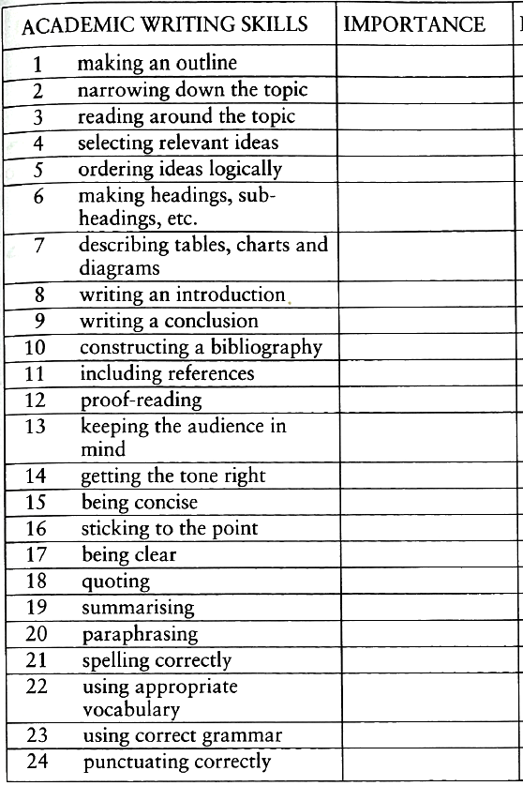
Choose the ten most important academic writing skills (list on p. 91)

Slide 5
With your friends, put together a list of five tips that can help you improve your writing
you can consider
consulting others
getting feedback
goals
attitude
writing habits ...

Slide 6
Establishing your focus
the general topic of an essay is set by the teacher BUT the focus is up to you!
no single correct response
be creative
express your point of view
DO NOT write mechanically
DO NOT be too general

Slide 7
Make sure you understand key words in the title or the essay question – they may determine the way in which you should approach the topic!
see the difference:
Compare the results of this research.
Analyse the results of this research.

Slide 8
These words are usually found in the titles of academic writing assingments. Match them with their meanings.
account for
analyse
argue
compare
criticise
define
discuss
evaluate
examine
illustrate
interpret
justify
outline
review
summarise
trace

Slide 9
Ask questions about the essay questions!
What questions could you ask in order to start focusing on these writing topics?
Evaluate the effects of deforestation on the economies of Southeast Asia
Examine the view that nations get the governments they deserve.
Outline the role of women in the developing world.

Slide 10
The process of questioning helps you to...
narrow down your focus
eventually decide on your focus
decide on a position
develop a list of the main aspects of your topic
The questions will probably be to do with:
the criteria for the writing assignment
the focus or position
the information you need to develop your focus

Slide 11
Choose one of the three topics we have discussed, do a basic research and write a short, structured essay (min. 200 words)
Evaluate the effects of deforestation on the economies of Southeast Asia
Examine the view that nations get the governments they deserve.
Outline the role of women in the developing world.
Note: This is a practice for another homework essay you will be assigned next week, and which will form part of exam evaluation. If two essays are the same (i.e. one student copies another student‘s work), both are failed.

