Slide 1
FAMILY MATTERS

Slide 2
WHEN YOU HEAR THE WORD ‘FAMILY’, WHAT WORDS AND IMAGES COME TO MIND?

Slide 3
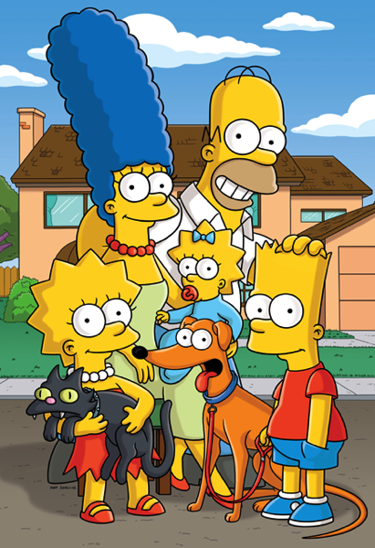
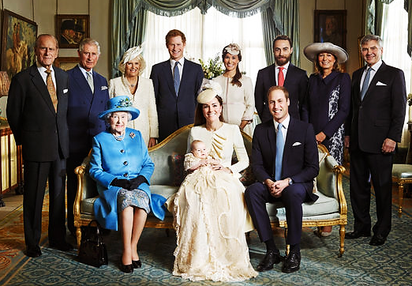
Look at the pictures of two families. How are they similar? How are they different?

Slide 4
Read about Alexa’s family. Which words from the box on the right apply to her?
Alexa has an older brother and a younger sister. She is not married but Tom recently proposed to her. They plan to get married next year.
single
engaged
divorced
fiancé/fiancée
only child
middle child
fistborn
spouse

Slide 5
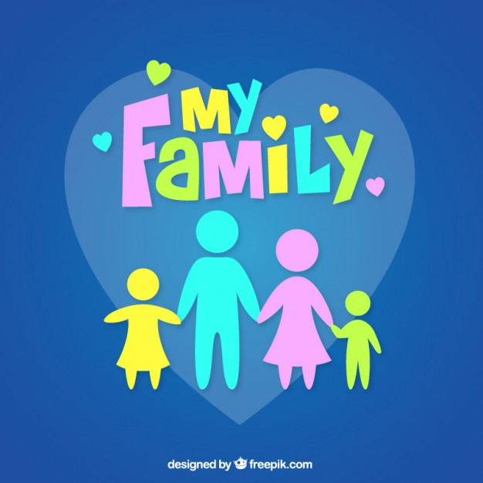
Tell each other about your family relationships.
Do you have any siblings?
Are you the firstborn?
Are you single?
Do you have a large family?
Who are your family members?
…
Do any of your classmates have families that are very different from yours?
What are the differences?

Slide 6
Look at the expressions on the left and try to classify them (put each one to one of the four categories on the right).
conflict
raise someone
look after someone
close-knit family
isolated
take care of someone
extended family
clash
bring someone up
bicultural
upbringing
bewildered
words related to caring for children
words that describe families
words that describe disagreement
words that describe feelings

Slide 7
words related to caring for children
look after someone
raise someone
take care of someone
upbringing
bring someone up
words that describe families
close-knit family
extended family
bicultural
words that describe disagreement
clash
conflict
words that describe feelings
isolated
bewildered

Slide 8
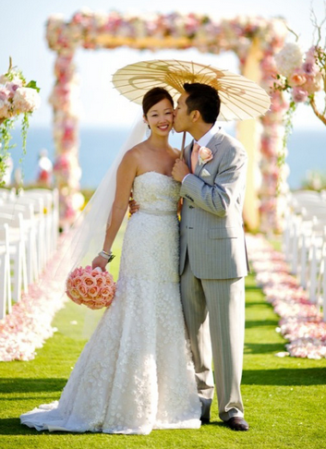
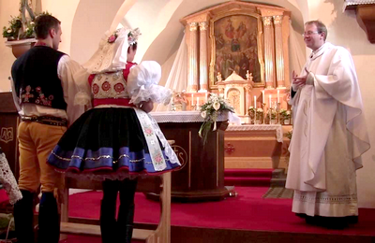
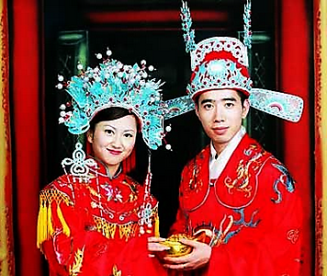
Weddings and marriage
What are the differences between traditional and modern wedding?
Which type is more popular these days? Why?
If you‘re married, which type of wedding did you have? If you‘re not married, which type of wedding would you prefer? Why?

Slide 9
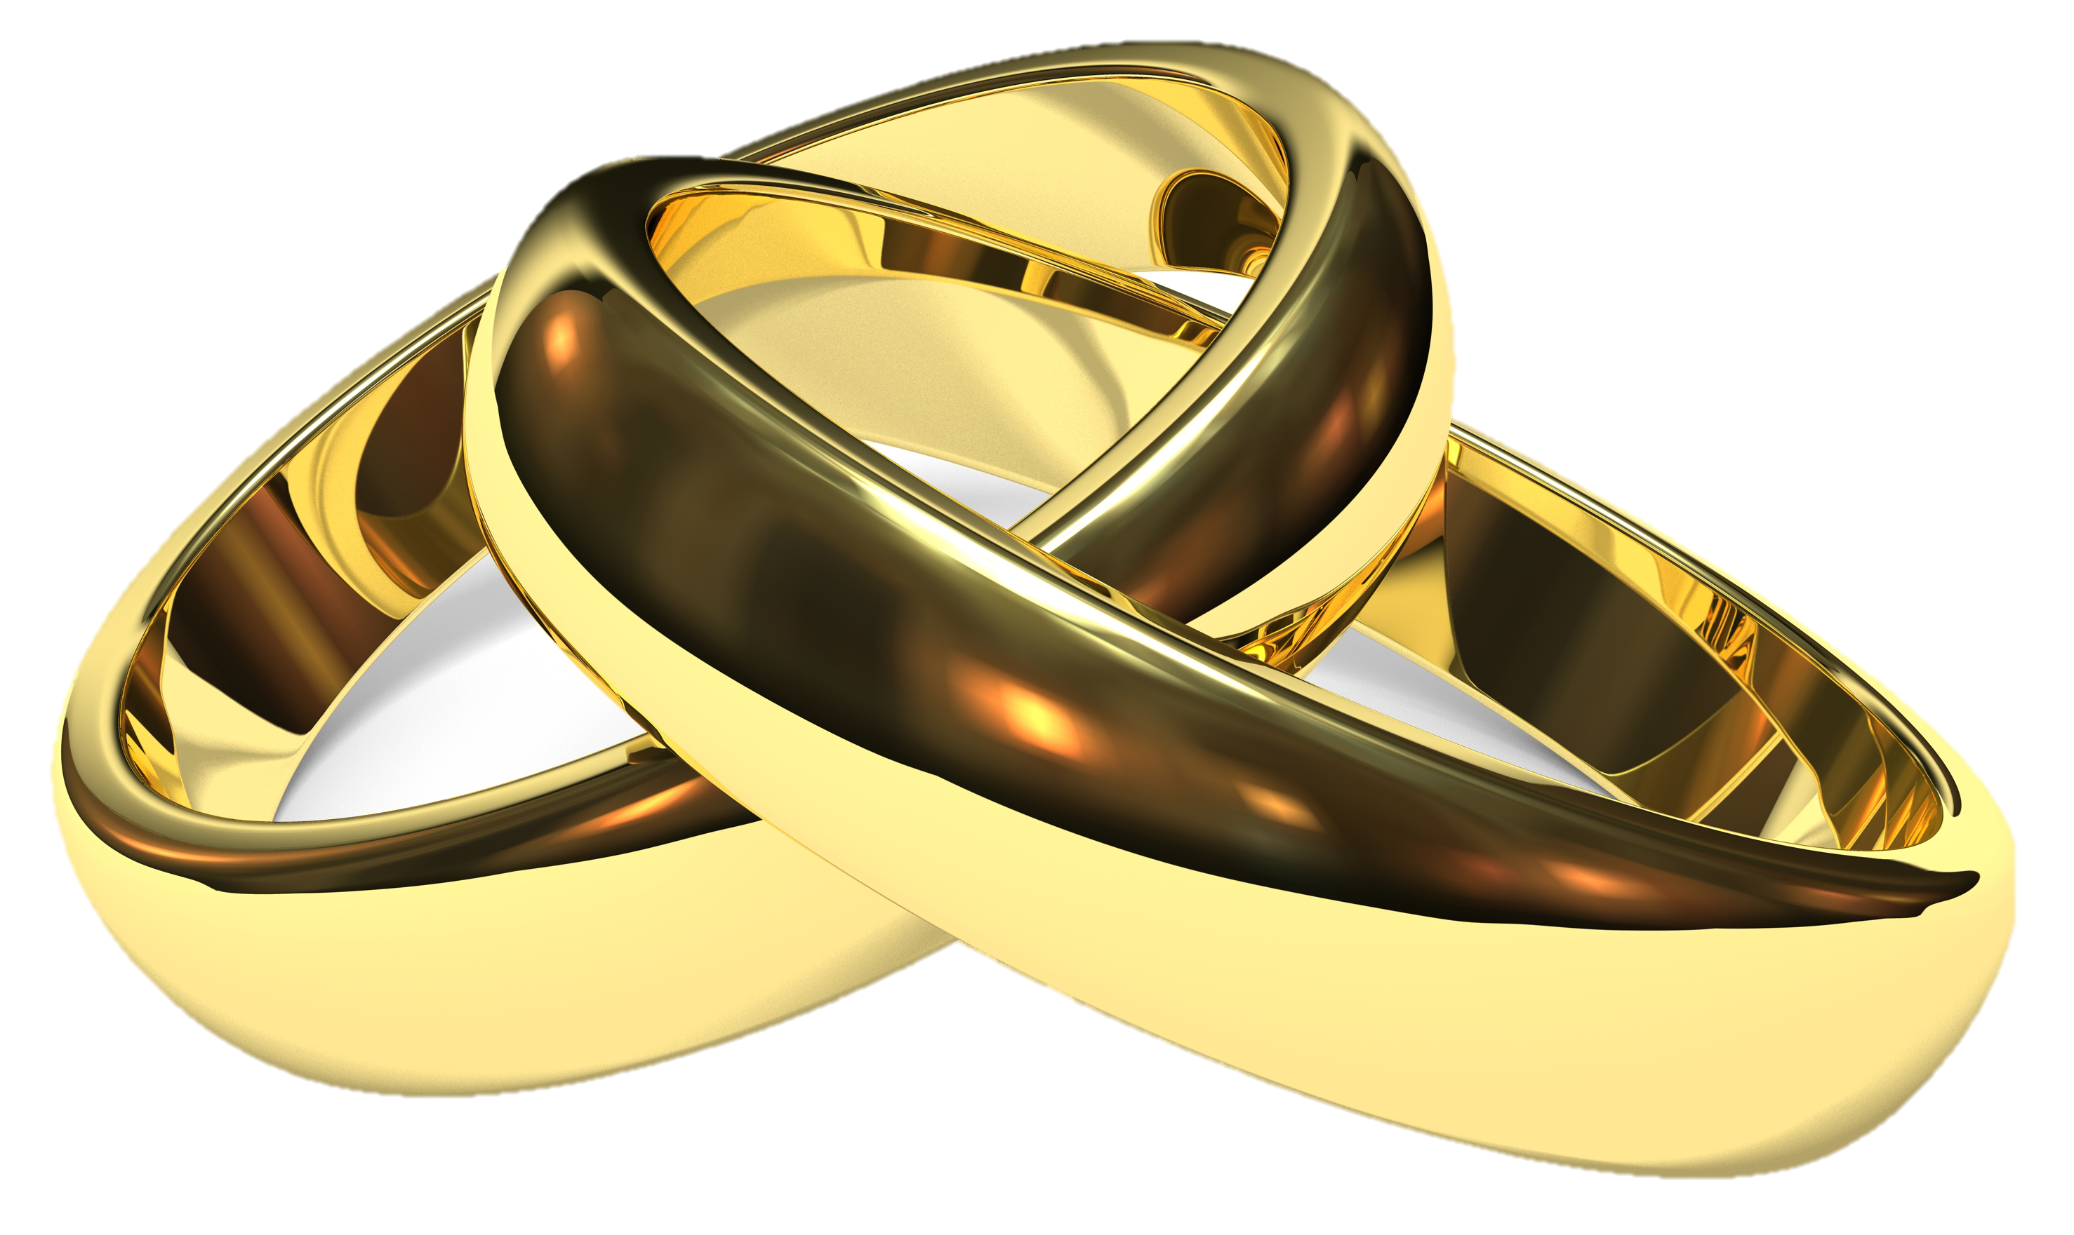
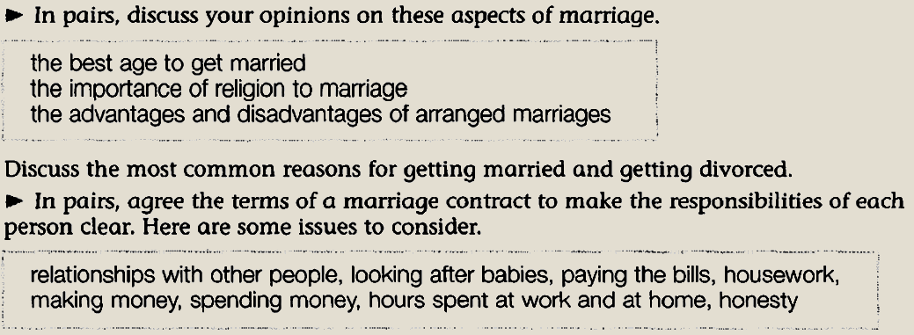
Aspects of marriage

Slide 10
Brainstorm words for this timeline

Slide 11
What do these expressions mean? Use them to fill in the sentences below.
adoptive family
biological family
immediate family
nuclear family
‘I’m sorry but hospital visitors are limited to ____________ family members only.
Some people are worried about the breakdown of the traditional ___________ family.
Tammy gave birth to Hudson. She and her husband are Hudson’s __________ family.
My sister couldn’t keep her son. He was raised by the Smith family. The Smiths are his __________ family.

Slide 12
