Slide 1
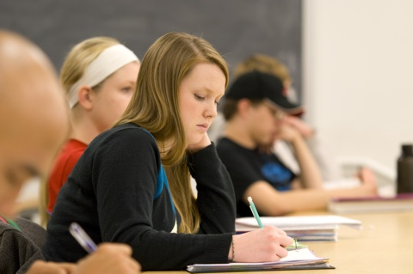
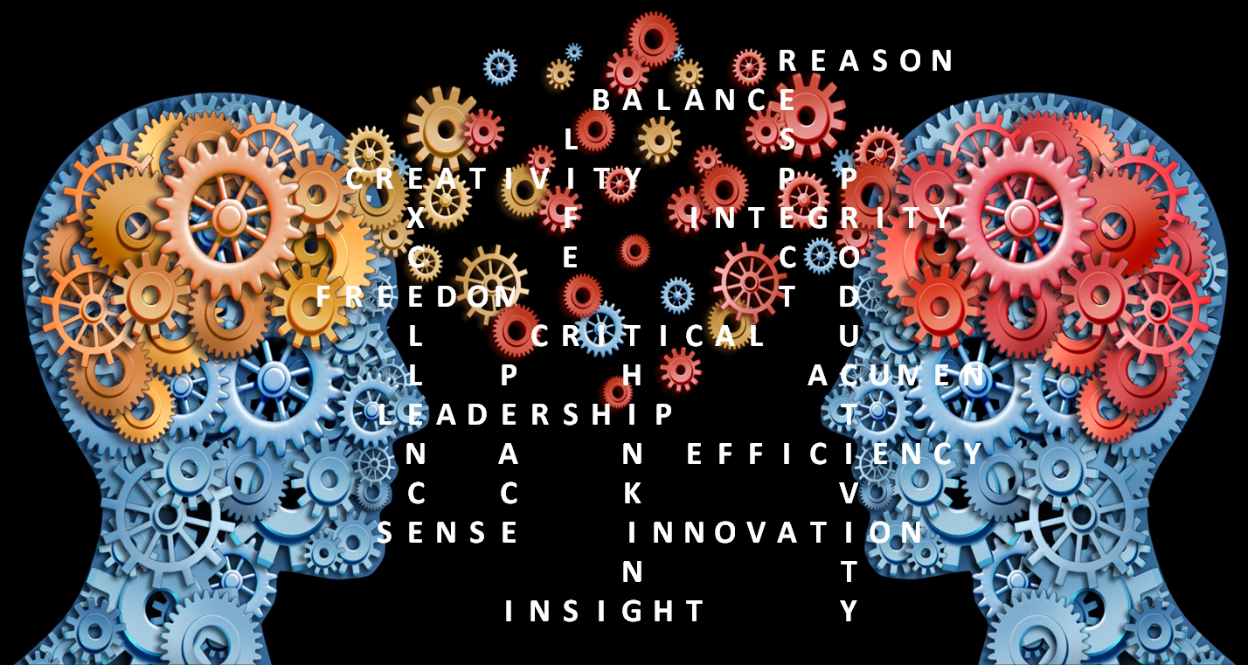
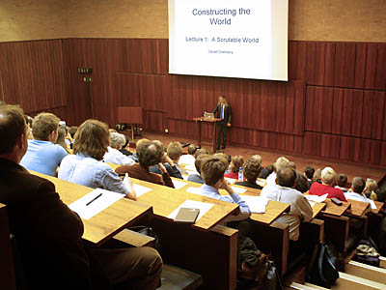
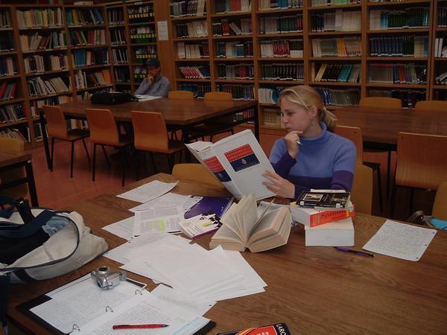
Some more Critical Thinking

Slide 2
Warm-up Discussions

Slide 3
Remember your assignment:
When is your essay due?
How long should your essay be?
What do you have to include?
How many sources do you need?
What will happen if you plagiarize?
Should you procrastinate?

Slide 4
Critical thinking…
…. is not natural.
… is something we must LEARN how to do.
… is well thought out.
… does not allow for beliefs with out evidence.
… analyzes/evaluates factual evidence.
… is logically reasoned (rational).
… is skeptical.
… is unbiased.
… is objective.
… liberates the mind to think independently.
… enables you to identify faulty arguments.
… enables you to construct good arguments.
… enables you to identify the relevance and importance of ideas (old and new).

Slide 5
Examining a Judgment (yours and others’)
Step 1:
Identify the relevant judgment/conclusion.
Step 2:
Identify the premises the person used to draw his/her conclusion.
Step 3:
Presume the premises to be true and determine whether or not the conclusion is logical.
Step 3:
If the conclusion is illogical, then the argument is faulty and should either be corrected or dismissed. If the conclusion is logical. We may now examine the premises to see if they are legitimate. If we find problems with the premise, then there must also be a problem with the conclusion.

Slide 6
Draw logical conclusions, Then question the premises:
Premise: All people who workout every day have good bodies.
Premise: Jessica works out every day.
Premise: Justin has a good body.
People with good
bodies.
People who
work out everyday.
Therefore: Jessica has a good body
And: Justin may or may not work out at all.

Slide 7
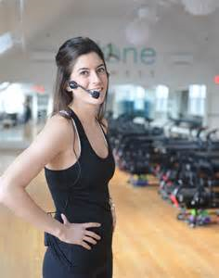
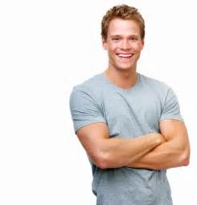
Correcting the argument:
Justin
last week
Mrs. Smith
Most people who workout efficiently every day have good bodies.
If someone has a good body, it is reasonable to believe that they workout.
According to Mrs. Smith (Jessica’s fitness instructor), Jessica works out efficiently every day.
The attached picture of Justin (taken last week) demonstrates that Justin has a good body.
People with good
bodies.
People who
Work out everyday.
Therefore: If we are to trust that Mrs. Smith is telling us the truth, then Jessica probably has a good body.
And: If we are to trust that this is a picture of Justin which was taken last week,
It is reasonable to believe that he may work out regularly.

Slide 8
Since red wine contains iron,
a glass of red wine everyday is good for you.
First premise: Red wine contains iron.
Second premise: Iron is good for you.
Conclusion: Red wine is good for you.
Step one: Identify the conclusion.
Step two: premises and consider them true (even if you know they aren’t).
Step three: determine whether the conclusion is logical or illogical.
Step four: The conclusion is logical.
Now let’s examine the validity of the premises. HOW???

Slide 9
All pilots have fast reflexes. So, I think Jackie Chan will make a good pilot because he has fast reflexes.
Premise: All pilots have fast reflexes.
Premise: Jackie Chan has fast reflexes.
Conclusion: Therefore Jackie Chan will make a good pilot.
The conclusion is illogical!
Change the premises to make the conclusion logical.
All people with fast reflexes make good pilots.
Jackie Chan has fast reflexes.
Therefore Jackie Chan will make a good pilot.

Slide 10
A well-known expert said that the world climate was changing, so it must be true.
Premise: Anything well known experts say must be true.
Premise: A well known expert said the world climate was changing.
Conclusion: The world climate is changing.
The conclusion is LOGICAL!
What should we ask ourselves about the first premise?
Are well known experts ever wrong? Can we find some examples of well-known experts being wrong about something? How often are well known experts wrong?
What should we ask ourselves about the second premise?
Who is this expert? What qualifies him/her as an expert? Did they really say this? When/Where did they say it? In what context did they say it?

Slide 11
HOW NOT TO ARGUE:
Lets look at some
VERY
common mistakes that people make
when they try to rationalize or justify
their judgments about objective reality.

Slide 12
Going around in Circles
Student A: I think Olga is honest.
Student B: Why do you think that?
Student A: Because Olga told me she was honest.
Student B: Why do you believe her?
Student A: Because I think she’s honest.
Student B: But WHY do you believe she is HONEST?
Student A: BECAUSE SHE TOLD ME SHE WAS!

Slide 13
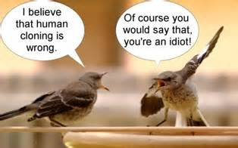
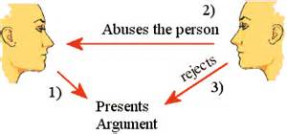
Personal Attacks
Student A: Legalizing drugs would actually provide for a safer healthier society (because premise x and premise y)
Student B: Says the drug addict!

Slide 14
Everything is Black & White!
Student A: Do you think George Washington was a good person or a bad person?
Student B: That’s complicated. I’m not sure there is a simple answer to that question regarding Washington or anyone else…
Student A: C’mon! Either he was good, or he was bad. Which one do you think he was?

Slide 15
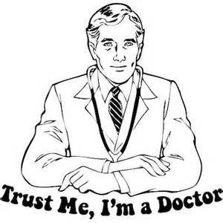
Trusting Authority
Student A: The stock market is going to crash this year.
Student B: How do you know?
Student A: All of the best economists are saying so.

Slide 16
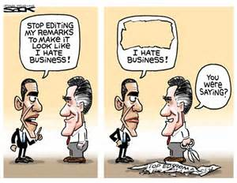
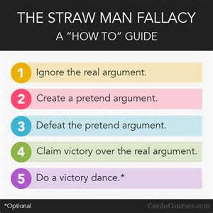
Misrepresenting the Opposition
Student A: I don’t think we should raise teachers’ salaries because we also need to pay for better school facilities like computers and whiteboards.
Student B: Student A doesn’t think teachers are important and doesn’t want to pay them a fair salary. We mustn’t listen to someone who thinks like this!

Slide 17
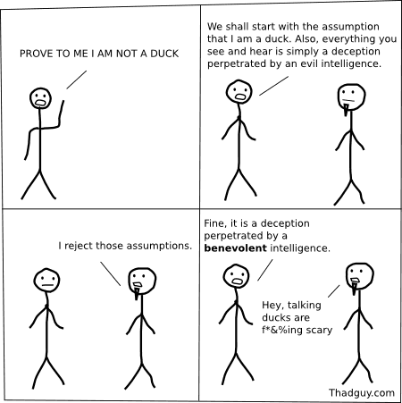
Can’t disprove it? Must be valid!
Student A: The United States Government is controlled by a small secret society who’s goal is to control the entire world and lower the world population to 2 billion.
Student B: How do you know that is true?
Student A: How do you know that it isn’t true?
The person who makes the claim
is obliged to support it!
The skeptical listener/reader has no obligation to
support the antithesis!

Slide 18
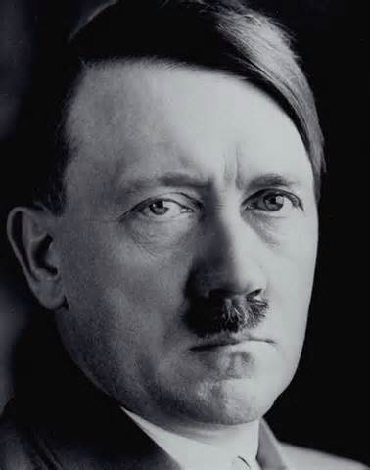
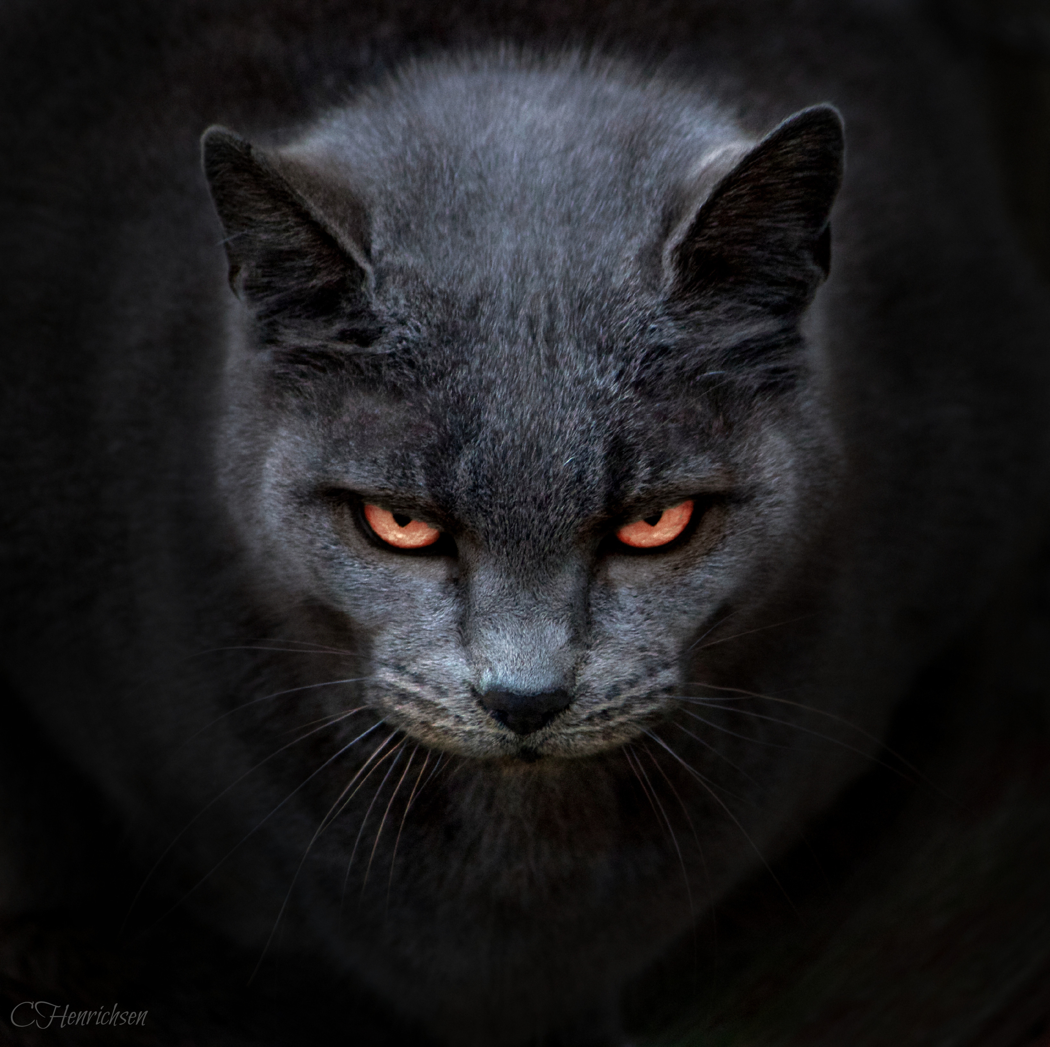
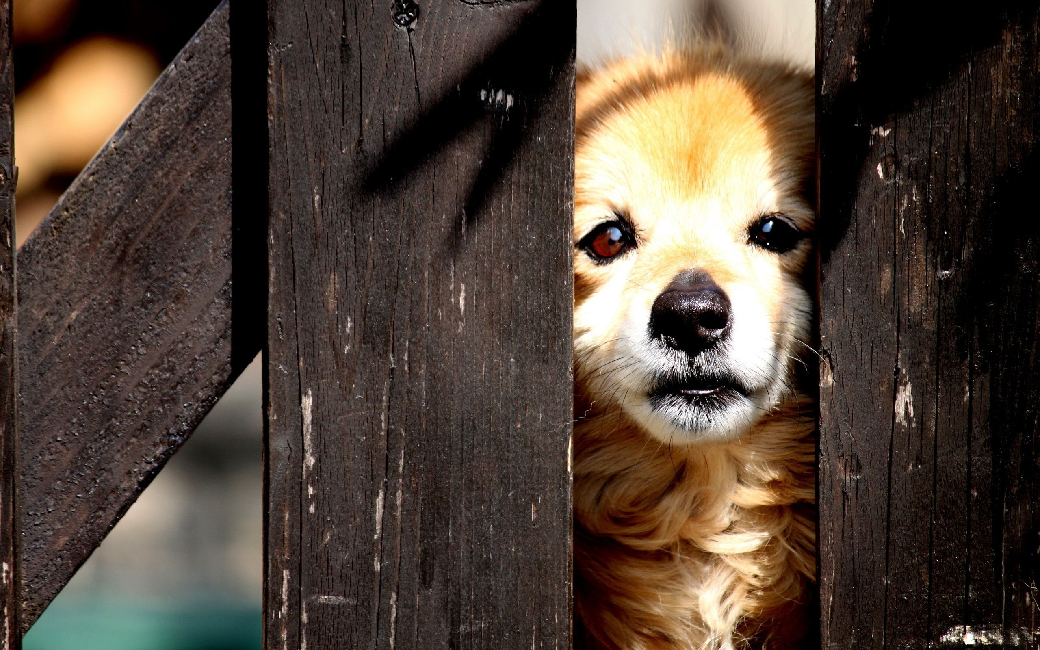
Guilt by Association
Student A: Who is smarter, cats or dogs?
Student B: I believe cats are smarter (because of these premises).
Student A: Do you know who else believed cats are smarter than dogs?
Student B: No. Who?
Student A: Hitler
Student B: Well…
Student A:
You’re a monster!

Slide 19
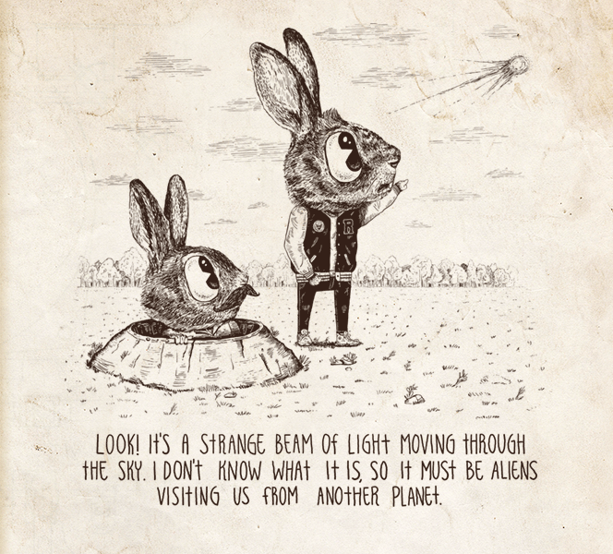
Arguing from ignorance
Student A: Of course I believe in evolution! Tons of scientific evidence clearly shows that evolution occurs in nature.
Student B : You mean, you believe people used to be fish???
Student A: In a sense, yes. And I can show you why it is true.
Student B: Ha-ha! How could a fish possibly turn into a human? That’s just ridiculous! Good-bye, moron!

Slide 20
Must be somewhere in the middle
Well, this newspaper said 300 people died, and that newspaper said only 100 people died. So I’m guessing it was around 200 people who died.
These workers took two days to finish the job, and these workers took four days to finish the job. We can therefore say that the average worker takes about 3 days to finish this job.

Slide 21
Thinking a conclusion must be wrong because the argument for it is bad.
Student A: Evolution is a fact. Darwin said so. Only an idiot wouldn’t believe it.
Student B: Your judgment is terrible! You are simply relying on trust in an authority figure and personal attacks to justify your argument!

Slide 22
Distraction
A: Killing someone by accident is not the same as killing someone on purpose. It is true that the end result is the same, but intent is a significant factor to consider. It can indicate how dangerous the killer actually is to our society. Therefore I believe the punishment for killing someone by accident should be much lighter or none at all.
B: I completely disagree with you. Killing is wrong! We can’t accept it at any level. There is so much needless killing in this world and I don’t see how anyone can be satisfied with that. Humanity needs to recognize that there is no difference between any of us and there is no need for war and hatred!
A: umm…. but…

Slide 23
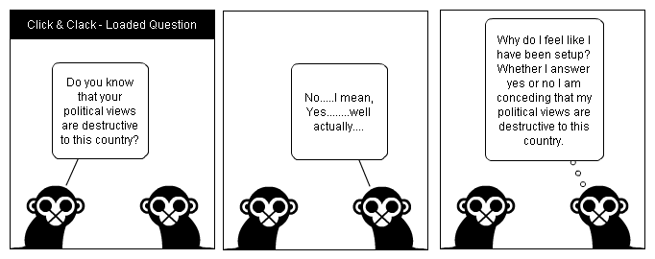

Slide 24
It’s only true for my argument, not for yours!
Donald Trump hates Russia. Putin wrote about it in his book.
Here is a book Trump wrote. In the 5th chapter he talks about how much he likes Russia.
Well, he was defiantly lying. Politicians lie about everything.
Doesn’t than mean Putin was lying when he said that Trump hates Russia?
No. Of course not! Putin knows Trump very well.

Slide 25
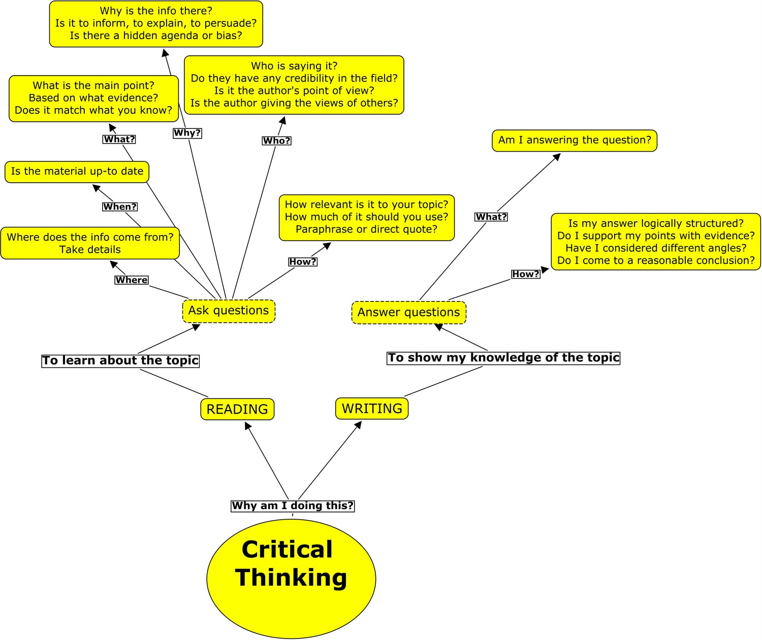

Slide 26
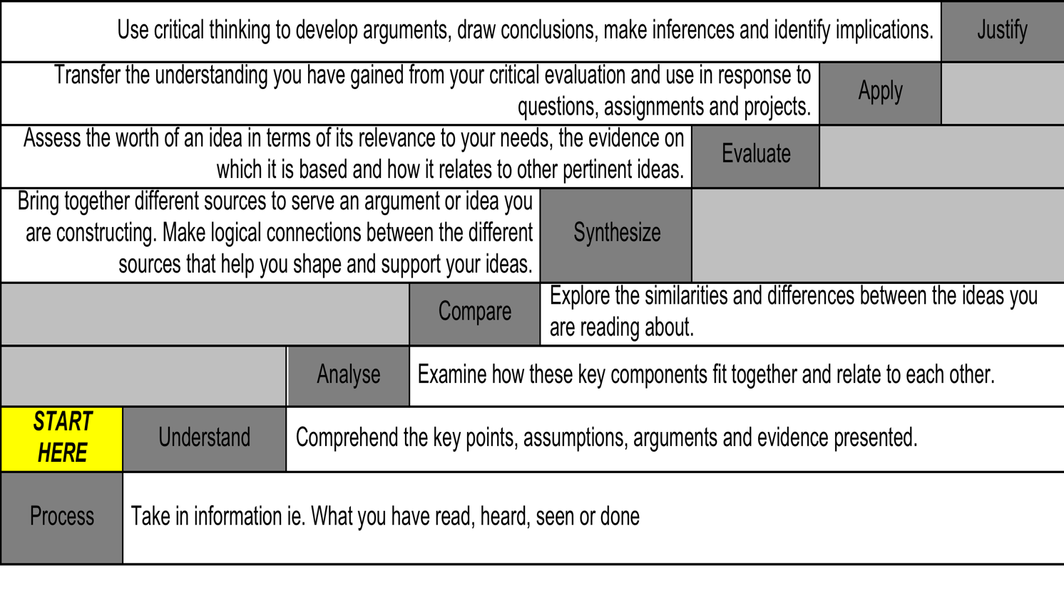

Slide 27
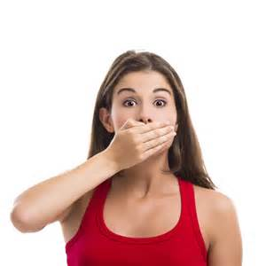
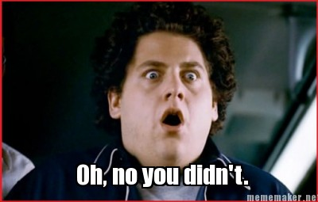
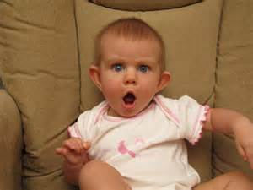
Taboo!

