Slide 1
Going away
travelling and holiday

Slide 2
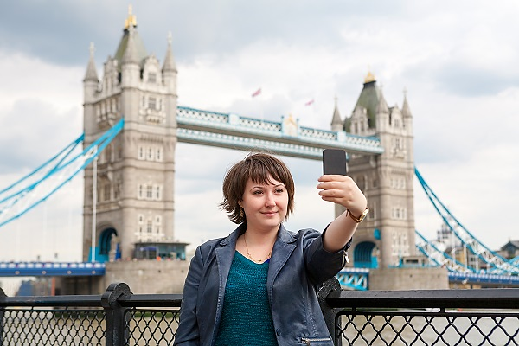
where is this person? what can tourists do there?

Slide 3
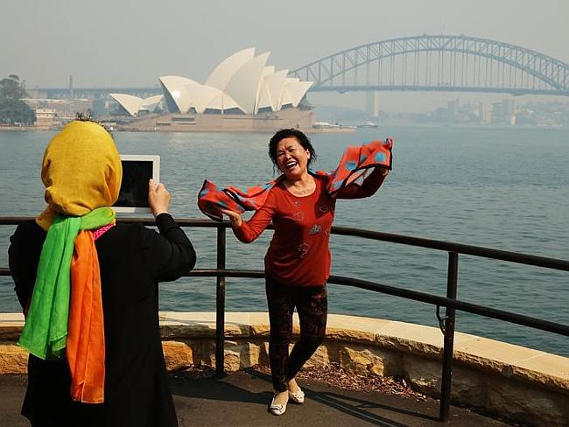
where are these people? what can tourists do there?

Slide 4
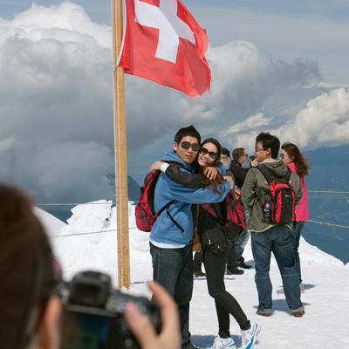
where are these people? what can tourists do there?

Slide 5
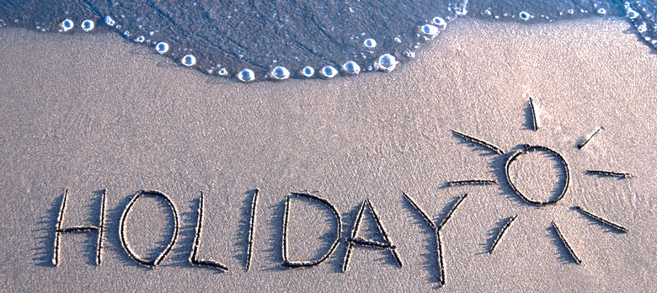
to get you talking... holiday = vacation
what was the best holiday is your life?
what was the worst holiday in your life?

Slide 6
Last holiday questions
Where __________________ ?
What __________________ ?
When __________________ ?
How long __________________ ?
Who __________________ with ?
How far __________________ ?
How much __________________ ?

Slide 7
your Suitcase
What do you take with you on a summer holiday?
what do you take on a winter holiday?

Slide 8
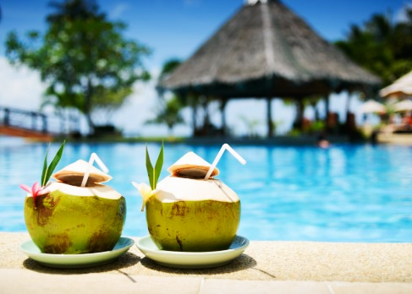
YOUR IDEAL HOLIDAY
summer or winter holiday?
where would you go? Why?
who would you take with you?
what would you do there?
what would you pack in your suitcase?

Slide 9
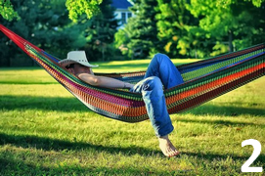
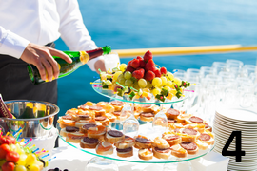
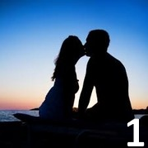
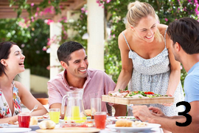
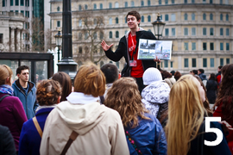
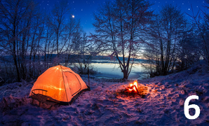
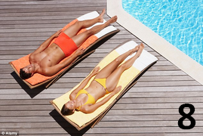
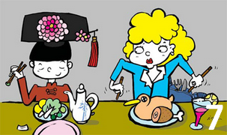
all-inclusive holiday
camping
culture shock
organised tours
romance with a stranger
self-catering holiday
siesta
sunbathing

Slide 11
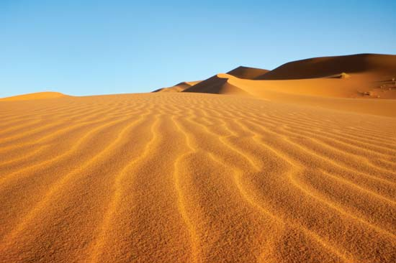
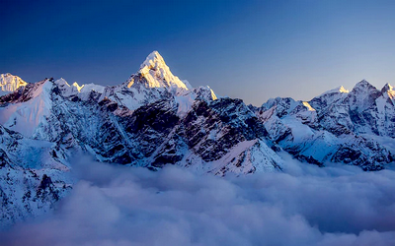
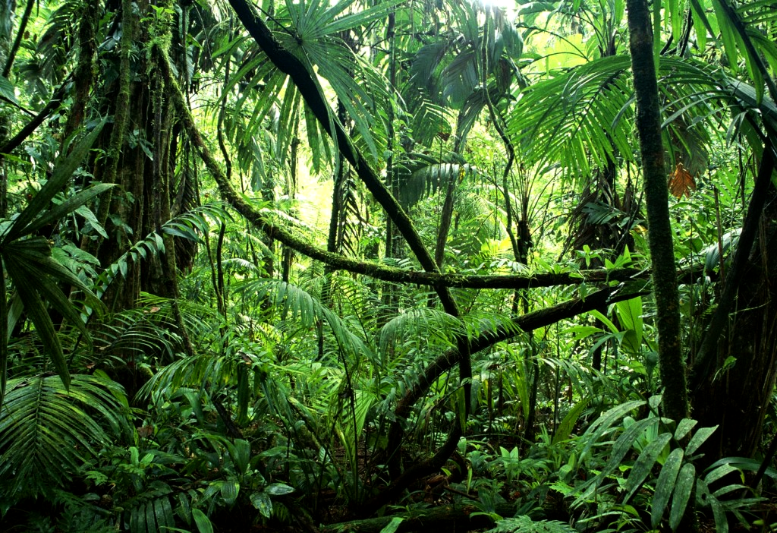
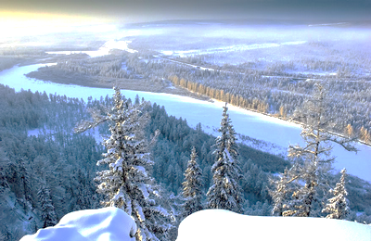
Adventure holidays
1
2
the Amazon
the Himalayas
the Sahara
Siberia
3
What are these places like?
Weather / main features / animals
What could you do there?
4

Slide 12
Infinitives

Slide 13
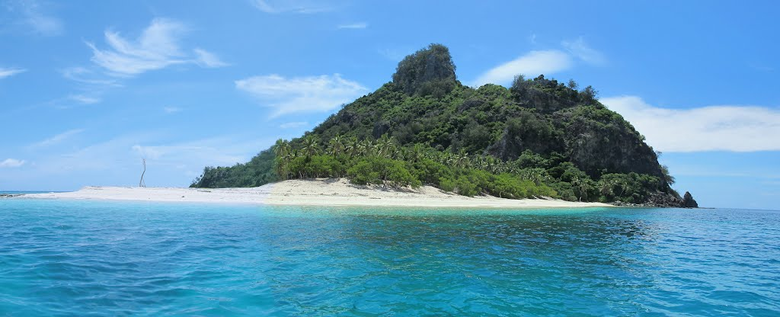
Desert Island
What would you take?
How would you survive?

