Slide 1
ESSAY WRITING
GETTING STARTED
WITH EXAMPLES

Slide 2
HOW TO START?
The biggest difficulty you face when starting an essay is to start.
For an A-grade you need to start with 3 things:
Your first sentence does not need to be brilliant, you just need to get things going.
A neutral sentence will always work as a great first sentence (example soon).
You need to know what you should write first.
The following few strategies will get you writing faster.

Slide 3
1. MAKE A LIST OF ESSENTIALS
Try a list with essentials, to make you start writing.
If you are just blocked, or you don’t know what to do just start writing on your piece of paper all the things you remember about the subject. Everything that comes to mind.
Once you have the list ready, draw a circle around any of the key ideas that might be good for your essay.
If you get 4-5 circles, you have a basic plan for your essay.

Slide 4
2. CREATE A MIND MAP
A mind map is very easy to create.
In the centre of the blank page write a single word or the topic of your essay (example on the next slide).
The strength of the mind map is that it allows you to empty out all the ideas that are racing round your brain and capture them in one page.
It also allows you to visualise the problem as a single picture and see the main areas that you would like to explore.
Ideas are not passive and solutions come more quickly when you are doing something.

Slide 5
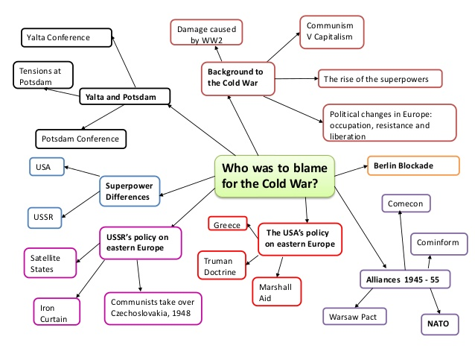

Slide 7
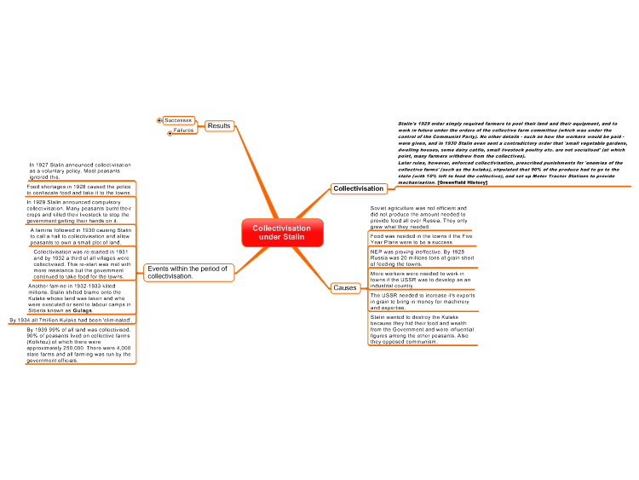

Slide 8
3. SPEAK A LIST
If you are not in an exam, take five minutes and speak a list.
Write words as they come loud.

Slide 9
4. CROSS EXAMINE YOUR QUESTION
If you are still blocked, try having a second look at your question.
Start taking it apart piece by piece.
Are you sure that you understand what each word in the question means?
Do you understand what the question is asking you to do?
Try rephrasing the question in your own words.

