Slide 1
How do i learn?
Study Tasks in English
UNIT 1

Slide 2
Getting to know Study Tasks in English
Task 1.1
In groups, answer these questions:
What is the title of the book?
Who are the authors?
When was it published?
What information does the table of contents provide?
How many units are there in the book?
What is the last section in each unit called?
What do you think ‘assessment’ means?
What is an appendix?
Where are the appendices in this book?
What information is given in the appendices?

Slide 3
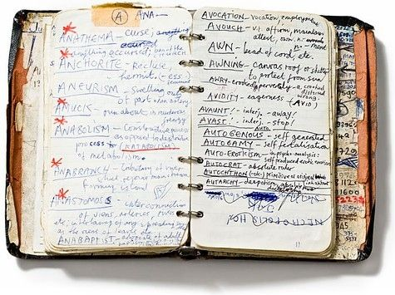
The two basic tools: NOTEBOOK & WORDBOOK
a NOTEBOOK should contain your class notes and material for exam revision
a WORDBOOK is your personal dictionary where you write unknown words from lessons and books

Slide 4
How do you learn best?
not everyone learns in the same way
pay attention to your learning style (refer back to the quiz we did at the beginning)
visual
auditory
kinesthetic
everyone is successful in some activities but less successful in others
Write down two things you have learn successfully and two things you feel you are weak at.

Slide 5
In groups, compare your answers and answer these questions
What contributed to your successes?
What contributed to your failures?
What are the similarities in your answers?
Are there any big differences?
What does ‘success’ mean?
Can you describe a clever person?
What makes a topic interesting?

Slide 6
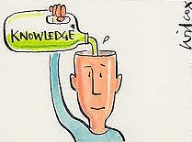
Are students simply empty heads to absorb information?
YOU NEED TO FEEL YOU ARE IN CONTROL OF YOUR LEARNING
YOU NEED TO BE CONFIDENT ENOUGH TO MAKE DECISIONS

Slide 7
In groups, list some of the steps students can take to help themselves be more successful

Slide 8
Why are you learning?
Discuss in pairs or groups:
Why are you learning?
What is your motivation?
Why have you chosen to study this course at SISU?
DON’T let your only reason for studying be parents or the vision of earning a lot of money! What are your personal needs?

Slide 9
Preparation and pacing
careful planning
healthy life-style

Slide 10
Healthy life-style varies from person to person. What is healthy life-style for you?
In groups, discuss these questions:
What do you tend to eat? Do you feel it is healthy?
How much sleep do you get? Is it enough?
How much exercise do you get? Is it sufficient?
How do you relax?
Do emotional problems affect your study? What can you do about them?
In groups, write down three to five points that affect your study and any changes or suggestions about what you could do to improve your life-style.

Slide 11
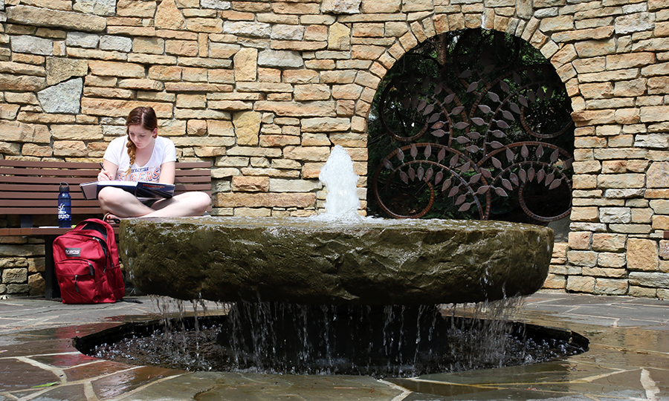
My ideal place to study
Where can you concentrate best and study most efficiently?
In your notebook, draw a picture of your ideal surroundings for study.
You can find a lot of inspiration on the internet.

Slide 12
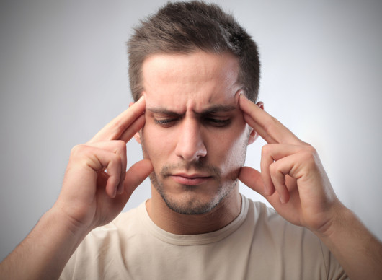
How do you use time?
Which ones apply to you? Discuss with other students.
I LIKE TO STUDY IN THE MORNING.
I LIKE TO STUDY AT NIGHT.
I LIKE TO STUDY IN THE AFTERNOON.
I LIKE TO TAKE FREQUENT BREAKS.
I LIKE TO CONCENTRATE FOR LONG PERIODS OF TIME.

Slide 13
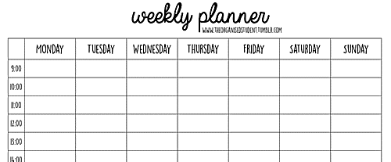
Weekly study plan
In your notebook, draw up a study plan for yourself for next week.

Slide 14
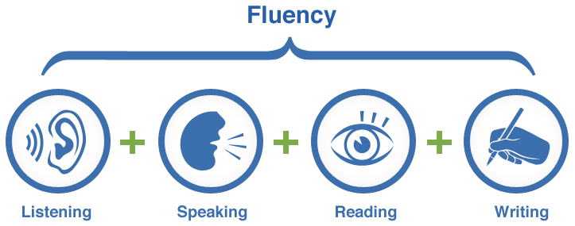
Study skills

Slide 15
What additional skills might you need when studying?
In groups, write a list of the skills you need to study successfully.
Which skills apply only to reading/speaking/listening/writing?
Look at the pictures on page 9 – they may give you a few ideas!

Slide 16
Self-assessment is essential for study.
At home, think honestly and critically about your own learning skills.
Write your answers in your notebook for future reference.
You can find a complete table at the end of the book and fill it in as you go.
Which skills do you feel you have mastered?
Which skills do you think need a lot more practice?

Slide 17
Looking back at the lesson…
What do you feel was the aim of this unit?
What were the most important points to remember?
In what way do you feel more prepared for your future studies in English?

Slide 18
Homework
get a notebook and a wordbook for Academic English lessons
draw a picture of your ideal surroundings for study
write your study plan for next week
self-assessment questions (page 10, task 4.3 a))

