Slide 1
END-OF-TERM REVISION
WEEKS 1 - 6

Slide 2
topics covered
Storytelling
Technology
Personality
Sports
Family
Changing the World
Mysterious disappearances
Jobs
Crime and punishment
Money
Travelling
Men and women
Emergency

Slide 3
topics for revision this week
Storytelling
Technology
Personality
Sports
Family
Changing the World

Slide 4
Storytelling (World Pass unit 1)
In Chinese tradition, are there a lot of stories which have been told for generations? What are they usually about?
Do you someone who is a good storyteller? Who is it? What do they like to talk about?
People use the word story in different ways (e.g. news story, bedtime story). Do you know other ways? Make a list.

Slide 5
To make a long story short, I applied for the job, but I didn’t get it.
I don’t care if Laura gets angry with me. I’m not going to her party – end of story.
It’s the same old story. I went on a diet, I lost ten pounds, and then I gained them all back, just like last time.
Patrick’s office is neat and well-organised, but his apartment is a different story.
What’s the story? You promised you’d be here two hours ago!
to show a surprising contrast between two things
to demand an explanation for something you are unhappy about
to talk about something disappointing that has happened many times before
to summarise a sequence of events to avoid going into much detail
to put a stop to an argument and show that you do not want to discuss it anymore

Slide 6
Fill in the blanks with the expressions we’ve just seen -to make a long story short - end of story - it’s the same old story - is a different story - what’s the story?
I don’t care what’s on TV! You can’t watch it until you’ve finished your homework. That’s the rule - ___________.
Just like always, I met a nice guy at work, we went out in a few dates, and then he never called me again. ___________.
It rained every day, the hotel was terrible, there was a taxi drivers’ strike so we couldn’t go anywhere - __________, it was an awful vacation.
You told me you were going to buy groceries, but the fridge is empty. ______________
My old boss was really nice and easy-going. My new boss _______________ - he’s never satisfied with anything.

Slide 7
What’s your story? Remember to use the past tense!
What was it like growing up in your city? What were some of your favourite places? Have those places changed?
What did you want to be when you were a kid?
Who were your heroes or role models growing up? Who did you look up to?
Does your family have any true stories they like to tell about family members (funny or scary stories about your parents’ or grandparent’s past)? What are they about?

Slide 8
Technology (World Pass unit 2)
Have you ever had a technology problem that you couldn’t solve yourself? (e.g. your computer broke down, you washing machine stopped working, your boiler started leaking…) How did you solve the problem?
Have you ever been in a blackout, a bad storm, an earthquake, or a similar event? What happened?
What should people do to prepare for such events?

Slide 9
Word combinations with trend - setting the trend - downward/upward trend - reverse/buck the trend - a trend toward (verb + ing) - economic/social trends
In my country, there’s _____________________ getting married at a later age. Nowadays people are waiting until they’re 27 or 28.
More and more children are overweight. The government is hoping to _______________ with nutrition programmes and fitness classes at schools.
Fewer people every year are using fax machines. This __________began about ten years ago with the popularity of email.
The Future of Money is a new book about _____________ in the world today.
Japanese companies are _____________ for energy-efficient hybrid cars.

Slide 10
The prefix over- (‘too much’) is used with certain nouns, verbs, and adjectives. Match the words with their meanings.
overdo it
overload
overlook
overpowering
overeat
overdue
unpleasantly strong
not done by the time required
give someone too much work or information
not notice something
eat too much
work too hard

Slide 11
Technology cannot solve every problem
More and more people use technology (IMs, email etc.) to communicate. Why is it a more convenient way than face-to-face communication?
How can we persuade people to communicate face to face more?
A lot of people lead a very sedentary (not very active) lifestyle. What are the reasons?
How can we persuade people to be more active?
What do you think of incorporating technology into areas like medicine and education?

Slide 12
Personality (World Pass unit 3)
What is your personality like? How does it influence your decisions and your daily life?
Is there any personal trait that is common to all the students in your class?
Do you like to work and study in a team, or do you prefer to work alone? Why?

Slide 13
Word combinations with personality a strong personality a split personality a personality clash a personality disorder a personality trait a TV/radio/sports personality
My best friend really has ____________. At work, he’s very aggressive, but he’s a real pushover with his family.
I had to leave my job because of ______________ with my boss. She was a real control freak who disagreed with everything I did.
Nathan’s brother is _______________. He played on the national soccer team, and now he’s a well-known coach.
A person who has ____________ is often driven and assertive.
____________________ is a kind of disease.
Being lazy and messy are two _______________ that I really dislike.

Slide 14
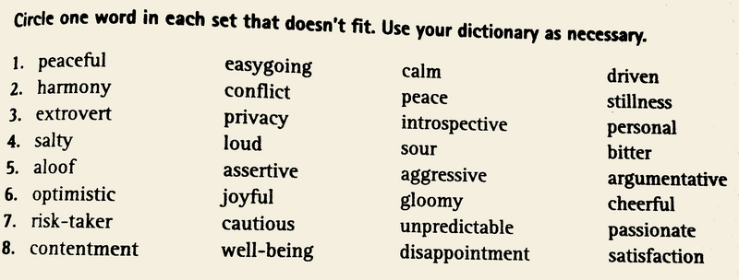
Odd one out

Slide 15
Turn-taking describe at least two people
 | GROUP A |  |  | GROUP B
A really | A complete | Such | Friendly | Talkative | A Pushover
A bit | so | A bit of | A shy person | Homebody | Lazy

Slide 16
Sports
What is the most popular sport in China? Why?
What sports are popular in other countries? (e.g. the UK, the US, Canada, Australia, …)
What are the benefits of doing sports?

Slide 17
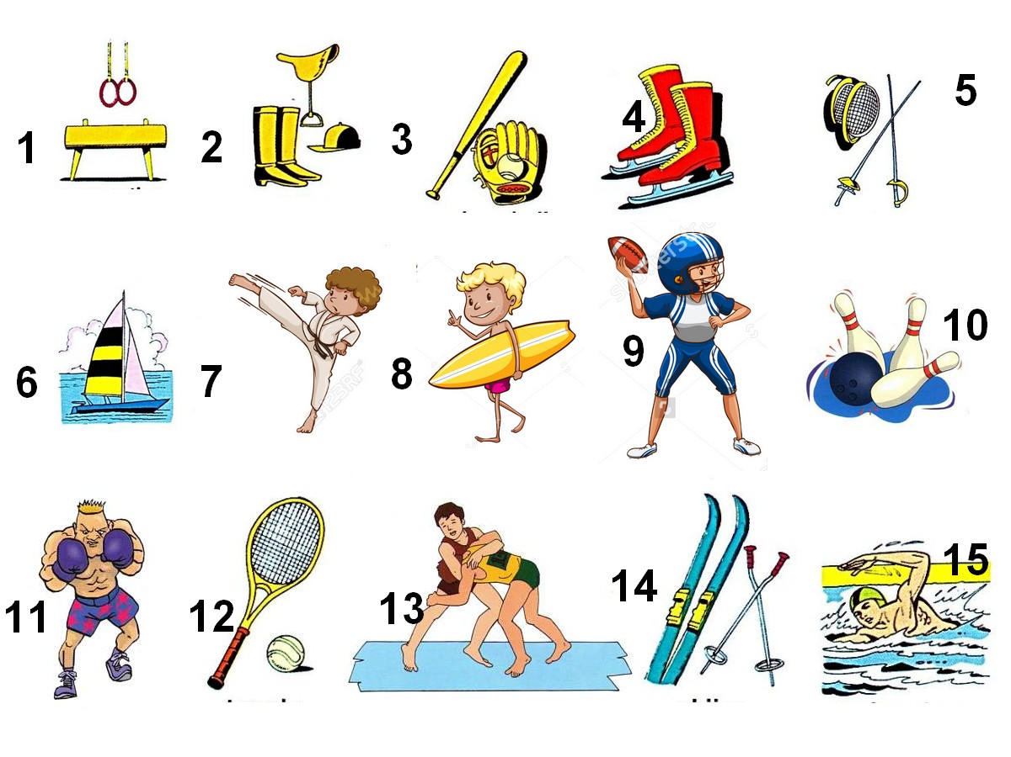
What sports are these? Play, do, or go?

Slide 18
Guess the Game
In pairs, take turns to think of a sport for your partner to guess.
You can ask 20 questions.
You can only answer ‘yes’ and ‘no’.

Slide 19
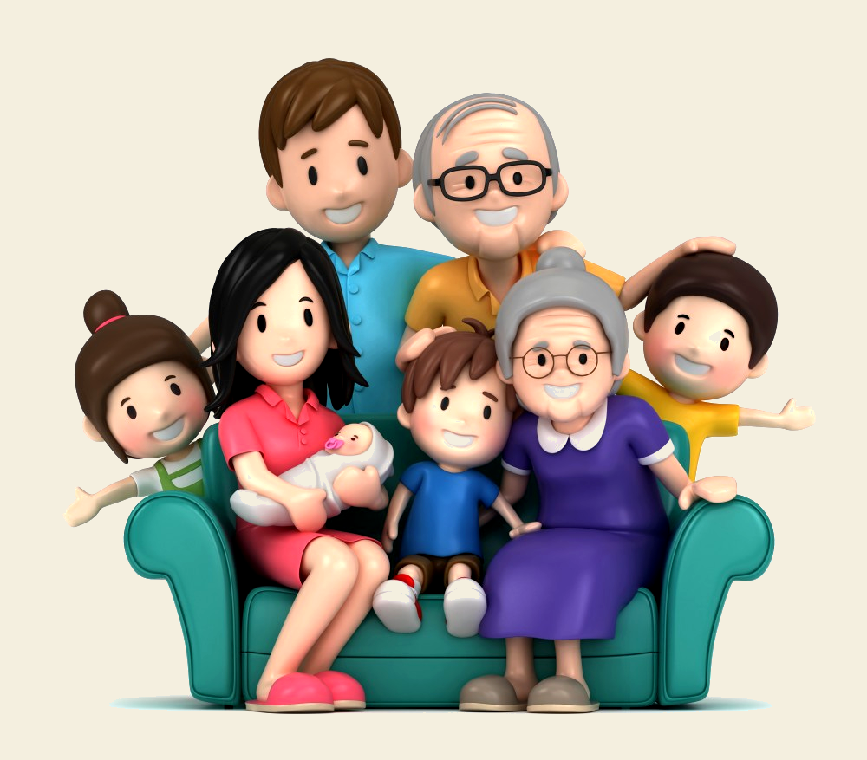
Family (World Pass unit 9)
If you could adopt a new family member (sister, brother, grandparent, aunt, uncle…), which would you choose? Why?
Who takes care of the elderly in your community?
How common is divorce in China? What are the reasons?

Slide 20
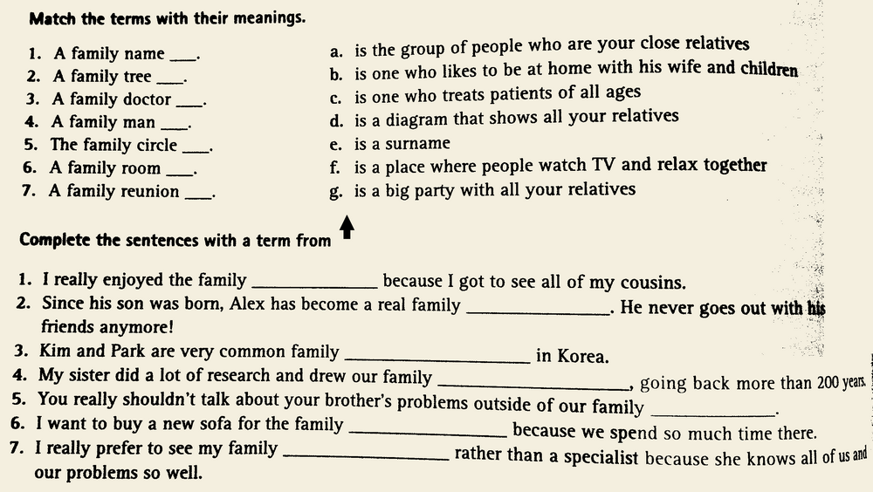

Slide 21
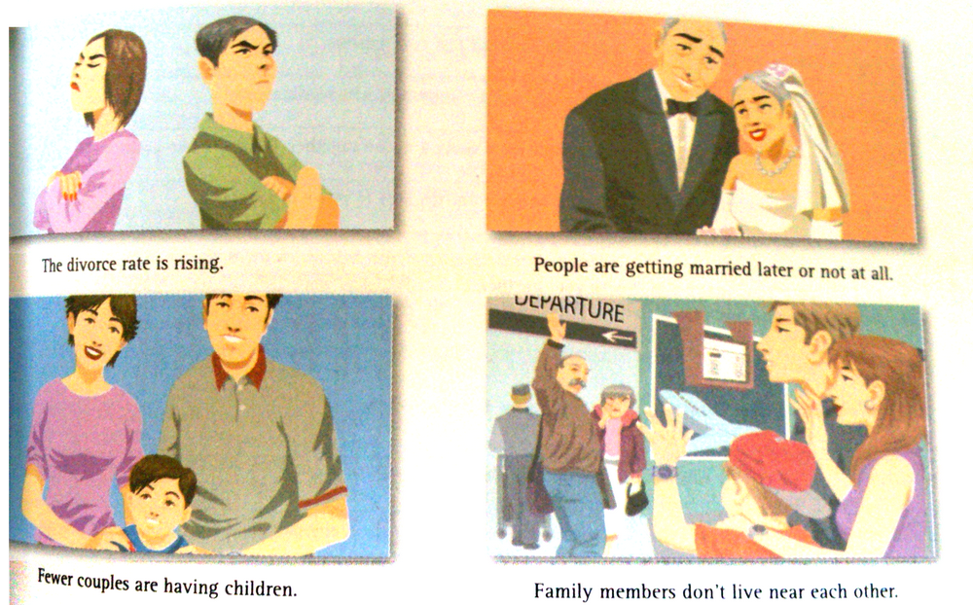
Look at the pictures. In pairs, discuss what the reasons for these changes in family life could be.

Slide 22
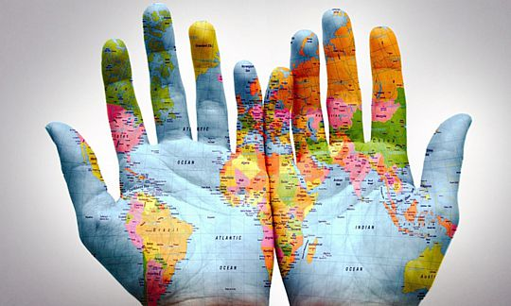
Changing the World (World Pass unit 4)
What would you do if you had unlimited power over the world?
How can ordinary people change the world?
What are the first three things you would change about your life?

Slide 23
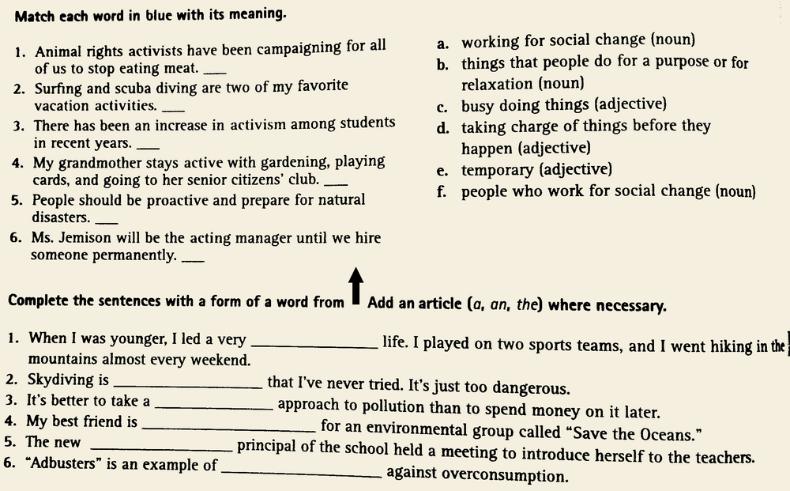

Slide 24
Do you like change? Discuss these questions in pairs.

