Slide 1
Communicate China’s National Image

Slide 3
China’s national Image
Ancient civilization: 62%
A major emerging country: 58%
A major power: 47%

Slide 4
Image of Chinese citizens
Over 50% willing to engage with the Chinese.
Over 2/3 Britons enjoy their experience with the Chinese.
Russians and Indians least willing to interact with the Chinese.
Chinese youth widely recognized: hardworking, energetic, the hope of China.
MYSTERIOUS SENSIBLE CREATIVE MILD HAPPY WITH LIFE

Slide 5
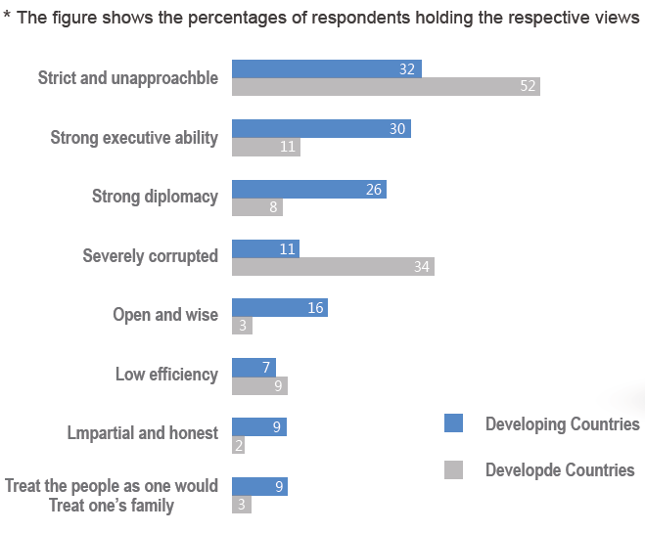

Slide 7
Rise as a super power?
Rise of the living standard of her 1.36 billion people.

Slide 8
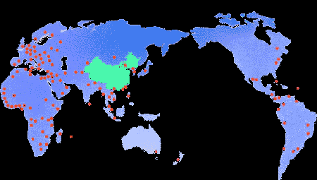
Xinhua News Agency
English French Spanish Russian Japanese Korean
The news bureaus of Xinhua News Agency

Slide 9
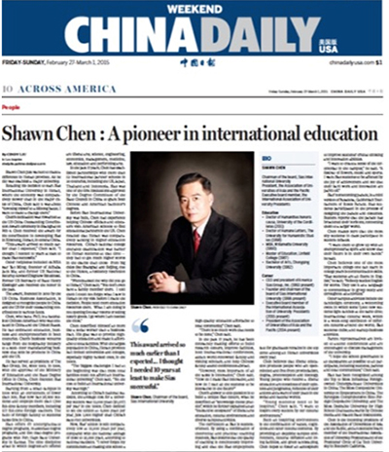
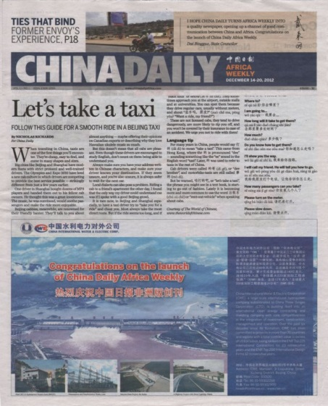
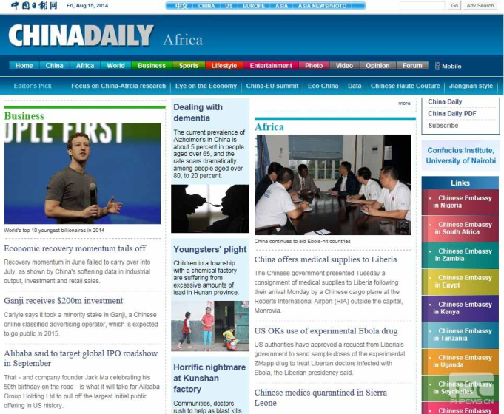
China Daily

Slide 10
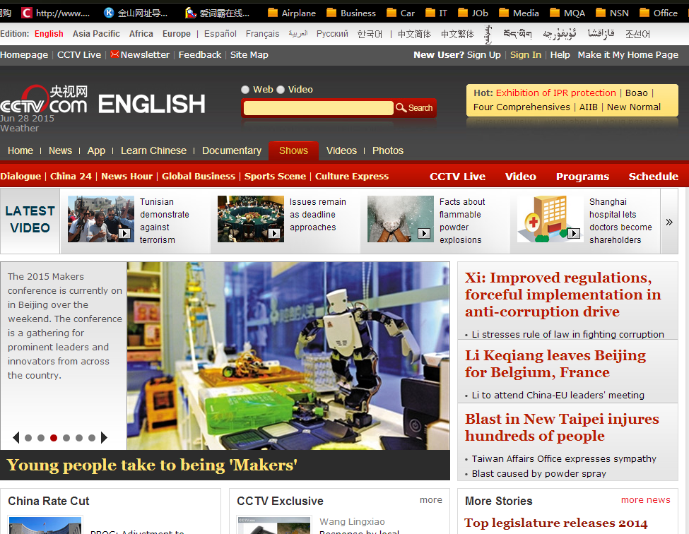
CCTV

Slide 11
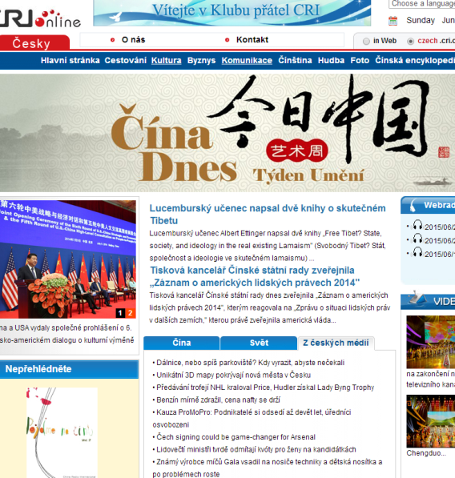
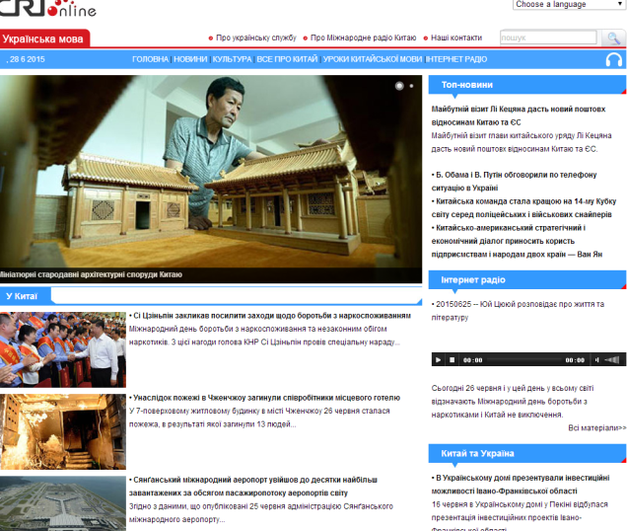
China Radio International
65 languages
95 overseas radio station with its own frequency
32 news bureaus
4112 overseas listeners’ clubs
3,893,000 letters
24,640,000 visits on multi-language websites.
By 2013

Slide 12
Great Wall Platform
A broadcasting platform aiming at overseas audiences

Slide 13
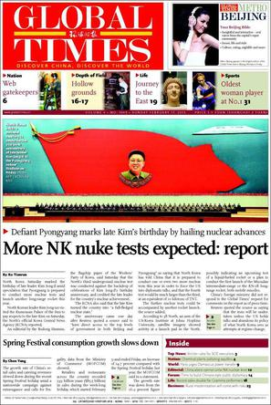
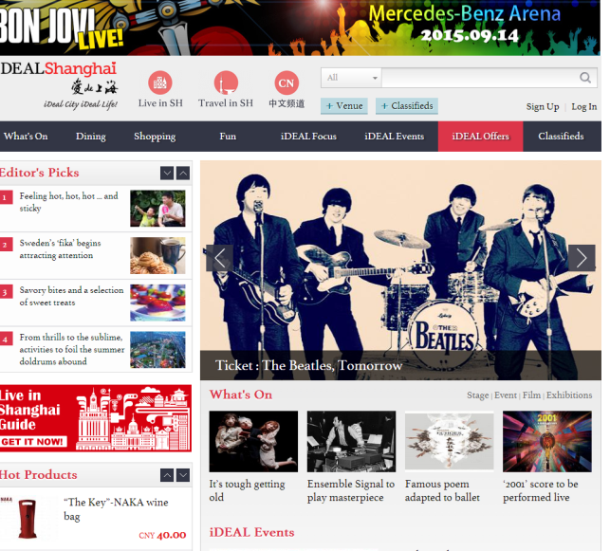
Global Times/Shanghai Daily

Slide 14
International Channel of Shanghai
http://special.icshanghai.com/MarkLEFF/gallery.shtml

Slide 15
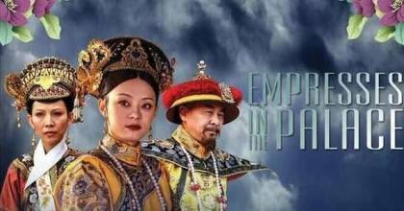
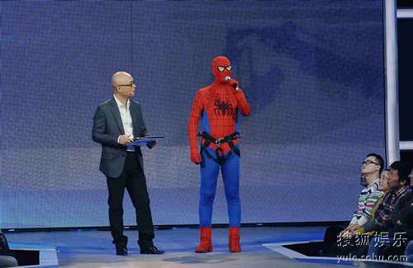
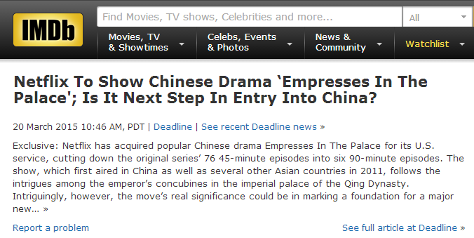
Entertainment: small people & real life
A Chinese TV drama in kiswahili.

Slide 16
International Journalism Education
language challenge

Slide 17
Practitioners
Demanding/Frustrating/Difficult/Ill-paid
“I can’t just stand by and see whenever something happened, only a few American and European media are defining the news fact and try to influence people’s perception and judgment” --- Wang Guan, a reporter from CCTV News.
“We are committed to the job because we believe the world needs more than one kind of voice.” --- a reporter from ICS

Slide 18
Reflections
“We are not building the country’s image, but building the country, and communicating the image.” --- Zhao Qi Zheng
From telling China’s story to telling the world’s story.
Confidence in one’s own culture is the starting point of any international communication.
谢谢！
Thanks

