Slide 1
EMERGENCY!
World Pass unit 12

Slide 2
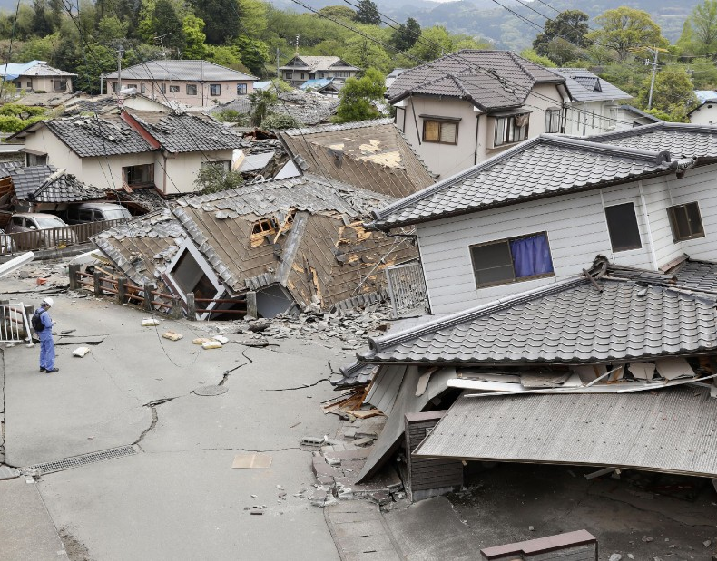
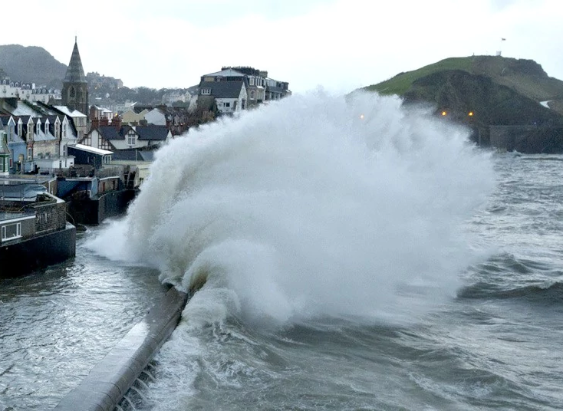
What types of emergencies and disasters occur in your country? Have you experienced any of them?

Slide 3
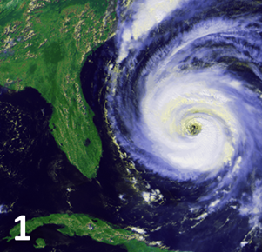
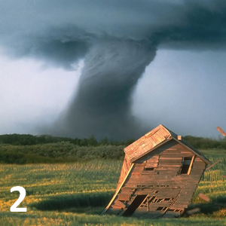
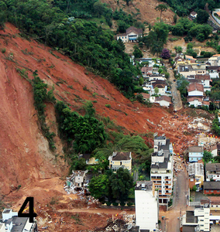
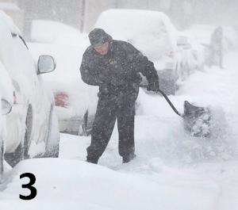
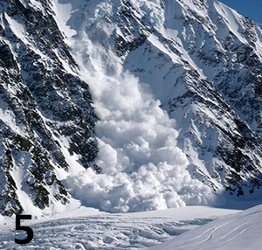
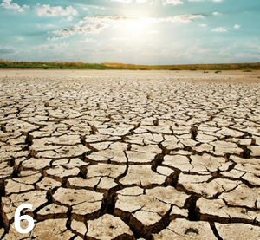
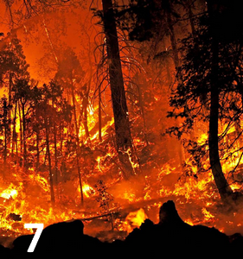
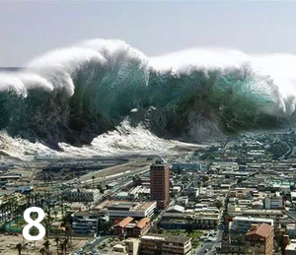
Can you name these disasters?

Slide 4
Which of the aforementioned disasters are likely to happen in your country?
What kind of plans does your city or country have in place for natural disasters, such as an earthquake or a flood?
Do you know where to go in case of an emergency?

Slide 5
Match the words with their definitions
essential
jeopardise
on hand
devise
walk through
back-up plan
implement
warning system
get through
evacuation
take into consideration
extent
evaluate
in-depth
hazard
invent
an extra plan
detailed
study the facts
readily available
size or amount
start using (a plan)
rehearse
necessary
think about
make a telephone connection with someone
endanger someone/something
something that is dangerous
the process of making people leave an unsafe place
a way of giving advance notice about danger

Slide 6
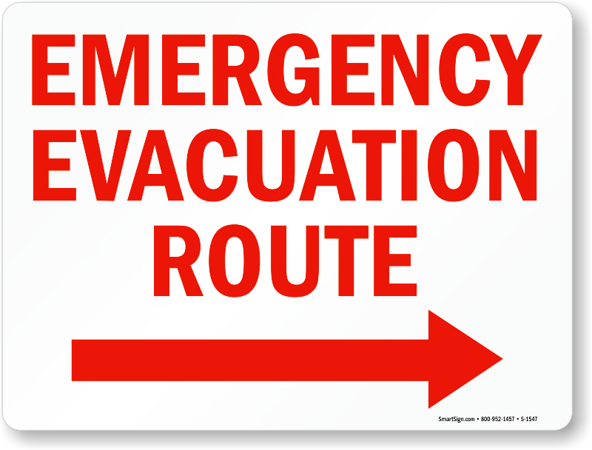
Discuss with your partner/group.
If you had to evacuate your home and could take only three items with you, what would you choose and why?
Have you ever practiced what to do in an emergency?
In general, would you say that you’re prepared for an emergency?

Slide 7
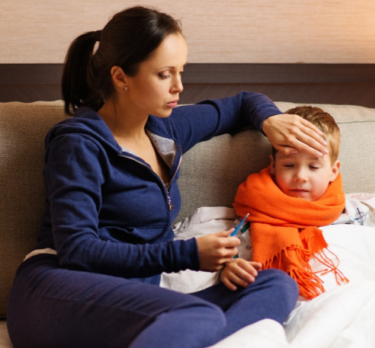
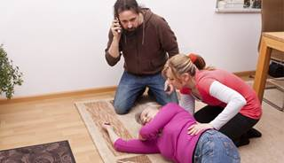
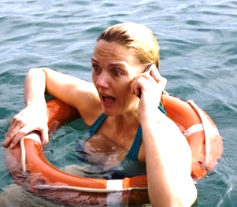
When you have a sudden problem, what do you usually do? Do you try to work it out yourself, or do you call someone? Who do you call in a crisis?

Slide 8
Both Rick and Julie are facing a crisis. Read the dialogues and notice the expressions in red.
CONVERSATION 1
Josh: Hello?
Rick: Hi, this is Rick… Josh, you’ve got to help me, my computer just crashed! And my paper is due tomorrow morning!
Josh: Aw, don’t get upset. I’m sure we can take care of it. Can you tell me exactly what happened?
Rick: I was typing the last page, and suddenly the screen went all blue!
Josh: What did you do then?
Rick: I just restarted the computer.
Josh: Well, why don’t you try finding the back-up folder and looking inside?
Rick: OK…
Josh: Did that work?
Rick: Yeah! There’s my paper! Hey, thanks!
CONVERSATION 2
Mrs Kang: Hello?
Julie: Mom – Tanya, my roommate, just cut her hand. It’s bleeding like crazy!
Mrs Kang: Take it easy. What happened?
Julie: She was cutting vegetables for a salad and the knife slipped.
Mrs Kang: Well, it might not be as bad as it looks. You need to put a clean towel on her hand and press down hard.
Julie: OK… I’m doing that…
Mrs Kang: Is it any better?
Julie: No, not really. It looks like a deep cut.
Mrs Kang: Then you better call 911. And don’t worry – everything’s going to be OK.

Slide 9
Now add the expressions from the conversations to the correct columns of this chart.
Reassuring someone | Figuring out the situation | Giving a solution | Checking the solution
Don’t worry. Relax. Nothing to worry about. Hang in there. Take it easy. ___________ ___________ | What’s the matter? What does it look/sound like? What happened after that? Can you tell me exactly what happened? ___________ ___________ | The first/next thing to do is… You’d better… ____________ ____________ | How is he/she/it now? What’s happening now? ___________ ___________
Don’t get upset. | What did you do then? | Why don’t you try… | Did that work? | What happened? | You need to… | Is it any better? | Everything’s going to be okay.

Slide 10
Who would you call for help in these situations? Role-play the phone calls with your partner.
You’re washing your hands at home when an expensive ring falls off your finger and down the drain of the sink.
You’ve just tried a new brand of shampoo. An hour later, your head starts to itch, and you see red bumps on your skin.
You’re at home watching TV when you hear the sound of running water. When you look up, you see a crack in the ceiling and water coming down.

Slide 11
Think of a problem, but don’t tell your partner what it is. Then ‘call’ your partner to ask for help, and work out a solution together.

Slide 12
Find someone who has…
… been in a car crash/accident
… been in an accident requiring hospitalization
… seen or been in a house that caught fire
… broken a bone
… been caught in a flood
… reported something to the police
… seen someone get arrested

Slide 13
Discuss with your partner or group.
Which emergency service in the city do you think is the best quality?
Police
Are the police somebody you can get help from easily?
Do you trust the police?
Have you ever had to speak to the police?
Fire brigade
How long does it take the fire engines to get to fires?
Ambulance
Are the ambulances good? What problems do they face?
Which Emergency Service do you think is most heroic?
Would you like to work in any of the services? Why/ why not?
Which would be the best job? Which would be the worst?
Are there enough of these services here in the city?
How could they be improved?

Slide 14
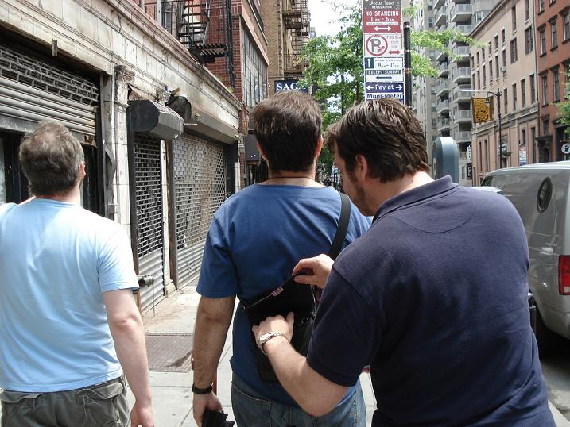
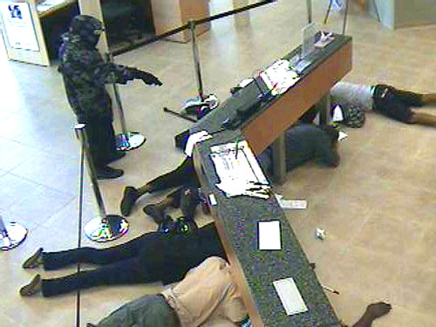
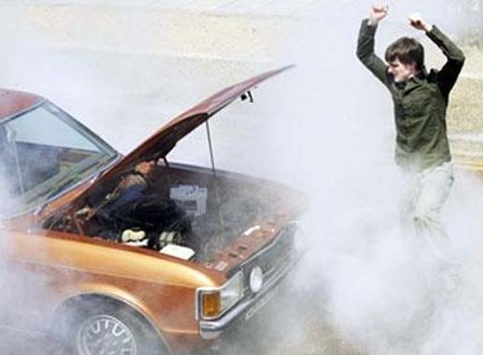
Who do you call? What do you do? Discuss.

Slide 15
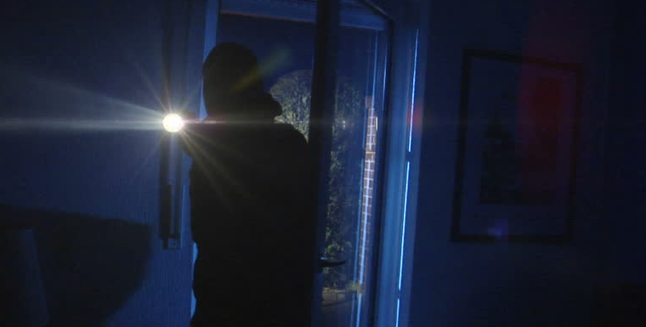
Who do you call? What do you do? Discuss.
You are at home in bed, it’s late and you have just woken up. You hear a noise outside your room. You live alone but you have heard about some break-ins around your area lately. You lie quietly, and listen. Maybe it’s just a... No! You hear it again. There is someone in your house! You have your mobile phone... But you must be careful!

Slide 16
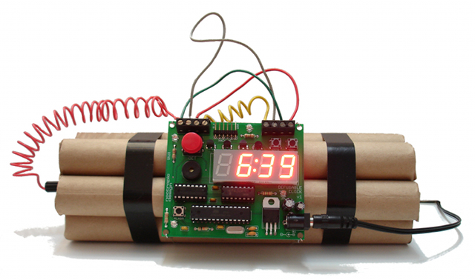
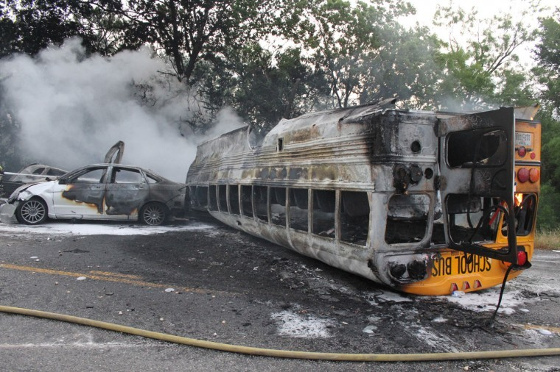
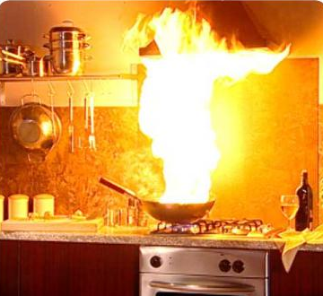
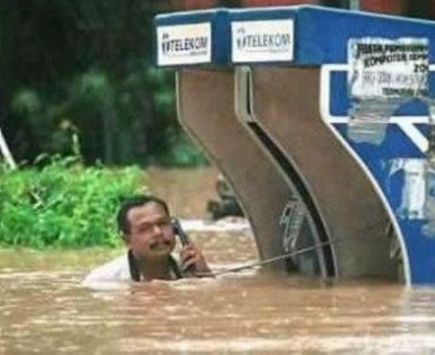
Who do you call? What do you do? Discuss.

Slide 17
Who do you call? What do you do? Discuss.
You are at the beach watching your friends surfing. He falls in the surf and is swimming to his surfboard when a fin breaks the water. People start screaming as the shark explodes out of the water beneath your friend. Your friend’s leg is in the jaws of the shark but he is kicking at the shark with his other leg and suddenly the shark lets go. You run into the water and pull out your friend, who is not moving and bleeding from cuts and gashes along his body. How can you help him?

Slide 18
China’s Survivors discussion
Imagine that terrorists have dropped bombs on East China cities and a deadly gas has been released. There are NOT enough trains for everybody to escape. This means that only half the population will be allowed onto the trains. The government has declared that only people with skills that can be used help will be let onto the trains.
You get the list below and your group must discuss who can go, and who will be refused – and give reasons. Only 5 people can go.
International Athlete
Politician
Teacher
Fitness coach
Civil Engineer
Police officer
psychiatrist
pediatrician
Nurse
Scientist
Musician
Construction Worker
Doctor
Factory worker
Singer
Farmer
Manager
Millionaire
Footballer
Electrician

