Slide 1
men and women
dating and breaking up
relationships

Slide 2
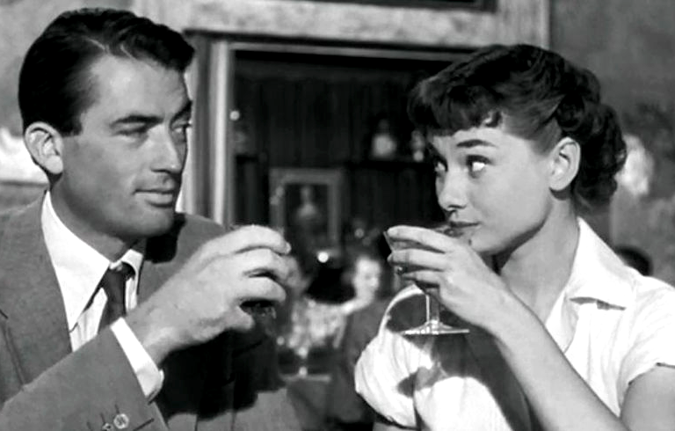
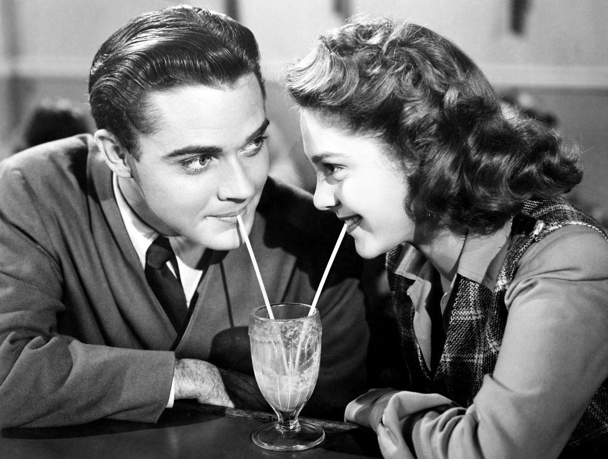
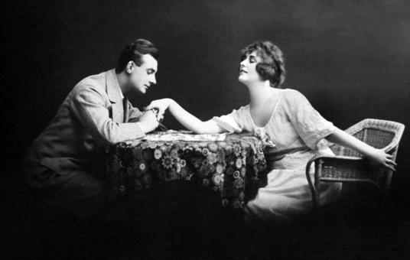
Imagine you are going on a date. you have an unlimited amount of money and one afternoon to spend it. What would you do for your date?

Slide 3
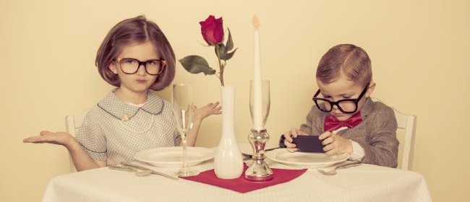
dating
blind date
dating agency
dating show
double date
matchmaker
speed dating
in traditional cultures, a person who arranges marriages between people who don’t know each other
two couples go out on a date together
a party attended by many men and women, at which they have very short, fast conversations and decide which potential partners they’d like to see again later
a date between two people who have never met, often arranged by mutual friends
a service that introduces people to potential romantic partners
a television programme that introduces people to potential romantic partners

Slide 4
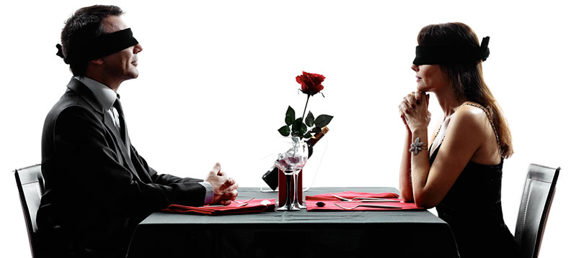
Blind date
Have you (or someone you know) ever been on a blind date? How was it?
If you haven’t been on a blind date, would you go on one? Why (not)?
What are some advantages and disadvantages of a blind date?

Slide 5
Expressions connected to dating
eligible
bachelor
browsing
compatible
uninhibited
reluctant
call the shots
cheat on sb
chemistry
not go over well
hit it off
fall head over heels
turnoff
meet for the first time and immediately like each other
looking around, searching
the way two people relate to each other
hesitant
secretly have a relationship with another person
a single man
not well received (by another person)
free and unrestrained in behaviour
available for dating
having similar tastes or interests
fall in love completely
deterrent, let-down
control the situation

Slide 6
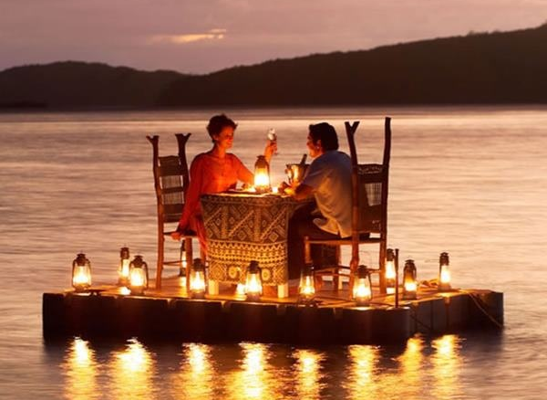
an ideal date
What is a real turnoff for you in a potential date/friend? Why? Think of compatibility:
age
appearance
character
interests
hobbies
What sort of chemistry do people need to really hit it off?

Slide 7
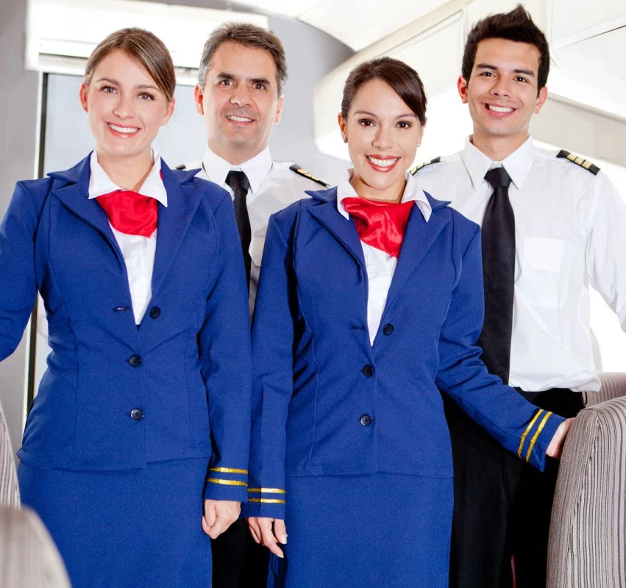
The work roles of men and women are changing in society and the English language is reflecting this change. match/FILL IN the old and new job titles:
OLD JOB TITLES
NEW JOB TITLES
foreman
postman
stewardess
fireman
policeman
salesman
actress
waiter/waitress
flight attendant
supervisor
mail carrier
server
?
?
?
?

Slide 8
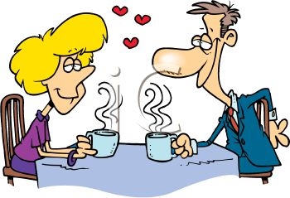
Mark wants a date for Friday night. He has asked out some women. Read their responses to his invitation and see who’s interested in going out with him, who’s not and who may be.
ALISON: Let me think about it, OK?
MIA: I’d love to. What time?
SUE: Can I get back to you about that later?
SACHIKO: I have to work late. How about another day?
ERIKA: Sorry, I’m sure I’m busy then.
DALIA: Hmmm. I’ll have to check my calendar.
SUN-HEE: Sure, sounds good.
JENNIE: I’m afraid I can’t. Thanks, though.

Slide 9
How should Mark respond? Match an appropriate response to each person. You may use a response more than once.
RESPONSES
Oh, OK. Maybe some other time.
Well, let me know if you’re free, then.
Sure, just let me know.
Great. How about 7:00?
What about Saturday?
ALISON: Let me think about it, OK?
MIA: I’d love to. What time?
SUE: Can I get back to you about that later?
SACHIKO: I have to work late. How about another day?
ERIKA: Sorry, I’m sure I’m busy then.
DALIA: Hmmm. I’ll have to check my calendar.
SUN-HEE: Sure, sounds good.
JENNIE: I’m afraid I can’t. Thanks, though.

Slide 10
What would you like to do on Saturday? Fill in the blanks and rank each of the ideas from 1 (most appealing) to 5 (least appealing).
IDEAS FOR SATURDAY | RANK (1 – 5)
GO TO A LECTURE ABOUT _______________________
SEE A ______________________ MOVIE
HAVE DINNER AT A __________________ RESTAURANT
GO TO A _________________ CONCERT
GO TO A _________________ GAME

Slide 11
Invitations
Walk around the class making and responding to invitations for the activities in your table.
Try to find one person who will do each activity with you.
Accept invitations only for your two favourite activities, and refuse the others politely.

Slide 12
Cancelling arrangements
Now imagine that your best friend has just invited you to a great party on Saturday.
Go back to the two people whose invitations you accepted before and cancel the arrangements.
Give an excuse (be creative in inventing one!), but don’t tell them about the party!
I’m really sorry, but I can’t…
I’m afraid I’m not going to be able to…
Sorry, something’s come up and…
What was the best excuse you’ve heard?

Slide 13
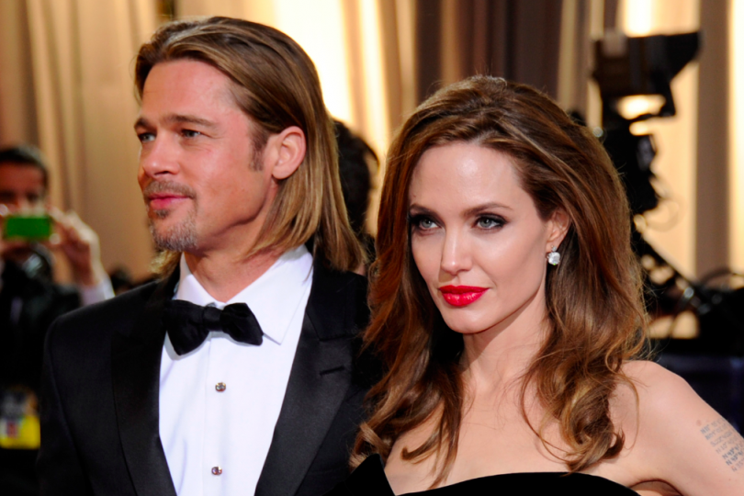
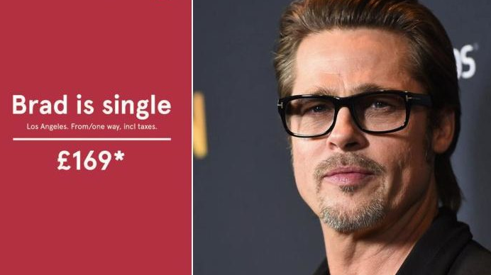
Commitment issues
You often hear people say ‘celebrity marriages never last.’
Why do you think celebrities are always breaking up?
Why do you think so many celebrities have unhappy love lives?
Do you know any celebrities in long, happy relationships?

Slide 14
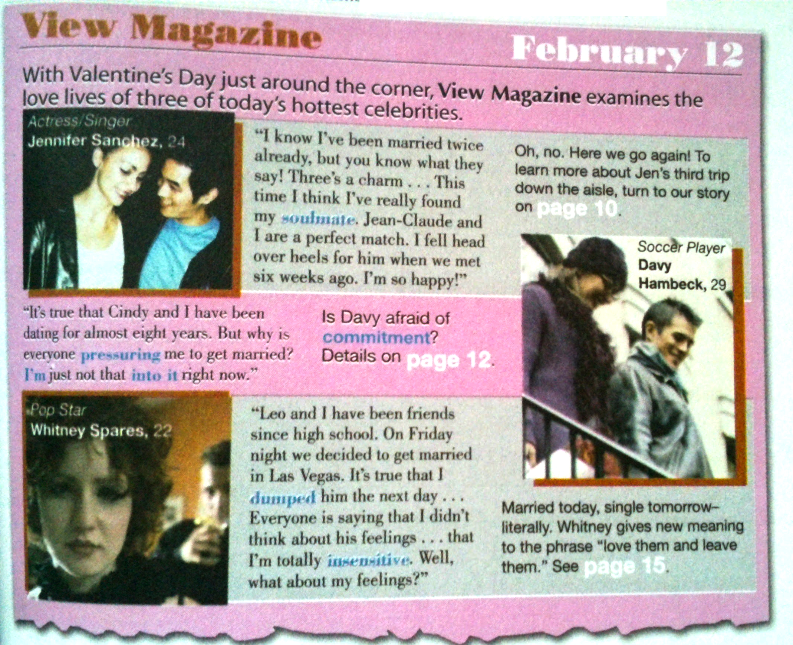
Read the magazine profiles on page 133. Pay attention to the words and phrases in blue. Then discuss the questions with your partner.
What do all three of these people’s love lives have in common?
If you had to use an adjective or two to describe each person, what would you use? Why?
What do the words in blue mean? Try to guess.

Slide 15
breaking up
What are different ways of breaking up with someone?
Which are the most common? Which are the least common?
Make a list with a partner and then share your ideas with the class.
What is the kindest way to break up with someone? Why?

