Slide 1
11
Chapter Seven
Advertising Design
信息策略和实施框架
Notes:
Chapter 7 addresses the second part of advertising design – message strategies and executional frameworks.

Slide 2
Chapter Objectives
11
广告设计
信息策略 and 实施框架
三种主要的信息策略是如何被用于增强广告的效果？
各种主要的实施框架是如何被用来帮助传递高质量的广告信息？
广告和电视宣传片中可以采用哪些类型的信源或代言人？
在选择信源或代言人时，需要考虑的最重要的特征有哪些？
信息策略
实施框架
发言人和代言人endorser
广告效果的原则
Notes:
These are the objectives for Chapter 7.

Slide 3
Message Strategies
Cognitive
Affective
Conative
Notes:
The message theme outlines the key ideas in an advertisement. It is a central part of the creative brief. The message then can be created using a number of different message strategies, which is the primary tactic or approach used to deliver the message theme. Message strategies can be divided into three main categories that correspond with the three components of attitude – cognitive, affective, and conative.

Slide 4
Message Strategies
Cognitive
Affective
Conative
Generic一般信息
Preemptive抢先信息
Unique Selling Proposition
Hyperbole夸张
Comparative对比
Notes:
A cognitive message strategy presents理性的论点或信息内容 rational arguments or pieces of information to consumers. 认知信息策略被设计来影响态度的认知构成，形成信念和知识。Cognitive message strategies are designed to influence the cognitive component of attitude, which deals with beliefs and knowledge. Cognitive message strategies can be divided into five types – generic, preemptive, unique selling proposition, hyperbole, and comparative.

Slide 5
一般信息 Cognitive Message Strategy
Notes:
一则广告直接指出产品的属性或利益，而不声称产品有什么优越性，那么它发送的就是一般信息。适用于领导者品牌。在特定品牌名和品类间建立认知联系，如Skechers和运动鞋。

Slide 6
抢先广告 Cognitive Message Strategy
抢先广告——在产品特定属性或利益的基础上声称自己更优越。这样做是为了阻止竞争对手做同样或类似的声明。

Slide 7
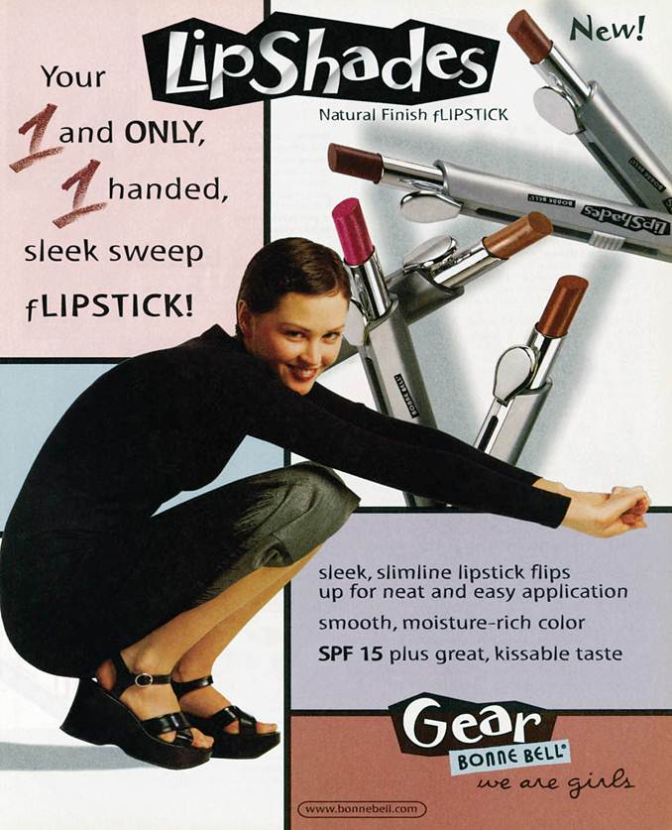
Unique Selling Proposition Cognitive Message Strategy
An advertisement by Bonne Bell using the unique selling proposition.
USP明确声称自己的产品独特或更优越，且该声称有证据支持。
Notes:
A unique selling proposition message strategy focuses on a testable claim of uniqueness or superiority. This ad for Bonne Bell says that its flipstick is the “1 and only 1 handed sleek sweep flipstick”. Such a claim is testable and as a result Bonne Bell must be able to support this claim.

Slide 8
夸张广告 Cognitive Message Strategy
无须验证的声明
不需要证明和具体化
流行的认知手法
Notes:
夸张认知策略是无须验证的生命an untestable claim based on some attribute or benefit. It does not require substantiation, which makes it a popular cognitive strategy approach. Notice in the ad says “I found something better” which is a hyperbole statement.

Slide 9
比较广告 Cognitive Message Strategy
直接或间接比较
真实或虚构的竞争者
优点：获取注意力
品牌关注可以增加
信息关注可以增加
缺点：不太相信，负面态度
负面对比广告Negative comparative advertisement
自发特质推理Spontaneous trait transference
小心选择比较
Notes:
A comparative cognitive message strategy focuses on a direct or indirect comparison to a competing brand. The brand can be real, mentioned, or fictitious. The advantage of comparative ads is that they tend to capture attention. Brand awareness and message awareness tend to be higher. The negative is that they can be less believable and can create a negative attitude. This is most likely to occur when a negative comparison approach is used in the ad, downgrading the competing brand. If the consumer does not believe the ad, then spontaneous trait transference can occur, which is placing the negative trait on the advertised brand instead of the competitor. It is important to choose competitors wisely in making comparisons.

Slide 10
Message Strategies
Cognitive
Affective
Conative
共鸣Resonance
情感Emotional
Notes:
Advertisements that invoke feelings or emotions are affective message strategies. These messages attempt to enhance the likeability of a product, recall of the message, and comprehension of the message. The two types of affective message strategies are resonance and emotional. Resonance advertising connects a product with a consumer’s experiences from the past in order to develop a bond with the brand. Often, advertisers will use music from that generation to create that emotional bond. Emotional messages attempt to elicit emotions that will lead to product recall and choice. Many different emotions can be connected with a product. Emotional messages are used in both consumer and business-to-business advertising. Affective message strategies help develop brand equity through creating an emotional bond with the brand.

Slide 11
情感信息策略
Invoke feelings or emotions
Attempts to enhance likeability
Resonance Advertising
联结消费者的经验
Comfort advertising & marketing
Emotional Advertising
感情导向回忆和选择lead to recall and choice
Consumer and b-to-b markets
Leads to positive feelings
Notes:
Affective message strategies invoke feelings or emotions with the goal of enhancing likeability, recall, and comprehension. Affective strategies can be resonance or emotional. Resonance advertising connects a brand with a consumer’s experience. A new form of resonance advertising is comfort advertising鼓励消费者购买一个品牌而不是一般产品，因为品牌经历了时间的考验，让消费者安心舒适. Emotional advertising elicits powerful emotions that lead to recall and choice. Used in both consumer and b-to-b markets. Emotional advertising can lead to more positive feelings about a brand.

Slide 12
Advertisement by Cheerios using a resonance, affective message strategy.
Notes:
有比与心脏病作斗争更好的事情等着你的心去做。
This ad for Cheerios is an example of resonance advertising. It shows the emotion of a 3-generation family.

Slide 13
Message Strategies
Cognitive
Affective
Conative
Action-inducing
Promotional support
Notes:
Conative message strategies are designed to lead directly to some type of action or response. 鼓励消费者采取某种行动，做某事。 Promotional support conative messages 绑定促销案例，可以是折扣券、竞赛或者抽奖。

Slide 14
An advertisement for Cub Cadet encouraging immediate action!
Notes:
This ad for Cub Cadet uses a conative message strategy because it encourages consumers to make an immediate purchase.

Slide 15
F I G U R E 7 . 2
The Hierarchy Of Effects Model and Message Strategies
Cognitive
Strategies
Awareness
Knowledge
Affective
Strategies
Liking
Preference
Conviction
Conative
Strategies
Purchase
Notes:
信息策略 对应于 态度组成 correspond to the components of attitude, they can be matched with the different stages of the hierarchy of effects model. Cognitive strategies deal with awareness and knowledge. Affective strategies deal with emotions and the stages of liking, preference, and conviction. Conative strategies encourage action and match the purchase phase of the model.

Slide 16
实施 框架
F I G U R E 7. 3
动画
Slice-of-life
Testimonial
Authoritative
Demonstration
Fantasy
Informative
Notes:
广告诉求的呈现方式，是在广告诉求选定后才选择的。七种诉求都配以恰当的实施框架。signifies the manner in which an advertising appeal will be presented. It should be chosen in conjunction with an advertising appeal and a message strategy. There are 7 different executions that can be used. While almost any execution can be used with any appeal and message strategy, there are logical combinations and there are some combinations that do not work well together. For instance, a common combination would be emotional appeal, affective message strategy, and slice-of-life execution. A combination that would be difficult to pull off would be rational appeal, affective message strategy, and demonstration execution.

Slide 17
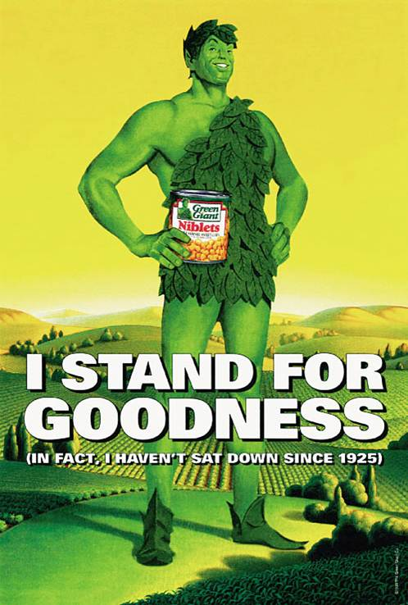
Animation
最初就是便宜的方式
Usage has increased
Enhanced graphics technology
Rotoscoping
Costs coming down
Business-to-business use
Notes:
不用演员使用动画。Animation was originally a cheap way to advertise. Companies that could not afford actors, used animation. Its usage has increased and is often now a chosen method of advertising. The skill and quality of animation has improved greatly in the last 20 years. One technique, known as rotoscoping, involves drawing animated characters into scenes with live characters. It also can be used to merge live video scenes to make it look like it really happened or all occurred at the same time. The costs of animation have come down in recent years which makes it more appealing to advertisers. It is now used even for B-to-B advertising.

Slide 18
Components of a Slice-of-Life Ad
F I G U R E 7. 4
Solution
Interaction
Problem
Encounter
Notes:
The slice-of-life execution was made popular by Procter & Gamble in the 1950s. The basic premise is the introduction of a problem that a product solves. Slice-of-life has four distinct stages. It opens with an encounter between people or with a situation. A problem occurs. Then there is interaction, which can be a voice-over or conversations between two people. Then comes the P & G product that solves the problem. The typical detergent scenario is of a child’s uniform getting dirty and now it is not available for the championship game. The mother interacts with a neighbor who recommends Tide or Cheer and the uniform is clean. All are happy as the child runs out onto the field in a clean uniform.

Slide 19
Slice-of-life
A business-to-business print advertisement using a slice-of-life executional framework.
The text asks:
“If the average single female breaks up with 4.3 men, avoids 237 phone calls and ignores 79 red lights per year - What are the chances she’ll read your e-mail message?”
Notes:
This is a business-to-business ad using a slice-of-life execution. It shows the encounter of how many times a female breaks up then comes the interaction – what are the chances she will read your e-mail? The solution to the problem, of course, is MessageMedia. 打破杂乱信息送达目标对象。It will break through the clutter to your female target market.

Slide 20
Testimonials
B2B购买的供应商
服务领域
Enhance credibility
Source
客户Customers
付费的演员Paid actors
Notes:
Testimonials are used in the business-to-business sector, also the service sector. Testimonials involve customers giving testimonies about a product or service. Testimonies can enhance the credibility of a product. The testimonies can be given by real customers or by paid actors. Real customers are more believable, but lack polish for a TV ad. Paid actors sometimes look like paid actors, and the testimony benefits are lost.

Slide 21
Testimonials
Use of the testimonial execution by Diamond Security.
Notes:
This TV ad for Diamond Security uses a policeman as the initial spokesperson. Because he uses Diamond Security for his home and he is a police officer, he has a higher level of credibility.

Slide 22
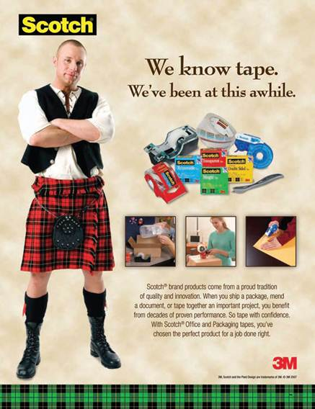
Authoritative
Expert authority
Scientific or survey evidence
独立证据
Business-to-business ads
Cognitive processing
对于印刷媒体特别有效
Notes:
When using the authoritative execution, advertisers seek to convince consumers of the product’s superiority. The most common approach is to use some type of expert authority, such as a doctor, dentist, lawyer, or electrician. Scientific evidence or even survey evidence can be used to support the claim. It works best if the evidence is independent, such as J.D. Powers & Associates or Consumer Reports. The authoritative approach is used in business-to-business ads, especially in trade journals. Authoritative executions rely on cognitive processing of the information, so work best with print media where copy can be supplied.

Slide 23
Demonstration
Shows product being used
Business-to-business sector
电视、互联网还有售点户外
Notes:
A demonstration execution shows how a product works. A demonstration is an effective way to communicate the benefits of a product to viewers. It is used in business-to-business advertising to show how a product can meet the needs of a business. It works best for television and the Internet.

Slide 24
Beyond reality
Common themes
Sex
Love
Romance
Perfume/Cologne
Fantasy
Notes:
Fantasy executions lift the audience beyond reality to a world of make-believe. Some are meant to be realistic, but most are fantasies that are irrational and would never really happen. The most common themes for fantasy executions are sex, love, and romance. As a result it works well for perfume and cologne. It also works well for clothing and vacation destinations. A few business-to-business ads have featured fantasies, but the danger is that customers will not take the business firm seriously.

Slide 25
Informative
广泛使用于广播extensively
Business-to-business usage
Key is buying situation
Level of involvement
Notes:
Informative executions present information to the audience in a straight-forward manner. It is used extensively in radio, often by DJs. Informative ads are less common in television and in print. Informative ads are common with business-to-business. The key to whether individuals pay attention is the buying situation. If someone is looking for a particular product, then they may notice the informative ad. Level of involvement is important. Consumers and business buyers have to be involved at the time to notice informative ads. Placement is also important. Ads placed next to an article on the topic are more likely to be noticed.

Slide 26
信源及代言人
Celebrities
CEOs
Experts
Typical persons
Source
Notes:
Selecting the right source and spokesperson for an advertisement is a critical decision. Advertisers have four choices – celebrities, CEOs of companies, experts from various fields, and typical persons.

Slide 27
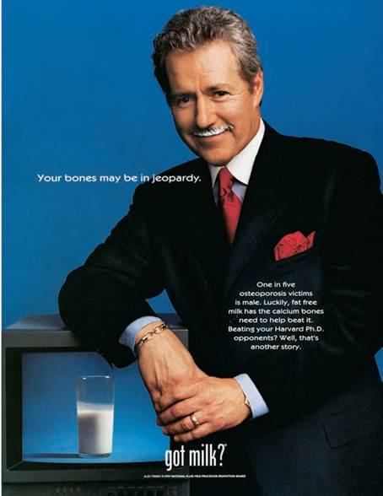
Celebrity Spokespersons
Most common
Featured in 6% of ads
Enhance brand equity
Create emotional bonds
More effective with younger consumers
Athletes popular
Establish brand personality
Notes:
The most common type of spokesperson is the celebrity. They are featured in about 6% of all ads. A celebrity can enhance brand equity and create emotional bonds with the brand. Celebrities are more effective with younger consumers than with older individuals. Athletes are a popular category of spokespersons. Celebrity spokespersons can be used to establish a brand’s personality.

Slide 28
Additional Celebrity Endorsements
无偿代言
高可信度的原因（慈善）causes
名人旁白
声音质量
声音识别
分散受众注意力
已故名人代言endorsements
Somewhat controversial
Becoming more common
Notes:
Three additional categories of celebrity endorsements are: unpaid spokespersons, celebrity voice-overs, and dead-person endorsements. Unpaid celebrity endorsements will sometimes occur with a charity or cause. When celebrities endorse a cause and are not being paid for the endorsement, they carry a high level of credibility. Celebrity voice-overs are used because of the quality of their voice. Sometimes it is because the voice can be recognized and will influence consumers. At other times the voice-over is a distraction because consumers pay too much attention to the voice and don’t hear the brand message. The last category, dead celebrities is somewhat controversial. It is becoming more common because they can’t bring negative publicity to themselves or the brand.

Slide 29
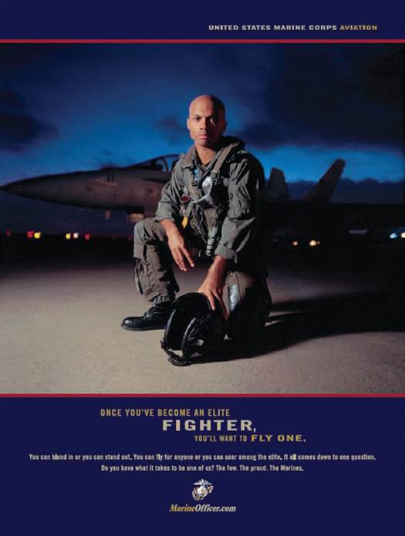
Spokespersons
CEOs
Highly visible and personable
Can be major asset
Used by local companies
Experts
Expert in their field
权威形象
Typical persons
Paid actors
Typical, everyday people
Notes:
CEOs can be used as spokespersons. They work well if they are highly visible and personable. They can be a major asset to a company. They work especially well for local companies where consumers in that area know them personally, or at least have met them. Expert spokespersons should be experts in their fields. They then serve as an authoritative figure and can provide expert opinions. The last category is typical persons. It can be either paid actors who portray a typical person, or it can be everyday, ordinary people.

Slide 30
F I G U R E 7 . 6
代言人有效的特征
可信度
吸引力
相似性
喜爱程度
可信赖
专业水平
Notes:
In evaluating sources, companies and ad agencies consider several characteristics. The effectiveness of the spokesperson depends on his/her degree of credibility. The level of credibility is determined by five factors – attractiveness, trustworthiness, similarity, expertise, and likability.

Slide 31
可信度 Source Characteristics
Derived from other five characteristics : attractiveness, trustworthiness, similarity, expertise, and likability
决定了个体接受信息程度Acceptance of individual and message
代言人是可信的
Most sources do not score high in all characteristics
Celebrities most likely to possess all characteristics
Notes:
Source credibility is derived from five characteristics: attractiveness, trustworthiness, similarity, expertise, and likability. Credibility determines the level of acceptance of the individual and his/her message. Credibility translates into the spokesperson being believable. Most sources do not score high on all of the dimensions. Celebrities are the most likely to possess all of the characteristics, at least to some degree.

Slide 32
Attractiveness Source Characteristics
外表Physical attractiveness
人格Personality attractiveness
Notes:
Attractiveness deals with both physical attractiveness and personality attractiveness. To be attractive, the spokesperson needs both. Someone who is physically attractive, but has a rotten personality will not be a good spokesperson. Individuals who are physically attractive will be seen as more credible than less attractive people.

Slide 33
Similarity Source Characteristics
相似性 Closely related to attractiveness
形成认同Allows for identification
Source has similar beliefs or attitudes
Preferences or behaviors similar
Aspiration similarity
Females can identify with Anna Roberts since most jockeys are male.
Notes:
Similarity is important, and closely related to attractiveness. Similarity allows for identification with the spokesperson. Identification can come from having similar beliefs, attitudes, preferences, or behaviors. Sometimes it comes from aspirations, something a consumer wants to be or has dreamed of being. Anna Roberts in this ad is seen as being similar to many females because of her gender, but also because many females like horses and some probably even dreamed of being a female jockey when they were growing up.

Slide 34
Likeability Source Characteristics
Consumers respond to sources they like
May like role an actor plays
May like an athlete because on favorite team
May like source because supports favorite cause
名人的厌恶也会转嫁到品牌Transfer of dislike to brand being endorsed
Notes:
Closely related to attractiveness and similarity is likeability. Consumers respond to sources they like. That likeability can be derived in a number of different ways. If it is an actor, it may be the role they play in a TV show or movie. If it is an athlete, it may be one of their favorite players or he/she plays for their favorite team. It may be that the source supports the consumer’s favorite charity. If someone likes the source, then that liking will usually transfer to the brand being endorsed. But, if for some reason an individual does not like a spokesperson, then that dislike will transfer to the brand also.

Slide 35
Trustworthiness Source Characteristics
Not all spokespersons are viewed trustworthy
对代言人所说的广告信息信任或认可的程度
Helps consumers believe message
Likeability and trustworthiness related
Notes:
Not all celebrities or spokespersons are viewed as trustworthy. Trustworthiness is the consumer’s degree of confidence in or acceptance of a spokesperson. Trustworthiness enhances the ability for a consumer to believe the message. Likeability and trustworthiness or closely related.

Slide 36
Most Trusted Celebrities
F I G U R E 7. 7
Betty White
Denzel Washington
Sandra Bullock
Clint Eastwood
Tom Hanks
Harrison Ford
Morgan Freeman
Kate Middleton
Will Smith
Johnny Depp
Source: Adapted from “Betty White Voted America’s Most Trusted Celebrity: Poll,” Reuters, August 18, 2011, www.reuters.com/assets/print?aid=USTRE77H2WE20110818
Notes:
List of most trusted celebrities.

Slide 37
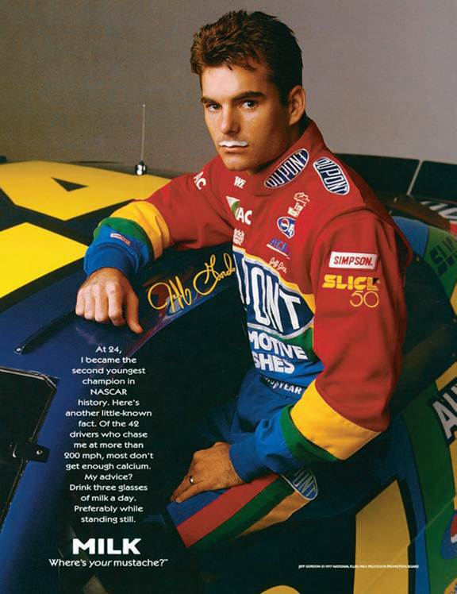
Expertise Source Characteristics
Higher expertise
Higher credibility
Notes:
Spokespersons with higher levels of expertise are viewed as being more credible. Expertise is often connected to a person’s livelihood or occupation. Jeff Gordon would be seen as an expert on products dealing with cars. He may not be seen as much of an expert for milk. But, his other characteristics may overcome a lower score on expertise, in terms of milk.

Slide 38
Matching Source Types and Characteristics
Celebrities
Tend to score high in credibility
Negative publicity
Endorsement of too many products
CEO
Trustworthy, expertise, and some credibility
Must exercise care in selection
Expert
Seek experts who are attractive, likable, trustworthy
有效降低消费者所感知的风险
Typical person
Multiple typical persons increase credibility
Real-person
Actor
Notes:
In choosing a spokesperson, it is important to match source types with characteristics. Celebrities tend to score high in credibility because they often score high on the other five dimensions. The risk is negative publicity and the endorsement of too many products, which lessen credibility. CEOs are typically seen as having high levels of trustworthiness, expertise, and credibility. But, not all are good on camera so an agency must exercise care when selecting CEOs. For experts, seek experts who are attractive, likable, and trustworthy. Valid credentials are important. For typical persons, using multiple typical persons in an ad increases credibility. Using 3 customers to talk about a product may better than using just one. Real people are good to use, but may not be good on television and the ad may come across poorly. Using actors helps because they are good at acting and learning lines. But, they may not appear to be real.

Slide 39
F I G U R E 7 . 8
Creating an Advertisement
Notes:
This figure illustrates the process a creative may use in designing ads. The means-end chain is at the center and is developed from information provided in the creative brief. While a creative may not draw a means-end chain out as was illustrated in this text, the creative will consider the product’s attribute, benefits, and the values it can fulfill. Decisions then must be made about the leverage point, the appeal, the message strategy and the execution. Finally, if a spokesperson is going to be used, the agency and client will need to decide who it will be.

Slide 40
F I G U R E 7 . 9
Principles of Effective Advertising
视觉连贯性
活动持续时间
重复广告口号
一致定位，避免模糊
简单
可识别的卖点
有效流畅地呈现广告
Notes:
Producing effective ads requires the joint efforts of the client and agency personnel. This slide lists some important principles to follow. Visual consistency across ads and across campaigns allows consumers to quickly identify an advertisement and a brand. Campaign duration is always an issue. From a cost perspective, clients want a campaign to last a long time. But, wear-out occurs and then ads are ignored. Timing for new campaigns is difficult to determine. Taglines repeated in ads helps tie campaigns together and identify a brand. It is important to use consistent positioning to avoid ambiguity and confusion. If at all possible, keep it simple. Use only one identifiable selling point. Don’t overwhelm consumers with too much information or too many benefits. Lastly, create ads that flow and are visually appealing.

Slide 41
F I G U R E 7. 10
Which Taglines Can You Identify?
Finger Lickin’ Good
Think Small
Between Love and Madness Lies Obsession
Save Money, Live Better
Innovation
Connecting People
I’m Lovin It
A Diamond is Forever
Have It Your Way
Buy It. Sell It. Love It.
Notes:
Taglines are important ways to make a brand memorable and to proclaim a product’s image or primary benefit. How many of these taglines can you identify? Answers are at the bottom of the slide. Answers: 1. KFC, 2. Volkswagen, 3. Calvin Klein, 4. Wal-Mart, 5. 3M, 6. Nokia, 7. Mc Donald’s, 8. DeBeers, 9. Burger King, 10. Ebay.

Slide 42
Beating Ad Clutter
Presence of competitor ads
Repetition
Variability Theory
Multiple mediums
Notes:
将广告放到不同情境中，变异理论variability theory. 变异理论增加了回忆和有效的信息编码。使用多种不同媒体投放广告也会有效，但是需要与TA媒介选择一致。

Slide 43
International Implications
Match culture of region
Comparison ads less common
Message strategy effects execution
Soft sell preferred in Japan
Notes:
The message strategy and execution chosen for an advertising campaign needs to match the culture. For instance, in many countries comparison ads are less common and not well received due to both social and cultural differences. It is important to make sure the message strategy fits the execution. For instance, in Japan a soft sell works best. Any type of execution that comes across as a hard sell will offend many Japanese.

Slide 44
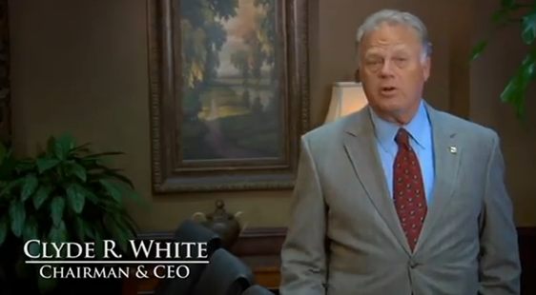
Ouachita Independent Bank (Part 7)
ClowBaack – Integrated Campaigns in Action
Attractiveness
Similarity
Likeability
Trustworthiness
Expertise
Credibility
Notes:
Discuss with students the concept of credibility of a spokesperson. Discuss the factors of attractiveness, similarity, likeability, trustworthiness, and expertise. Students will differ on how they evaluate Clyde White on these characteristics. You may also have them think about a person who is 40 or 50 and lived in the community for the entire life. Would their evaluations of credibility be different?

