Slide 1
SCIENCE AND TECHNOLOGY

Slide 2
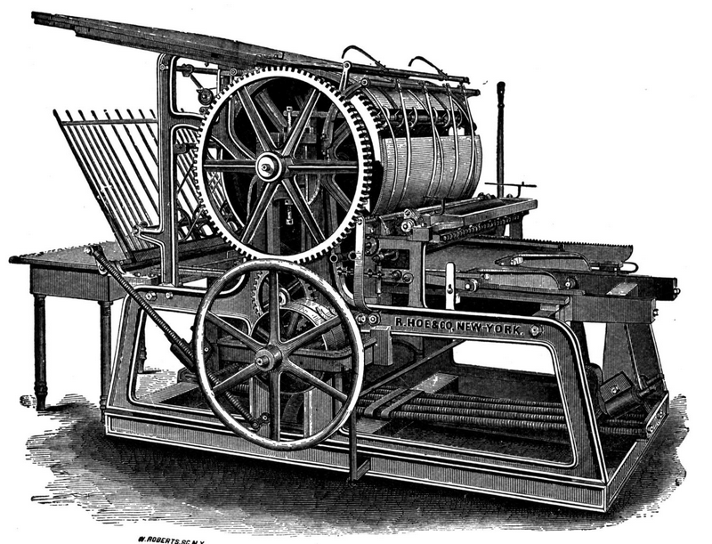
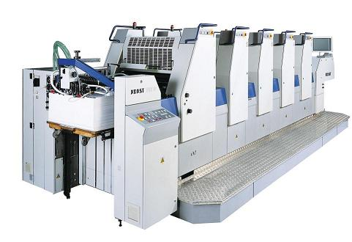
The development of technology can you recognise these pieces of technology? How have they changed over time?

Slide 3
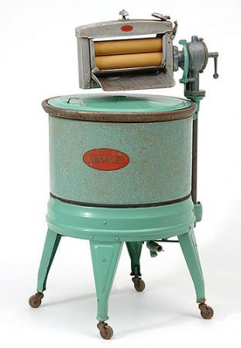
The development of technology can you recognise these pieces of technology? How have they changed over time?

Slide 4
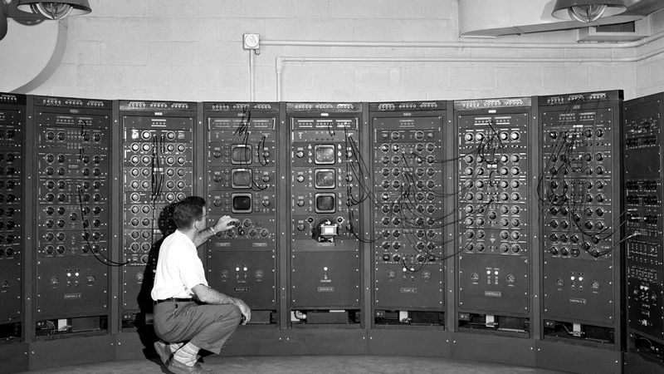
The development of technology can you recognise these pieces of technology? How have they changed over time?

Slide 5
Tell your classmates what PIECE OF TECHNOLOGY is the most important one in your life, and why. It can be anything – your phone, computer, watch, washing machine...

Slide 6
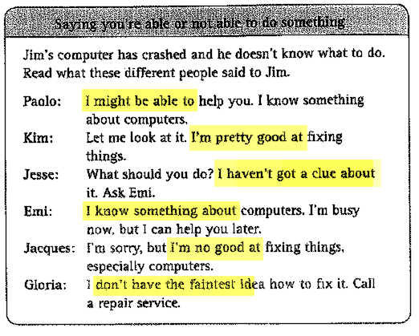
Read the situation below. Pay attention to the expressions in yellow. Who should jim go to for help?

Slide 7
Find someone who...
… might be able to change a tire
… is pretty good at typing on an English keyboard
… is pretty good at golf
… has tried scuba diving
… knows something about computers
… is really good at karaoke
… is great at cooking Italian food

Slide 8
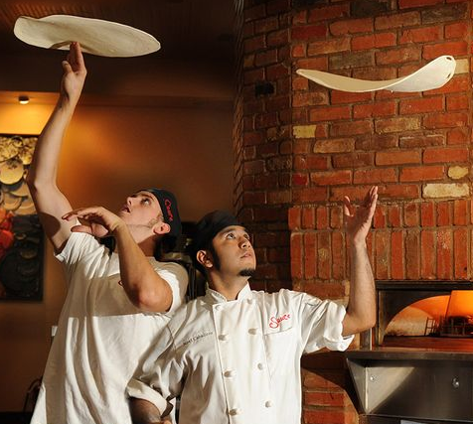
what are you really good at?
Interview your classmates, and find out what they are really good at!
Ask about these details:
when they learnt it
how long it took them to learn it
how they learnt it (from a friend, in a course, ...)
why they chose this particular skill
... and anything else you may be curious about!

Slide 9
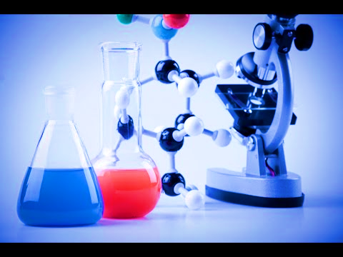
In science and technology we speak about...
DISCOVERIES
and
INVENTIONS
... what is the difference?

Slide 10
can you name any... ... IMPORTANT DISCOVERIES? ... IMPORTANT INVENTIONS?

Slide 11
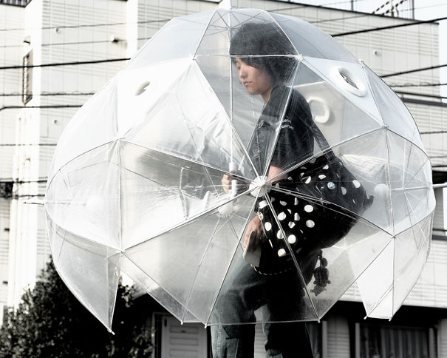
What about these inventions? What do you think they’re good for?

Slide 12
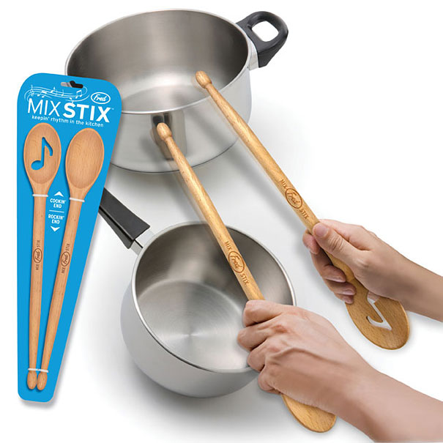
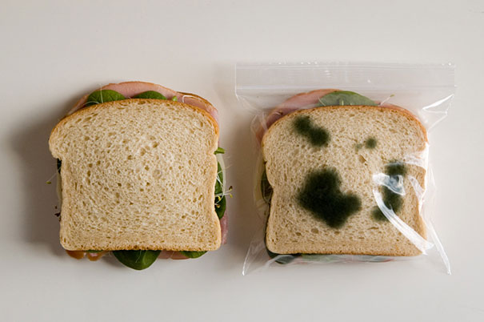
What about these inventions? What do you think they’re good for?

Slide 13
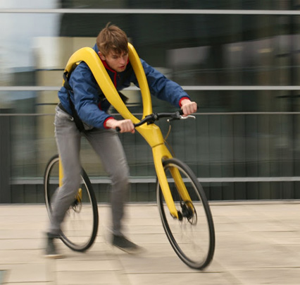
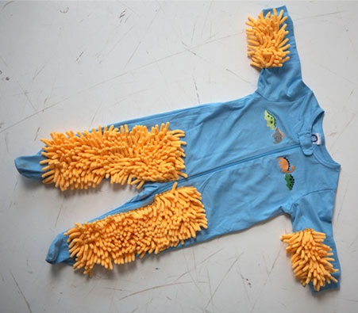
What about these inventions? What do you think they’re good for?

Slide 14
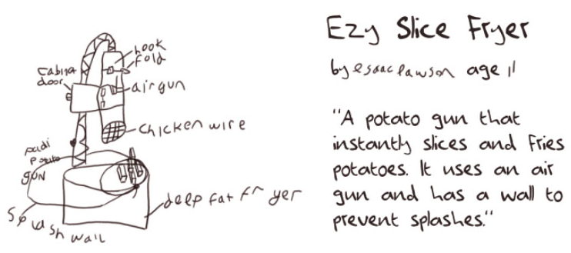
now you invent something new!
try to invent a COMPLETELY NEW PIECE OF TECHNOLOGY that could make your life easier or more fun
give it a name
you can try to draw it
describe its functions
USE YOUR IMAGINATION

