Slide 1
Academic reading
reading journal articles

Slide 2
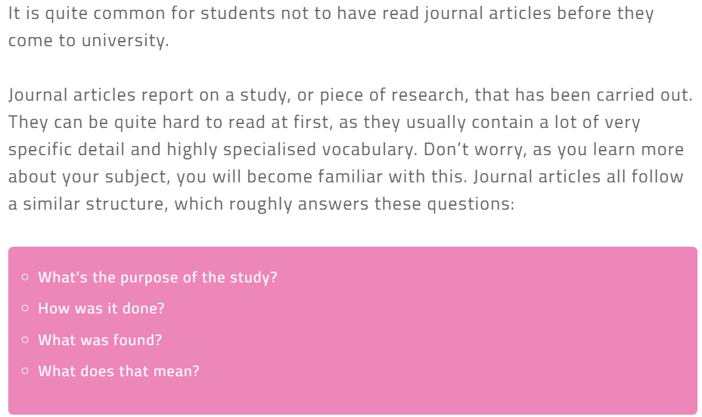

Slide 5
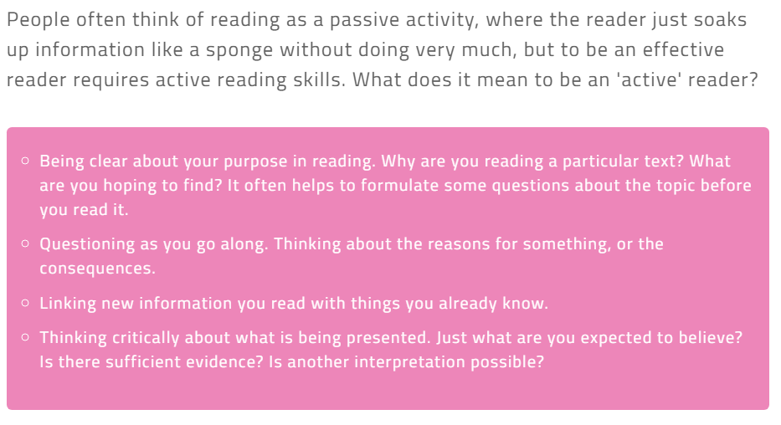

Slide 6
