Slide 1
SPORTS

Slide 2
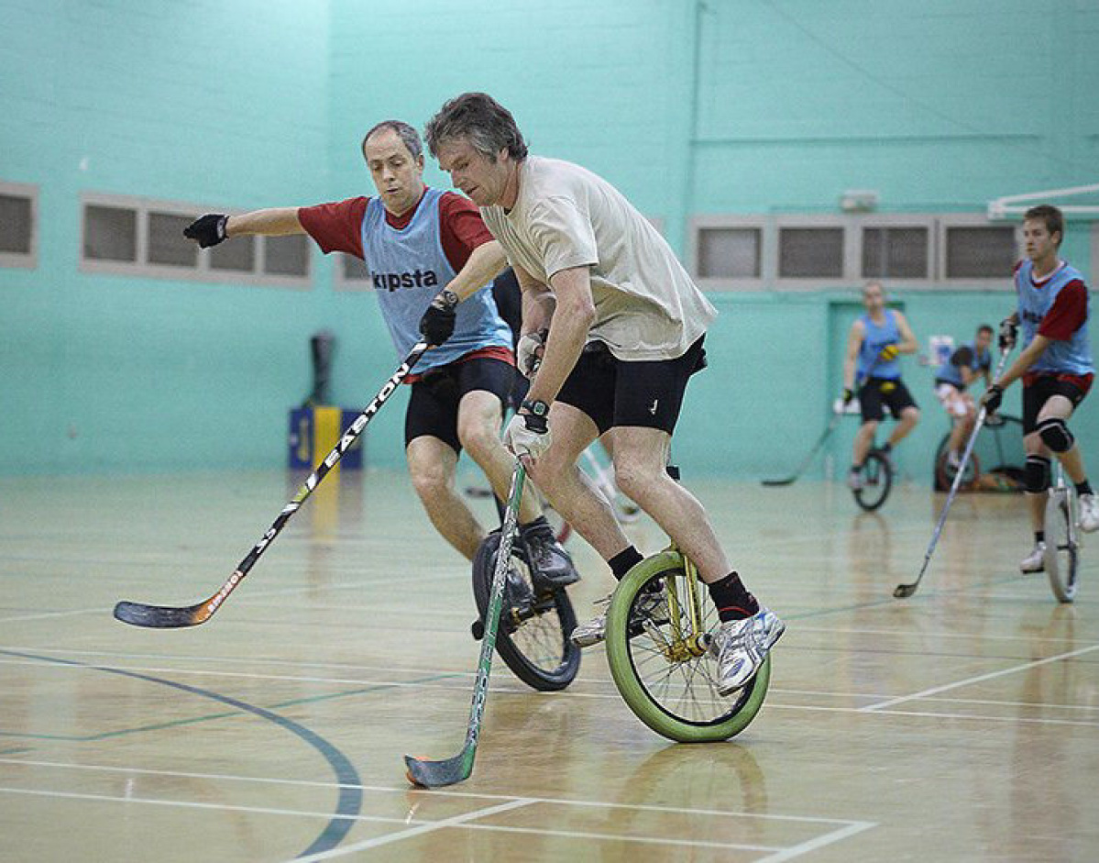
What do you think this sport is? What is the participators’ goal? Would you like to try it?

Slide 3
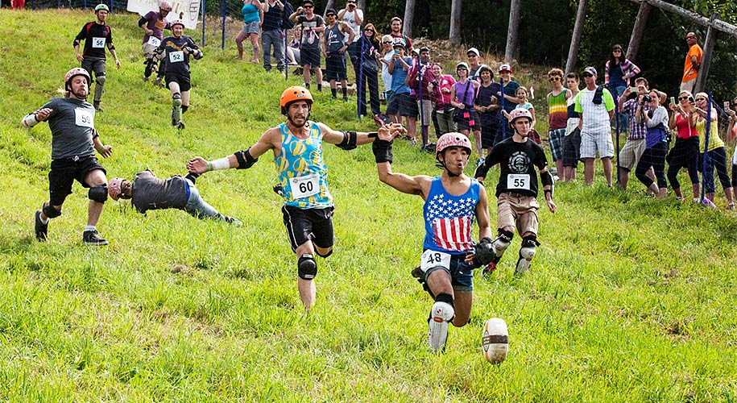
What do you think this sport is? What is the participators’ goal? Would you like to try it?

Slide 4
Do you know these sports?

Slide 5
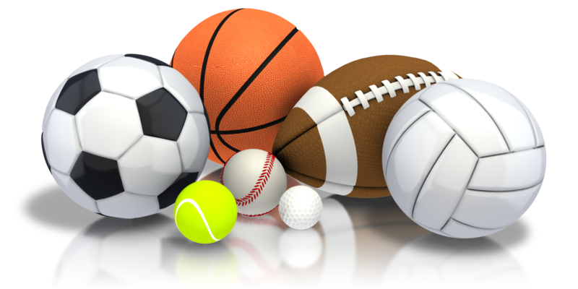
What sport do you like doing? What sport do you like watching? Tell your classmates.

Slide 6
PLAY, DO OR GO?
Play + (sport) … for competitive team sports with an object (ball, puck…)
Do + (sport) … for sports which are done in one place
Go + -ing … for sports which involve movement from place to place
Give examples!

Slide 7
Where can we do sports?

Slide 8
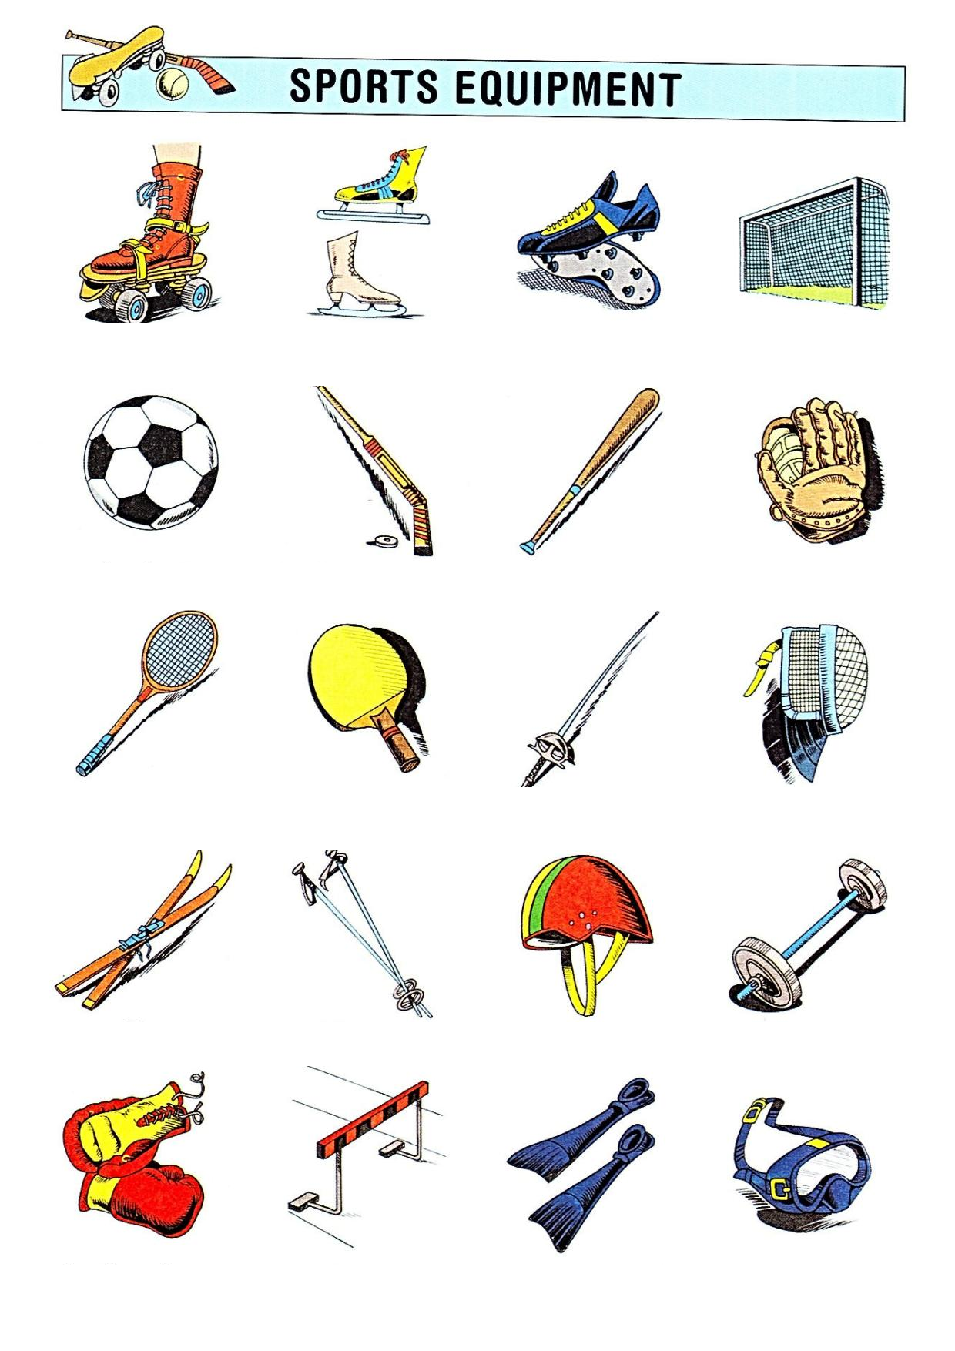
What equipment do we need to do sports?
Baseball bat
Boxing gloves
Diving mask
Football
Football boots
Foil
Fencing mask
Flippers
Goal
Glove
Helmet
Hurdle
Ice hockey stick
Ice skates
Roller skates
Tennis racket
Table tennis bat
Skis
Ski sticks
Weight

Slide 9
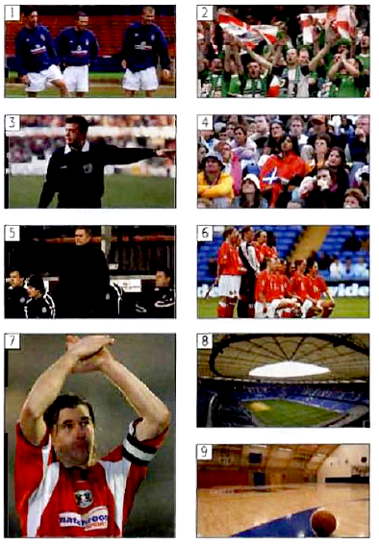
Match the words and pictures
captain
coach
fans
players
referee
spectators
team
stadium
sports hall

Slide 10
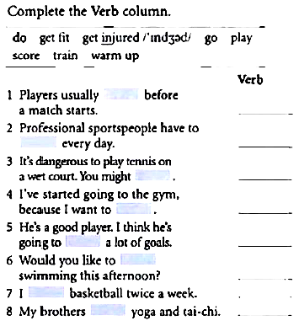
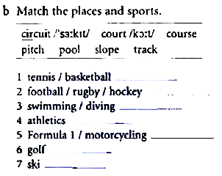

Slide 11
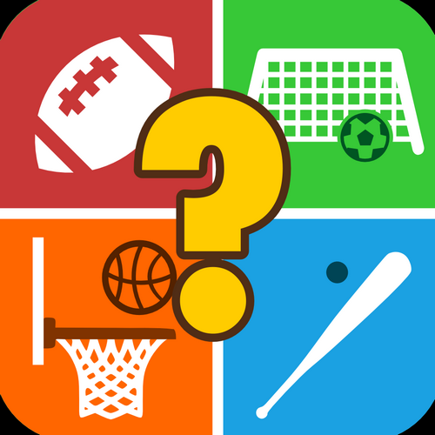
SPORTS QUIZ!
played in teams (pairs or groups)
there will be 10 questions
write your answers down
at the end, the teacher will tell you the correct answers
the team with the highest number of correct answers wins!

Slide 12
Question 1
Which is the only Grand Slam tennis tournament played on grass?

Slide 13
Question 2
Where was the game of golf invented?

Slide 14
Question 3
Name a water sport that is only done by women.

Slide 15
Question 4
What do the five interlinked Olympic rings on the flag represent?

Slide 16
Question 5
Which sport has four different colour codes for the balls, depending on the speed of the ball?

Slide 17
Question 6
Name three sports where gloves are worn.

Slide 18
Question 7
What do you call the special glasses you wear for swimming?

Slide 19
Question 8
What do Americans call the game that in the UK is called ‘football’?

Slide 20
Question 9
How long is a marathon?

Slide 21
Question 10
Which two British universities race against each other in an annual boat race?

Slide 22
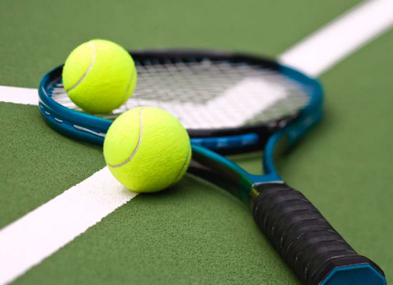
VOCABULARY TENNIS
word-association game
played in pairs or groups of three
the teacher starts the game, giving one word related to sports; e.g. football
the students then alternate to say words that are associated with one another: e.g. (football) – referee – players – team – match...

Slide 23
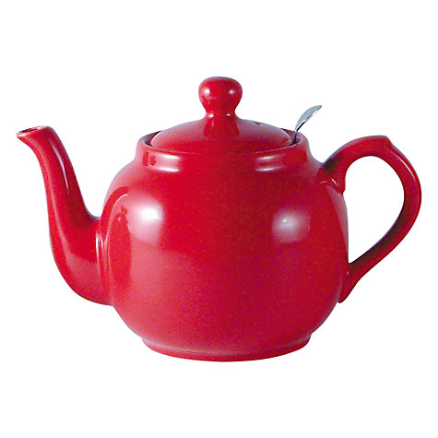
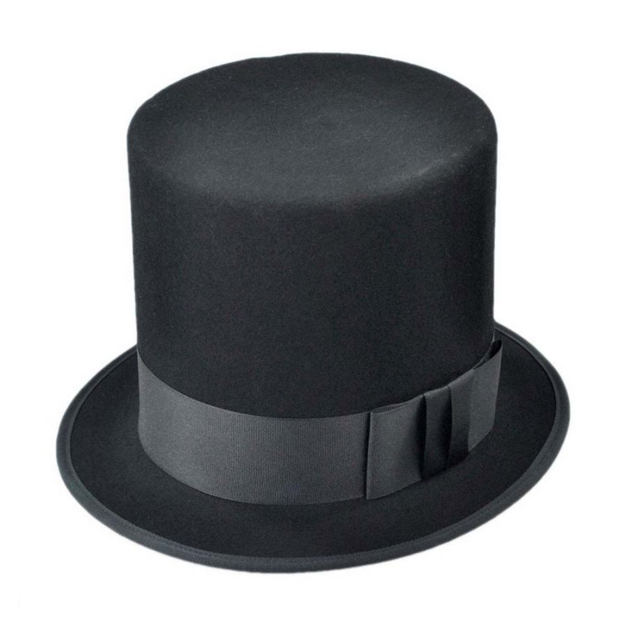
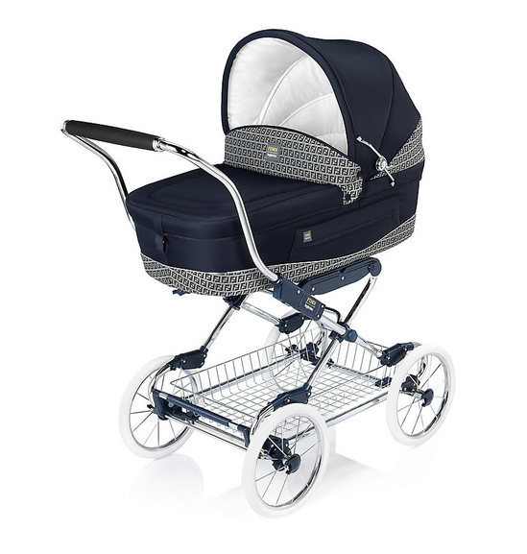
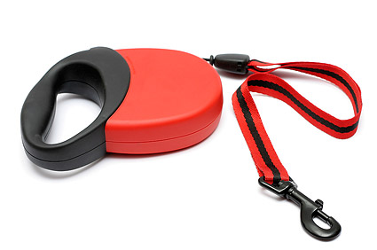
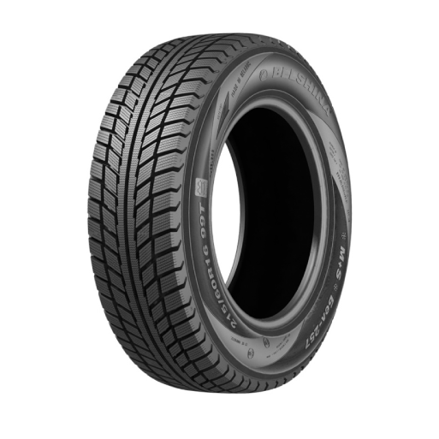
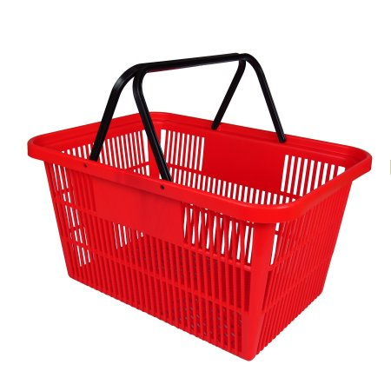
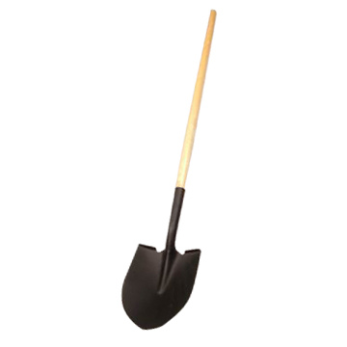
Invent your own sport! Choose two or three of these objects, use them in your sport, write down the name of your sport, its rules, number of players, the goal… Use your imagination!
teapot
top hat
pram
dog leash
tyre
shopping basket
paint
shovel

