Slide 1
Personality
PERSONALITY AND Compound nouns

Slide 2
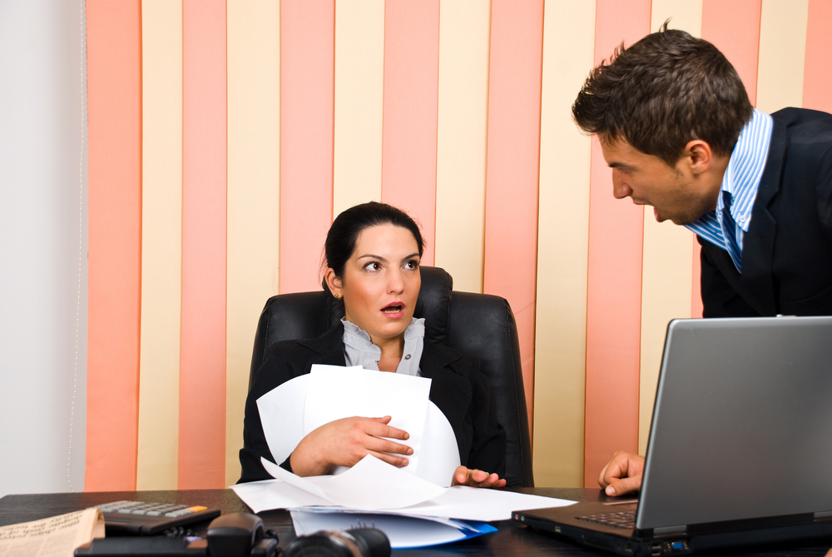
Who do you think are these people? What might their character be?

Slide 3
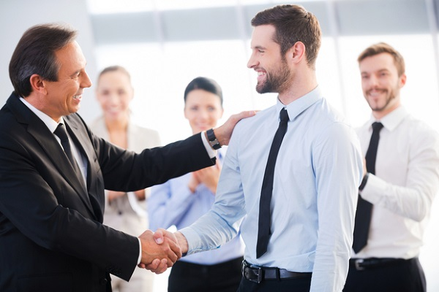
What are some characteristics that make someone a good employee?
You can use these adjectives in addition to your own. What do they mean?
thorough
productive
motivated
energetic
creative
sincere

Slide 4
Look at the words describing personalities (left). Match them with definitions (right).
early riser
hothead
pushover
go-getter
team player
risk taker
overachiever
control freak
works harder than necessary to succeed
is a very ambitious person
gets angry easily
likes to give orders
gets up early
is easily manipulated by others
tries to cooperate with other people
likes to try new things and isn‘t afraid of danger

Slide 5
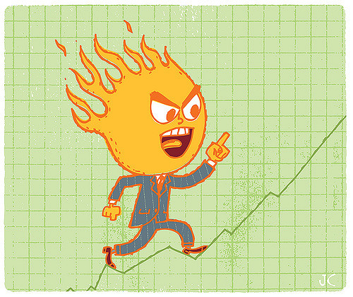
Look at the words again and discuss these questions: Do any of the words describe you? Are they positive or negative traits?
early riser
hothead
pushover
go-getter
team player
risk taker
overachiever
control freak

Slide 6
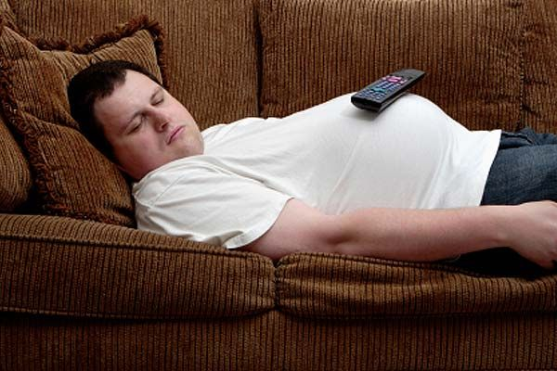
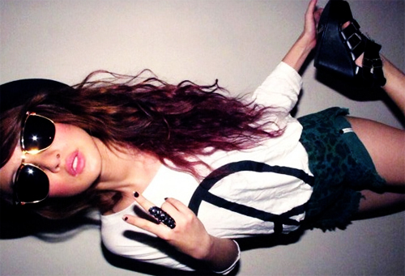
Opposites attract
Look at the photos of Sandra and Ali and then at the words below. Which words could be used to describe each of them?
homebody
heartbreaker
early riser
free spirit
night owl
Sandra
Ali

Slide 7
All of the words we’ve just discussed are called compound nouns.
What are compound nouns?
Find some compound nouns in this piece of text:
Anita dreams of becoming a tour guide. But now she is just a university student and has to do a lot of homework. That is why she only has a part-time job: in her spare time she works as a baby-sitter.
There are three ways of writing compound nouns. They can be:
separate words
hyphenated
one word
Give your own examples of compound nouns! Compound noun race.

Slide 8
Complete the sentences. Match the types of people with the correct definitions.
Role model
Follower
Loner
Pessimist
Problem solver
Born leader
Optimist
Know-it-all
A(n) _________ feels positively about the future.
A(n) _________ feels negatively about the future.
A(n) _________ tries to find solutions.
A(n) _________ acts as an example to others.
A(n) _________ thinks he or she has all the answers.
A(n) _________ prefers to be alone.
A(n) _________ follows the crowd.
A(n) _________ guides or directs others naturally.

Slide 9
WHO CAN BE A ROLE MODEL? WHO’S YOUR ROLE MODEL?

Slide 10
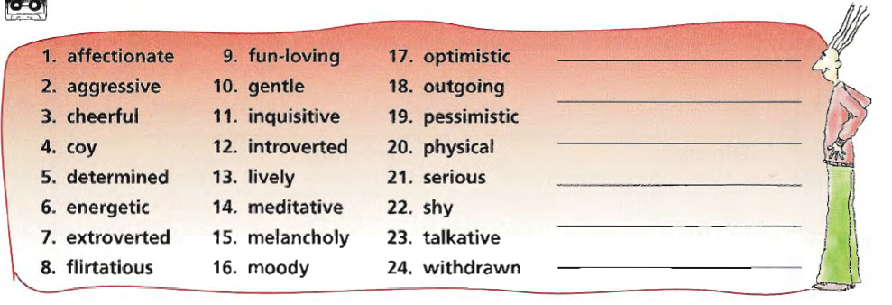
Good or bad?
Good | Bad

Slide 11
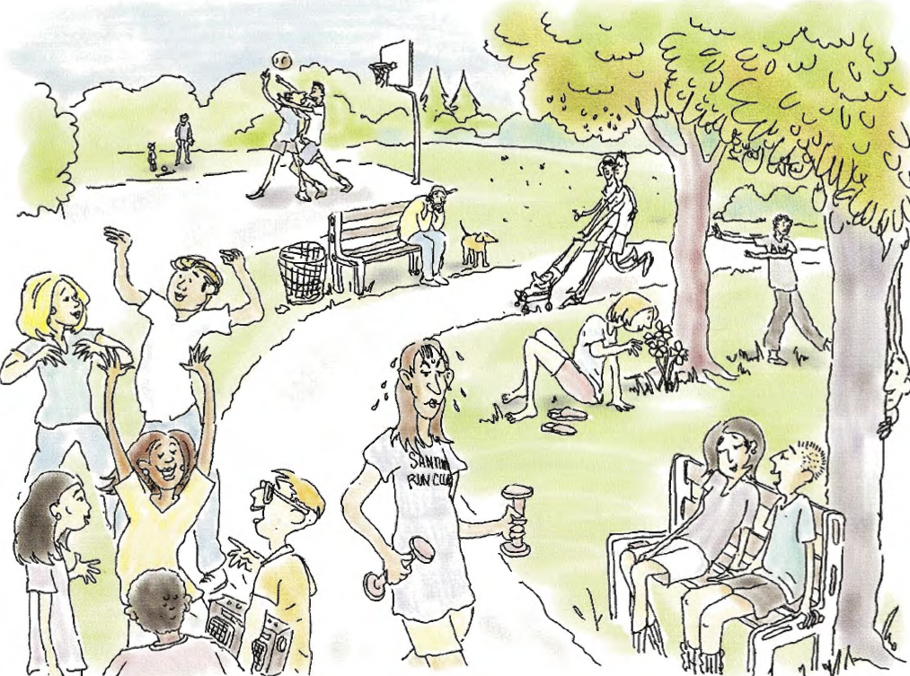

Slide 12
Think of a friend or colleague
Is your friend usually in a good mood?
Is it important for your friend to be successful?
Does your friend notice your feelings?
Does you friend often give presents, or pay for lunch or a coffee?
Does your friend work hard?
Does your friend become angry or annoyed if they have to wait ?
Can you trust your friend with a secret?
Does your friend listen well when you are speaking?
Does your friend keep their feelings to themselves?
Is your friend usually not worried by things?
Does your friend think the future will be good?
Does your friend often change their opinion?
Does your friend often postpone things he/she has to do?
Is your friend happy one moment and then sad the next?
Does your friend like to be with people?
generous
easygoing
ambitious
cheerful
hardworking
trustworthy
impatient
optimistic
sensitive
moody
sociable
indecisive
reserved
lazy
attentive

Slide 13
LEADER X FOLLOWER
What does it mean to be a leader? What qualities should one have?
What does it mean to be a follower? What are their personal characteristics?

Slide 14
ARE YOU A LEADER OR A FOLLOWER?
Interview your partner to find out if he or she is a leader or a follower.
Check your partner’s answers.
Count the points: each YES is worth one point, each NO is worth zero points.
1. Are you usually the first of your friends to try new things?
2. Do you ignore what‘s trendy and buy the things you like?
3. Are you confident in your skills and talents?
4. Do you feel comfortable making difficult decisions?
5. Do you get excited by new challenges?
6. Are you someone others see as a role model?

Slide 15
Generalising: sometimes true or always true?
Generally speaking, what kind of music do you listen to?
In general, what do you like to do for fun?
For the most part, where do you like to do out with your friends?
Typically, what do you do at the weekend?
As a rule, what do you do when you face a difficult problem?
Normally, how often do you study?

Slide 16
Role play!
Choose one of the personality types below but don’t tell your partner.
Apply it in the role play.
At the end, your partner has to guess what personality type you were.
free spirit
go-getter
hothead
introvert
overachiever
pushover
risk taker
team player
‘You are at the airport. Your flight has been delayed for two hours. You talk while you are waiting for your flight. Take turns asking each other questions about your jobs, your hobbies, how you spend your free time, and so on...’

