Slide 1
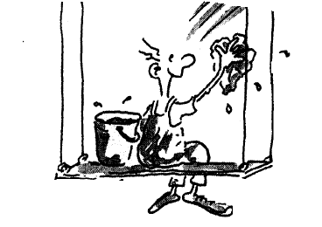
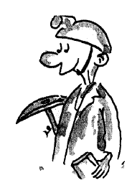
Jobs
What are they good for?

Slide 2
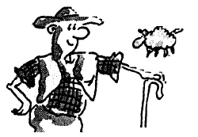
Discuss with your group: Two jobs which…
- can be done by robots
- no longer exist
- require absolutely no intelligence
- have low salaries but high prestige
- require very long training
- will be most needed in the future
- are overpaid
- young children typically want to do
- can be done from home
- you would really hate to do

Slide 3
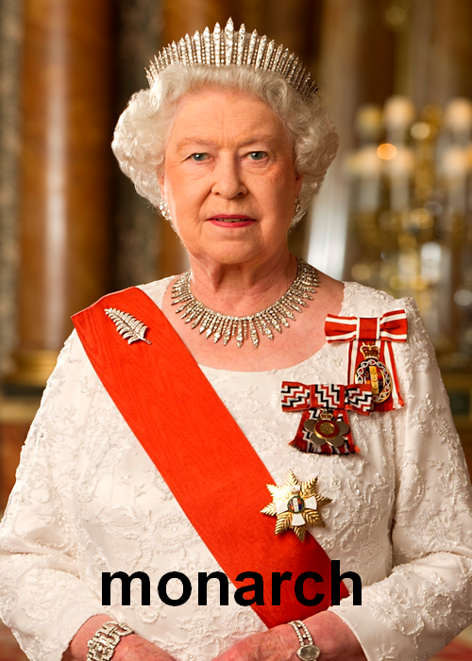
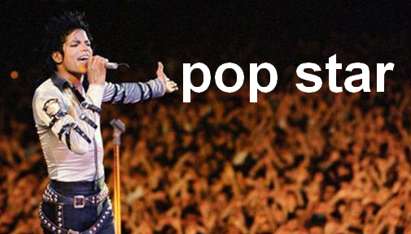
Real jobs? are these real jobs? Why (not)? Discuss.

Slide 4
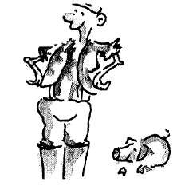
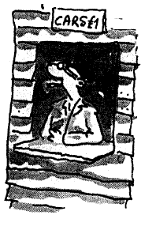
Which job is...
Which is the easiest job?
baby-sitter, dentist, footballer, teacher
The most boring?
Car park attendant, assembly line worker, shepherd, window cleaner
The most tiring?
doctor, farmer, miner, top model
The most useful?
journalist, market researcher, nurse, postman/woman
The worst?
grave digger, prison warder, soldier, toilet cleaner

Slide 5
Job description
DISCUSS THE ASPECTS MENTIONED ABOVE IN THE CASE OF THESE JOBS:
miner
assembly line worker
waiter
teacher
CEO of an international corporation

Slide 6
Jobs 20 questions Yes/No answers only!
Do you…
Work in the day/ at night?
Work with children / animals / old people?
Use a computer / special equipment?
Wear a uniform / protective clothes?
Work shifts / 9 to 5
Work alone / in a team?
Work inside / outside?
Get paid well / badly?
Do dangerous / stressful / difficult work?
Work in a hospital / school / office / vehicle? etc.

Slide 7
Jobs and personality
LOOK AT THIS LIST OF ADJECTIVES!
WHICH ONES APPLY TO THESE JOBS?
flight attendant
doctor
actor/actress
caretaker
personal trainer

Slide 8
S/He looks like a…
Hairdresser
Nurse
Teacher
Politician
Farmer
Police officer
Journalist
Architect
Actor
Musician
Doctor
Lawyer
Because…
A _______ needs to be…
S/he looks …

Slide 9
Dirty jobs?
A pharmaceutical company which tests its beauty products on animals.
A multinational which trades with the governments of politically oppressed people.
A weapons producer.
A fast food chain that opens 'restaurants' in beautiful places
A nuclear power station.
A tobacco company.

Slide 10
How bad? WHY? Rank from worst to least bad
- Failing to report a small mistake you made.
- A woman at a job interview who doesn't say that she Is two months' pregnant.
- Phoning up to say you're ill, when you're not, to get a day (or days) off.
- Making personal photocopies on the company's photocopier.
- Lying about your qualifications at a job interview.
- Drinking a lot of alcohol during the work break.
- Stealing office supplies (e.g. pens and paper).
- Taking longer breaks than are authorised.
- Cheating on the expense account.
- Selling company secrets.

Slide 11
Fair or unfair?
A German presenter hosted a TV show which assembled groups of journalists to discuss topical problems. At its height, and as a result of the ability of the presenter, the programme attracted 100 million viewers. He lost his job after revelations that he was a 'desk war criminal'; during the Second World War he had written newspaper articles in favour of Nazi activities, such as executions.
Should the man have been fired?
Should what you have done before affect your future jobs?
What should and what shouldn’t?

Slide 12
Fair or unfair?
An air hostess was sacked after she returned rather overweight to work, six months after giving birth. The airline company claimed that their image would suffer and that the hostess was having difficulty moving down the aisle in the plane.
Should changes in your physical appearance affect your job?
Does being attractive make getting a job easier?
What jobs are dependent on being beautiful?

Slide 13
Fair or unfair?
A man, whose job involved high precision technical work, was dismissed for drinking alcohol at home on a Sunday night. He had signed a contract which stated that he was not allowed to smoke, drink alcohol or take high-cholesterol snacks either at -work or home.
Should your employer be able to say what you can and can‘t do outside of work hours or outside of the workplace?
Why? Why not?
What if you are famous?
What salary or bonuses would you expect in exchange for this?

Slide 14
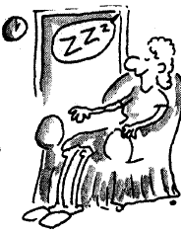
Final thoughts
Tell your group about these things:
(a) My ideal job...
(b) A day in the life of a (choose a job you know)...
(c) How I would end unemployment…

