Slide 1
Research questions and lines of inquiry (Spring 2018) 1 Credit
Prof. Michael Steppat

Slide 2
Research questions
Spring 2018
大家好
祝你成功 !

Slide 3
Research questions
Welcome!
Who are we???
Please introduce yourself, and your research situation. Where are you on your research journey?
We will come back to this
…..

Slide 4
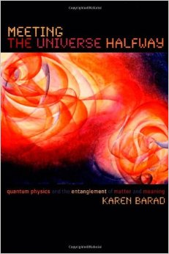
Research questions
A proposition …..
In our course, an important aim will be to explore the following assumption:
Since observations involve an indeterminable
discontinuous interaction, as a matter of principle,
there is no unambiguous way to differentiate
between the “object“ and the “agencies of
observation“—no inherent/fixed/universal cut
exists. Hence, observations do not refer to objects
of an independent reality.
Karen Barad

Slide 5
Research questions
Section I
To help in this exploration, please choose ONE of these two sample topics:
Traveling musicians OR
Foreign teachers in China
Task: suggest some suitable research questions for the chosen topic together with forms of observation or investigation and kinds of data. Please send your suggestions to me (michael.steppat@uni-bayreuth.de) AND bring them to the next session for discussion.

Slide 6
Research questions
Section I
In order to assist this sample inquiry, we should first bear in mind
• that the M.A. kind of inquiry is different from Ph.D. (in what ways?)
• that we need to know how to generate a topic from research questions (HANDOUT Thesis/dissertation topic to be considered, further down)

Slide 7
Research questions
Section I
We should then bear in mind
• that we can investigate ‘society‘ and/or ‘culture‘
……. is there a distinction?
……. can the methods be the same?

Slide 8
Research questions
Section I
We should also bear in mind
• that we need to understand ‘primary research‘ questions:
…. For what purposes would you use either observation or interview or survey? Advantages and drawbacks of each?
…. How can we distinguish between participant and unobtrusive observation?
…. What methods could you use to eliminate bias in your questions and evaluations?

Slide 9
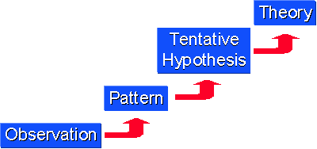
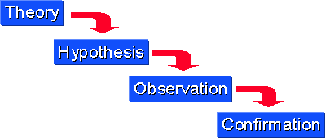
Research questions
Section I
Which is deductive, and which is inductive?
Is there any way to
assemble these two graphs into ONE?

Slide 10
Research questions
Section I
It's sunny in Singapore today. If it's sunny in Singapore, Li won't be carrying an umbrella. So, Li won't be carrying an umbrella.
Every time I've walked by that dog, he hasn't tried to bite me. So, the next time I walk by that dog he won't try to bite me.
Inductive reasoning? Or deductive reasoning?

Slide 11
Research questions
Section I
In order to understand ‘primary research questions‘:
… we should remind ourselves of the design for writing qualitative research questions: John Creswell for qualitative, quantitative, mixed methods
… avoiding ‘bias‘ in data collection?
… we will be mostly referring to forms of qualitative research

Slide 12
Research questions
Section I
In order to lead on from there, we should bear in mind
• that we need to understand ‘research questions‘ as a process
→ Uwe Flick (more advanced level)
• that these pertain to studying society/societies—also with attention to ‘cultural systems of meaning‘ (Flick)
• that we generate topics from research questions (see HANDOUT)
Is there any relevance to your research situation?

Slide 13
Research questions
Section I
Uwe Flick on research questions:
• Starting point = “analytical & sensitizing concepts“
… from Glaser & Strauss Grounded Theory: hence we need to look at this next!
• The questions pertain to studying society/societies—sometimes with attention to ‘cultural systems of meaning‘ (Flick)

Slide 14
Research questions
Section I
• A systematic investigation should launch a process of knowledge production (see Flick)
• … and knowledge has a cumulative nature, a progressive build (as we learn from Grounded Theory)
→ We will hence look more closely at Grounded Theory, AND then also at the theory of knowledge

Slide 15
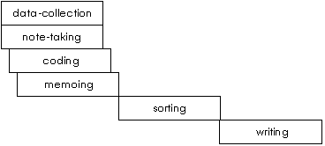
Research questions
Section I
For these reasons, we will next look more closely at
• Barney Glaser & Anselm Strauss: The Discovery of Grounded Theory (Chapters 1-3): a classic exposition
With an update…

Slide 16
Research questions
Section I
The ‘Discovery‘ of Grounded Theory:
Social constructionist version explains: categories and theories do not emerge from the data, but are constructed by the researcher through interaction with the data. The researcher creates an explication, organization, presentation of data, for a social construction of reality. Discover = the ideas the researcher has about the data after interacting with it. Is theory generated rather than discovered?
→ Implications for your own research questions?

Slide 17
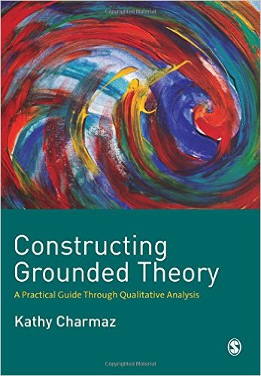
Research questions
Section I
To follow up the social construction in more depth:
Charmaz, Kathy. Constructing Grounded
Theory: A Practical Guide Through
Qualitative Analysis. SAGE, 2006.
… Epistemological or ontological
inference? Realist or relativist position?

Slide 18
Research questions
Section 2
First of all:
YOUR results concerning the first sample topic

Slide 19
Research questions
Section 2
Now please choose ONE of these two sample topics:
Westerners in a major Chinese city OR
Effective methods of intercultural education
Task: suggest some suitable research questions for the chosen topic together with forms of observation or investigation and kinds of data. Please send your suggestions to me (michael.steppat@uni-bayreuth.de) AND bring them to the next session for discussion.

Slide 20
Research questions
Section 2
To extend our exploration:
Process of “knowledge“:
“There are things that are known, and things that are unknown—and in between there are doors“
(William Blake)

Slide 21
Research questions
Section 2
For the “doors“:
A Khan academy presentation on Theory of Knowledge (hoping it will work)
Then, based on this presentation:
What do YOU think you need to do, for your project, in order to be able to contribute to ‘knowledge‘?

Slide 22
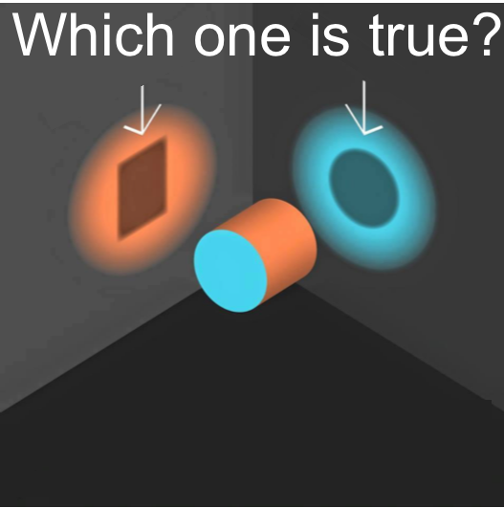
Research questions
Section 2
For the “doors in between“:
Keith Lehrer, Theory of
Knowledge Chapter 1
“Which one is true“: does any-
thing in your research resem-
ble this?

Slide 23
Research questions
Section 2
For the “doors in between“:
“Acceptance condition of knowledge” → Is it enough to think your data supports a certain hypothesis/assumption because that seems to be consistent? Is it enough to take published analyses to compare with your own use of data?
Any relevance to your
research questions/situation?

Slide 24
Research questions
Sections 2-3
Next
Is knowing possible through “falsifiability”?
First, please be aware: “False“ ≠ deliberately untrue or intentionally deceptive or not genuine
Rather: “False“ = contrary to fact or truth, arising from mistaken ideas

Slide 25
Research questions
Sections 2-3
Then
Thomas Nickles, “Falsifiability” (New Dictionary of the History of Ideas)
Is falsification relevant mainly for universal statements (law claims), or for any kind of hypothesis? And is testability relevant for any kind of hypothesis?

Slide 26
Research questions
Section 3
At this stage:
YOUR results concerning the second sample topic

Slide 27
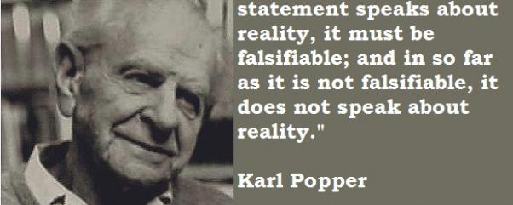
Research questions
Section 3
Then
Karl Popper, The Logic of Scientific Discovery Part 1
“In so far as a

Slide 28
Research questions
Section 3
“In so far as a
What does ‘inter-subjective testing‘ mean? How does it affect your research questions/situation?

Slide 29
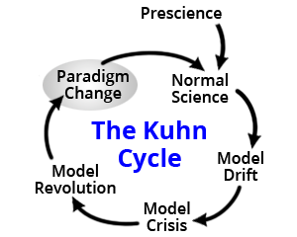
Research questions
Section 3
But perhaps we should consider the ‘logic of discovery’ in light of:
Thomas S. Kuhn, The Structure of Scientific Revolutions Chapters 1-5, 12
… only in physics?

Slide 30
Research questions
Section 3
Thomas S. Kuhn: “In normal science, there must be rules that limit both the nature of acceptable solutions and the steps by which they are to be obtained. … The scientist with a new paradigm sees differently from the way he had seen before. The scientist after a revolution works in a different world.
The scientist who embraces a new paradigm
is like the man wearing inverted lenses. …
Two men with the same retinal impressions
see different things. … The proponents of
competing paradigms practice their trades
in different worlds.”
Does any of this affect your area of research,
or your topic(s)?

Slide 31
Research questions
Section 3
For the concept of “paradigm”, compare Michel Foucault’s concept of “épistème”
= Historical conditions enabling the possibility of knowledge in light of discourse
as “the strategic apparatus which permits of separating out from among all the statements which are possible those that will be acceptable within a field of scientificity, and which it is possible to say are true or false. … Each society has its regime of truth”: not only in science

Slide 32
Research questions
You may remember …..
“Observations do not refer to objects of an
independent reality“ (Karen Barad)
From Lehrer to Kuhn …. do you see any
connections to this proposition?
Could they affect your research questions/topic?

Slide 33
Research questions
Section 4
Finally, as we are concerned with implications for both ‘society’ and ‘culture’:
Michael Pickering, Research Methods for Cultural Studies begins (p. 1) with Kuhn’s “rules that limit the nature of acceptable solutions”: these become “the rules of asking questions, with codified procedures and the prescription of set methods” (Pickering) … while Chapter 5 reflects on competing paradigms
HENCE we will look more closely at →

Slide 34
Research questions
Section 4
Michael Pickering, Research Methods for Cultural Studies Sections 1 and 2
….. And then: preparation
of summary reflective
paper

Slide 35
Research questions
For credit
Summary reflective paper:
An account of the process and procedure of finding a research topic, with attention to the problems involved, and considering the course materials’ relevance to the process

Slide 36
Many thanks for your sustained attention!

