Slide 1
Research project
The way Russian social networking site
“Vkontakte” conveys news about China
Made by
Gordeeva Tatiana
ID:0167419004

Slide 2
Introduction
Development of
Social media
Virtual world space,
No boundaries
New ways of
interaction,
social relations
Globalization
of media.
Time for change
Increase in public space
and public opinion
New ways of
interaction,
social relations

Slide 3
Introduction
Vkontakte
the most popular social media website in Russia (June 2016, 369 million accounts)
4th most popular website in the world, 80 supported languages
VK lets its users stream and share media files
Chinese pages: Xinhua news, China every day, magazine “China”, Pro China News, Chinese language for idlers

Slide 4
Peculiarities of news presenting in VK groups
All issues are in the Russian language
It’s possible to comment each article, share it with other users, put your “like” after reading
There are a lot of pictures, videos relating to different issues that create visual perception

Slide 5
Literature review
1
agenda setting theory
What kind of news is repeated and thus gets more interest from the public, has more impact on readers
21
Framing theory
How the information is packaged: which words, ideas, catch phrases, images are chosen to present any issue about China

Slide 6
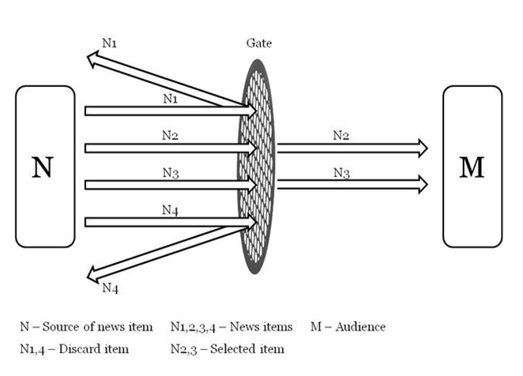
Literature review
Gatekeeping
3
To define what kind of news about China is not covered, the reasons of that

Slide 7
Methodology
Content analysis
of news about China in vkontakte in comparison with the same news in English websites representing China(BBC, ABC, Guardian, Global Times)
Sample: randomly selected news on different topics for one month presented in “vk news groups” and in English websites

Slide 8
Methodology
Units of analysis:
individual articles, images, comments of the public
Representative categories, concepts:
news framing, news coverage, agenda setting, cultural similarities/difference, economic relations between China and Russia, China and USA

Slide 9
Questions for analysis:
What kinds of news topics are presented and not presented in VK?
What is the main tone of this news (positive, negative, neutral)?
What are people’s comments about this news?
Is there any censorship and government control over news about China?
Does news content in VK coincide with content about the same topic with English news websites?

Slide 10
Thank You!

