Slide 1
11
Chapter Eleven
数据库
直复营销
人员推销
Notes:
Chapter 11 covers database marketing, direct response marketing, and personal selling.

Slide 2
Selling Words
11
二八法则
常旅客计划
优质会员
Notes:
1400 Words is a copywriting service located in Dallas, Texas. The company consists of 4 writers and Paula Ramirez, business development specialist. Paula uses the typical steps to generate sales. Prospecting involves networking and using word-of-mouth communications from contacts. Information is collected into a system called SUGAR. For strong prospects Paula sends the company newsletter. Prospects are divided into groups based on potential interest. Sales call approach depends on the type of business. For closings, Paula usually uses head creative Margie Bowles.

Slide 3
★单次销售拜访实现的销售额提高，因而平均销售费用得以降低。
★单批销售的规模扩大，因而平均运输和服务费用得以降低。
★对客户的需求有更深入透彻的了解。
★更好地预期客户需求，并为这些需求提前做好准备。
★出现问题时，客户更有可能给你改正和修补的机会（毕竟你与客户的关系就像是“一家人”）
★买方能得到供应商更多的关注。
★通过整合采购节省管理供应商的开支。
★面对供应商时的议价能力更强。
★与熟悉的供应商合作风险较小。
★出现问题时，供应商更有可能自费解决问题，而不是一走了之。

Slide 4
Database
Direct Response Marketing Personal Selling
11
Chapter Objectives
数据仓库、数据库编码和分析，数据挖掘在内的数据库营销在建立并加强与顾客的关系中发挥什么作用？
数据库驱动的营销传播计划可以如何帮助实现与顾客互动的个性化？
数据库驱动的营销项目是如何促进销售并加强与顾客之间的联系的？
直复营销项目应当何时用做向顾客传递信息和产品的其他方式的补充？
针对消费者市场和企业市场制定成功的人员推销计划时要完成那些任务？
针对国际市场，数据库营销和人员推销方案应当作出哪些调整？
Notes:
These are the objectives for Chapter 11.

Slide 5
11
Database
Direct Response Marketing Personal Selling
Chapter Overview
数据库营销
建立数据仓库
数据编码和分析
数据驱动营销
传播沟通
营销项目
人员推销
Notes:
Chapter 11 begins with a discussion of database marketing and the role of a data warehouse. Data is an integral part of company’s today and is used for a variety of purposes. The chapter presents information on how to build a data warehouse, database coding and analysis, data mining, and database-driven marketing programs and communications. The chapter concludes with a discussion of personal selling, which is largely based on database information.

Slide 6
Database Marketing
Identifying customers
Database
Building relationships
Notes:
Database marketing involves collecting and utilizing customer data for the purpose of enhancing interactions with customers and developing customer loyalty. Successful database marketing emphasizes 1) identifying customers and 2) building relationships with them.

Slide 7
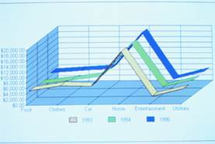
F I G U R E 1 1 . 2
Tasks in Database Marketing
Building a data warehouse
Database coding and analysis
Data mining
Data-driven marketing communications
Data-driven marketing programs
Notes:
Database marketing involves five tasks: 1) building a data warehouse 2) coding and analyzing the data in the database 3) mining the data for useful information 4) using the data to develop data-driven marketing communications 5) using the data to develop data-driven marketing programs.

Slide 8
Building a Data Warehouse
Operational database经营性数据
Customer transactions交易数据
Follows accounting rules会计准则
Marketing database营销数据
Current customer information客户信息
Former customer information
Prospect information
Notes:
A data warehouse has two primary types of data. The operational database contains all of the customer transactions and follows the rules of accounting. It is used for accounting and tax purposes. The marketing database contains information about current customers, former customers, and prospects.

Slide 9
Marketing Data Warehouse
Customer names and addresses
E-mail addresses
Record of visits to the firm’s Web site
Customer history
Customer survey results
Preferences and profiles个人喜好和画像
Marketing campaign results以往营销活动反馈
Appended data扩展的统计与心理数据
Coded data
Notes:
This is a list of the types of information that should be contained in a marketing database. Customer information is normally easy to obtain, especially for a B-to-B operations. It may be more difficult for a consumer-based businesses. Customer information that is needed is names, addresses, e-mail addresses and phone numbers. There should be a record of every visit to the firm’s Web site and every contact with the company. Customer histories and results of any surveys should be in the database. Preferences, profiles, and results of marketing campaigns should also be there. It will be discussed later, but the database should also contain appended and coded data.

Slide 10
E-Mail and Internet Data
邮件地址是有效营销数据库的基本元素。
Cost effective communications
Build relationships
Cookies
Store information登记和存储网站访问和浏览模式
Personalize Web site
Customize content
Notes:
E-mails are an essential element of a quality marketing database. The Internet and e-mail provide a cost-effective channel of communications that can be used to build relationships. The Internet has the capability of storing information about customers through cookies placed on the customer’s computer. With this information the Web site can be personalized with the person’s name. The content can be customized based on the person’s interests and past behaviors.

Slide 11
Purchase and Communication Histories购买和沟通历史
详细记录Detailed customer histories
Every interaction with the company
Determine future communications
Assist marketing team in evaluating
Customer’s lifetime value
Other customer metrics
Notes:
Effective database programs maintain detailed histories of customers that include every transaction and every interaction. These histories can provide valuable information that can be used for future communications. It also assists the marketing team in evaluating a person’s lifetime value and other customer metrics that can be used to target specific marketing programs and communications.

Slide 12
Customer Information Companies
Data research firms
Knowledge Base Marketing
Donnelly
Dialog
Claritas
Demographic data
Psychographic data
Online information + offline information
Acxiom
Datran Media
Notes:
如果自身缺乏数据获取能力, a number of data research firms can supply this information. Some of the more well-known companies are Knowledge Base Marketing, Donnelly, Dialog, and Claritas. These companies can provide demographic information and psychographic information. Other companies, such as Acxiom and Datran Media can combine online information a company may have about their customers with offline information. Purchasing this type of information is necessary for companies who cannot obtain it themselves and want a data warehouse.

Slide 13
Geocoding
Adding geographic codes
Plot on a map
Combine with demographic and lifestyle information
Identify clusters
CACI Coder/Plus
Notes:
Geocoding is the process of adding geographic codes to customer records so that customers can be plotted on a map. Geocoding also allows for adding demographic and psychographic information to the customer’s record. With this information, customer clusters can be identified using software such as CACI Coder/Plus. The concept behind the geographic clusters is that people who share common values and interests tend to live in the same neighborhoods.

Slide 14
Trade Area Draw Analysis Sample CACI Report for a Proposed Store Site
Percentile # of Customers Distance # of Households Penetration Rate
25% 492 0.99 1,992 24.7%
50% 985 2.32 14,803 6.7%
75% 1,477 4.28 45,390 3.3%
90% 1,772 8.48 97,382 1.8%
Based on a customer profile presented to CACI, 50% of the firm’s target customers live within 2.32 miles of the proposed retail site. Of the 14,803 customers who live within 2.32 miles, only 985 (or 6.7%) are currently customers of this firm.
Notes:
Geocoding 确定零售业最佳选址,对现有零售场点周边人群的营销。In this example, 50% of this store’s customers live within 2.32 miles of the store. Of the 14,803 households that live within 2.32 miles of the store, only 985, or 6.7% are customers of the store. Depending on the type of store, this appears to be a low penetration rate. For households within 1 mile of the store, the penetration rate is 24.7%.

Slide 15
Database Coding and Analysis
个性化传播
Marketing campaigns
Common forms of coding
终身价值分析
客户分群
Notes:
Database coding and analysis provides critical information for the development of personalized communications. It also assists in creating marketing campaigns. Common forms of database coding are lifetime value analysis and customer clusters.

Slide 16
Lifetime Value Analysis
Represents the profit revenue of a customer throughout the lifetime of the relationship
Individual lifetime value
Customer segment lifetime value
Key figures
Revenue and costs
Retention rate保留率
Visits or purchases per time period
Notes:
The lifetime value figure represents the present value of future profits a customer will generate over his or her lifetime relationship with a company. Some companies will calculate individual lifetime values for each person. Others will look at clusters of customers and calculate an average value for the cluster, or segment. Key figures needed for lifetime value calculations are revenue, costs, retention rate, and visits or purchases per time period. Revenue and costs associated with customers and customer clusters can normally be obtained. More difficult is the retention rates. The lifetime value figure represents the value of that customer (or customer segment) and provides an idea on how much effort should be expended to keep the customer and to upgrade them to a more loyal customer.

Slide 17
Customer Clusters
Group customers into clusters集群
Develop unique marketing programs for each cluster
Increase
advertising effectiveness
Notes:
Coding can be used to group customers into clusters based on a wide variety of criteria. Once clustered, unique marketing programs can be created that would appeal to that cluster increasing the effectiveness of the marketing program. For instance, a bank may group customers based on the number of accounts they have, or the total number of dollars in all accounts within the bank. Then different marketing programs can be developed to upgrade each cluster with the hope of increasing each cluster’s value to the bank. Clustering can also be used for cross-selling other services or goods.

Slide 18
Data Mining
Building profiles of customer groups创建顾客细分市场的特征
Preparing models that predict future purchase behavior建立模型预测未来购买行为
Examples
First Horizon – profiles best prospects
American Eagle – price markdowns
Staples – profiles of best customers
Notes:
Data mining involves using computer data analysis software to mine data for meaningful information and relationships. Data mining is used to build profiles of customer groups. Data mining is often used to build profiles of a firm’s best customers. Then a search can be made for customers who fit this profile, but are not spending at the level of the best customers. These individuals can then be targeted with special marketing programs or even personal selling. Data mining can also be used to prepare models that will aid in predicting future purchase behavior. Retailers can learn what other products a person buys when a particular product is purchased. Barnes and Noble uses this process when you pick out a book to purchase, they tell you what other books were bought by purchasers of that particular book.

Slide 19
F I G U R E 1 1 . 3
Purposes of Data Coding and Data Mining
开发营销传播方案
开发营销项目方案
对销售队伍的支持
高质量潜在客户
销售电话的对象信息
Notes:
The purpose of data coding and data mining is to develop marketing communications aimed at specific individuals or clusters of individuals. In addition, marketing programs can be developed that will enhance the relationship with customers and upgrade how much they spend with the company. Salespeople can use the information to qualify prospects and to make a decision on who should receive a personal sales call.

Slide 20
Database-Driven Marketing Communications
Identification codes识别码
Customer profile information顾客特征信息
In-bound telemarketing进站电话营销
Trawling拖网
Notes:
The Internet is the key technology for database-driven marketing communications. A major reason for a database is the ability to communicate and interact with customers and prospects. This process starts with developing identification codes and profile information for customers. It can then be used for communications, in-bound telemarketing, and trawling.

Slide 21
F I G U R E 1 1 . 4
互联网在客户沟通中的重要性
Low cost
Available 24/7
Metric analysis指标分析
If the message was read信息是否被阅读
Time it was read何时阅读信息
How much time was spent用在阅读时间
Customers access to additional information顾客可以在需要的时候查找到更为详细信息
Build a bond with customers与顾客结成纽带
Notes:
The Internet is an ideal medium for customer communication. It is low cost and available 24/7. Metric analysis is available that will tell if a message is read, the time it was read, and even how much was read. Customers can access additional information at anytime and most important, it can be used to build a bond with customers.

Slide 22
Identification Codes
Log-in access to special pages登录接入到特别网页
Cookies
Customized Web pages客户订制化网页
Individual offers个性化服务
Specialized communications特殊的沟通
Communication chain with purchase关联销售的服务沟通链
Notes:
A database-driven marketing program begins with assigning individuals customer IDs and passwords. This allows them to login to a site and to special pages not available to general browsers at the site. Cookies placed on the customers’ computers allow for customized Web pages and individual offers based on the person’s purchase history, interactions with the company, and browsing history. Specialized communications can be sent. If the person does make a purchase, then a chain of communications can be initiated at every step of the way until the merchandise arrives at the person’s home.

Slide 23
Customer Profile Information
Customer preferences顾客偏好
Customer information客户信息
Individualize messages个人信息
Bluefly.com
Sends messages about new fashions
Personalized responses to inquiries对于问询的定制化回应
Notes:
Customer profile information is important because it tells a company about an individual’s preferences. It allows for individualizing messages. It allows for personalized responses. Companies like Bluefly.com can send out personalized messages letting customers know that some new fashions have arrived in their size and in the style they like.

Slide 25
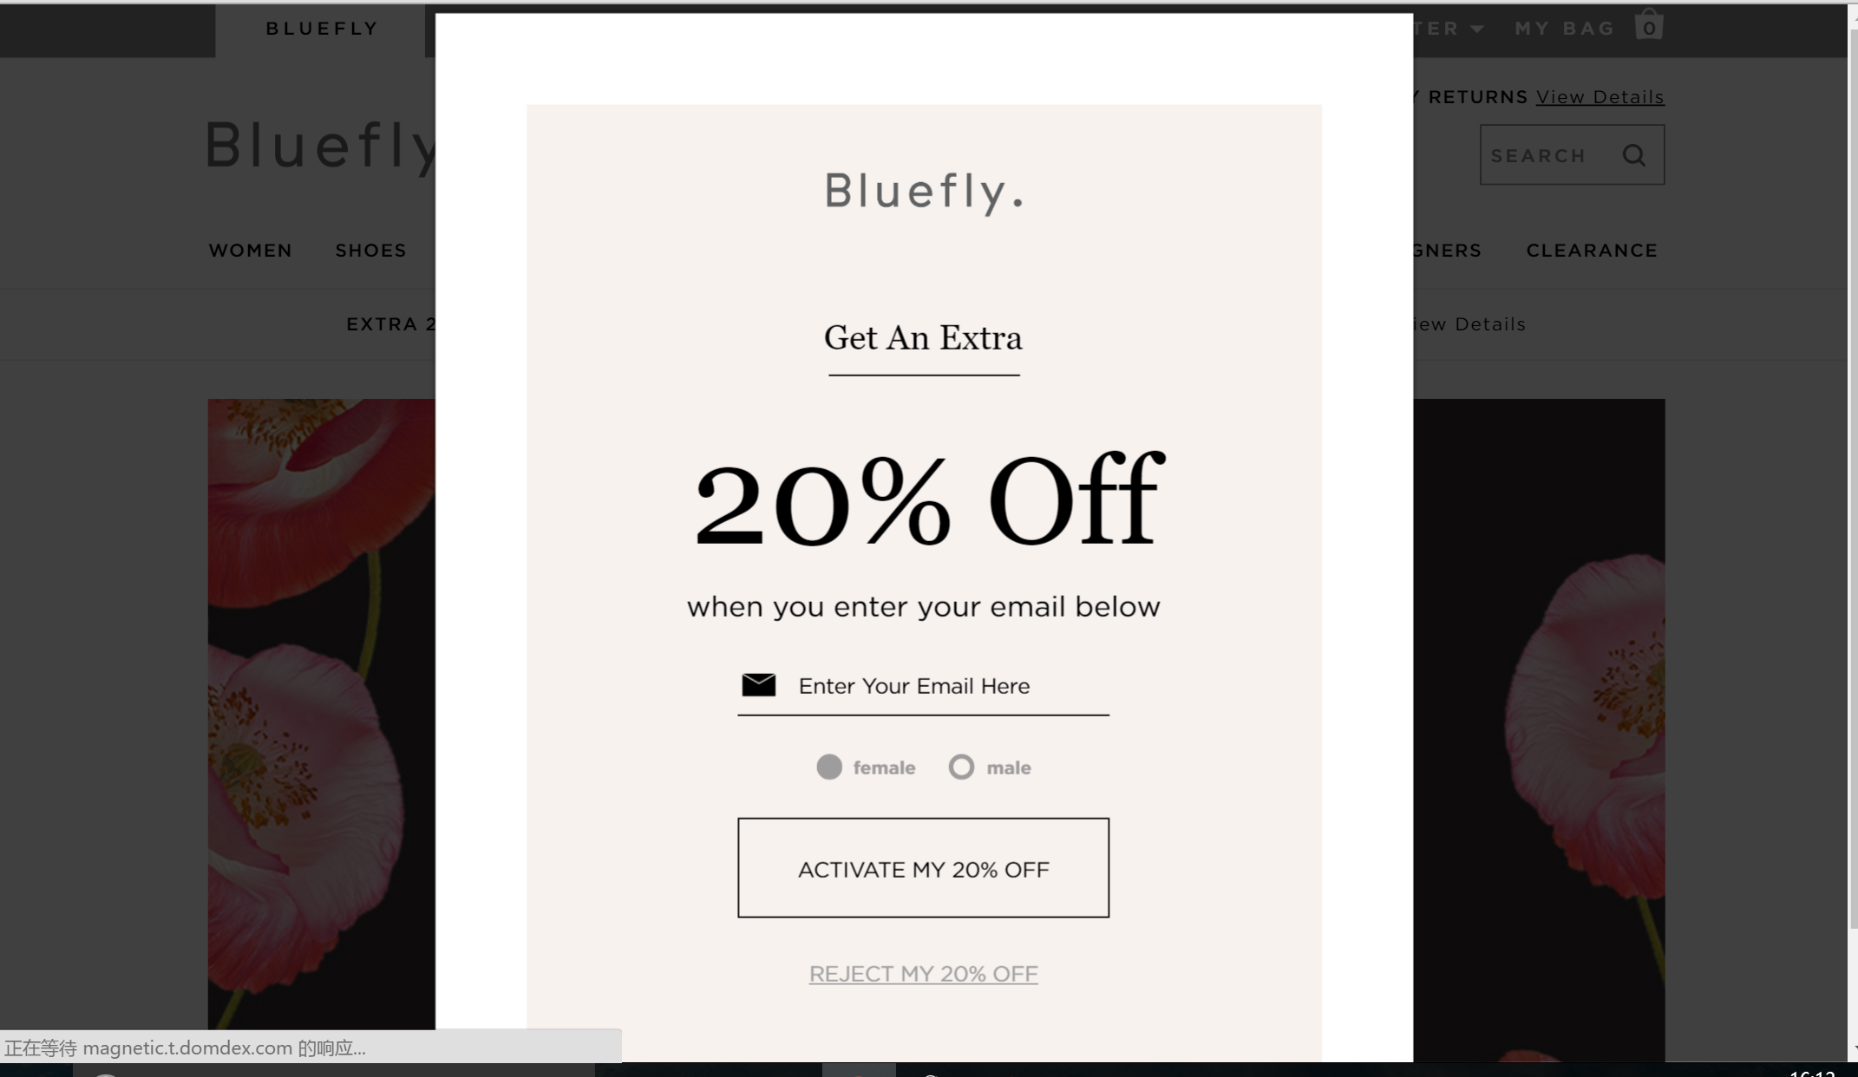

Slide 26
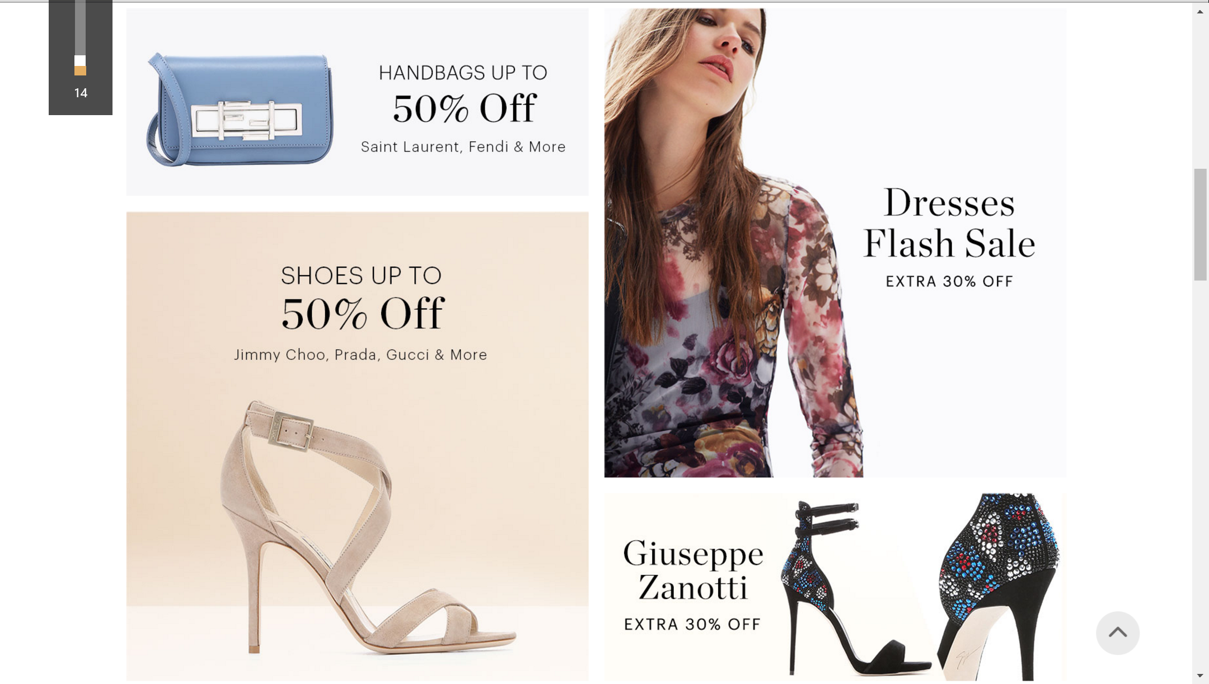

Slide 27
In-Bound Telemarketing
Immediate knowledge of customer客服电话接听人员立即能知道来电者身份
Customer data immediately available
Personal interaction人际的互动
Customer value and status顾客价值和状态
Recent purchases or interactions
Customer preferences and profile
Notes:
Database information is valuable for in-bound telemarketing. Service personnel can access the database and have instant information bout the customer. This allows for personal interactions. Based on customer value and status, it can provide information on how the customer should be treated and what special offers should be extended. If recent purchases were made, the telemarketer can inquire about their level of satisfaction.

Slide 28
Trawling
Search for specific information
Some possible uses
Home Depot – individuals who moved
Anniversary of last (special) purchase
Individuals who have not made recent purchase
Individuals who have made recent purchase
Purchase of a specific item – then cross-sell
Notes:
Trawling is the process of searching a database for specific information for marketing purposes. Trawling can be used in a wide number of ways. Home Depot can use it to locate individuals who have recently moved to offer them discounts on home furnishings and building materials. Companies can send a card or email on the anniversary of a past purchase, such as a new car. Individuals who have not made a purchase recently, say within the last 90 days, can be sent a special offer to come back. Individuals who have made a recent purchase can be thanked, or encouraged to purchase another product that goes with the original purchase. Trawling can locate specific items that have been purchased for the purpose of cross-selling.

Slide 29
Database-Driven Marketing Programs
许可营销Permission marketing
频率计划Frequency programs
Customer Relationship Management
Notes:
The three primary database-driven marketing programs are permission marketing, frequency or loyalty programs, and customer relationship management programs.

Slide 30
Permission Marketing
Backlash to spam, junk mail
Consumers give permission许可公司这么做的消费者
Can be offered through
Internet
Telephone
Mail
Higher response rates
Notes:
Consumers today are fed up with spam and junk mail. Permission marketing sends materials to only individuals who give permission. Companies need to make sure consumers have given permission. Sometimes when placing an online order, companies will automatically check the box that grants permission to send e-mail offers and if the customer doesn’t want to participate, they must uncheck the box. In addition to online, permission can be given through the telephone and in the mail. The advantage of permission marketing is that it generates a higher response rate since the individual has agreed to receive marketing materials.

Slide 31
F I G U R E 1 1 . 5
Steps in Building a Permission Marketing Program
Obtain permission.得到顾客的许可
Offer a curriculum over time.提供有意义的课程
Offer incentives to continue the relationship.加强激励从而维持关系
Increase level of permission.提高客户许可级别
Leverage the permission to benefit both parties.利用客户许可，实现双赢
Notes:
The first step in building a permissions marketing program is to obtain permission. This needs to be upfront and honest. The second step is to develop some type of curriculum, or program. The third step is to offer incentives to continue the relationship. The incentives should not end with just joining. As time goes by, increase the level of permission. Obtain more information, more data that can be used for better targeting of marketing programs. But, it is important to leverage that permission so that it benefits both the customer and the company.

Slide 32
Keys to Successful Permission Marketing
Ensure recipients have granted permission
Make e-mails relevant相关性
Customize program by tracking member activity追踪会员行为
Empowerment
& Reciprocity
Notes:
Empowerment and reciprocity are the keys to a successful permissions marketing program. Ensure recipients have truly granted permission to receive materials and want them. Make e-mails relevant. Customize the program to meet the needs of individuals through tracking each person’s activities. People should feel they have power during the relationship and that it is based on reciprocity. As they offer more information or make purchases, greater rewards or better deals are given.

Slide 33
F I G U R E 11 . 6
消费者参加电子邮件许可营销的原因
Source: Based on Joseph Gatt, “Most Consumers Have Reached Permission E-mail Threshold,” Direct Marketing (December 2003), pp. 1-2.
Notes:
This graph shows the reasons individuals opt into an e-mail permission program.

Slide 34
F I G U R E 11 . 7
将顾客留在许可营销项目中的激励因素
Source: Based on Joseph Gatt, “Most Consumers Have Reached Permission E-mail Threshold,” Direct Marketing (December 2003), pp. 1-2.
Notes:
This graph shows the reasons individuals remain in a permissions marketing programs.

Slide 35
常客计划
奖励忠诚
鼓励重复购买
Airlines and grocery stores……
2/3 of consumers belong
Average household in 14 programs
Actively participate in 6 programs
How many programs?
Notes:
Frequency or loyalty programs offer consumers free merchandise or discounts for a series of purchases. The goal is to reward purchases and maintain a customer’s patronage with a firm and discourage them from purchasing from competitors. Airlines and grocery stores are the two most well known frequency or loyalty programs. About 2/3 of consumers belong to a frequency program and the average household belongs to 14 different programs. They actively participate in 6.

Slide 36
F I G U R E 11 . 8
消费者加入忠诚计划的利益点
Source: Adapted from Mark Dolliver, “Gauging Customer Loyalty,” Adweek, www.adweek.com/aw/content_display/news/agency/e3i4a73f5d7451749a37c7fca20, February 16, 2010.
Notes:
This graphs shows the results of a survey of consumers on the benefits they receive from being in a loyalty or frequency program. The number one reason is to receive discounts and savings, 66%. The top five reasons all deal with some type of free merchandise, special deals, or savings.

Slide 37
F I G U R E 11 . 9
Frequency Program Goals
维持销售额、收入或利润
提高现有顾客的忠诚度
应对或阻止竞争对手的常客计划
对现有顾客进行搭售
差异化品牌
阻止新品牌进入
Notes:
Companies have different reasons for utilizing frequency programs. Often it is to maintain sales, margins, and profits. An obvious reason is to increase the loyalty of existing customers. It can be used to cross-sell merchandise to existing customers. It can differentiate a company from a brand parity situation, but this goal is probably not going to be longed lived. Competing firms are likely to add their own programs to match. It might be a deterrent for new brands wanting to enter a market.

Slide 38
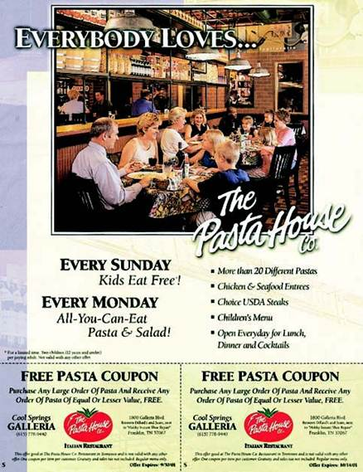
Principles Frequency Programs
设计增加产品价值.
计算常客计划的全部成本
尽量最大化顾客进行下次购买的动机
Frequent Diner Club
Sent letter to 4,000 offering $5 discount on dinner.
Average visits increased
From 25 to 42 during promotion
From 25 to 29 after promotion
Card holders visits increased
Incremental sales increased
$17,100 during promotion
$4,700 after promotion
Notes:
For successful frequency programs, companies should keep in mind 3 basic principles: 1) design the program to enhance the value of the product and company; 2) calculate the full cost of the program, including the free merchandise and the cost to administer the program; 3) design the program to maximize customer motivation to join and to make additional purchases. An example of a Frequent Diner Club is used to illustrate the benefit of a loyalty program. Incremental sales increase by $17,100 during the promotion and another $4,700 after it was over.

Slide 39
Customer Relationship Management
Database technology
Customize products
Customize communications
Many CRM programs failed
Built on two primary metrics
Lifetime value终生价值
Share of customer顾客份额
Notes:
Customer relationship management (CRM) programs were built on the premise of using database technology to customize products and communications to meet the needs of individual customers and to enhance their relationship with the company. Many CRM programs failed. While the failures were caused by a number of reasons, often it was because CRM was another program to build sales rather than a program to develop relationships with customers. CRM programs are built on two tenets – lifetime value and share of customer. The share of customer refers to the percentage of purchases a customer makes with one firm compared to the total expenditures in that product category.钱包份额，品类购买支出中的客户品牌购买份额。

Slide 40
Customer Relationship Management 开发步骤
Identify the company’s customers.
Differentiate customers in terms of needs and value.
Lifetime value
Share of customer
Interact with customers.
Improve cost efficiency
Enhance effectiveness of interaction.
Customize goods or services.
Notes:
The first step in building a CRM program is to identify the customers who will be in the program. Step two is to use the database to differentiate customers in terms of needs and value using lifetime value figures and share of customer figures. Step three is to interact with each customer or customer segment with the goal of improving cost efficiencies and enhancing the effectiveness of interaction. This occurs through knowledge of customer needs and value. The last step is to customize goods and services to meet customer needs.

Slide 41
Customer Relationship Management Reasons for Failure
Implemented before a solid customer strategy is created.
Rolling out a CRM program before changing the organization to match the CRM program.
Becoming technology driven rather than customer driven.
Customers feel like they are being stalked胁迫 instead of being wooed恳请.
Notes:
Research has shown four primary reasons CRM programs failed. CRM programs were implemented before solid customer strategies were created. Programs were rolled out before changing the organization to match the CRM program. The CRM program was technology driven rather than customer driven. Customers felt like they were being stalked instead of being wooed and rewarded for being a customer.

Slide 42
Direct Response Marketing
Direct Marketing Association
Prospecting →60%预算于探测潜在顾客
Customer retention → 40%用于保有现有顾客
It works!
Customers respond
Telephone
E-mail
Retail store
PURL
Notes:
Direct response marketing is the targeting of goods and services to customers without the use of other channels of distribution. According to the Direct Marketing Association, about 60% of direct marketing is to prospects to encourage a first purchase and the other 40% is for customer retention and to encourage repeat purchases. Direct response marketing is used because it works. Customers can respond to direct offers using the telephone, e-mail, retail store, or a PURL.

Slide 43
F I G U R E 11 . 11
Methods of Direct Marketing
Source: Based on Richard H. Levy, “Prospects Look Good,” Direct, Vol. 16 (December 1, 2004), pp. 1-5.
Notes:
This graph shows the percentage of companies using particular forms of direct marketing. Direct mail to customers and prospects was number 1, used by 77% and 73% of companies, respectively. E-mail to customers and prospects was the next most used methods.

Slide 44
Direct Mail
Most common form of direct marketing
Types of lists商业名单
Response list应答者名单Hot list热点名单
Compiled list汇编名单
Advantages
Target mailings (consumer, B-to-B)
Measurable
Driver of online sales
Disadvantages
Clutter
Costs
Digital direct-to-press数字直接制版系统
Notes:
The most common form of direct response marketing is direct mail. Over 70% of companies use some form of direct mail. The key to direct mail is the list that is used. A response list consists of individuals who have made purchases or who have responded to direct mail offers in the past. A hot list are individuals who have responded to a direct mail offer within the last 30 days. A compiled list is a list of individuals who meet specific demographic characteristics. Direct mail offers the advantage of targeting specific people, which increases the chances of a response. Direct mail is measurable, and is a driver to online sales. The disadvantages are the clutter, too much junk mail, and the high costs per contact. A recent development in direct mail is digital direct-to-press where letters, offers, and even catalogs can be personalized and even customized to fit individual needs.

Slide 45
Catalogs目录邮购
Long-term impact垂直杂志
Low-pressure sales tactics
First stage in buying cycle
Database
Specialty catalogs
Business-to-business
Notes:
Catalogs offer a long term impact because they lay around for a long time and are often picked up months after they come out. Catalogs are a low pressure sales tactic and often the first stage in the buying cycle. Rather than large catalogs sent to masses, companies are using databases to send catalogs to individuals most likely to use them, either through ordering through the catalog, by phone, or online. Specialty catalogs are the norm, based on each person’s interests. Catalogs are still important for business customers.

Slide 46
Direct Response Media 广告结尾一般是请立即拨打电话
Television
Radio
Magazines
Newspapers
Notes:
Other direct response media are television, radio, magazines, and newspapers. With most of these media, a scarcity approach is used where individuals have a limited time to respond and/or a limited number are available. Urgency is the key to response.

Slide 47
Internet
Direct response to ads
Cost-effective
Builds relationships
Personalization of communication
Customization of offer
Search engine ads
Notes:
The Internet has become a valuable form of direct marketing. It is cost effective and can be used to build relationships with customers. Communications can be personalized and offers can be customized to meet individual needs. Search engine ads can be purchased that will make direct offers to individuals looking for specific products.

Slide 48
Direct Sales
Consumer direct sales
Host parties
Amway, Mary Kay, Avon
Mark
Notes:
In the consumer sector, companies such as Amway, Mary Kay, Avon, and Mark use direct sales. The salesperson contacts friends, relatives, coworkers, and others to provide them with small catalogs or marketing brochures. Alternatively, individuals can host parties and invite friends and other people. Mark is a new line of cosmetics developed by Avon for women under 30. Currently, more than 40,000 “Mark Girls” work in the United States selling cosmetics through a variety of direct selling tactics.

Slide 49
Telemarketing
Inbound telemarketing
Cross-selling
Outbound telemarketing
Cold calling
Database
Prospects
Notes:
Telemarketing can be either inbound or outbound. With inbound, customers call the company to place an order. For most companies, it is being handled by a call center. The advantage of inbound is that it presents an opportunity to cross-sell other products. Outbound telemarketing is the most challenging. Most people do not want sales calls. Cold calling is very difficult. But, if a database is used, then customers who are more likely to respond can be contacted. This is especially good if it is a prospect list, individuals who have an interest in the product.

Slide 50
Personal Selling
Face-to-face opportunity
Build relationships
New customers
Current customers
Relationship selling
Create customer for life
Notes:
Personal selling offers an opportunity to sell a product face-to-face. It can be used to build relationships with new customers as well as current customers. The trend in personal selling is to relationship selling, which is building relationships rather than just making a sale. The idea is to create a customer for life, not just for one transaction. This changes the approach in dealing with individuals to a softer sell.

Slide 51
F I G U R E 11 .12
Steps in the Selling Process
Generating leads
Qualifying prospect
Knowledge acquisition
Sales presentation
Handling objections
Sales closing
Follow-up
Notes:
This slide presents the steps in personal selling. It starts with generating leads and then qualifying leads so only the customers most likely to respond receive a sales call. Others can be handled in a different way. The salesperson then needs to acquire information about the prospect. A sales presentation needs to be prepared and given. Handling objections and using a good sales closing are important in getting orders. To create a customer for a lifetime requires follow-up to make sure they are satisfied with the product.

Slide 52
F I G U R E 11 .13
Methods of Generating Sales Leads
Referrals
Database-generated leads
Trawling
Analytical techniques
Data mining
Networking
Directories
Cold calls
Notes:
Referrals are the best way to generate leads. It also allows a salesperson to bypass the gatekeeper and gets them in to see the prospect. Database-generated leads are also very good. These leads can be generated through trawling for specific information, through one of the analytical techniques (such as lifetime value), or through data mining. For some goods and services, networking can provide good leads and allow a salesperson to meet people. A directory of occupations or businesses can be beneficial. The worst is cold calling since the salesperson has no idea of the level of interest, or if they even need the product.

Slide 53
Qualifying Prospects
Not all leads线索 are viable
Not all leads are equal in value
Two dimensions
可能带来的销售收入
获得客户的可能性
Categorize prospects
Notes:
Not all sales leads are good prospects. Many companies will hire other individuals to qualify prospects so salespeople can concentrate on making sales calls. Two dimensions are important when evaluating sales leads – potential income and probability of acquiring the prospect as a customer. Often leads are categorized into 3 or 4 groups based on these two dimensions. Those in the best group (high potential income and high probability of acquiring) receive a personal sales call. Leads in the other groups can be handled through telemarketing, mailing out marketing materials, or other strategies that are less expensive.

Slide 54
Marketing Approaches Prospect Categories
Sales Calls
“A” Leads
“B” Leads
“C” Leads
“D” Leads
Telemarketing / E-mail
Marketing materials
Monitored for future
Notes:
This slide illustrates the marketing approach when leads are placed into 4 categories. “A” leads receive sales calls since they have a high potential and high probability of acquiring. “B” leads are usually those that have high potential, but the probability is low. Contact needs to be made, but it can be done by e-mail or through telemarketing. “C” leads normally are low income potential, but high probability. They may be sent marketing materials. They also might be handled by telemarketers. The “D” group is low on both dimensions so nothing is done at this time.

Slide 55
F I G U R E 11 .14
Knowledge Acquisition Information
Understand the prospect’s business.
Know and understand the prospect’s customers.
Identify the prospect’s needs.
Evaluate risk factors and costs in switching vendors.
Identify the decision makers and influencers.
Notes:
The purpose of the knowledge acquisition stage is to learn as much as possible about the company and the people the salesperson will be meeting. The more information the salesperson has, the easier it will be to make a sales call and usually the more successful it will be. It is important to know who the prospect’s customers are and to understand the type of business they are in. Identifying the prospect’s needs in advance shows the salesperson did his homework and is serious about the sales call. Think about the risk factors in switching vendors. If possible, identify the decision markers and influencers.

Slide 56
销售陈述
Stimulus-response刺激-反应
Need-satisfaction
需要-满意
Problem-solution
问题-解决
Mission-sharing
任务-共享
Notes:
Sales presentations can be grouped into four major types. The stimulus-response approach is often called the “canned” approach because it consists of statements (stimuli) designed to elicit specific responses from customers. It is used with telemarketing and sometimes with new salespeople. The need-satisfaction approach strives to discover a customer’s needs and then provide a solution to those needs. With the problem-solution approach, employees from the selling organization spend time analyzing the prospect’s business to identify the problems being faced and the best solutions to them. With mission-sharing the two organizations work together for a common goal. This sales presentation almost always involves people at the very top levels of both organizations.

Slide 57
F I G U R E 11 .15
Handling Objections
Head-on method
Indirect method
Compensation method
“Feel, Felt, Found”
Notes:
Almost all sales calls will at some point create objections on the part of the buyer. Salespeople need to be prepared in advance to handle these objections. With the head-on approach, the salesperson answers the objection directly. With the indirect method, the salesperson sympathizes with the prospect and indirectly talks about how the product can meet the need without saying the prospect is wrong. In the compensation method the salesperson will reply “Yes, but …” and then explain how the product’s benefits can overcome the objection being made. With the “feel, felt, found” approach the salesperson lets the customer talk about his/her fears and feelings, then responds how the product can eliminate or reduce those fears.

Slide 58
F I G U R E 11 .16
Methods of Closing Sales
Direct close
Trial close
Summarization close
Continuous “yes” close
Assumptive close
Notes:
Closing a sale is important. Many salespeople fear this part of the sales call because of fear that the customer will say no. Five different sales closings can be used. The direct close asks the customer for the order. The trial close seeks feedback to gauge the customers willingness to buy without directly asking for an order. In the summarization close the salesperson summarizes all of the benefits of the product and how it meets the needs of the buyer prior to asking for the order. The continuous “yes” close asks small questions along the way that require a yes answer then when it comes time to ask for the order, the customer is more likely to respond with a yes. The assumptive close assumes the customer has decided to make the purchase and so asks how or when the item is to be shipped or the payment method.

Slide 59
International Implications
Differences in technology
Laws and regulations
Local customs
Infrastructure
Notes:
Database marketing and personal selling face the same challenges as other IMC programs in the international arena. Differences in technology can be a huge factor in building and using a database. Laws and regulations vary in terms of direct response marketing. Local customs affect how personal selling is done and the importance of formality and building relationships prior to the sales calls. Infrastructure can be an issue with direct response marketing as well as personal selling.

Slide 60
Integrated Campaigns in Action
Centric Federal Credit Union
Notes:
Emogen Marketing was retained by Centric Credit Union to increase new memberships and increase deposit accounts. Emogen developed a campaign “Free-er Than Free Checking” that featured television, radio, and billboard spots. The tagline used with the campaign was “Just like a bank … only better.”

