Slide 1
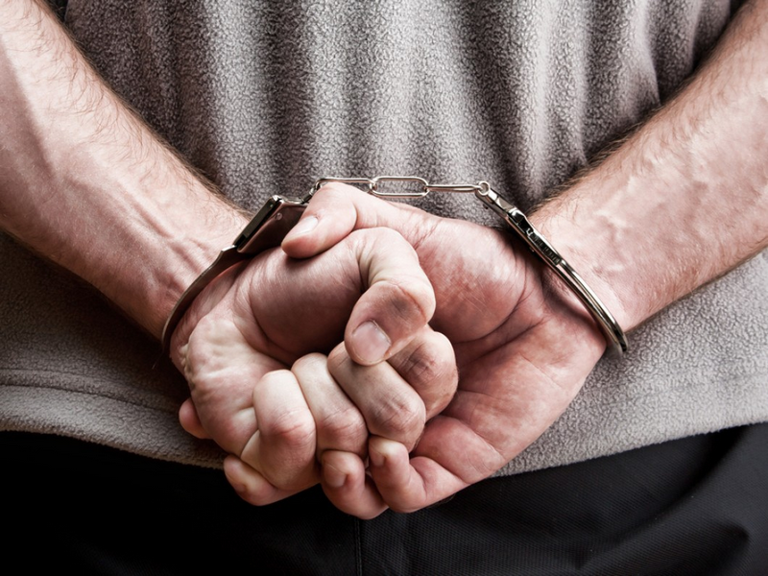
Crime and punishment

Slide 2
Crime
What kinds of crime are most common in your country?
What kinds of punishment are there?
Are there different punishments for children and for adults?
Is capital punishment used in your country?

Slide 3
Fill in the table
CHOOSE FROM THESE DEFINITIONS
act of attacking someone and stealing their money
buying and selling goods illlegally
demanding money from people by threatening them
illegal copying of documents or paintings
stealing things from people’s pockets or bags
violent action for political purposes
violent attack

Slide 4
Legal Expressions Give an example of a situation involving each expression.
to prove to suspect to break to file
to commit to pay to sentence to accuse
_______a lawsuit against someone (= to sue someone).
_______someone publicly of committing a crime.
_______the law.
_______a sneaky person of committing a crime.
_______compensation to the victim.
_______that the criminal is guilty.
_______a horrible crime.
_______a convicted criminal to punishment.

Slide 5
Discussion Questions
What is your view of capital punishment? When should someone be sentenced to the death penalty?
Some people think that criminals are not born, they are created by society. Do you agree?
Do you think crime is a big problem in China?
What kind of law enforcement should the government use to control crime rates?
Generally speaking, Chinese cities are safer than cities in the west. Why is this?

Slide 6
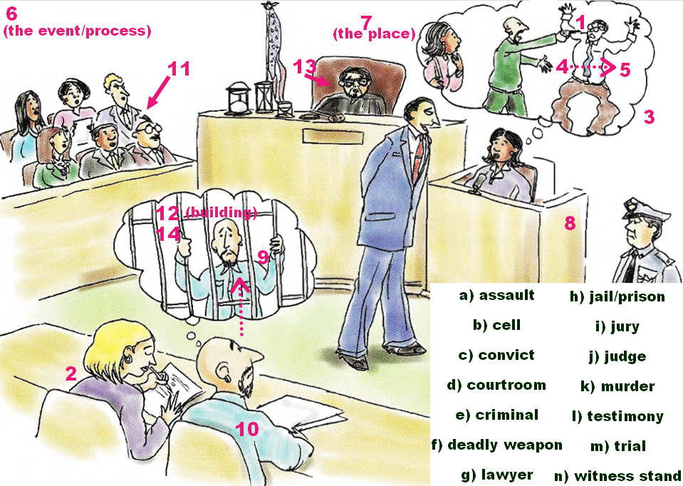

Slide 7
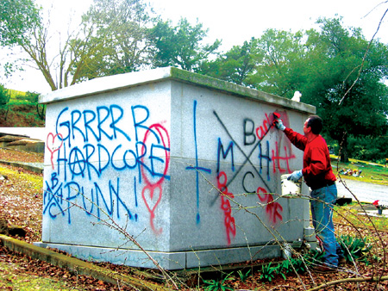
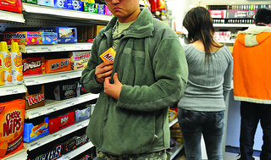
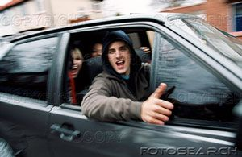
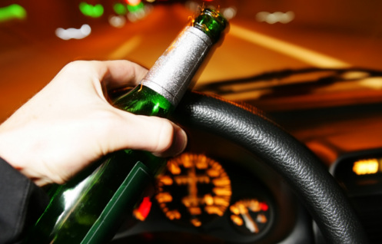
Penalties

Slide 8
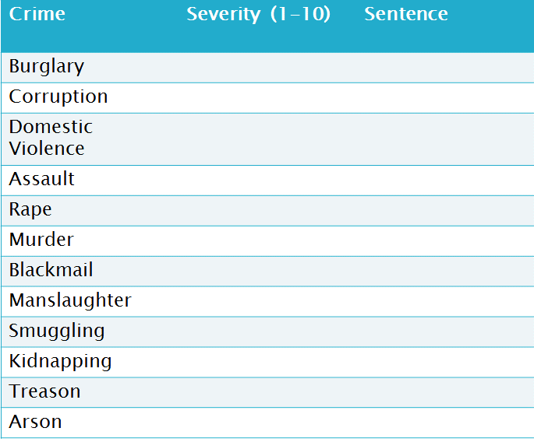
Rank the severity of each crime and discuss what sentence would be appropriate

Slide 10
What is your verdict?

Slide 12
Do you agree or disagree? Why?

Slide 13
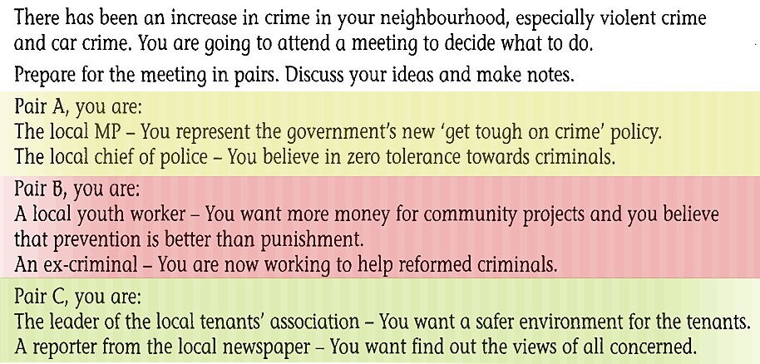
Roleplay: Neighbourhood Watch

