Slide 1
MYSTERIOUS DISAPPEARANCES
AND OTHER OUT-OF-THE-ORDINARY EVENTS

Slide 2
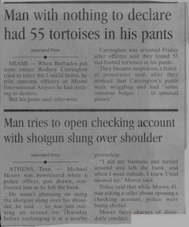
Do you like to read police stories in the newspaper or on the internet? Why do you think people are interested in crime stories?

Slide 3
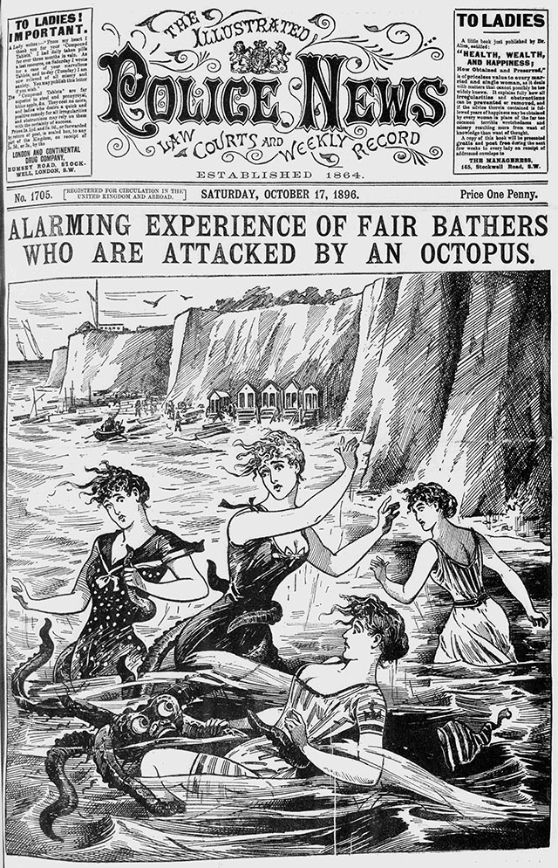
What is this police story about?

Slide 4
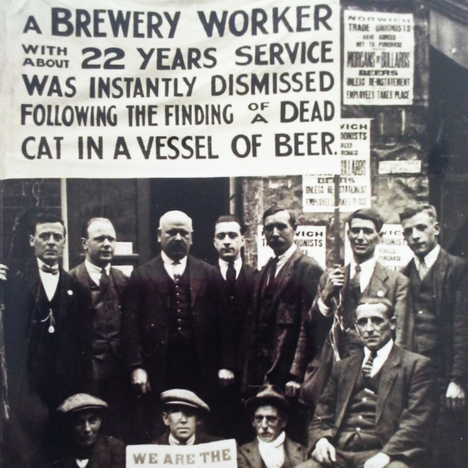
What is this police story about?

Slide 5
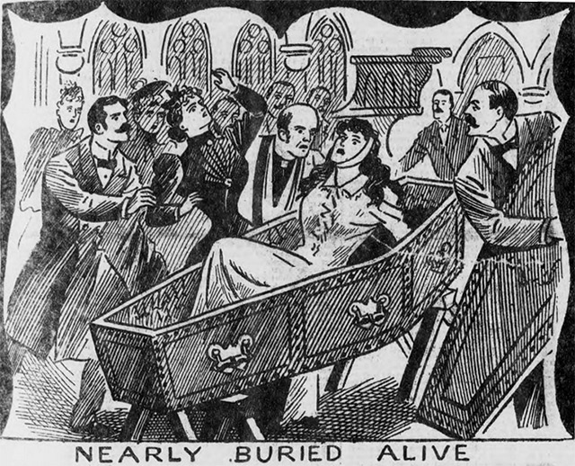
What is this police story about?

Slide 6
Match these expressions to their definitions
to be sought
to be devoted
a distress call
to be stranded
authorities
a witness
the involvement
seemingly
to have vanished
outcome
to be indentified
documents
evidence
a theory
an incident
a person who sees an event
official papers
to be looked for
apparently
an emergency call for help
to be recognised
officials, in this case the police
to have disappeared suddenly
objects that prove that something is true
to be in a helpless situation, unable to move
an event
an result
to be dedicated
participation
an explanation not yet proven to be true

Slide 7
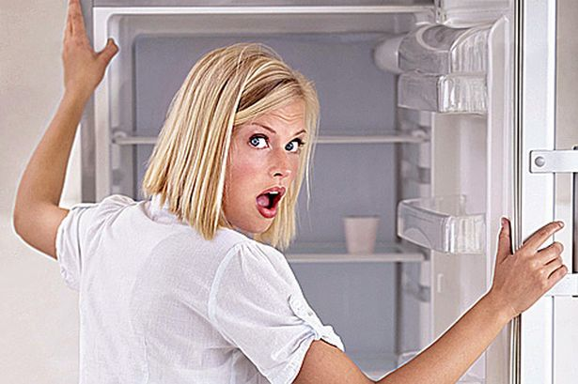
The disappearance of a birthday cake
The students planned to have a birthday party for their teacher at lunch time today.
Yesterday at 5 p.m., they put the birthday cake in the school office refrigerator.
When they opened the fridge this morning at 8 a.m., it was empty.
WHAT HAPPENED?

Slide 8
Making speculations
LESS CERTAIN
I wonder if the cleaners ___g____
I suppose a thief _________
I suspect that our teacher _______
I’m pretty sure that one of our classmates _____
I’m convinced/certain/positive that our teacher’s colleagues ______
It’s impossible that we ________
There’s no doubt that the cake ________
MORE CERTAIN
… stole the cake. We all love desserts.
… took it home with her yesterday. It had her name on it.
… forgot to order it. We know that we picked it up.
… could have broken into the office last night.
… ate it. They were in the office until 7 p.m. last night.
… was gone when we got to school.
… emptied out the fridge.

Slide 9
list five possible explanations for each of these situations
Your class started fifteen minutes ago. Your teacher still isn’t there.
stuck in a traffic jam
_____________________________
______________________________
______________________________
______________________________
You are at the train station to meet your friend after class. Your friend has never been there before. You have been waiting for an hour.
got lost
______________________________
______________________________
______________________________
______________________________

Slide 10
talk about the situations you’ve written down, and respond to your classmate’s explanations
I wonder if Olga is stuck in a traffic jam.
RESPONDING TO SPECULATIONS
Definitely!
You’re probably right.
You may be right.
Well, maybe, but…
That hardly seems likely.
No way! (informal)
No way! She takes the train.

Slide 11
Think of a mysterious situation and write it down. give it to another pair/group. role-play explaining the situation you received. e.g.
You come to class late. When you open the door, no one is there but there’s a big empty box on the teacher’s desk.

Slide 12
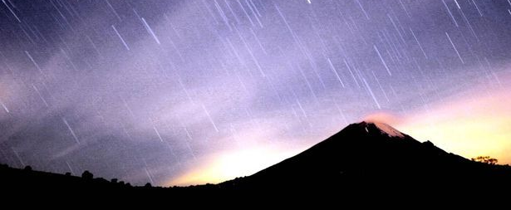
... and other interesting phenomena

Slide 13
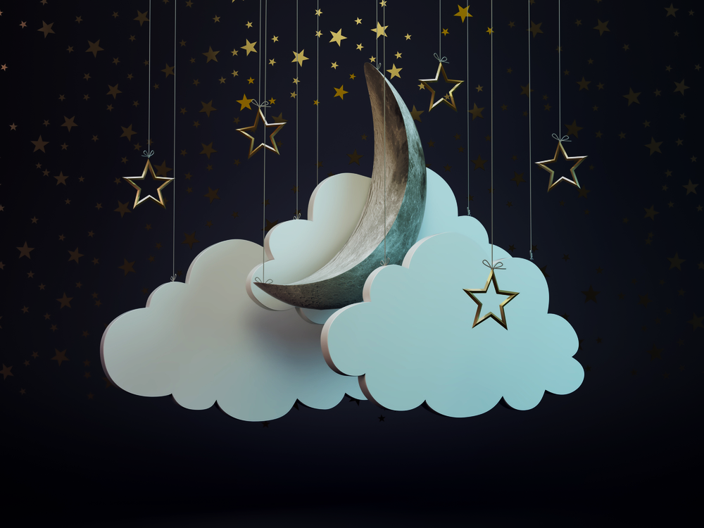
dreams
Are your dreams usually nightmares or sweet dreams?
How often do you daydream?
Are dreams predictions?
Why do we dream?
Do you usually remember your dreams?
Do you think that animals dream? Why or why not?
Have you ever had the same dream more than once?
Have you ever had a dream that later came true? Why might this happen?

Slide 14
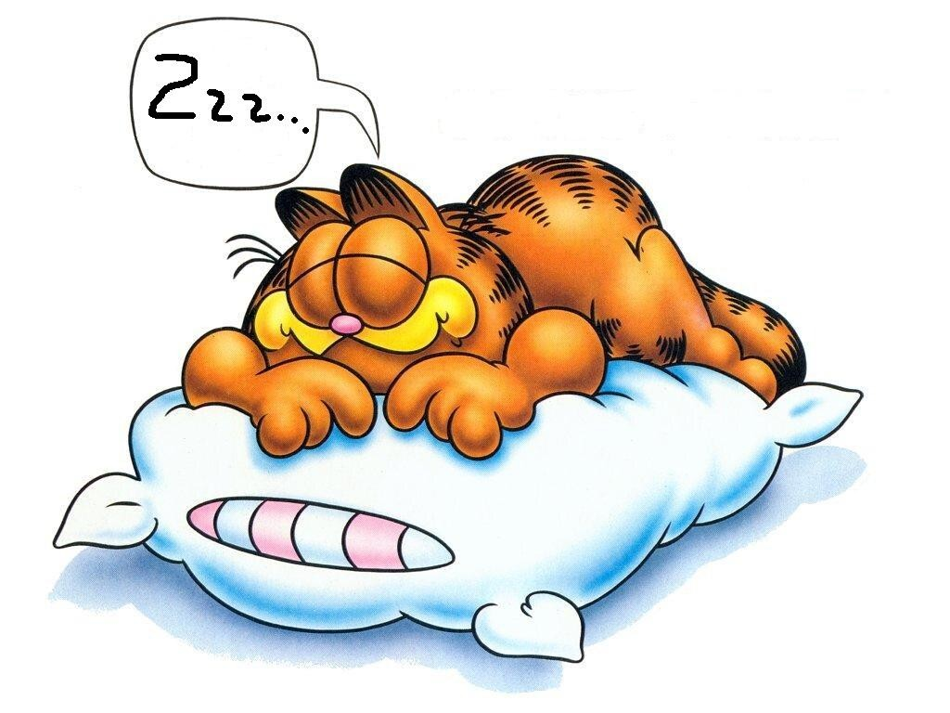
sleep
How many hours a night do you usually sleep? Do you think you need more sleep?
Do you talk in your sleep?
Do you ever take naps?
Do you snore?
Have you ever slept outside?
Are you a light sleeper or a heavy sleeper?
Do you prefer to sleep late or wake up early?
Have you ever known anyone who walked in their sleep?
If you could have an operation that would allow you to get only 2 hours of sleep each night, would you have it?
Have you ever experienced insomnia? What can you do to treat it? What do you think causes it?

Slide 15
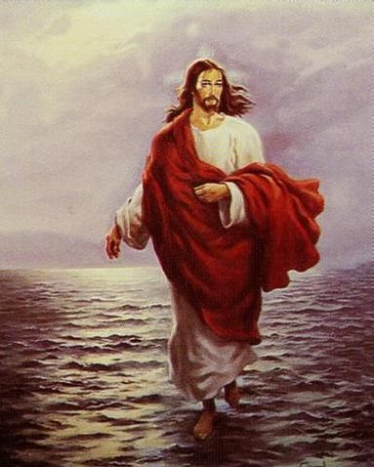
what do these expressions mean?
Déjà vu
Telepathy
Soul mate
Reincarnation
Miracle
Fortune
Horoscope
Ghost
Prediction
Séance
Life force
Psychic
Superstition
Mystery
Coincidence
Luck

