Slide 1
3
Chapter Three
消费者行为
Notes:
Chapter 3 covers both consumer and business-to-business buyer behaviors. Understanding how and why consumers and businesses make purchases is important in developing integrated marketing communications.

Slide 2
Chapter Objectives
3
Buyer Behaviors
内外部信息搜寻的消费者过程
消费者购买决策模型
趋势影响消费者购买环境
2B营销购买步骤
双重渠道营销提高顾客保有量和销量
3-2
Notes:
These are the objectives for Chapter 3.

Slide 3
F I G U R E 3 . 1
Consumer Decision-Making Process
Notes:
The consumer decision-making process involves five steps. The first step is problem recognition. It involves a consumer recognizing he/she needs something, has run out of something, or has an interest in something. Step two is information search. Consumers will first search internally for information. If they have enough information already stored in memory, then he/she will move to the next step. If not, then the consumer will conduct an external search. For high-involvement and high dollar purchases, most consumers will conduct an external search. Step three is evaluation of alternatives. This may take only a few minutes for low cost, low involvement decisions to several months for high involvement decisions. After alternatives are evaluated, consumers will move to the next step, the purchase decision. While consumers will normally purchase the brand they intended to buy, sometimes in-store signage or deals will alter the purchase decision. The last step in the process is postpurchase evaluation. Consumers will determine the level of satisfaction with the purchase, which will impact their next purchase decision for that product.

Slide 4
Consumer Purchasing Process
Consumers recognize need or want
Physical
Social
Psychological
Can be triggered by advertising
Stimulus
Notes:
The first step in the consumer decision-making process is the recognition of a need or want. It can be a physical need or want, such as thirst or hunger. It can be a social need or want, such as seeing a friend with the latest cell phone or new wheels on his car. It can be a psychological need or want, such as purchasing a new outfit to wear to make an individual feel good about themselves, or because they are depressed and buying something lifts their spirits. Many purchases are triggered because of need or running out of something. An individual needs groceries, food to eat, or runs out of beverages. But, advertising can also trigger a need or want. This advertisement for Skyjacker can trigger a desire for a lift kit for a vehicle. The desire can be reinforced through seeing someone else’s vehicle with a one installed, or the reverse can occur.

Slide 5
Marketing Attitude of Value
PRODUCT
Delivery the Value，
Same Price More Value,
Same Value Lower Price.
PRICE
4P
PLACE
AD
PROMOTION
TRADE PROMOTION
CUSTOMER PROMOTION
Oriented from the need and requirement, send the brand message to audience，at the right time right place，with a designed way to the special customer.

Slide 6
Value to Hedo
Exceed customer expectations
Surprise
Hedo level
尊重的需要
Novel
Abnormal and Excited feelings
爱和归属的需要
Pleasure
Positive Experience
Satisfied
Acceptable Products/Services
Relief
Relief from Trouble

Slide 7
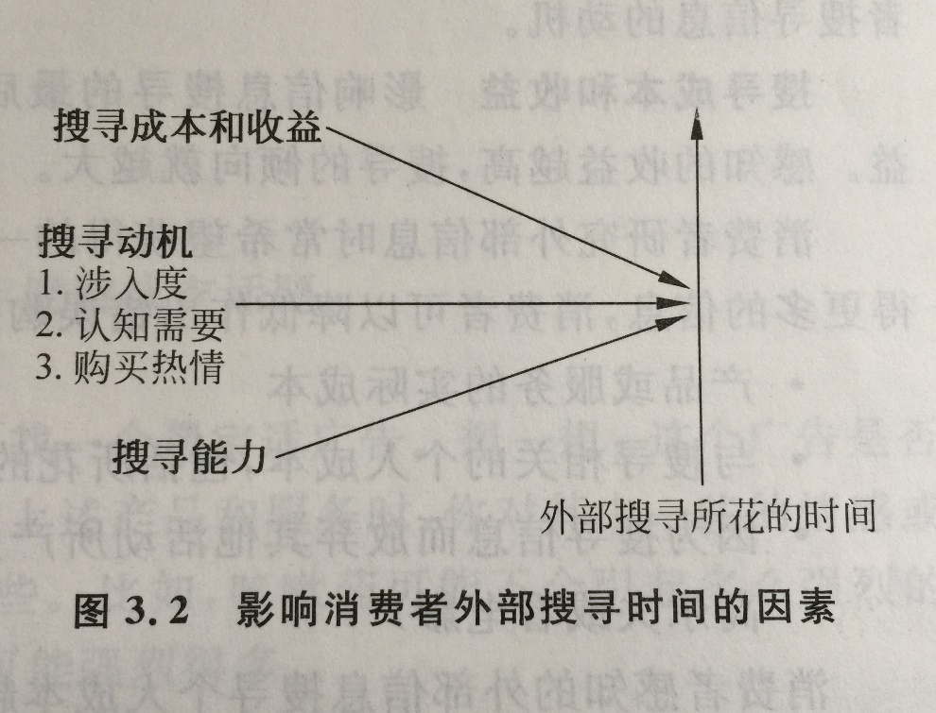
信息搜索
内部搜索
外部搜索
Notes:
Once a problem, need, or want has been recognized, consumers move to the next stage of the process, information search. Understanding information search is important for marketing communications. There are two types of information search, internal and external.

Slide 8
Internal Search
想到的品牌Memory
快速减少选择
基于过去经历的选择
Brand awareness and brand equity important
Notes:
Internal search for information is a mental activity. Consumers search their memories for information. They think about brands they have purchased in the past. If the brand met their needs and the experience was good, it is very likely they will buy the same brand again. If not, they will conduct a longer internal search or move to the external search for additional information. Past experience is an important part of internal search and how long the individual thinks about various brands. Consumers typically reduce the number of options quickly and concentrate on only a couple or small set of options. With internal search, brand awareness and brand equity are important. If a consumer is not aware of a brand, such as Neutrogena, then it will not be considered as a purchase option unless the search process moves to an external search. The higher the level of brand equity, the more likely the brand will be purchased with little mental effort and no additional consideration of other brands.

Slide 9
External Search
Ability to search
Level of motivation
Perceived cost versus benefit
Notes:
External search for information normally occurs under three conditions. First, the consumer was not happy with the last purchase experience and wants another brand or product. Second, it is a high involvement decision and the consumer wants more information. Third, it is a socially-visible product and the consumer wants to make sure others will approve or be impressed with the purchase decision. The amount of time consumers spend searching for information depends on 1) their ability to search for information, 2) their level of motivation to search for information, and 3) the perceived cost of searching versus the perceived benefit of searching.

Slide 10
Ability to Search
决定搜索的程度
Education level
Increases search
Knowledge of product and brands
Moderate level – most likely to search
Notes:
The ability to search for information determines the extent of an information search process. Ability consists of a person’s educational level combined with their knowledge of the product and brands. Educated individuals tend to search for more information and spend more time searching than individuals with less education. Knowledge of products and brands has an inverted U-shape curve. Individuals with little knowledge of a product category or brands tend not to search for information, primarily because they do not know where or how to search for information. They don’t know the product category well enough to know what to look for. At the other extreme, individuals with a great deal of knowledge spend less time searching since they already possess the knowledge. The group that spends the most time searching is in the middle. They have some knowledge so they have an idea what to look for and what to ask, but not enough knowledge to make a decision.

Slide 11
Level of Motivation
Involvement
Need for cognition
Level of shopping enthusiasm
Notes:
The level of motivation has an impact on the amount of time spent in external search. Motivation is determined by involvement, cognition, and shopping enthusiasm. The higher the level of involvement, the more time a consumer will spend in searching for additional information. The need for cognition is the level of mental activity a person enjoys. People who have a high need for cognition, that is they want to think about options before making a decision, will spend more time searching for information. Some people want to weigh every option, make sure they are right, so this need to think about all angles will lengthen the search process. The last motivating factor is the person’s enthusiasm for shopping. Individuals who like to shop, who enjoy comparing brands, will spend more time than individuals who hate or dislike shopping.

Slide 12
Involvement
涉入的观念，最初是用在研究社会事件中个人态度的问题，后应用于营销学领域，并专注于探讨消费者行为问题，如Krugman(1965)在广告学研究中的应用。
一般学者多半使用个人的心理认知状态来定义涉入，将涉入视为一种内在心理状态，受到个人、产品、情境或其它特殊刺激的影响，感受到事物对己身的重要性和攸关性，进而对事物产生不同的关注程度。

Slide 13
涉入度本质的分类：情境涉入、持久性涉入和反应涉入
情境涉入指在特殊情境下，消费者对事物的一种暂时性关切。所谓暂时性，是指消费者受特殊情境之刺激而提升的涉入程度会随着购买目标之达成或情境消失而回复到原先的水平。
持久涉入指个人对事务的持续性关切，乃起源于个人的内生持续性原因，例如需求、价值观、兴趣或所追求的目标等，涉入程度不随着情境的转换而有所更动，亦即并不会因为特定外生情境目标被满足而消失。持久涉入的来源有二：一是个人的主观价值系统，个人的自我观念、个性、目标、需求等都会影响消费者对一项产品的持久涉入；另一来源是对该事物的先前经验。
反应涉入是由情境涉入与持久性涉入结合所产生对某事物的心理状态，反映消费者决策处理之复杂性及广泛性的认知过程及行为过程。

Slide 14
Personal Involvement Inventory
Rational relevance
Emotional relevance
Of the ads
Notes:
下节课 准备PII问卷量表

Slide 15
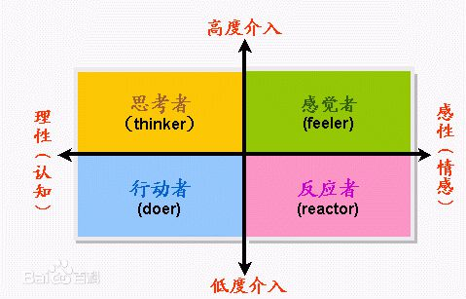
FCB grid模型
信息提供型 汽车、住宅、家具、新产品 学习-感觉-行动 可能的广告策略 广告效果：记忆、诊断 媒体：可载长文案、思考导向型 创意：信息提供型、演示型 | 感觉型人群 宝石、化妆品、流行服饰、自行车 模型：感觉-学习-行动 可能的广告策略 广告效果：态度改变、感觉觉醒 媒体：大版面公告、能提高形象的特别节目；创意：冲击力强的形象诉求
习惯形态（行动者） 食品、家庭用品 模型：行为-学习-感觉 可能的广告策略 广告效果：销量量 媒体：小版面的广告 10s广播 广告：售点广告 创意：提醒广告 | 自我满足型（反应型） 烟、饮料、糖果 模型：行为-感觉-学习 可能的广告策略 广告效果：销售额 媒体：户外广告、报纸、售点 创意：注目型
Notes:
博达大桥网格模型

Slide 16
涉入程度与消费者行为关系表
行为构面 | 高涉入过程 | 低涉入过程
资讯收集 | 积极主动收集与产品或品牌有关的资讯。 | 只收集有趣的产品或品牌资讯。
认知反应 | 抗拒那些和原来认知不同的资讯。 | 消极接受那些和自身经验有差异的资讯。
资讯处理 | 层级式顺序处理资讯，决策过程复杂且伴随购买前方案评估。 | 尝试使用决策顺序处理资讯，容易产生冲动性购物。
态度改变 | 不太容易也不常发生。 | 经常改变态度。
品牌偏好 | 经常有品牌偏好，忠诚度较高。 | 可能重复购买产品。但非高忠诚度者。
认知失调 | 容易产生购后认知失调。 | 认知失调不易发生。
同侪影响 | 外控倾向者较易受人影响。 | 较不注意他人行为。
广告反应 | 易受广告吸引且资讯内容比重复次数重要。 | 资讯重复次数对态度影响较大。

Slide 17
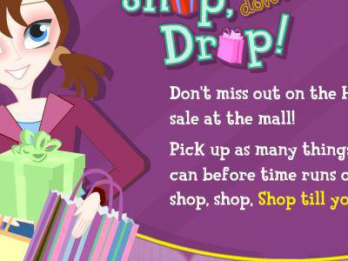
Cost versus Benefits
产品/服务实际的成本
Subjective cost
搜寻时间
决策时焦虑感
机会成本
Notes:
Consumers will weigh the cost versus the benefits of an external search. There are the actual costs to search, such as driving to the mall to look at various brands. Then there is the cost of the product. If a particular brand is purchased and the consumer doesn’t like it, that money is basically lost. So for high cost items, there is more pressure to search to make sure the right decision is made. Then there are subjective costs, the amount of time spent and the anxiety involved. For most people, time is valuable. Yet, if the purchase decision causes anxiety, then spending more time searching for information is worth it, to reduce the anxiety and ensure the right decision is made. The last consideration is opportunity cost. Once the purchase is made, the consumer forgoes the alternatives. The higher the perceived costs to search for information, the less consumers will search. Alternatively, the higher the perceived benefit in gathering additional information, the more time a person will spend searching.

Slide 18
Consumer Attitude
Affective
Cognitive
Conative
Notes:
有效的营销传播可以影响消费者态度
Attitude is the mental position a person takes towards a topic, person, or an event that influences an individual’s feelings, perceptions, learning processes, and behaviors. Attitude consists of three components.态度三要素
Affective is the feeling and emotional part of attitude.
Cognitive is the individual’s knowledge, understanding, and interpretation of a topic, person, or thing.
Conative is an individual's intentions, actions, or behavior.
This ad for St. Francis North Hospital is designed to impact the cognitive component of attitude by providing information and knowledge about imaging technology.

Slide 19
意识
认知
Hierarchy Of Effects
六大步骤及行为模式：拉维尼及斯泰纳认为这六大步骤可以分为三大阶段：认知、情感及意动。而广告主需要对这三大阶段采取行动。
认知（思想）：受众产生产品意识以及收取产品内容知识；
情感（感受）：受众喜欢产品品牌并相信该品牌；
意动（行为）：受众购买该产品品牌。
知识
爱好
情感
偏好
信服
意动
购买
效果模式的六大步骤

Slide 20
Attitude Sequence
Cognitive → Affective → Conative
Affective → Conative → Cognitive
Conative → Cognitive → Affective
Notes:
In terms of influencing or changing consumer attitudes, marketers have three options.
先了解和形成产品认知信念和知识（产品），而后生成情绪和感觉（品牌），导致购买。The most common sequence is to first impact a person’s cognitive beliefs and knowledge about a product, then develop emotions and feelings for the brand, which then results in purchasing the product.
The second sequence begins with affective, the feelings and emotions. The marketing message is designed to elicit an emotional response followed by the purchase action. Then once the person has tried the product, he/she will make judgments about it.
The third sequence begins with the conative. The idea is to get the person to try it. Food items and other low cost products often use this approach.
After the person tries the product, he/she will develop thoughts about it and then decide if they like it or not. Feelings follow the knowledge. The sequence determines the content and how an ad is designed. Ads aimed at the affective component will look different than ads designed to impact the cognitive or conative component of attitude.

Slide 21
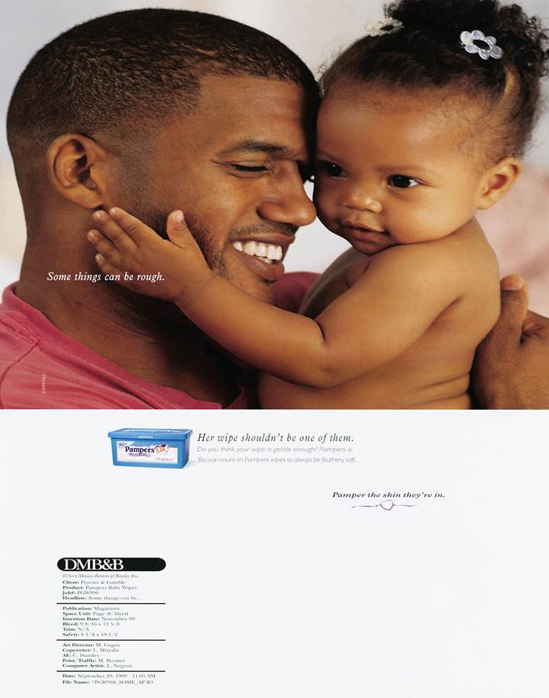
What emotion does this Pamper Wipes advertisement solicit?
Which attitude sequence would be the most likely for this product?
“Some things can be rough.”
“Her wipe shouldn’t be one of them.”
Notes:
This ad is designed to impact the affective component of attitude.
While information is presented, the photo and tagline are designed to make a person feel good and to feel love.
In terms of attitude sequence, this ad is using affective→ conative → cognitive.

Slide 22
F I G U R E 3 . 3
Personal Values
生活舒适
平等
活力
自由
生活有趣、刺激
快乐
内心宁静
真爱
个人成就
愉悦
助人为乐
安全
自我实现
自尊
归属感
社会认可
明智
Notes:
Attitudes reflects an individual’s personal values.
Values are strongly held beliefs about various topics and concepts.
Values frame attitudes and guide personal actions. This is a list of some of the primary values individuals hold. The strength of the value will determine a person’s attitude and actions. Individuals who deem excitement to be important and who crave excitement will have different attitudes and make different purchase decisions than someone who values mature love, wisdom, or personal accomplishment. In designing marketing messages, creatives need to think about personal values and how products can help an individual obtain the values being sought.

Slide 23
Which personal values does this Skeeter ad target?
Notes:
This ad for Skeeter boats will have an impact on individuals whose personal values match the actions of bass fishing, and in this case tournament fishing.
Some of the values that might respond to this ad are excitement, fun, exciting life, pleasure, and perhaps personal accomplishment in winning a fishing tournament. The headline might also be offering a “comfortable life” value.

Slide 24
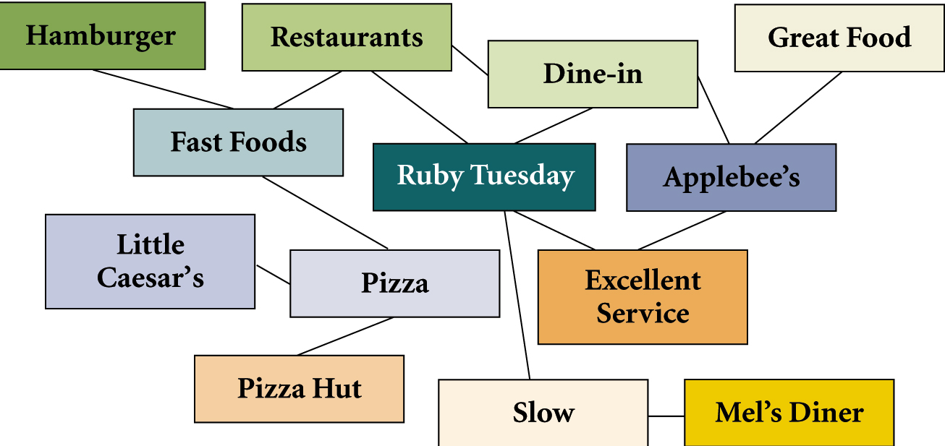
F I G U R E 3 . 4
Cognitive map for Ruby Tuesday
Notes:
人脑的模拟知识和记忆结构。结构包含了个人前提假设，信念，事实理解，对世界的态度。这些想法解释新信息并决定回应新信息情境。原始勾画脑海联结
Cognitive mapping are simulations of the knowledge structure and memories embedded in an individual’s brain. These structures contain a person’s assumptions, beliefs, interpretations of facts, feelings, and attitudes about the world around them. These thoughts interpret new information and determine a response to fresh information or a novel situation. This map is a crude illustration of the structure of the brain and the many linkages that are present.
This represents one individuals cognitive map of Ruby Tuesday. Ideas connected to Ruby Tuesday are restaurants, dine-in, excellent service, slow. When the person thinks of slow, they immediately think of Mel’s Diner. When the person thinks of restaurants, fast foods come to mind, then pizza, then Pizza Hut and Little Caesar’s. It is easy to see from this illustration how concepts, thoughts, and ideas are all interconnected in our brains.

Slide 25
Cognitive Mapping
认知联结
处理新信息
保留信息
新的概念
Notes:
Cognitive mapping serves a number of functions. It provides an idea of how the brain contains many linkages at a number of levels. Cognitive maps allow individuals to deal with new information in one of three ways. New information that is consistent with current information will strengthen linkages that already exist. If no linkage is there, then the consumer may develop a new linkage between the concepts. On the other hand, the person may determine the new information is not consistent with current linkages and dismiss it immediately. It is these linkages that allow consumers to retain information in long-term memory. Unless it is connected in some manner in the cognitive map, the information will not be stored for future use.

Slide 26
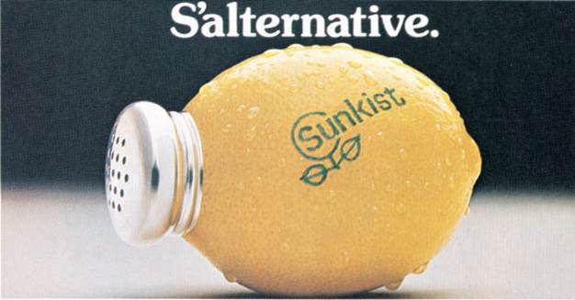
F I G U R E 3 . 5
Role of Marketing Messages in Cognitive Mapping
Strengthen current linkage
Marketing
Message
Modify current linkage
Create new linkage
Notes:
Marketing messages have three roles when it comes to cognitive mapping. First, the message may be designed to strengthen current linkages. Second, it may be designed to modify current linkages. Third, it may create new linkages. If consumers did not know that lemons could be used as a salt substitute, then this ad would create a new linkage. Perhaps consumers knew there were some natural salt substitutes but weren’t sure if they really were good or not, this ad may modify that linkage to say lemons would be a good option to try. Adding new linkages or modifying current linkages is more difficult than strengthening current linkages.

Slide 27
信息处理和认知地图的主要作用
认知地图强化了信息从短期记忆向长期记忆转移
Most persuasive messages reinforce current linkages
Repetition is necessary to establish new linkages
Difficult to modify or create new linkages
Notes:
Cognitive mapping helps explain how consumers process information and how messages are moved from short-term memory to long-term memory. Most persuasive messages reinforce current linkages, which is the easiest task for marketers. Establishing new linkages is more difficult. It requires repetition. Just like repeating a phone number several times helps move the number from short-term to long-term memory, seeing an advertisement message a number of times helps establish new linkages. It is difficult to modify and create new linkages. It takes time.

Slide 28
F I G U R E 3 . 6
Methods of Evaluating Alternatives
Evoked set
Multiattribute
Affect referral
Problem
Recognition
Information
Search
Evaluation of
Alternatives
Notes:
The third stage of the consumer decision-making process is the evaluation of alternatives.
Understanding how consumers evaluate brands and products is important for creating effective marketing messages.
Three models illustrate the nature of evaluation of alternatives: evoked set, multiattribute, and affect referral.

Slide 29
The Evoked Set Method
排除组Inept set
惰性组Inert set
激活组Evoked set
Notes:
The evoked set consists of brands that an individual considers in making a purchase decision. Evoked sets are often generated internally during the information search stage of the process. It consists of brands the consumer is aware of and would consider purchasing, often brands that the consumer has used in the past. Two other sets of interest to marketers is the inept and inert sets. The inept set are the brands the consumer will not purchase, either because of a bad personal experience or information received from another source. It may be something someone told them. The inert set are brands the consumer does not know anything about or has so little information a judgment cannot be made. If a brand is in consumers inert set, the goal is to transfer it to the evoked set because in most purchase situations only brands in the evoked set will be considered. For instance, if a consumer decides to dine-out, in most cases only brands in the evoked set will be considered.

Slide 30
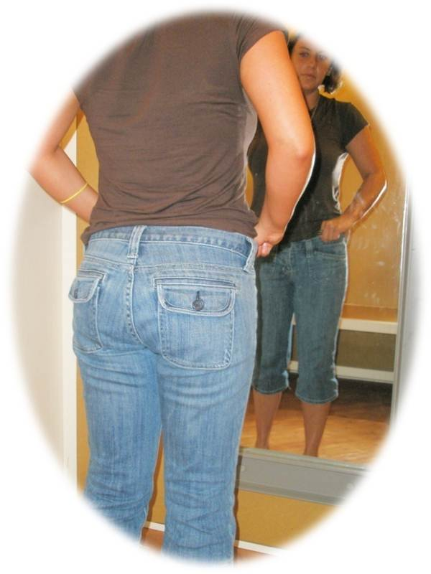
How important is it for each of the following brands to be a part of a consumer’s evoked set?
Guess (jeans)
Advil (pain medicine)
Head & Shoulders (shampoo)
Black & Decker (power tools)
C & H (sugar)
Smith & Kline (attorneys)
Hall’s (cough drops)
Blockbuster (video rentals)
Dr. Nelson (neurosurgeon)
Pearle Vision (optical)
Notes:
If consumers are not likely to conduct an external search for information, then being in the evoked set becomes more important. Also, for lower involvement type products, being part of the evoked set is important because consumers will not spend a great deal of time evaluating alternatives. The less time spent in the evaluation of alternatives, the more important it is to be part of the evoked set. Also, if a brand wants to develop a high level of brand equity with consumers, it starts with being in the evoked sets of individuals.
Answers will vary among students on how important the evoked set would be for these brands. Certainly, for an attorney and neurosurgeon, being part of the evoked set is not too important since people will very likely do a more extensive search for information.

Slide 31
The Multiattribute Approach
High-Involvement
Products
Brand’s performance for each attribute
Importance of each attribute
Notes:
The multiattribute approach is used for high-involvement purchases, such as vehicles. With the multiattribute approach, the evaluation is based on two dimensions: 1) the brand’s performance on product or brand attributes and 2) the importance of each attribute. The higher brands rate on attributes that are important to consumers, the more likely the brand will be chosen.
It would be extremely rare for a brand to score the highest on all attributes. Instead, there are trade offs. In purchasing a car, not one single automobile is likely to have every feature the consumer wants, especially if the auto is being purchased from a dealer’s lot and not being ordered. The same is true for purchasing a home. Consumers must make tradeoffs取舍.
The final choice comes down to the brand that offers the most features desired by consumers. While consumers aren’t likely to do this mathematically on paper, they will conduct a simulated approach mentally comparing one brand against another on various attributes.

Slide 32
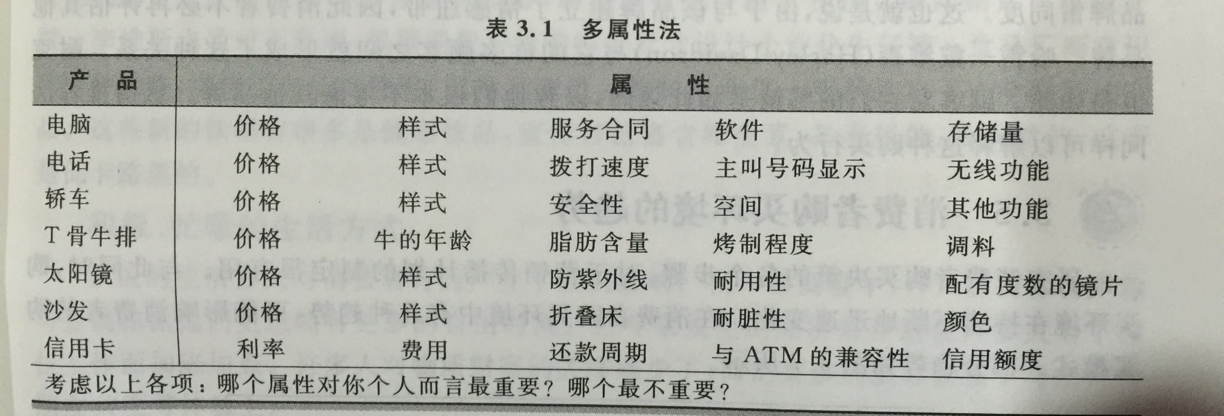
广告创意中的产品核心利益，只能突出1-2个，否则信息就会过载。

Slide 33
Affect Referral
Saves mental energy
Multiattribute approach may have been used previously
Consumers often develop emotional bonds with brands
Notes:
Affect is the third part of attitude. It deals with emotions and feelings. With the affect referral method, consumers purchase the brand they like the best. There may not even be a strong reason they like the brand, they just do, or they may have a strong emotional attachment to the brand for some reason. It may have been a brand their parents used so they developed an emotional attachment. The affect referral method saves energy. Consumers don’t have to think about the other brands, consider other alternatives, they just purchase the brand they like. It’s possible that the multiattribute approach was used in the past to determine the best brand, and so the process does not have to be repeated. The experience with the brand was positive, so they continue buying it and over time develop a stronger emotional bond with it. Oscar Mayer in this ad wanted to tap into the affective component of attitude and encourage consumers that with Oscar Mayer hotdogs “it doesn’t get better than this.”

Slide 34
F I G U R E 3 . 8
Trends Affecting Consumer Buyer Behavior
Age complexity
Gender complexity
Active, busy lifestyles
Diverse lifestyles
Communication revolution
Experience pursuits
Health emphasis
Notes:
Consumer behavior is a moving target and always changing because people change and culture changes. The environment and economy changes, forcing changes in the way consumers purchase products. These trends have impacted consumer behavior in recent years and are expected to modify future buyer behaviors. Age complexity refers to children growing up at a much faster rate and becoming involved in purchasing products which in the past were for teenagers and adults. At the other end of the spectrum, older consumers refuse to get old, purchasing products of younger generations. Gender complexity refers to the merging of the gender roles in occupations, products, and family relationships. Individualism refers to consumer desires to be treated as individuals and wanting products that are made specifically for them. They don’t want to be like everyone else. Today’s consumers lead active and busy lifestyles and want goods and services that cater to that lifestyle. Cocooning refers to the desire to stay at home, to build relationships with family and friends. With the pressures of life, there is a trend for people to enjoy an occasional pleasure pursuit, as a reward. Finally, with an aging population there has been a growing emphasis on health and products that promote good health and that treat health problems.

Slide 35
Petty, Richard; Cacioppo, John (1986)
传播模式（形象、语言渠道）
情绪参与的方式
关注与理解
积极参与的方式
外围
核心
信念改变
认知和反应
行为改变
信念与态度的转变
态度改变
行为模式的转变
图1：详尽可能性模型（Elaboration Likelihood Model）
该理论认为，在做决定的过程中，说服的途径有两种选择。第一种途径是中心途径，这一途径适用于人们对某一情况深思熟虑，专注相关信息，并易于产生不同意见。这一路径产生于该人的积极性与能力指数较高的情况下。第二种途径是外围途径，这一途径适用于人们对某一情况并不在意并且用很短的时间作出判断。这一路径发生在该人的的积极性与能力指数较低。

Slide 36
F I G U R E 3 . 9
Responding to New Consumer Buying Trends
Monitor consumer environment for changes
Create goods and services that are compatible with changes
Design messages that reflect changes
Notes:
Understanding consumer buyer behavior trends is important. Companies need to respond to these changes in buying behaviors. The first step is to monitor the consumer environment and note especially changes in patterns of behavior. The second step is to create goods and services that are compatible with these changes. Third, marketing messages that reflect these changes should be designed. This ad for St. Francis North Hospital focuses on the emphasis people now place on health.

