Slide 1

Learning Skills and Time Management
talking about
MOTIVATION; GOALS; SUCCESS
Damon L Hansen SISU Spring 2017

Slide 2
what am I riddles
I am the beginning of the end, the end of every place. I am the beinning of eternity, the end of time and space. What am I?

Slide 3
the letter E

Slide 4
I eat, I live. I breath, I live. I drink, I die.

Slide 5


Slide 6
I have a face but no eyes; hands but no arms. What am I?

Slide 7


Slide 8
Class intentions and goals week two
quotation analysis group activity
Discuss and evaluate learning strategies and techniques.
Group article sharing activity and discussion
Tasks from book about study habits
discuss strategies specific to various academic subjects
share intrinsic versus extrinsic motivation

Slide 9
critical thinking exercise
THE BOMB SHELTER
Unitarian: Christian religious person who believes in Jesus, god, etc.
Parolee : a person who just got out of jail and has to talk to the police often ; criminal

Slide 10
REASONS FOR CHOOSING PEOPLE
YO
IMHO in my humble opinion
LOL
ACRONYMFINDER.COM

Slide 11
Reasons for selecting people to survive
Rebuild society
Military and defense knowledge ; knowledge of guns and weapon
Intelligence, beauty, health, wealth
Ability to contribute to education.
Ability to build and construct.
Ability to have children.

Slide 12
I think X person will not contribute to society and is not important because ______ .
X person is important to keeping society together and functioning because_____

Slide 13
Process of quotation analysis
Define and fully understand key terms and concepts
Think of a way you can personalize or apply the quote to yourself and your own life
Explain what is the pearl of wisdom or what the quote has to teach (i.e. THIS QUOTE IS SAYING THAT YOU CAN BE A HAPPIER PERSON IF______)

Slide 14


Slide 15
VOCABULARY JOURNAL ENTRY
EXPECTATION
Def. Something that is demanded, required or strongly requested by an individual.
Expectation: n
Collocates with: adj. unreasonable, realistic, specific
What kinds of expectations might you have?
Ex. Sentence
I think you have a really unreasonable expectation and should improve it

Slide 16
VOCABULARY NOTEBOOK ENTRIES
MAKE SURE YOU INCLUDE:
Definition (use online oxford dictionary ; collocation dictionary (bing.com ) ; USE ENGLISH- ENGLISH DICTIONARY(
Collocation (patterns of words together)
Word root (if written in dictionary entry)
Translation (if it helps – use PLECO application
Example sentence that is COMPLEX and demonstrates the meaning of a word.

Slide 17

What Learning Style means?
Learning Style is the way a person processes, internalizes, and studies new and challenging material.

Slide 19

In groups, compare your answers and answer these questions
What contributed to your successes?
What contributed to your failures?
What are the similarities in your answers?
Are there any big differences?
What does ‘success’ mean?
Can you describe a clever person?
What makes a topic interesting?

Slide 20
WRITE YOUR OWN UNIQUE DEF. OF SUCCESS
I WILL KNOW
ONE EX
FAILURE ; ONE EXAMPLE

Slide 21
FACTORS THAT CONTRIBUTE TO SUCCESS
Persistence (never give up ) and resilience (to effectively deal with pain and suffering )
When life throws SOUR lemons, make SWEET lemonade

Slide 22
FACTORS THAT CONTRIBUTE TO FAIILURE

Slide 23
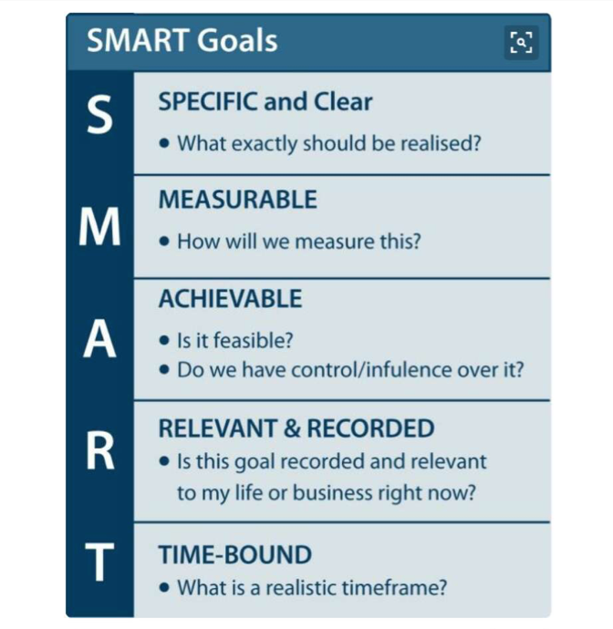
ONE KEY ELEMENT OF SUCCESS: GOAL SETTING

Slide 24
I will know that I am indeed successful if X Y and Z are obtained or achieved.
MATERIAL THING (iphone 8
PERSONAL GOAL
INTELLECTUAL ACHIEVMENT

Slide 25
SKYPE.com.cn ACCOUNT
Skype id damonleohansen

Slide 26
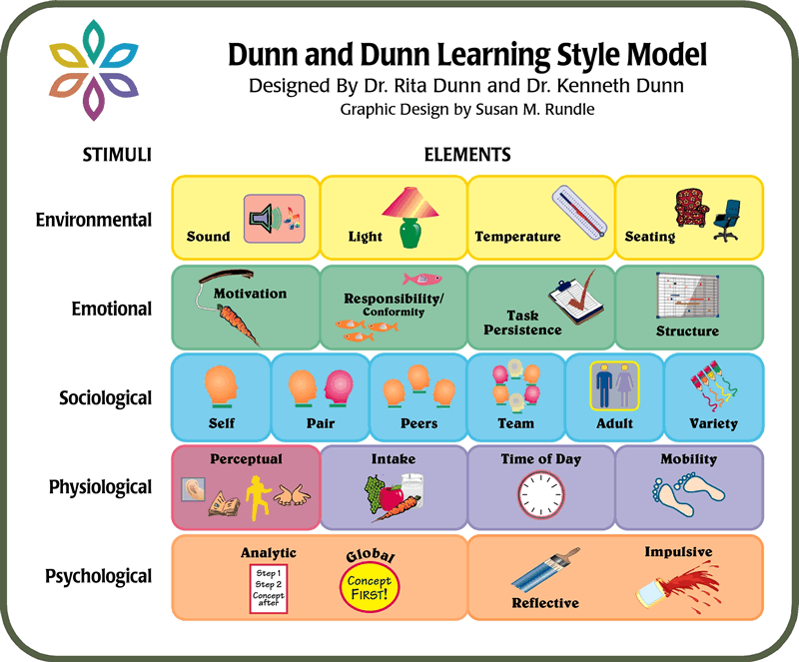

Slide 27
Definition
Motivation is a process which begins with a physiological or psychological need or deficiency which triggers behaviour or a drive that is aimed at a goal or an incentive.

Slide 28

Motivation: the Key to Success
Successful teaching
Successful learning
MOTIVATION
Achievement

Slide 29
Introduction (Cont.)
that
leads to
that
results in
Motivation
is the
psychological
process
Some level
of job
performance
Choice of
behavior
The Motivation-Behavior-Job Performance Sequencea

Slide 30
Concepts of Motivation
Motivation
Motivation is a process which begins with a physiological or psychological need or deficiency which triggers behavior or a drive that is aimed at a goal or an incentive.
Motivating
While a motive is energizer of action, motivating is the channelization of motives.
Motive
A motive is an inner state that directs behavior towards goal

Slide 31
Motivation Is
Two-Dimensional
Intrinsic motivation is self-granted and comes when something is meaningful or gives sense of purpose
Examples:
  Job contentment
  Individual growth
  Achievement

Slide 32
Motivation Is
Two-Dimensional
Extrinsic motivation is an action taken by another person
Usually involves an incentive or anticipation of a reward
Examples:
  Money
  Awards
  Performance feedback

Slide 33
Extrinsic
teacher
grades
self-fulfillment
parents
Intrinsic
job
love for the culture
pleasure
salary
love for the language
requirement

Slide 34
ONE THING YOU LEARNED
ONE QUESTION
DIET, EXERCISE AND SLEEP
DIET (CONSTANT SUGAR IN BLOOD ; NO PEAKS AND LOWS
CARBOHYDRATES (POTATOE CHIPS

Slide 35
FOR NEXT WEEK LECTURE
GO TO BING.COM
TYPE THE POEM NAME ‘WEST RUNNING BROOK’
ROBERT FROST
READ AND WRITE PRE-LECTURE NOTES
POETIC ANALYSIS OF FREE VERSE POETRY OF ROBERT FROST

Slide 36
ARTICLE DISCUSSION GROUP
ARTICLE DISCUSSION
TITLE; TECH BREAKTHROUGH TAKE BACKSEAT IN UPCOMING IPHONE LAUNCH
; BREAKTHROUGH (NEW DISCOVERY
INNOVATION (NEW TECH DEVELOPMENT
DISCUSSION QUESTIONS
IT IS NECESSARY TO BUY THE IPHONE 8?
IS AN IPHONE 8 AN IMPORTANT STATUS SYMBOL? HOW DOES IT COMPARE TO XIAOMI; HUAWEI, ETC.
IT IS WORTH THE COST?
WHAT NEW FEATURES DOES IT HAVE?

Slide 37
ENVIRONMENTAL
The environmental strand refers to these elements:
lighting
sound
temperature, and
seating arrangement.
MY IDEAL STUDY ENVIRONMENT IS

Slide 38




LIGHTING

Slide 39


DO NOT LISTEN TO
ROCK; TECHNO
LYRICS

Slide 40

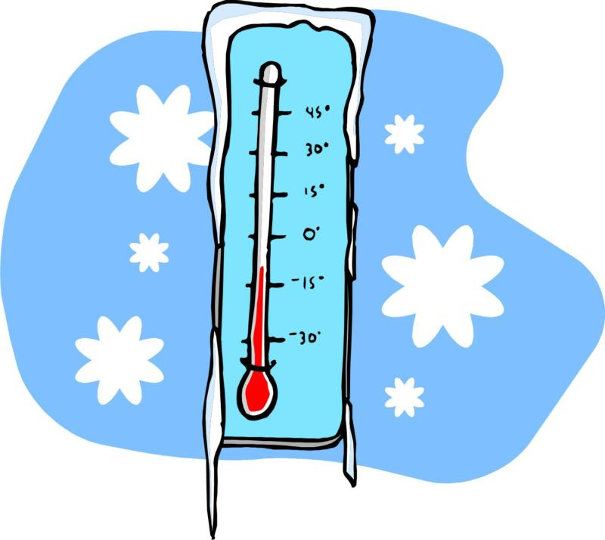
TEMPERATURE

Slide 41



SEATING
ARRANGEMANET

Slide 42
EMOTIONAL SUPPORT
This strands includes the following elements:
motivation
persistence
responsibility, and
structure.

Slide 43

MOTIVATION

Slide 44


PERSISTENCE

Slide 45



RESPONSIBILITY

Slide 46



STRUCTURE

Slide 47
SOCIOLOGICAL COMPOSITION
The sociological strands represents to elements related to how individuals learn in association with other people:
alone or with peers,
an authoritative adult or with a collegial colleague,
learning in a variety of ways or in routine patterns.

Slide 48


ALONE

Slide 49

With PEERS

Slide 50



With AUTHORITATIVE ADULT or COLLEGIAL COLLEAGUES

Slide 51

PSYSIOLOGICAL ELEMENTS
The elements in this strand are:
perceptual,
Time-of-day energy levels,
intake, and
mobility.

Slide 52

PERCEPTUAL

Slide 53


Time-of-day energy levels

Slide 54

INTAKE

Slide 55
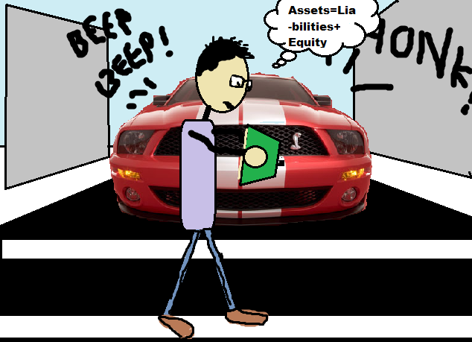

MOBILITY

Slide 56
PSYCHOLOGICAL
The elements in this strand correspond to the following types of psychological processing:
hemispheric elements
impulsive or reflective style
and global learners and
Analytic learners.

Slide 57
The hemispheric elements refers to left and right brain processing models;
the impulsive versus reflective styledescribes how some people leap before thinking and others scrutinize the situation before moving an inch.
Global learnersprefer to work in an environment with soft lighting and informal seating. People with the processing style need breaks, snacking, mobility and sound.
Analytic learnersprefer to work in an environment with bright light and formal seating. They work best with few or no interruptions, in a quiet environment, and little or no snacking.

Slide 58



IMPULSIVE vs. REFLECSIVE

Slide 59

TIME MANAGEMENT
TIME AND TIDE WAIT FOR NONE

Slide 60
Discipline versus procrastination
Hard work often pays off over time, but laziness always pays off NOW
What is the long term benefit of consistent hard effort in studies / university?!??
PROCRASTINATION

Slide 61
Academic work in a nutshell
Understand the task
Find information
Find good information
Make note of good information
Carry out the task
Carry out the task by the deadline

Slide 62
Parkinson’s Law
The amount of time one has to complete the task is the amount of time it will take to complete the task
Work expands to fill the time available

Slide 63
Student Syndrome
The phenomenon whereby a student will only begin to fully apply her/himself to a task immediately before the deadline
    Eliyahu Goldratt 1997, The Critical Chain

Slide 64
PROCRASTINATION
PROCRASTINATION TASKS IN STUDY SKILLS BOOK
LOOK AT LIST OF REGULAR DAILY ROUTINES !!
  PUT THE ACTIVITIES IN ORDER OF IMPORTANCE – EXPLAIN WHY !!

Slide 65
Procrastination: the terrible results
Stress
Anxiety
Lack of planning
Lack of sleep
Lack of productivity
Lack of marks

Slide 66
Things that might help
Know what date it is today
Know the dates of your deadlines
Use a diary or calendar (www.calendarlabs.com)
Work backwards from your deadline
Come up with some sort of plan
Understand yourself

Slide 67


Original Topics
Study Skills
Time Management

Slide 68

How about these?
Learning Strategies
Time Leadership

Slide 69
Learning Strategies
Visual → Take good notes, draw pictures
Auditory → Explain to someone, read aloud
Kinesthetic → Make models, group study
VERBAL OR LINGUISTIC**
Pick a style that works
One style may not work for all subjects

Slide 70
Learning Strategies
Study regularly, not several chapters at once
Read ahead, if you can, to get a rough idea
Connect with previous chapters so a story begins to form in your mind

Slide 71
Task 2.4
Making a list of the ingredients of success in academia or your career .
INGREDIENTS OF SUCCESS IN ACADEME

Slide 72
ingredients of success
Persistent effort
Overcoming procrastination
Thinking about long term benefits of short term effort
Being aware of environmental, sociological, emotional, physiological factors that influence study.
Complete awareness of the task ; understand expectations
Intrinsic motivation / extrinsic motivation
Internal / external

Slide 73
WHICH OF THESE SUBJECTS WILL BE IMPORTANT
WHEN YOU ARE 30
English essay composition
Vocabulary development
Algebra
Geometry
Calculus；
Physics
Science(biology / chemistry )
Business
fine arts．

Slide 74
ＣＯＮＦＩＲＭＡＴＩＯＮ ＢＩＡＳ
ＤＥＦＩＮＥＤ：
An unjustified belief in an idea that you hold onto strongly because it is something you have always believed; the tendency to reject evidence that contradicts something you strongly believe in.
A belief or opinion you strongly hold
What would contradict that!??

Slide 75
Learning Strategies
Shift your mindset
j
Mindset A: I am preparing for a test
Mindset B: I am learning the subject
Which one do you think is better?

Slide 76
Learning Strategies
Do your homework, mindfully
Not when
  chatting
  texting
  listening to music on ear phones
  facebook open
  watching tv
  lying upside down ☺ or in odd positions
  in the car on the way to school
  there is lot of noise around you

Slide 77
Learning Strategies
Explain to someone
Pick one person who you know is listening
Keep a paper or notebook next to you, write down the topic when this happens
Factoid: We don’t know what we don’t know
Only way to know what we don’t know is to tell someone what we know

Slide 78
Learning Strategies
Maintain a Learning Tracker
Got an awesome grade → capture why that happened (contributing factors)
Fell short of expected grade → reflect on why and fix it before the next test
Continuously improve the way you learn

Slide 79
Learning Strategies
Draw pictures or mind maps
A picture is worth a thousand words
Put it up near your study area
Exercise: What is Angioplasty?

Slide 80
The Real Truth
What you learn may fade away
Way you learn will be your strength for life

Slide 81
Next Topic
Time Leadership

Slide 82
Quiz
Jack has a state-level speech & debate competition on Nov 19, 2011
When should Jack begin the preparation?
The night before, on Nov 18 2011
About 2-3 weeks before

Slide 83
Quiz
Cadel Evans wants to win again in Tour De France 2012
When should Cadel begin practicing?
About 4 months before
A week before on June 24th, 2012

Slide 84
Quiz
Jill wants to get into Harvard Class of 2018
When should Jill begin working at this goal?
Summer 2013 (App due: 1/1/14)
Starting now

Slide 85
Quiz
Mom wants to make fresh apple pie next Sunday
Mom should start preparing the dough …
Starting now
Night before

Slide 86
Let us reflect…
What can we learn from the Quiz?
Planning and preparation are important
Time to start preparing depends on activity

Slide 87
Tasks in a typical week
Eating / Sleeping
Texting
Phone calls
Movies/TV
Visiting Friends
General Reading
Hobbies
Recreation/Sports
Online Games
Talents
Relaxing
School time
Homework
Help at home
Voluntary Activities
Chatting/Email
School Homework
Dreaming

Slide 88
Time Leadership
PRIORITIZE YOUR TASKS
High
Urgent, Not Important | Urgent, Important
Not Urgent, Not Important | Not Urgent, Important
Urgency
Low
Low
Importance
High

Slide 89
LIST 5 ACADEMIC TASKS
READING AND WRITING ASSIGNMENTS
PROJECTS PRESENTATIONS
ESSAYS, RESEARCH

Slide 90

1: write 200-300 wd response to article discussion question
2. Read WEST RUNNING BROOK from online to prepare for note taking activity (bing.com)
3. Install essential applications you need this semester: SKYPE, PLECO, DICTIONARY.COM
COLLOCATION DICTIONARY
skype.gmw.cn
damonleohansen

Slide 91
Time Leadership
Analyze your time sinks
Do not let time lead you, you take the lead
Maintain a log (approximate) and review
Plan TV/games/chatting time too, wisely
Re-prioritize, to minimize time sinks

Slide 92
Q & A
THANK YOU
YOU HAVE BEEN AN AWESOME CLASS TO WORK WITH

